Slide 1
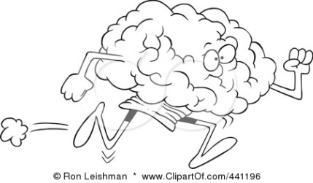

Topic 4: Learning Approach (Behaviourism)
Practical Investigation – Observation/ChiSquared
I can ...
Describe the observation as a research method
Describe the aim of your study
State your research question for the qualitative observational field notes
State a directional alternative and null hypothesis for your study
I can ...
Explain your choice of research method and design, including the ethics section
Explain your sampling technique, materials an procedure
I can ...
Explain your choice of descriptive and inferential stats (chi squared)
Calculate chi squared using a set of fake data as a practice for calculating your own
Use the critical values table to decide whether to accept or reject the null hypothesis

Slide 2
Topic 4: Learning Approach (Behaviourism)
Practical Investigation – Observation/ChiSquared
I can ...
Describe what is meant by thematic analysis and content analysis with relational to observational “field notes”
Describe how to analyse qualitative data in this nature
I can ...
Analyse my qualitative data (field notes)
Complete checks for inter-rater reliability and “fit”
Explain what is meant by subjectivity, researcher triangulation and data triangulation, reflexivity
I can ...
Evaluate my qualitative analysis with regard to credibility and trustworthiness and make suggestions about how this could be improved

Slide 3
 | With children | Alone, (not with children) | Row Total
Waits for green man | 12 | 6
Does not wait for green man | 9 | 8
Column Total: |  |  | Final total:

Slide 4
Topic 4: Learning Approach (Behaviourism)
Practical Investigation – Observation/ChiSquared
I can ...
Evaluate my study with regard to generalisability
Evaluate my study with regard to the reliability of the data collection including the concept of inter-rater reliability
Evaluate with regard to reliability and subjectivity within the thematic analysis of the field notes
I can ...
Evaluate my study with regard to internal and external validity including the operationalisation of the variables, the covert and naturalistic, structured and unstructured, quan and qual aspect of the data collection and other factors that might have affected the observed behaviour
I can ...
Evaluate my study with regard to ethics and possible applications to real life

Slide 5

Time to reflect….
One thing you will do to follow up, or question you want to ask
Two things you think you need to revisit
Three areas which you have made progress on today

Slide 6
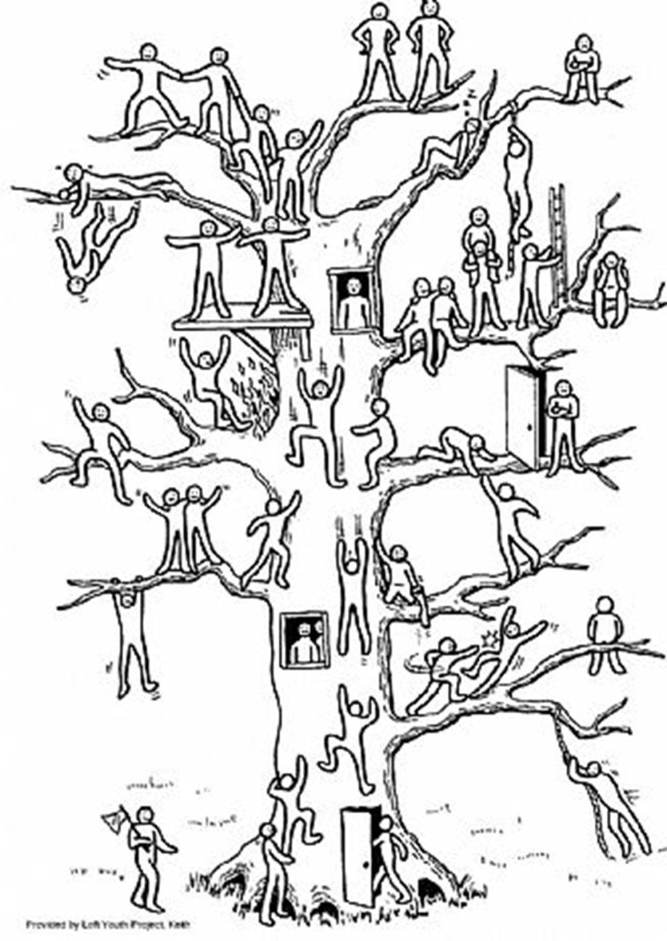
Climbing the Plenary Tree

