Slide 1

Social Learning Theory
Bandura (1977)

Slide 2
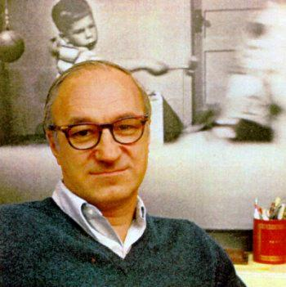
Social Learning Theory (1960s)
Combines concepts of ‘identification’ (Psychodynamic Approach) and reinforcement (Learning Approach)
tendency to observe and imitate people we identify with (models)
learn new behaviours, via the process of 'modelling'.
more likely to imitate models who are seen to be rewarded; vicarious reinforcement

Slide 3
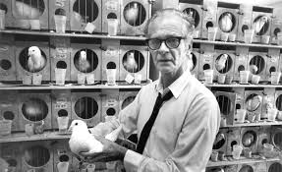
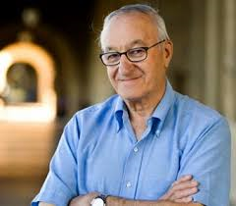
Comparing Bandura and Skinner
SLT says reinforcement is not a necessary condition of learning but vicarious reinforcement does make it mote likely that an observed behaviour will be repeated
Bandura thought learning was more complex than Skinner;
Skinner was a Behaviourist and rejected the idea of mental events
Bandura felt that “thought” or cognitive processes were important in terms of whether an observed behaviour was imitated
Skinner said reinforcement strengthens or weakens a response; Bandura said vicarious reinforcement acts as a motivator, it provides information about likely consequences of the behaviour; we are able to anticipate our future

Slide 4
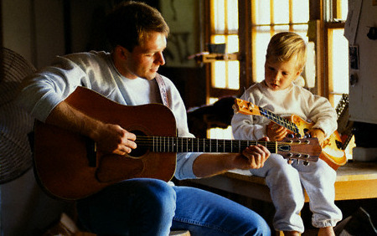
4 SLT processes
Bandura explained that for modelling to be successful,
  the observer had to pay attention to the model (ATTENTION)
  retain that knowledge (RETENTION)
  be able to reproduce the behaviour (REPRODUCTION)
  be motivated to do so (MOTIVATION)

Slide 5
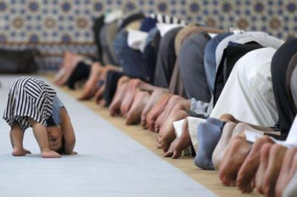
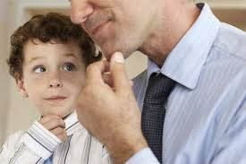
Example of Social Learning
small children observe and imitate the behaviour of adults particularly around the age 2-3
start to imitate behaviour of their parents
e.g. a child may watch her parent working from home and then pretend to work on her own toy computer
Children also pick up facial expressions and mannerisms from their parents, e.g. talking with their hands (gesture).

Slide 6
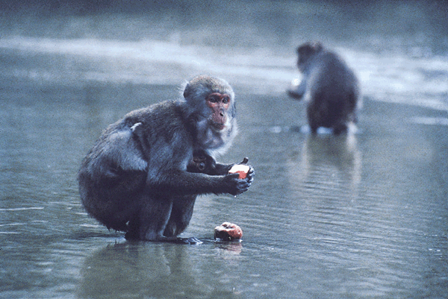
SLT in the Animal Kingdom
The island of Koshima, Japan
a juvenile Japanese macaque developed the innovation of washing sweet potatoes before eating them
Other macaques observed the behaviour and soon the whole population were potato washers
none of the original macaques are alive yet potato washing continues as each generation observes and imitates its elders.

Slide 7
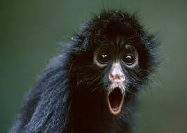
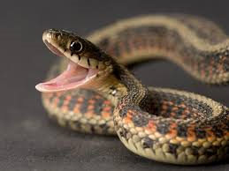
Mineka et al
Monkeys who had observed another monkey being frightened by a snake went onto avoid snakes themselves
this is an example of observational learning through vicarious punishment

Slide 8
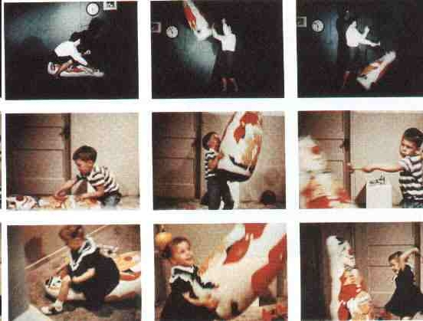
Bandura’s research
children watched video footage of male or female models playing in an aggressive way with an inflatable BoBo doll
when they were later given the opportunity to play with the same BoBo doll, they were more likely to play aggressively and use similar language to the model.

Slide 9
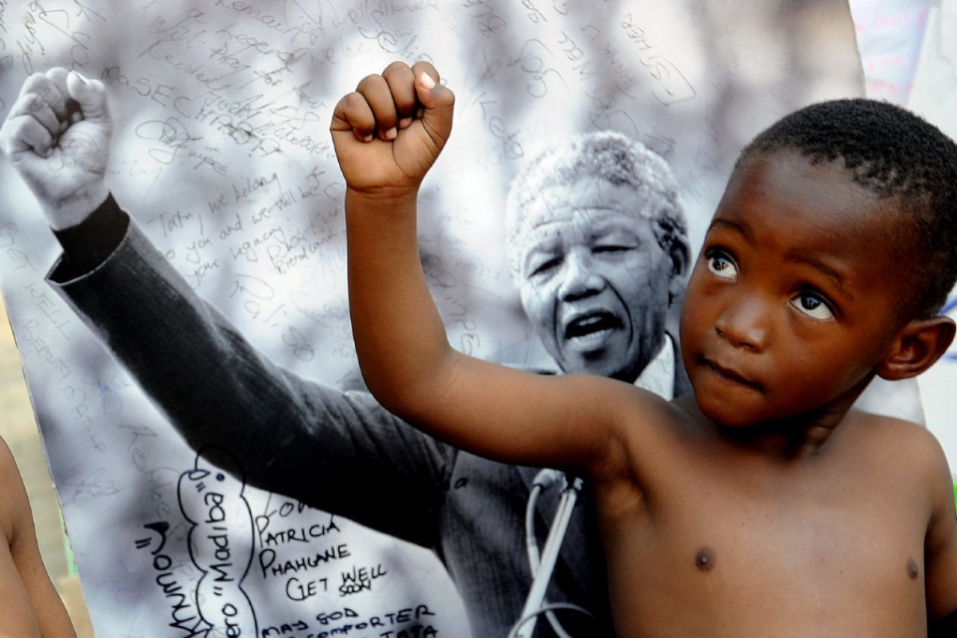
Observation
an individual sees another person’s behaviour, paying specific attention to the important parts of that behaviour
more likely to happen if the person is motivated to observe them for some reason,
e.g. the model is powerful, attractive, successful or even simply the same gender, seen to be rewarded these qualities make identification more likely

Slide 10
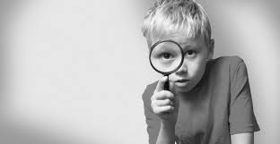
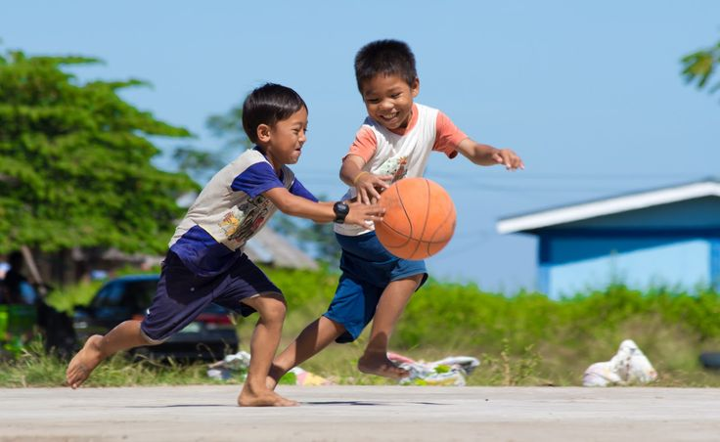
Observation cont’d…
Once a person has been identified with then they are more likely to be observed and the behaviour observed is more likely to be imitated.
Children may identify the most interesting child in the class, interesting because they are attractive, popular or rewarded by the teachers
this child then models behaviour which may be observed by others and imitated.

Slide 11
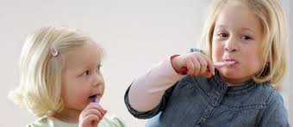
Imitation
a behaviour which has been observed is then copied (reproduced) by the observer
can only take place if the individual is physically able to carry out the act
more likely to happen when the individual is motivated to do so, i.e., if they have observed another individual being rewarded for the behaviour

Slide 12

Imitation cont’d…
A person is more likely to be imitated if the observer identifies with them in some way, i.e. same gender, attractive or powerful.
An example of imitation is when a child dresses up like their parent and enacts their behaviours, i.e. talking on a toy telephone, working on a toy computer.

Slide 13
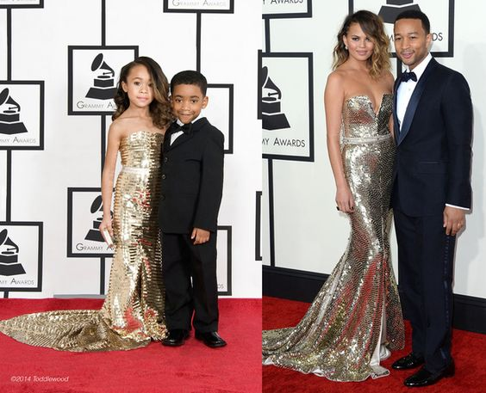
Modelling
an individual enacts a certain behaviour which will act as an example to others who may or may not observe and imitate the behaviour.
also important is the process of the observer identifying with the model.
Without identification, the person is not a model and thus modelling does not take place, the person is simply behaving in the presence of others
e.g. a celebrity is involved in some new diet or beauty treatment and young women identify with the celebrity in some way, i.e. they see themselves as similar in some way.
the women may replicate the behaviour, beginning the same diet or saving up towards the same treatment.

Slide 14
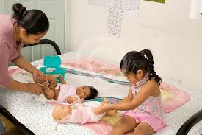
Modelling cont’d…
Example 2: a mother changes a younger sibling’s nappy while watched by an older daughter.
Young children usually identify with their same-sex parent and thus they are likely models.
The child may then imitate the nappy changing routine with her dolls.

Slide 15
Comparing SLT and OC
OC is reductionist, meaning that it is seen as a foregone conclusion that an individual will adapt their behaviour in line with environmental forces in a simplistic and deterministic way
Bandura sees learning as much more complex based on self concept, self monitoring and self efficacy.
He also uses the phrase reciprocal determinism to explain that not only does the environment shape the individual and the individual shapes his/her environment

Slide 16
SLT evolved into SCT (1986)
Bandura reworked his theory to become more cognitive, hence the “C”
Included “abstract modelling” where the ‘to be learnt’ information is not explicit
This way children learn values, beliefs, expectations, “standards for “self-evaluation” and so on
The indivudal internalises societal standards and uses these to “self-monitor” and “regulate” their behaviour, even in the absence of reinforcement
He says there is no more devastating punishment than out own “self contempt” (links to Freudian concept of super-ego)

Slide 17
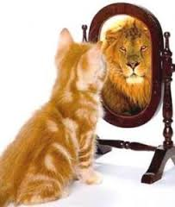
Self efficacy
Our perception of our ability to be effective and control our behaviour/environment;
we may not imitate an observed behaviour, even if motivated to do so, if we believe we are not capable of pulling it off
This concept helps to explain indivudal differences (people are exposed to the same role models but act differently)

