Slide 1
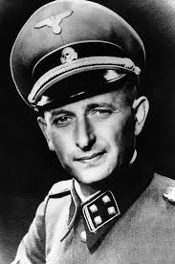
Agency Theory:
An Explanation of Obedience
Milgram (1974)

Slide 2
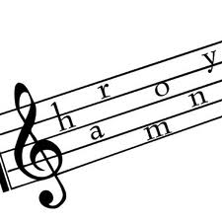

Rules help to maintain social harmony and stability
Milgram believed that obedience to authority and “following the rules” was a way of maintaining stability in society.
When we follow them we surrender some of our free will
We have evolved two states that enable us to become obedient when confronted with an authority figure:
Agentic state
Autonomous state
He said sometimes when we are in the agentic state we suffer from moral strain

Slide 3

Agentic State
If a person is perceived as having more authority than us we make the agentic shift
We become their “agent” and believe we are acting on their behalf
We follow their orders, sometimes without question or fear of reprisals
We may believe that we have no choice but to obey
In this state, we may do things that we would not normally choose to do
This is often because we defer responsibility; we believe the authority figure is responsible
This can create moral strain in the individual obeying the order, whereby the individuals suffers psychological and physical symptoms of anxiety

Slide 4
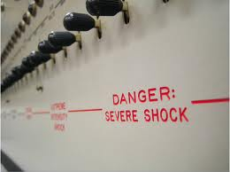
Example of agentic state:
Milgram (1963)
65% of participants administered 450 V electric shocks to an innocent person simply for making mistakes on memory task.
Milgram explained that they had made an agentic shift from the autonomous state into the agentic state, seeing the experimenter as responsible for their actions

Slide 5
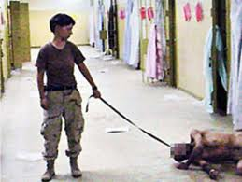
Examples of Agentic state in real life
Behaviour of death camp officials in the Holocaust, e.g. Adolph Eichmann
Behaviour of American Soldiers such as Chip Frederick and Lynndie England in Abu Ghraib.

Slide 6

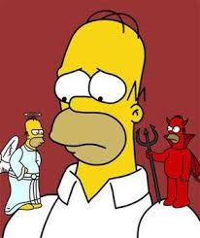
Autonomous state
In the autonomous state we recognise our own free will, we act independently of others and able to make our own decision
We take responsibility for our actions and think twice when given orders.
The person follows their own personal moral code of conduct rather than deferring responsibility to someone else.

Slide 7
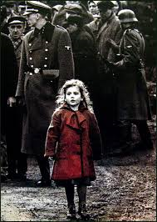

Examples of Autonomous State in Milgram’s own research
It is possible that those participants who dropped out of Milgram’s famous ‘electric shock’ study had made the agentic shift back from the agentic state in to the autonomous state as they realised that they were in charge of making their own decisions.
In the all female Pp variation, Gretchen Brandt (aged 31, a medical technician) refused to continue above 210 volts; she said “I think we are here of our own free will”, it transpired that she had grown up in Nazi Germany and during debriefing said “perhaps we have seen too much pain”.
Jan Rensaleer, an industrial engineer stopped at 225 volts, saying ‘I know what shocks do to you. I’m an electrical engineer’. When asked who was responsible for the shocks he said ‘I would put it on myself entirely’. His ability to resist might be put down to this two things: a sense of knowledge and a sense of responsibility.
A minister refused to go further than 150 volts saying ‘I don’t understand why this experiment is placed above this person’s life...If he doesn’t want to continue , I’m taking orders from him’. In the post-experiment interview he said ‘If one has as one’s ultimate authority God, the it trivialises human authority’. The minister’s ability to resist is due to a strong sense of moral responsibility.

Slide 8
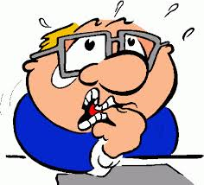
Moral strain
a state of mental discomfort (anxiety) caused when a person behaves in a way which conflicts with their beliefs about right and wrong as can happen whilst in the agentic state
We may use defence mechanisms to avoid the distress of having to perform acts which we would normally find difficult
For example denial means that we reject the idea that what we have done is wrong

Slide 9
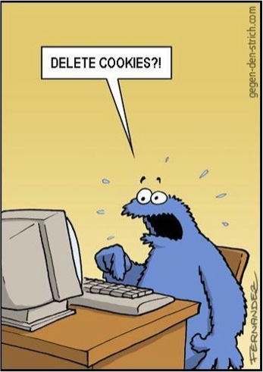
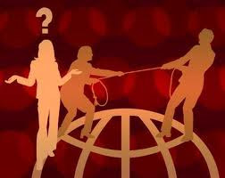
Cognitive dissonance (Festinger, 1957)
This state of discomfort occurs when we hold two ideas that conflict with each other
Moral strain is an example of this, e.g. “harming people is wrong” and “I have harmed some-one”
As we cannot erase behaviours we have already enacted (I have harmed someone) we instead change our beliefs about why we did this, e.g. we might over exaggerate the scientific value of the study in our mind

Slide 10
• E.g. denial was common in soldiers during the Holocaust as
they refused to confront what they were doing/eq;
An example of moral strain can be seen in Milgram’s infamous study, where the participants, behaving in the agentic state, apparently administered electric shocks to the learner. They were seen to stutter, tremble, dig their fingernails into their palms, sweat, bite their lips and even have seizures.
These responses resulted from the participants’ awareness (whether conscious or pre-conscious) of the two conflicting ideas that they did not wish to harm the victim but at the same time that they felt unable to resist the urge to obey the authority figure, a behaviour which has become almost instantaneous, and separated from conscious decision-making.

Slide 11

The Socialisation process
The theory believes we are socialised into an agentic state from a young age, from an early age obedience becomes more likely as we are rewarded for obedience and punished for going against instructions
Children learn to act as agents, following social rules

Slide 12
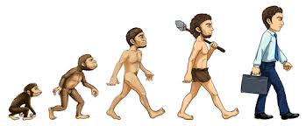
Obedience and survival: an evolutionary explanation
the ability to make the agentic shift in certain social situations has survival value; evolutionary psychologists argue that common behaviours today reflect the selection pressures that existed in our environment of evolutionary adaptation, 35,000-3 million years ago.
Being an agent of society helps to avoids conflict and enables smooth running of a society; Milgram argues that obedience has survival value
Those humans who know their place in the social hierarchy and stuck to the rules were more likely to have been accepted and survived, those who rebelled may have been rejected and found survival more difficult thus not passing the genes to the next generation; therefore over time creatures whose survival relies on being part of a group become increasingly more obedient with each generation

Slide 13
Key terms to mention in your AO1
Authority figure
Agentic state
Autonomous state
Agentic shift
Moral strain
Cognitive dissonance
Denial
Socialisation
Evolution
Survival
Social harmony/stability

