Slide 1

Describing CBT as a treatment for schizophrenia
Paper 2: Clinical
Content
© Amanda J Wood, 2016-2017

Slide 2
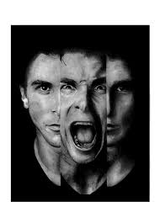
Stress and schizophrenia
People may lack necessary coping skills to manage their symptoms
leaves them vulnerable to stress
can trigger relapse;
CBT used to identify stressful situations and train clients to regulate emotions associated with stress serving to prevent relapse

Slide 3

CBT and schizophrenia
CBT sessions tailored to individual needs
length and number of sessions vary widely
initial session:
  establishing the “therapeutic alliance”
  trust between therapist and client is essential to the success of the therapy
  discuss rationale of the therapy
  identify and agree on treatment goals

Slide 4
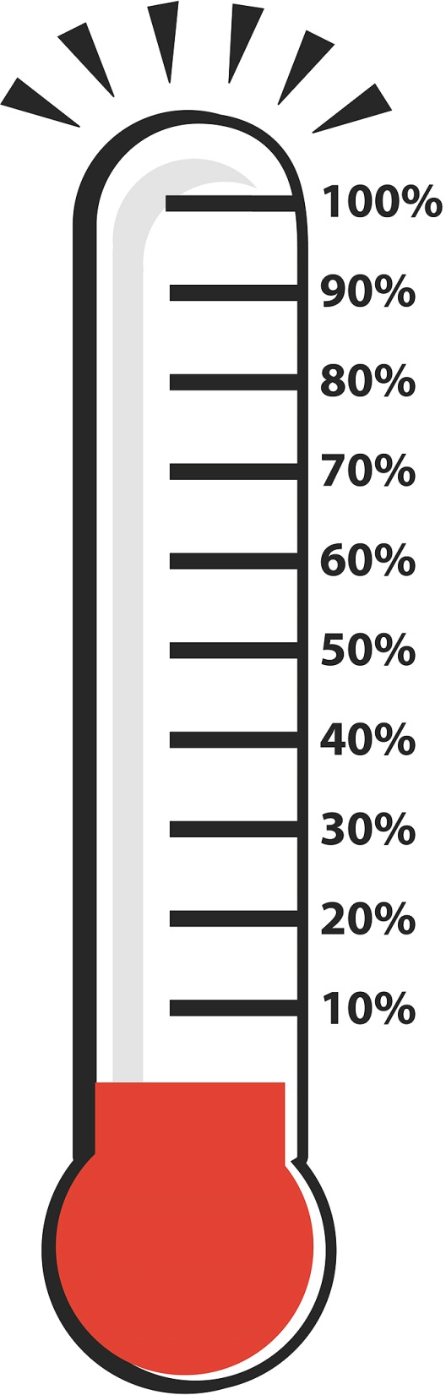

Therapy sessions
structure the day into blocks which can then be reviewed in therapy
Use the ABC model to identify stressors or activating events and emotional consequences;
therapist helps the person talk though the unhelpful beliefs associated with events and emotions
“stress thermometer” to keep a daily record of their stress levels throughout the day

Slide 5

CBT can help to…
improve self-awareness and recognition of situations and prodromal symptoms which may precede decompensation
initiate adaptive coping strategies such as stress management strategies (e.g. meditation) reducing the probability of relapse.

Slide 6
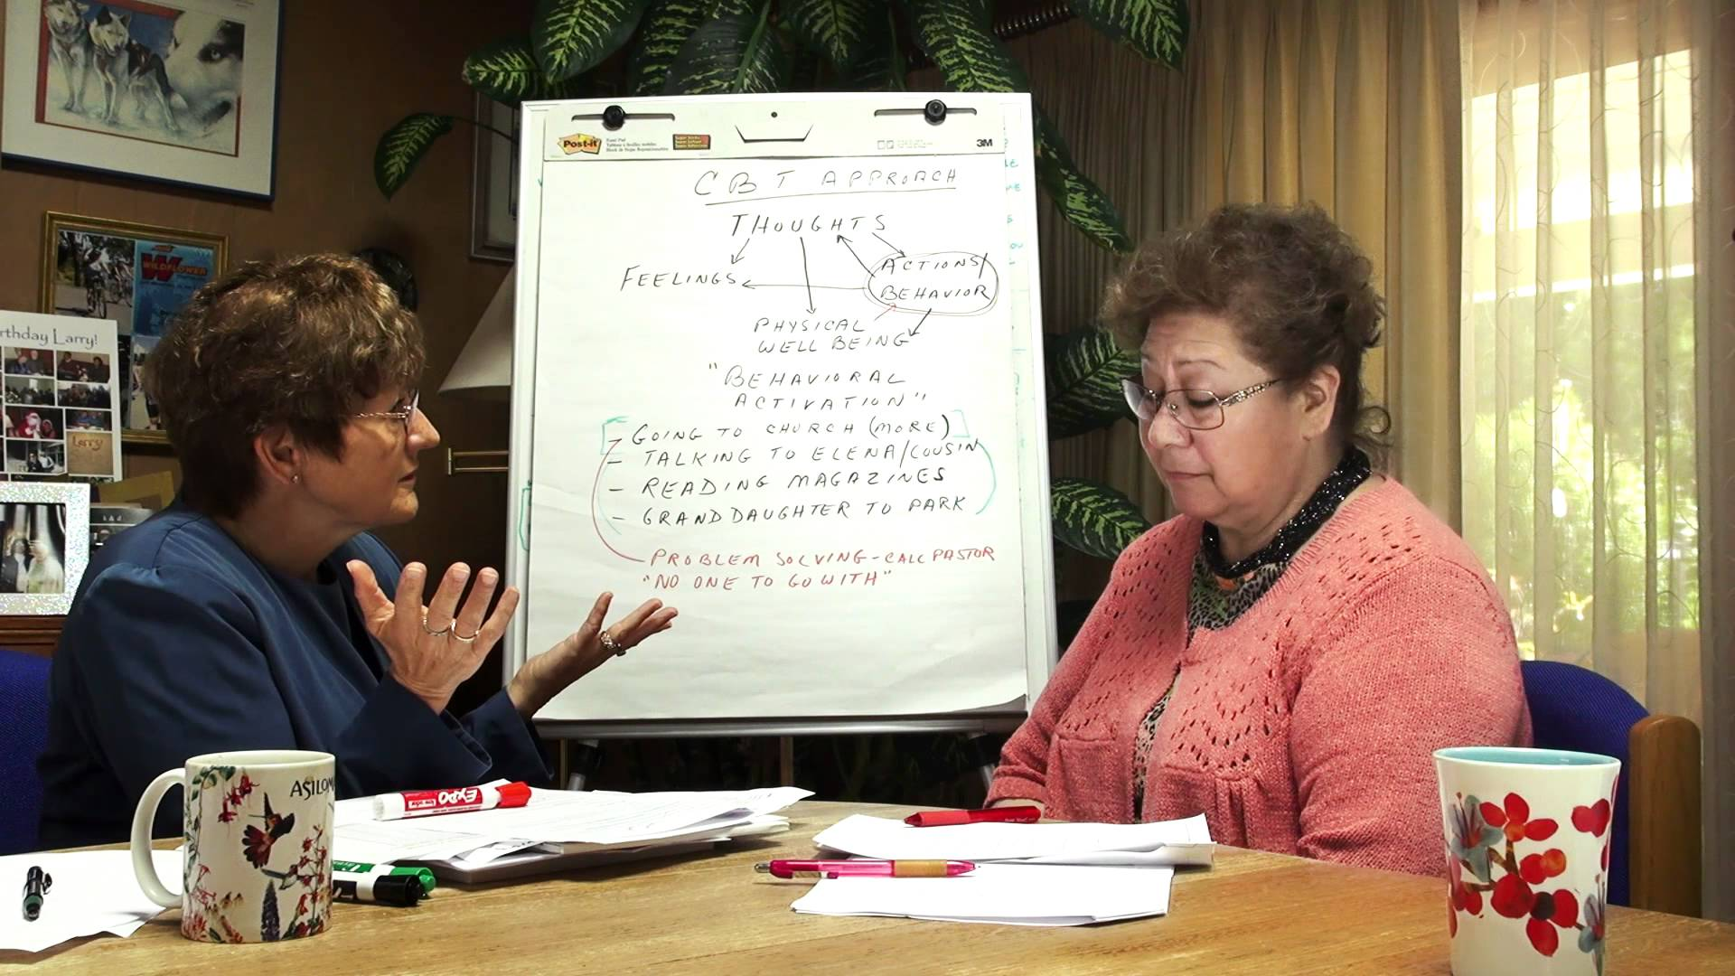
CBT can also be used to help…
combat hallucination and delusions through verbally challenging the perceived reality
encouraging the person to test their hypotheses by collecting evidence from behavioural experiments
evidence can then be discussed and used to debunk erroneous beliefs
If real world behavioural experiments are not advisable, role play with therapist may be used

Slide 7

CBT can help to…
educate the person about their condition and vulnerability to stress
build their sense of self
help them to recognise they are more than a person with a diagnosis of schizophrenia
destigmatise their experience.

Slide 8

Improving sense of self
exploring previous interests
expanding the range of activities they are involved in
must be done appropriately; increased social interaction can be stressful
the person may need regular rest days with lower levels of stimulation

