Slide 1
The function of neurotransmitters as an explanation of schizophrenia
The dopamine hypothesis; Version 1

Slide 2
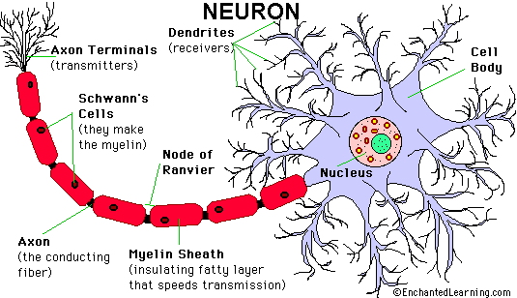
The dopamine hypothesis
Neurones - brain cells which transmit and receive messages and we have billions of them!
They communicate with each other via chemical messengers called neurotransmitters
mental disorders may be caused by an imbalance (either an excess or a deficiency) of certain neurotransmitters

Slide 3
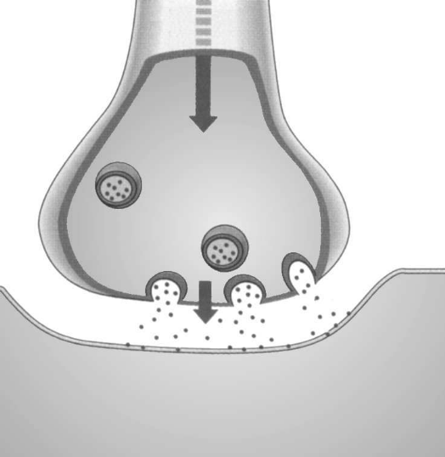
The synapse
A neural impulse triggers release of neurotransmitter molecules
Neurotransmitter molecules are released from the end of the presynaptic cell (the axon) into the space between the two nerve cells (the synapse).
Having travelled across the synaptic gap or cleft, molecules may then be ‘taken up’ by specially shaped receptor sites on the postsynaptic nerve cell (the dendrite) and so the chemical message is passed on.
The relationship between the neurotransmitter molecule and the receptor site is like a lock and key, molecules will only fit certain receptor sites.
Excess molecules are ‘taken back up’ by the pre-synaptic cell and recycled.
Excess neurotransmitter molecules are broken down or recycled
Neurotransmitter molecules are
released into the synaptic gap.
Neurotransmitter molecules binds to
receptor sites

Slide 4
The dopamine hypothesis, version 1: Rossum (1966)
Originally, Rossum suggested that an EXCESS of the neurotransmitter dopamine may be responsible for schizophrenia
Question: Why might a person have an excess of dopamine?

Slide 5
Possible answers
Too many molecules of dopamine are manufactured in the presynaptic cell
Too many are released from the presynaptic cell
Not enough enzyme in the synaptic cleft to break down left over molecules
Leftover molecules are not recycled and are left in the gap
Too many receptor sites on the post synaptic cell
Receptor sites are overly sensitive

Slide 6
Dopamine
as dopamine is responsible for directing attention, it was felt that too much dopamine might make the brain overactive, leading to disordered thinking, racing and unrelated thoughts, paranoia and other delusions and hallucinations
the first wave of anti-psychotics called “typcials” work by blocking dopamine receptors without activating them
the first anti-psychotics were discovered in the 1950s; the first was called chlorpromazine
the original version of the hypothesis , highlighted issues with either too many or overly sensitive dopamine receptors, particularly D2 receptors, as blocking these seemed to reduce symptoms most effectively

Slide 7
Other research fed into the original version of the hypothesis
Ldopa (a precursor of dopamine that can be created artificially) is used to treat Parkinson's Disease, which is caused by a lack of dopamine
amphetamines also enhance dopamine activity and can bring on schizophrenic like symptoms

Slide 8
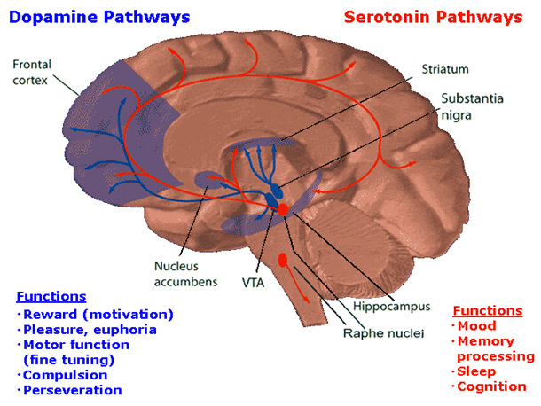
Dopamine hypothesis revisited, David (1991)
An update of the dopamine hypothesis by David (1991) suggested that a lack of dopamine receptors sites in one area of the brain may mean that an excess of receptor sites develop in another area.
For example, a lack of dopamine receptors in the pre-frontal cortex could lead to excess numbers in an area called the striatum.
The implication here is that anything which interferes with development of the pre-frontal cortex could be indirectly linked with schizophrenia.

Slide 9
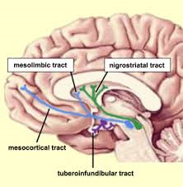
an excess of dopamine receptors in the…
meso-limbic pathway maybe associated with positive symptoms
While a lack of receptors in the ..
meso-cortical pathway is associated with negative symptoms.

