Slide 1

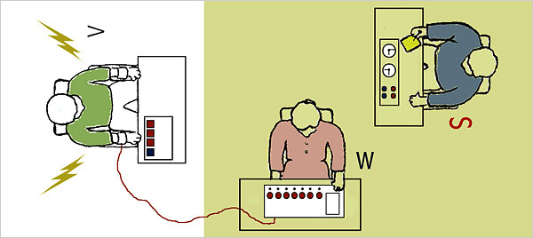
Gender and Obedience

Slide 2
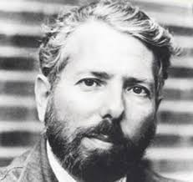
Milgram: Experiment 8
Milgram’s female variation = 65% identical to males;
obedient women self-reported higher levels of tension/nervousness during the procedures than in 20 groups of obedient men;
Milgram (1974) speculated that the similarity between men’s and women’s behaviour could be attributed to two opposing tendencies.
On the one hand, women may have been more empathic toward the learner’s suffering, which would have led them to end the procedure.
On the other hand, women may have had a more difficult time asserting themselves in the face of the pressure exerted by the experimenter.

Slide 3

Blass (2000)
gender differences do surface on occasion but Blass (1999) found no evidence of a gender difference in eight out of nine replications of Milgram’s studies.

Slide 4

Burger

Slide 5

Kilham and Mann
Study conducted in Australia
40% male and 16% female

Slide 6

Shanab and Yahya (1977)
Conducted in Jordan
school children
females were more likely to show visible signs of tension than were males.

Slide 7

Ring, Wallston, and Corey (1970)
voice-feedback replication using 57 female subjects.
main focus was the relative effectiveness of different debriefing methods
an important finding was that 91% of their subjects were fully obedient, the highest rate for a standard condition reported in the obedience literature.

Slide 8

Sheridan and King ( 1972
conducted a unique Milgram-type study using a puppy as the “learner.”
Even though the cute puppy was visible to the subjects and enough actual shock was delivered to cause the puppy to yelp and jump in pain, 100% of the female subjects were fully obedient, while only 54% of the males were obedient.

Slide 9

Eagly (1978)
reviews gender differences in “influenceability” showed that the widely held assumption about women being generally more influenceable than men was wrong.
She found no gender differences in the majority of the studies she reviewed.
A tendency for women to be more susceptible to influence than men showed up in only one domain-the Asch-type (Asch, 1956) group-pressure conformity situation, in which 34% of the studies found women to be significantly more conforming than men.

