Slide 1
Psychology Paper 1 Mock
Improving your grades in
Sections A, D and E

Slide 2
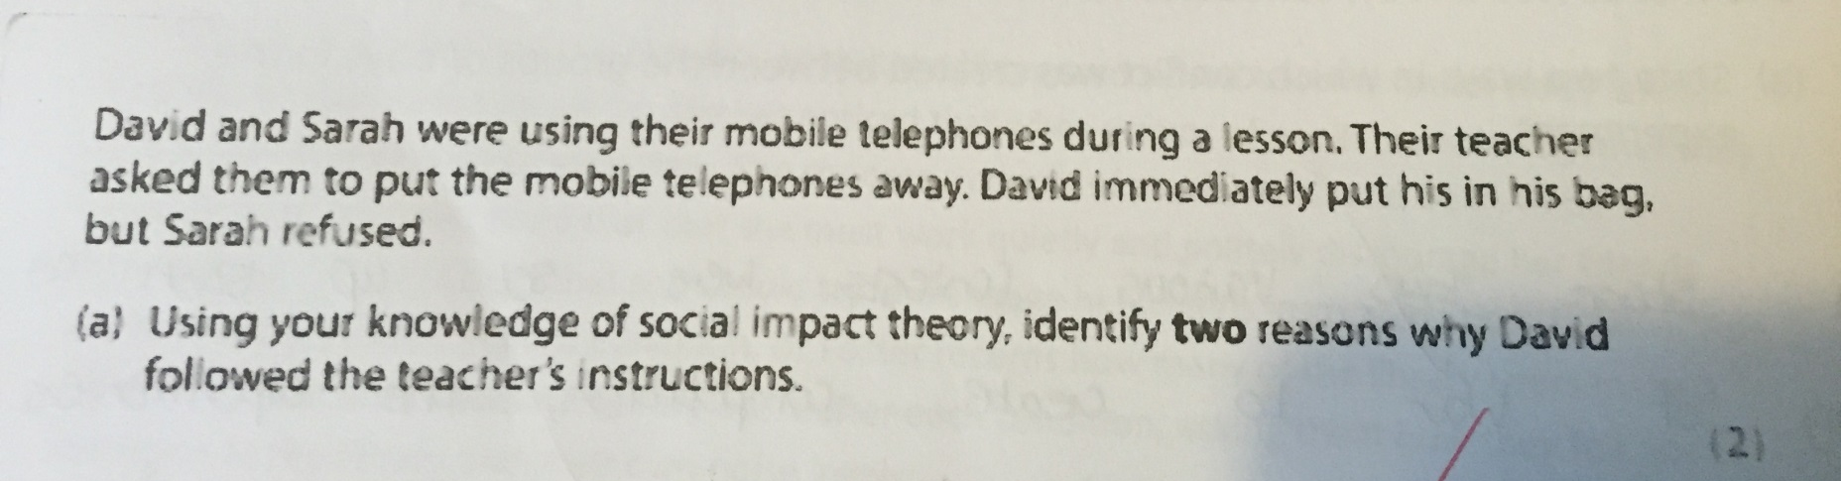
Question 1a.

Slide 3

What should go in this answer?
Command term is IDENTIFY suggest that you do not need to go into an awful lot of detail here.
Read over again, did David obey or resist the order?
What key terminology can you think of relating to social impact theory? Why not make a brain-map in the margin to give yourself some ideas…
Are you sure you are not accidentally getting mixed up with agency theory?
How can you make sure you don’t muddle these two theories?

Slide 4
Social Impact Theory
Immediacy
Strength
Number
Lightbulb analogy
Targets and Sources
Multiplicative and divisional effects

Slide 5
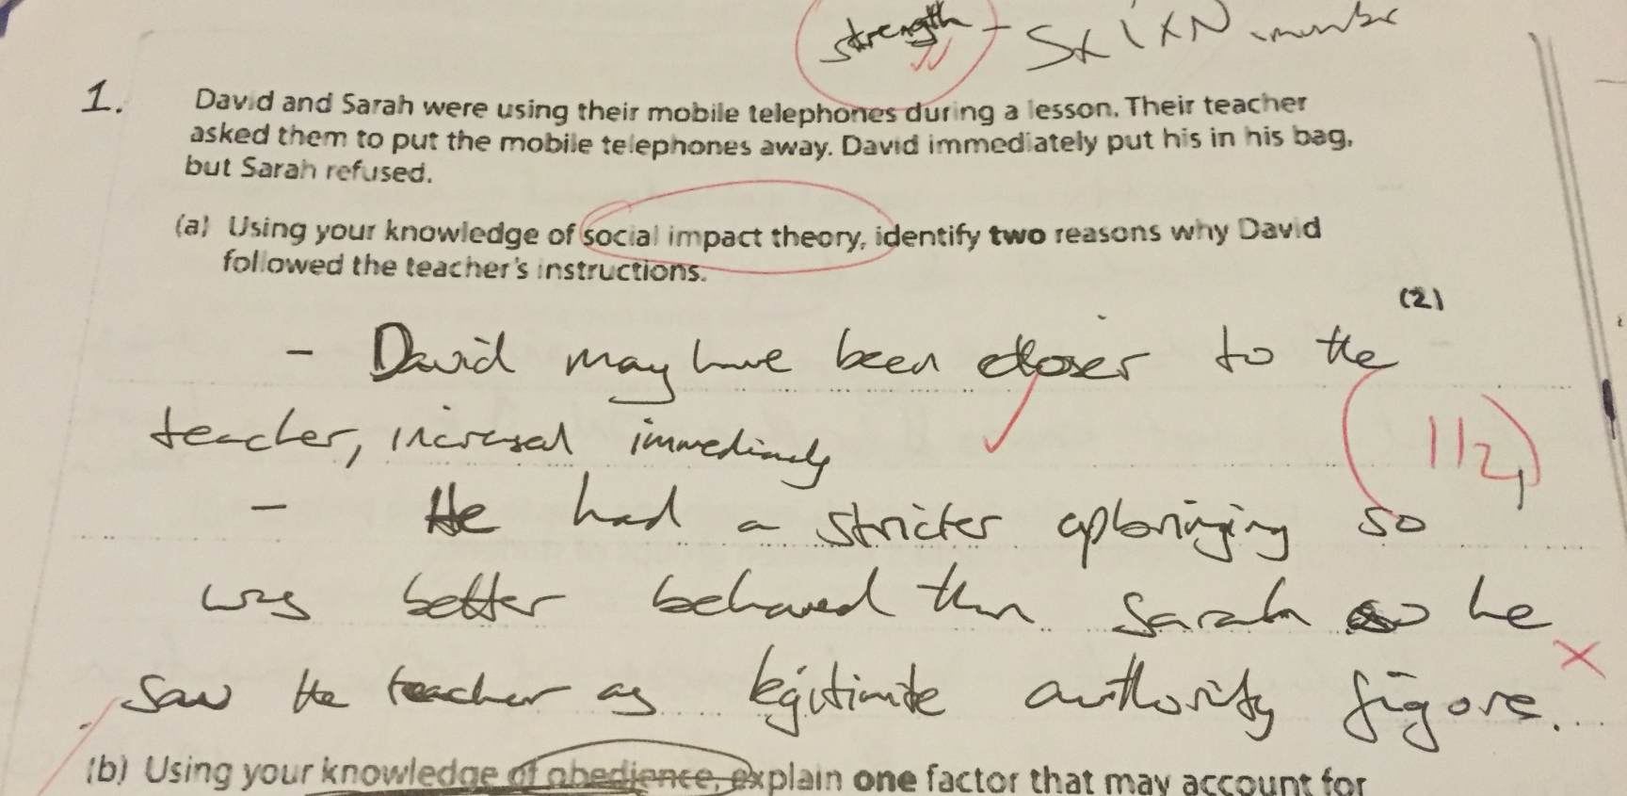

Slide 6
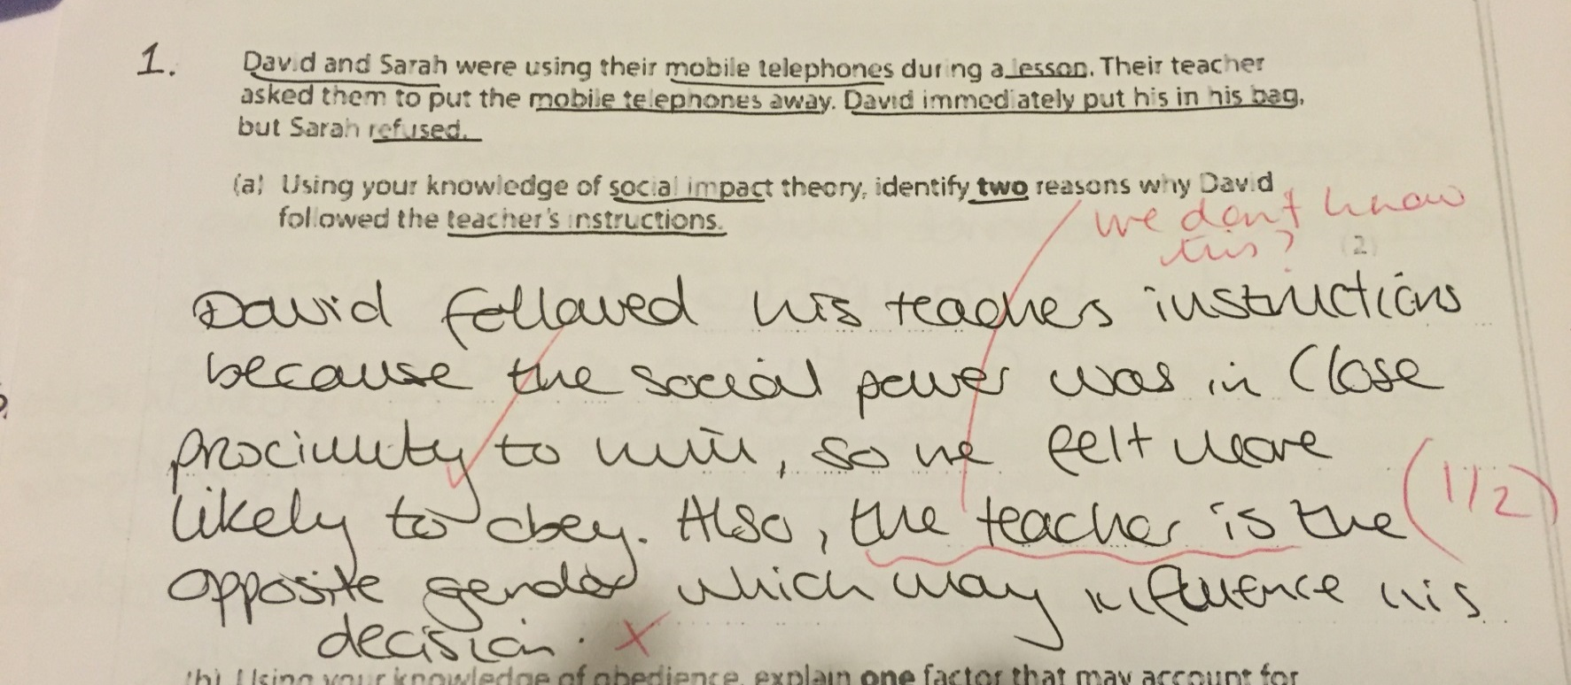

Slide 7
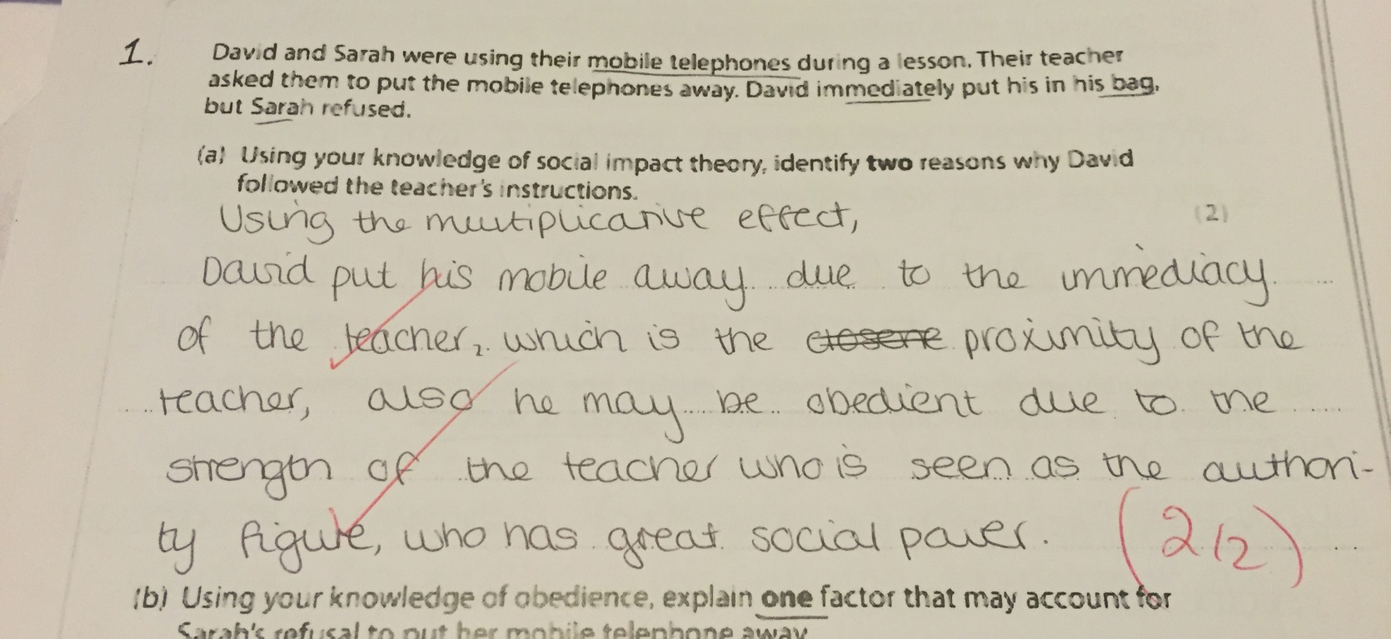


Slide 8
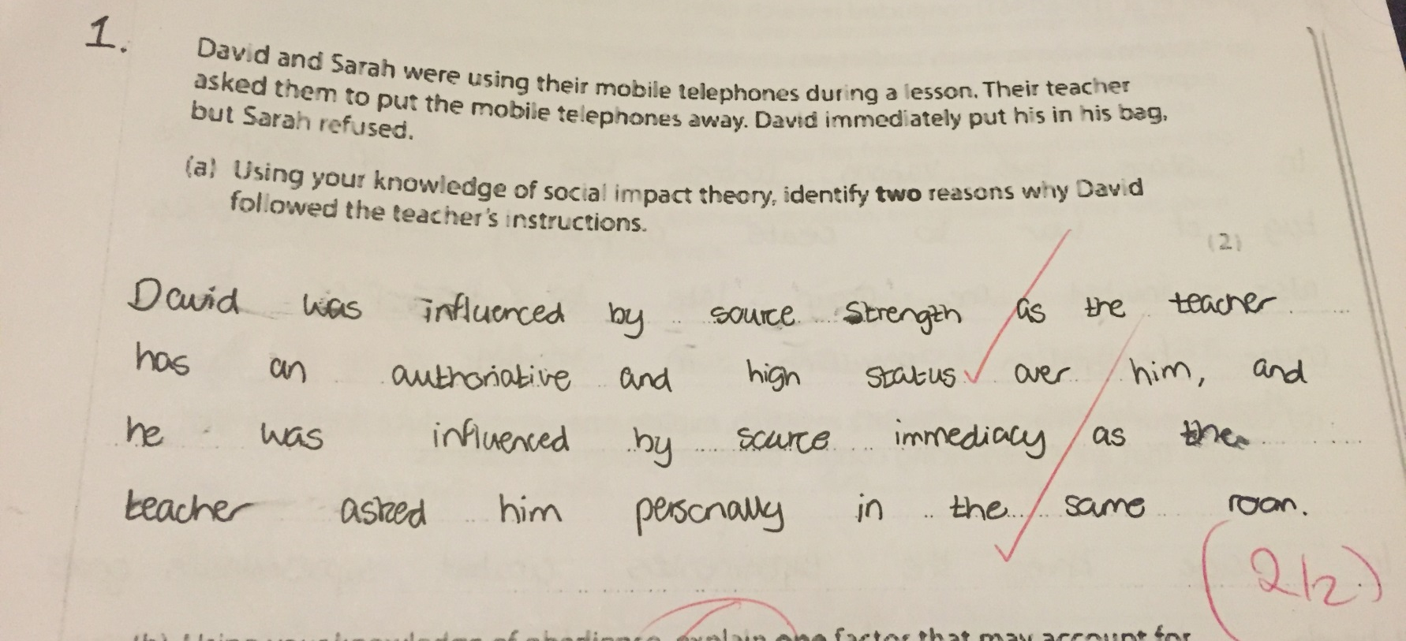

Slide 9
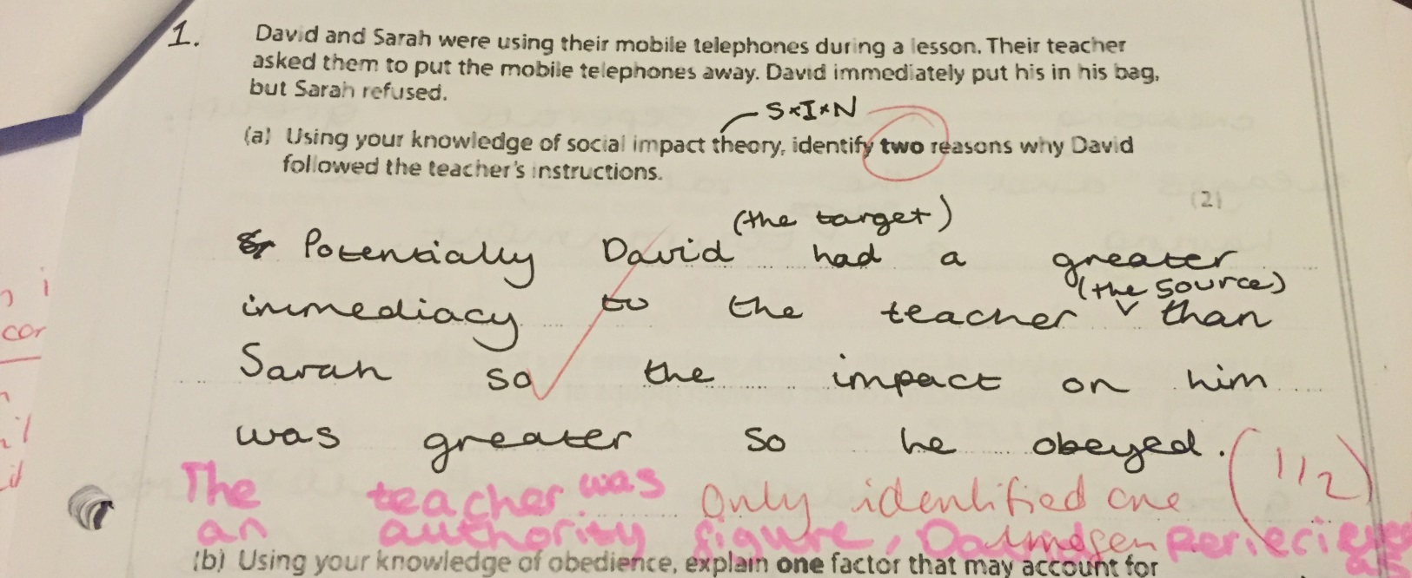

Slide 10
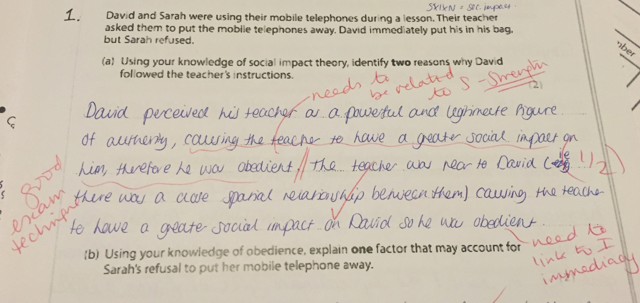

Slide 11
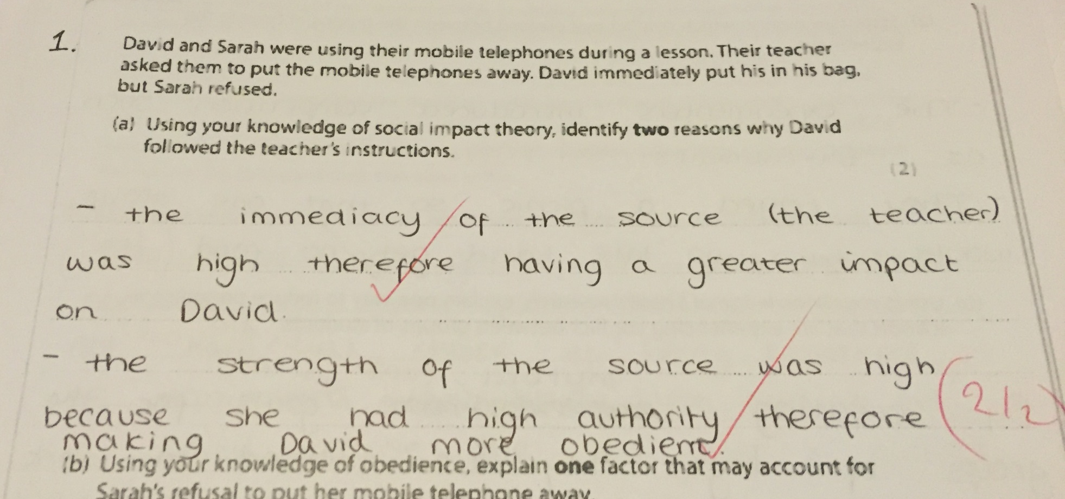

Slide 12
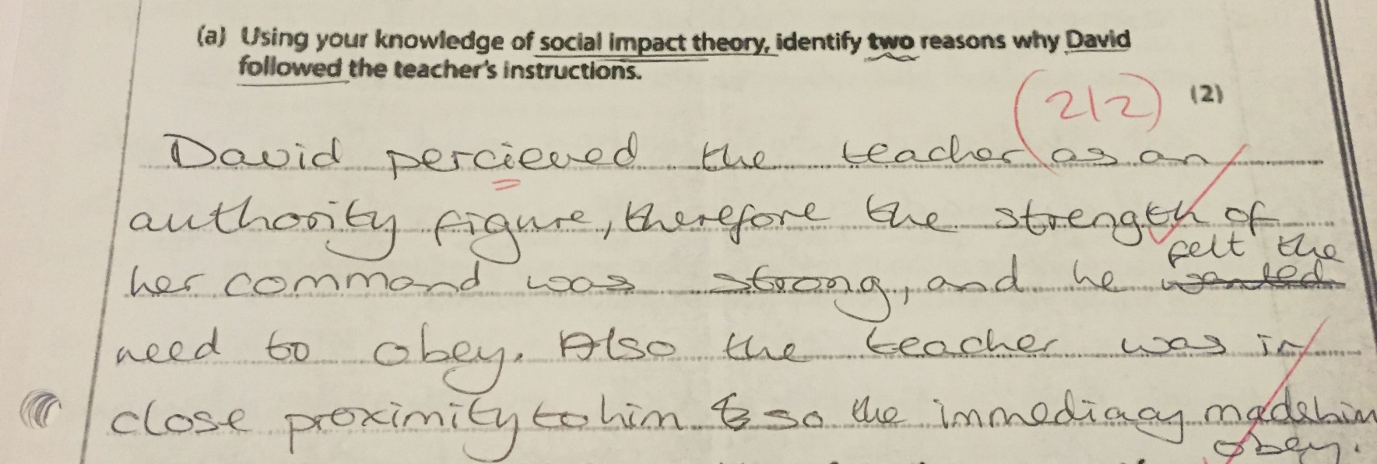

Slide 13
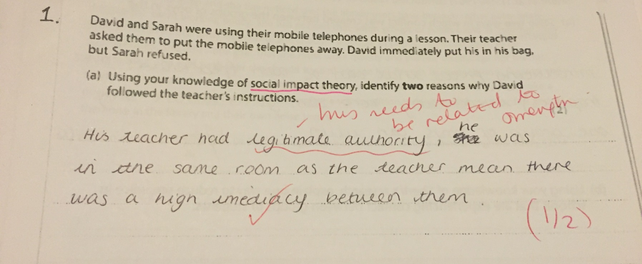

Slide 14
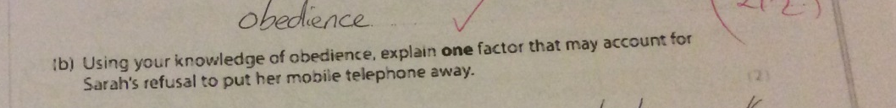
Question 1b

Slide 15
What should go in this answer?
“Using your knowledge of obedience” this mans you have to think about everything you have learnt in psychology on this topic….why not make a brain-map in the margin to give yourself some ideas

Slide 16


Knowledge of Obedience
Agentic state & autonomous state
Milgram (1963)
Disobedient Stooges
Moral strain
Agency theory
Evolution and socialisation
Factors affecting obedience
Culture
Situation
Personality
Gender

Slide 17
Explain one factor…
EXPLAIN as a command term means you have to go further than just describing the WHAT and aim to give the HOW and the WHY ☺
You must think about all the FACTORS that might affect Sarah and choose the ONE which you think you can EXPLAIN (how and why) most effectively for the numebr of marks available (2)
You need to think about FACTORS (in the spec we have a list of factors that we have to consider and this should have been a clue word in the question

Slide 18
Sarah’s refusal to put her phone away
Sarah is NOT obedient
This means you need to combine your knowledge on the factors and think how they make people disobedient NOT obedient

Slide 19
Personality
Which of the following personality traits would you choose to talk about and why?
Which one’s are you able to elaborate upon using research for example?
Authoritarian Personality | High or low on the f-scale?
Empathic Concern | High or low degree of concern?
Desire for control | High or low desire for control?
Locus of control | Internal or external?

Slide 20
Culture
Individualist versus Collectivist Cultures
Confucian Dynamism – short term orientation versus long term orientation

Slide 21
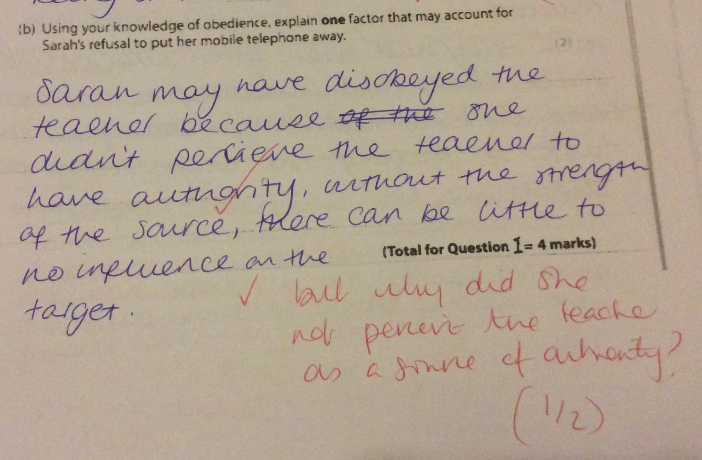

Slide 22
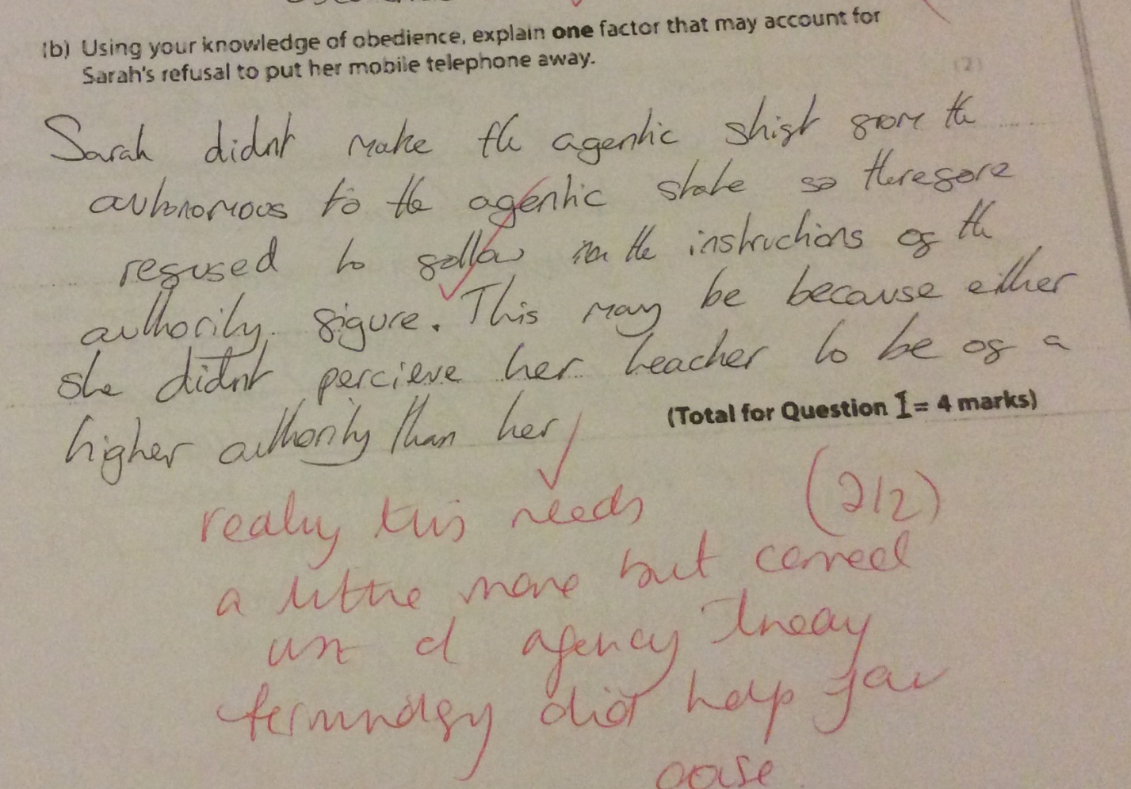

Slide 23
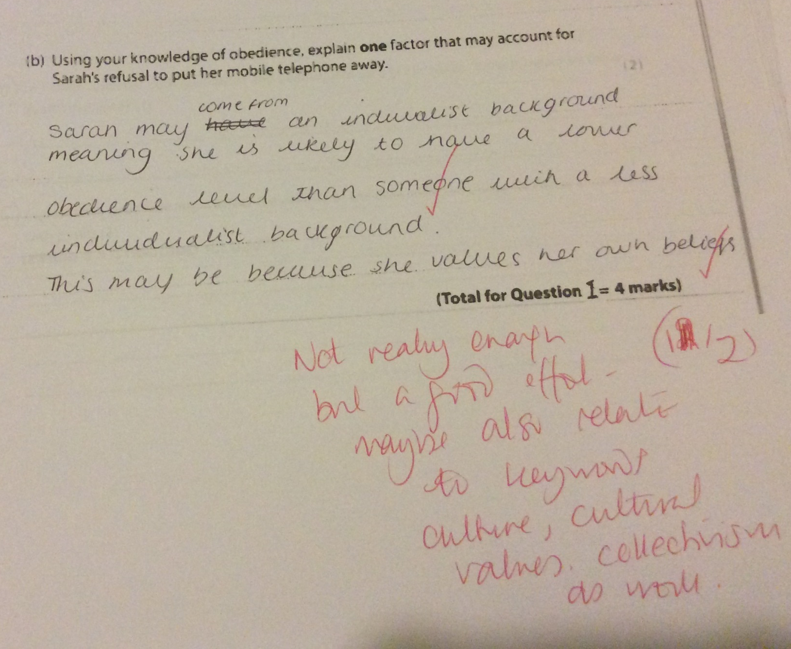

Slide 24
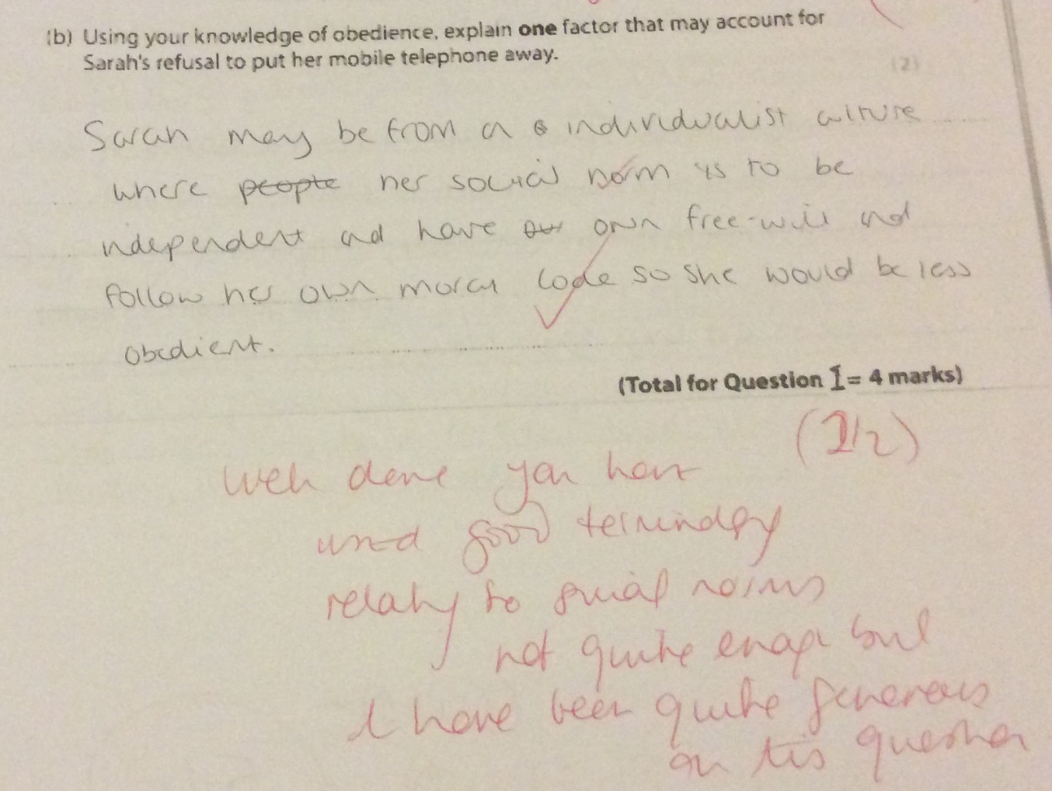

Slide 25
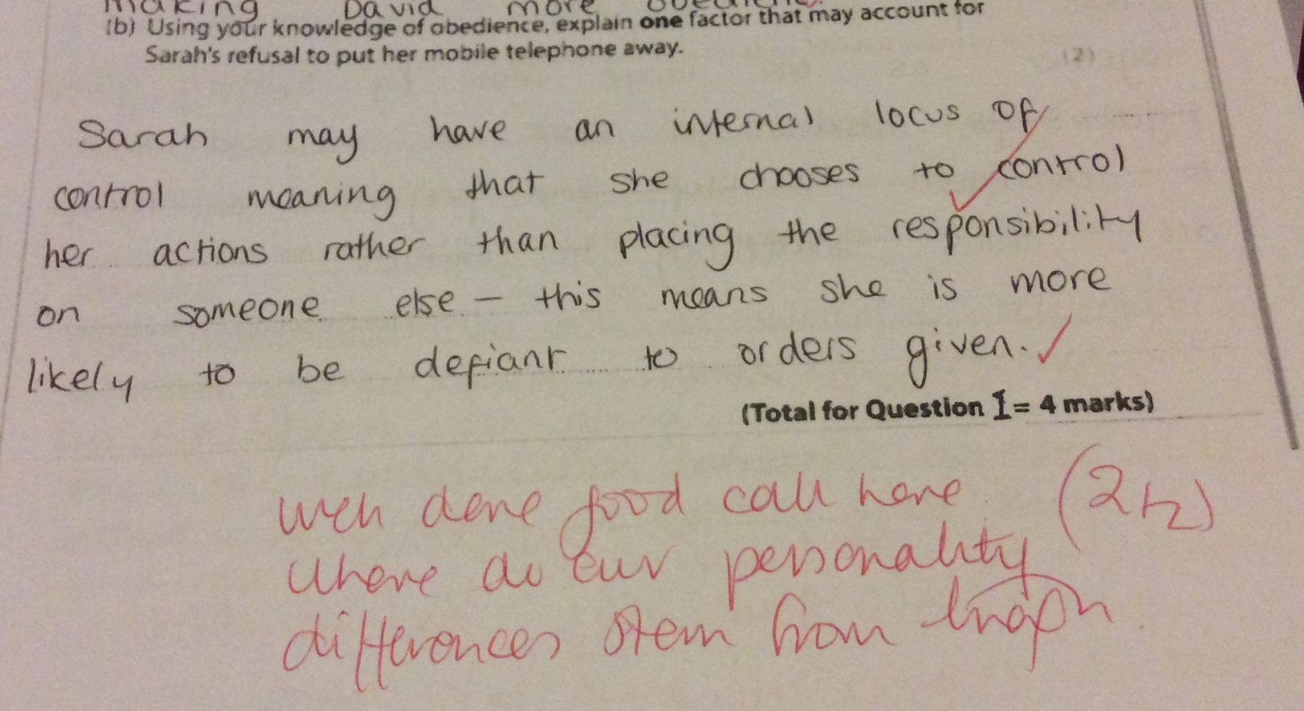

Slide 26
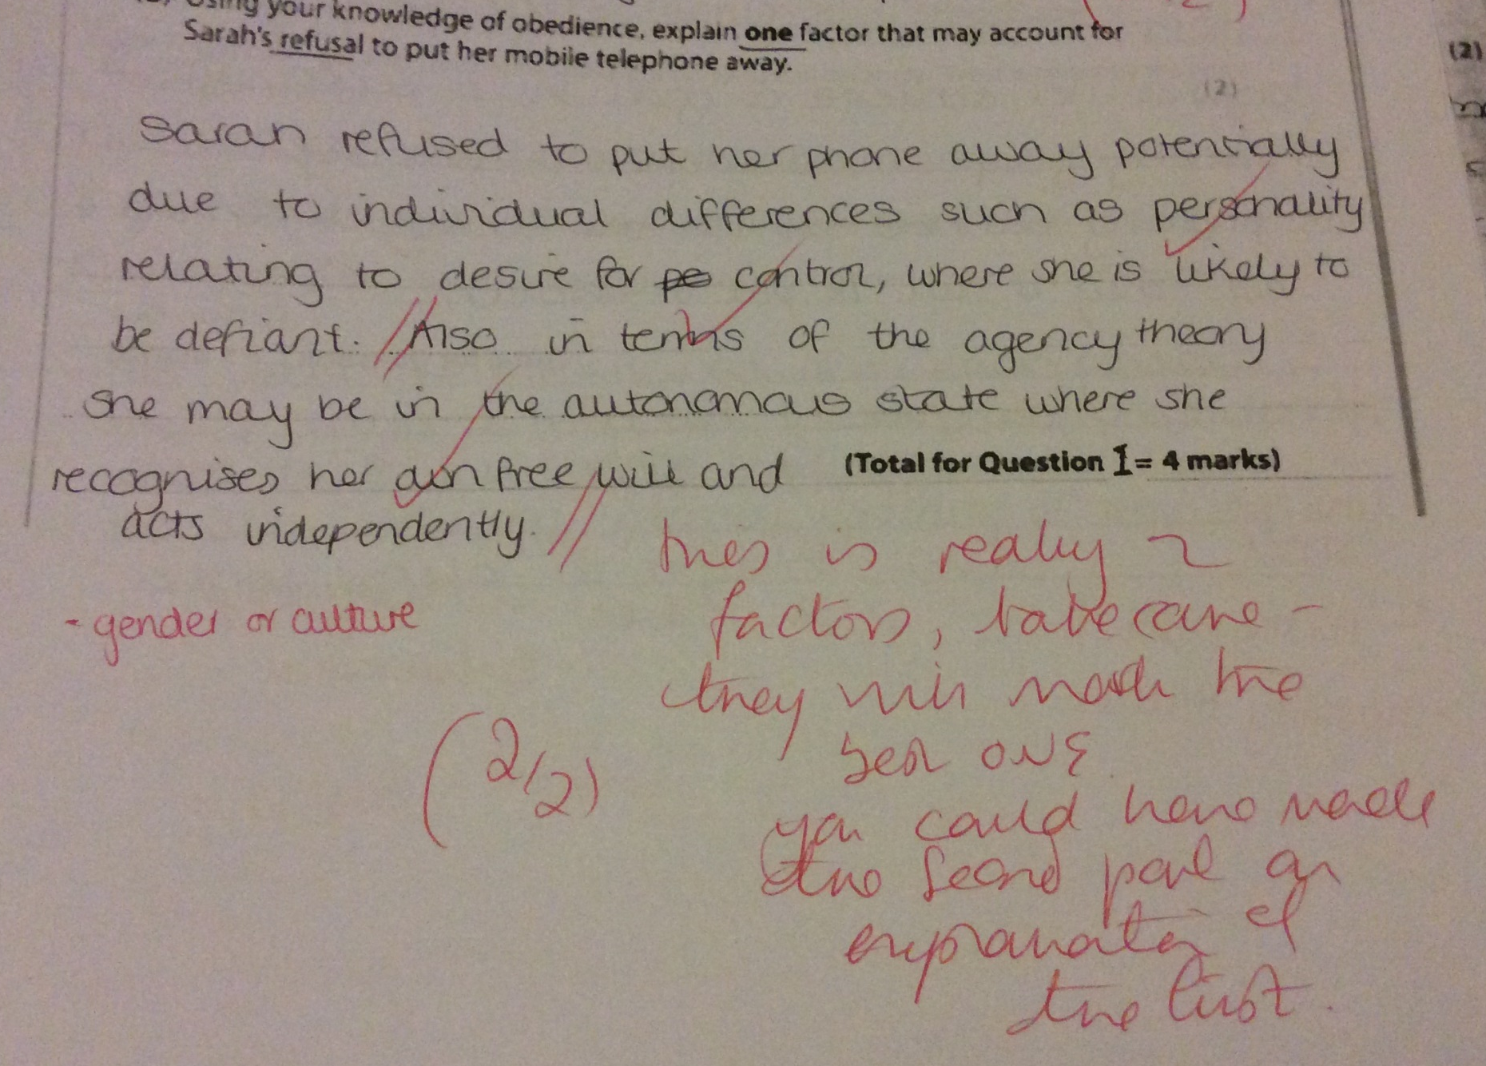

Slide 27
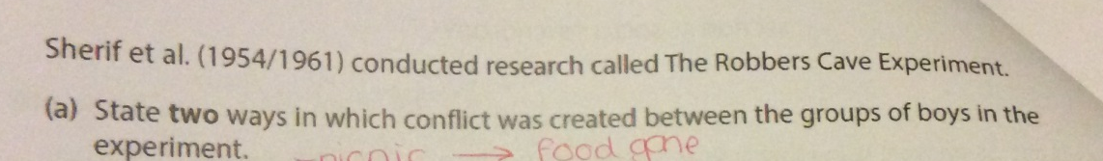
Question 2 a.
Sherif et al (1954/1961);named study in the spec (CLASSIC) Robbers Cave
STATE – this command term means that you do not have to describe in any depth , but this does suggest that answers need to be highly specific and accurate in order to get the marks
The question uses the term CREATED suggesting that you need to talk about the deliberate actions taken by the experimenters to attempt to induce conflict
You had to give TWO ways

Slide 28
Extended examples
Inviting one of the groups to the picnic at the wrong time meaning that …
  the other group had eaten most of the food by the time they arrived
Setting up sporting tournaments such as …
  baseball
  tug of war
  Swimming
Offering prizes that only one team could win including…
  Trophies
  multi-blade penknives.

Slide 29


Slide 30
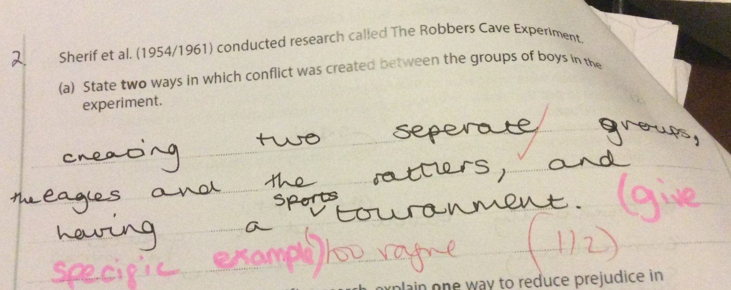

Slide 31
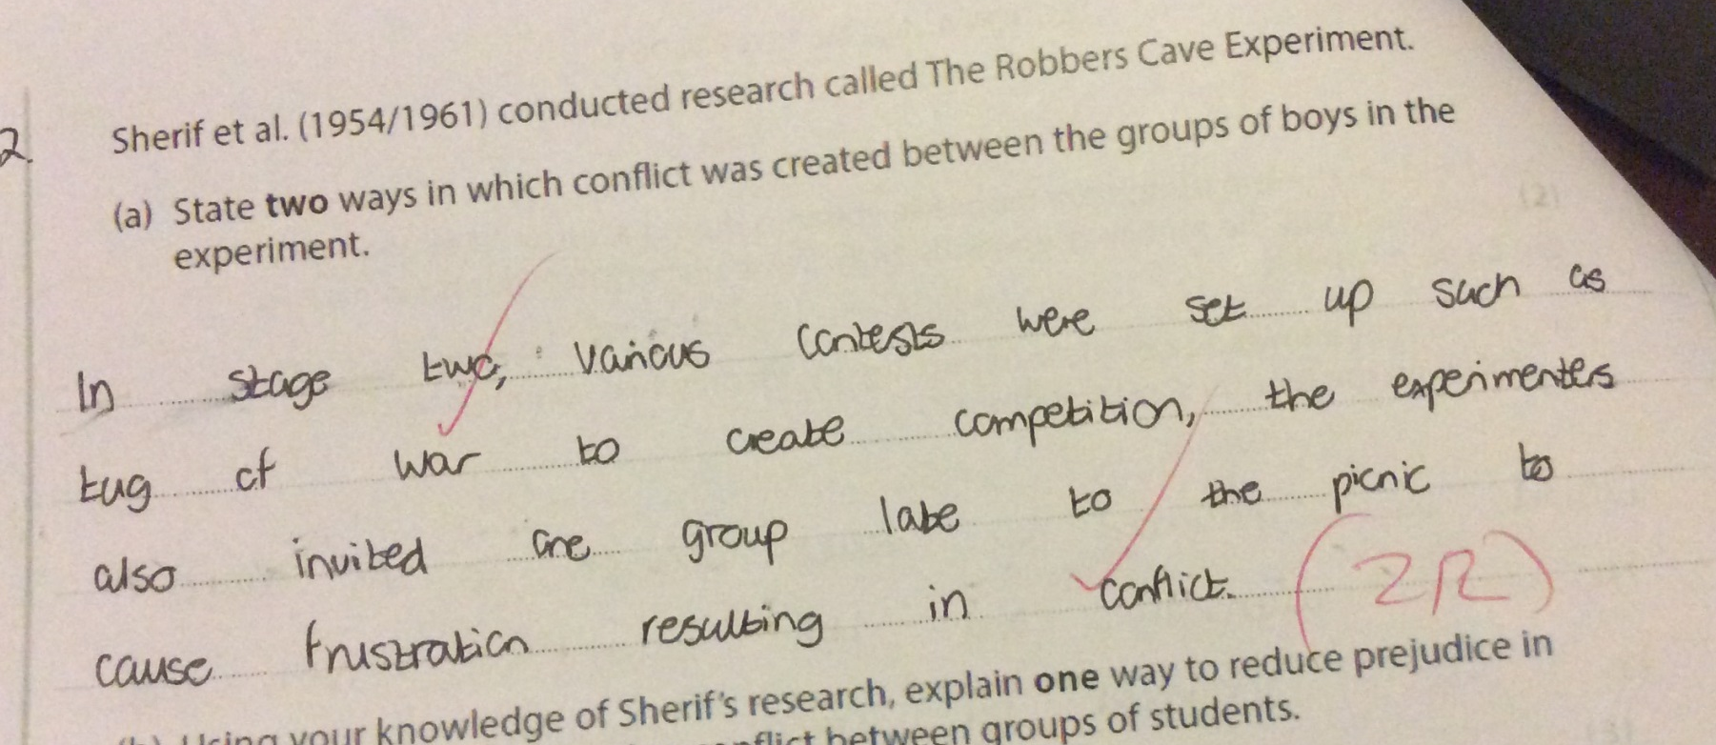

Slide 32
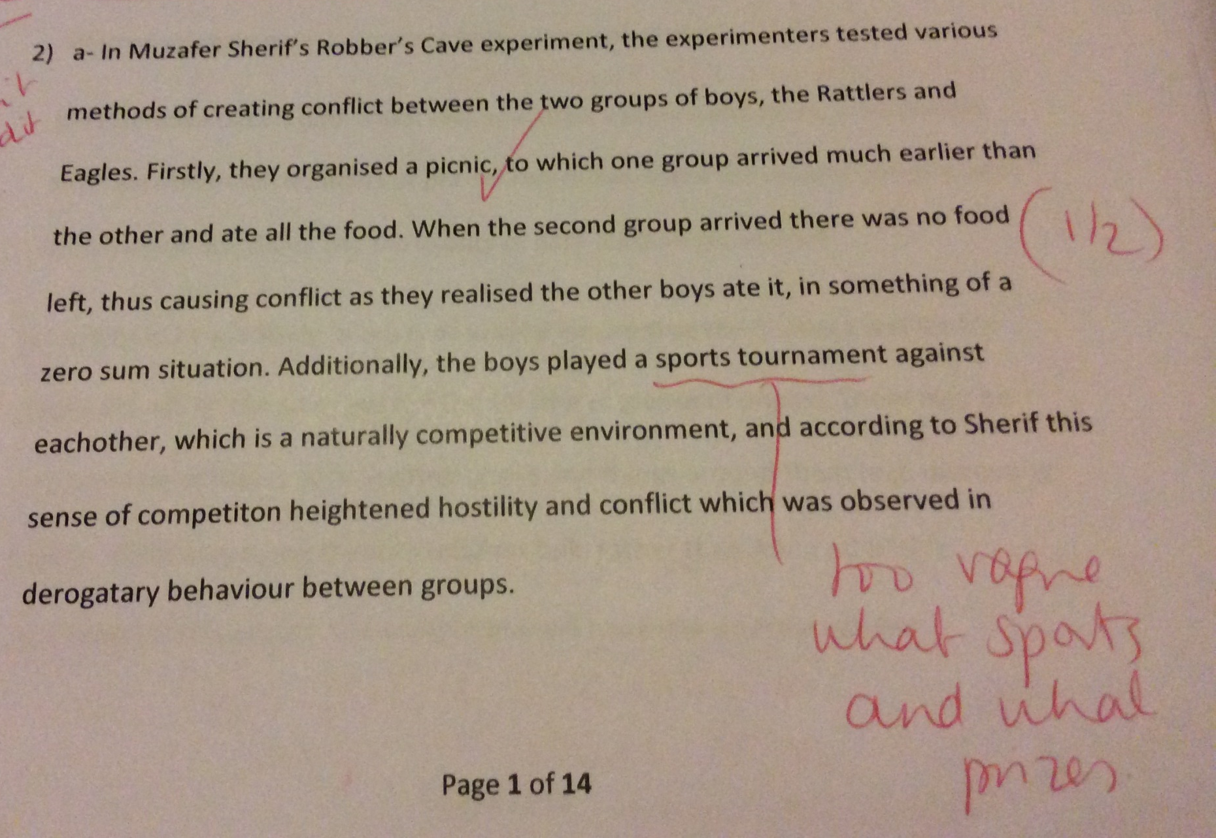

Slide 33
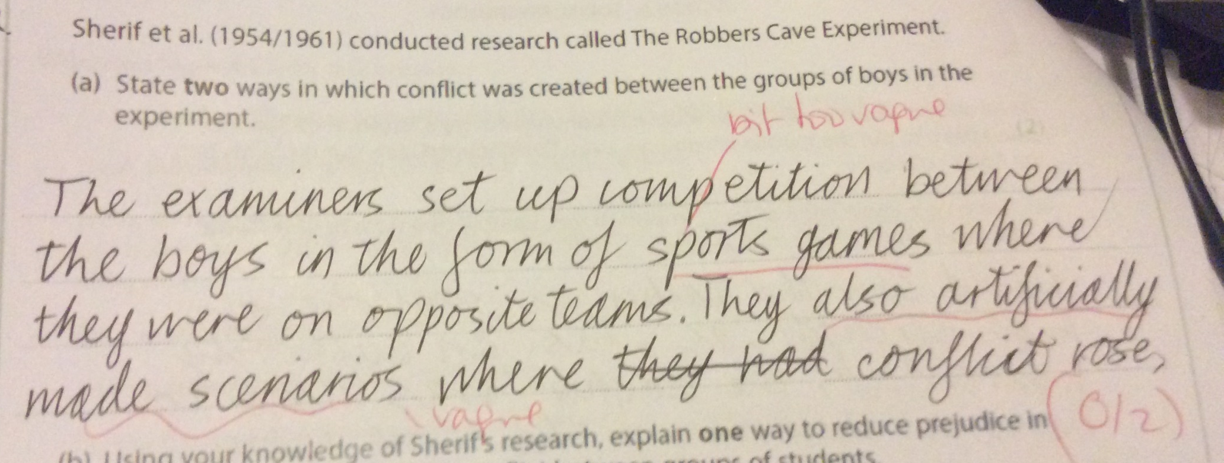

Slide 34
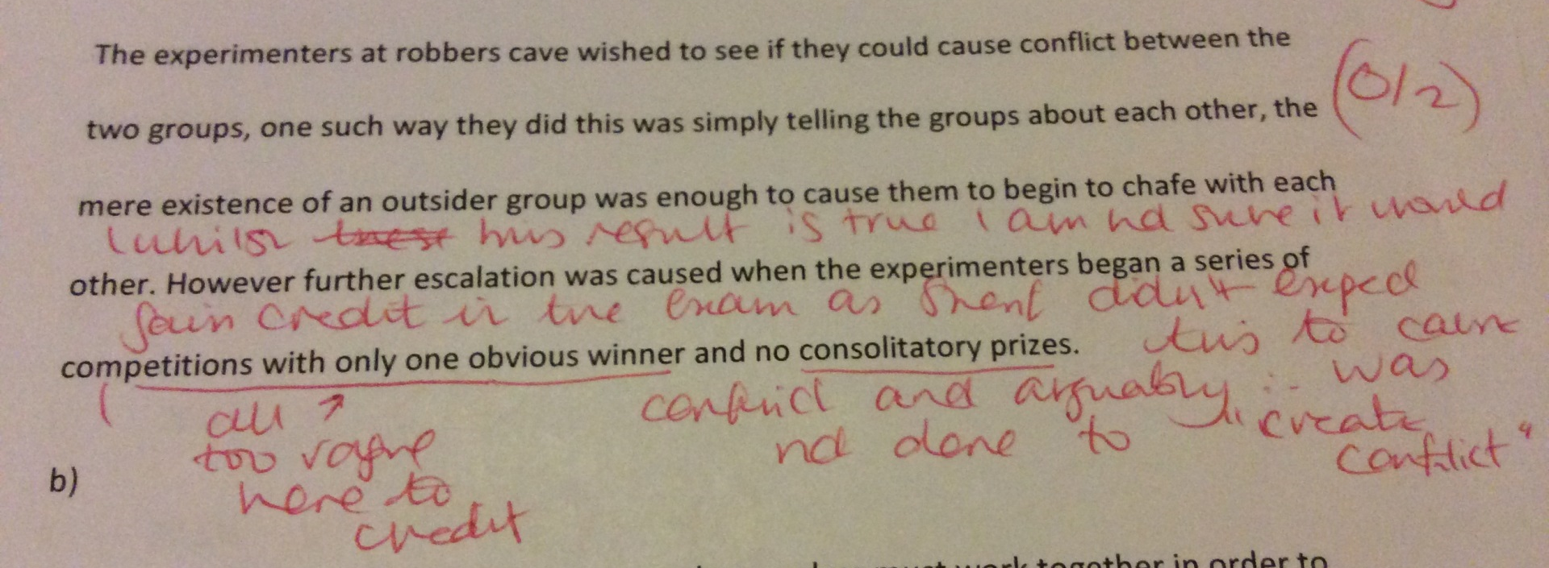

Slide 35
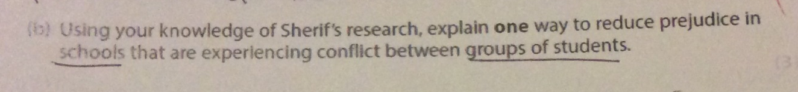
Question 2b
Using knowledge of Sherif’s research…
SUPERORDINATE GOALS (describe what this means accurately and give examples to show your knowledge of Sherif)
Explain (HOW and WHY)
Way to reduce prejudice
  How would you do it?
  Why would it work? (wat effects would you expect on behaviour?
Contextualise to schools experiencing conflict between groups of students
Check the mark allocation

Slide 36
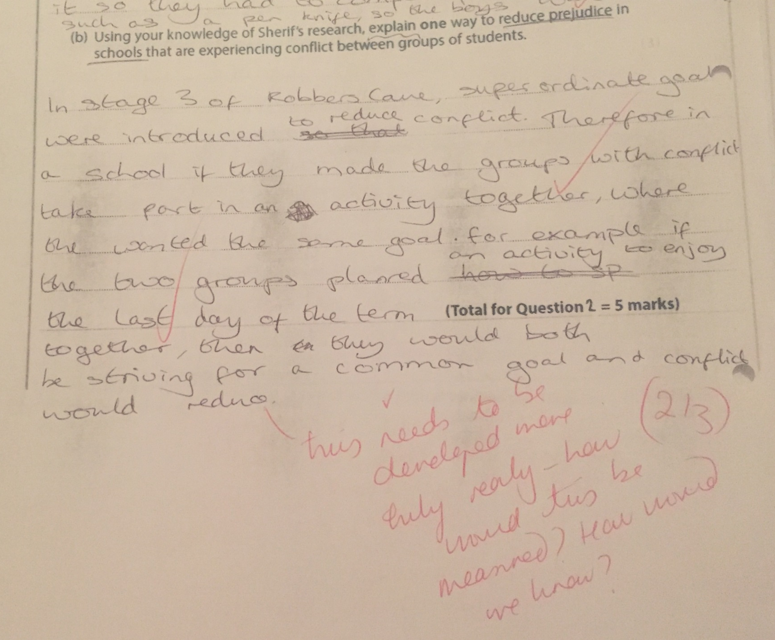

Slide 37
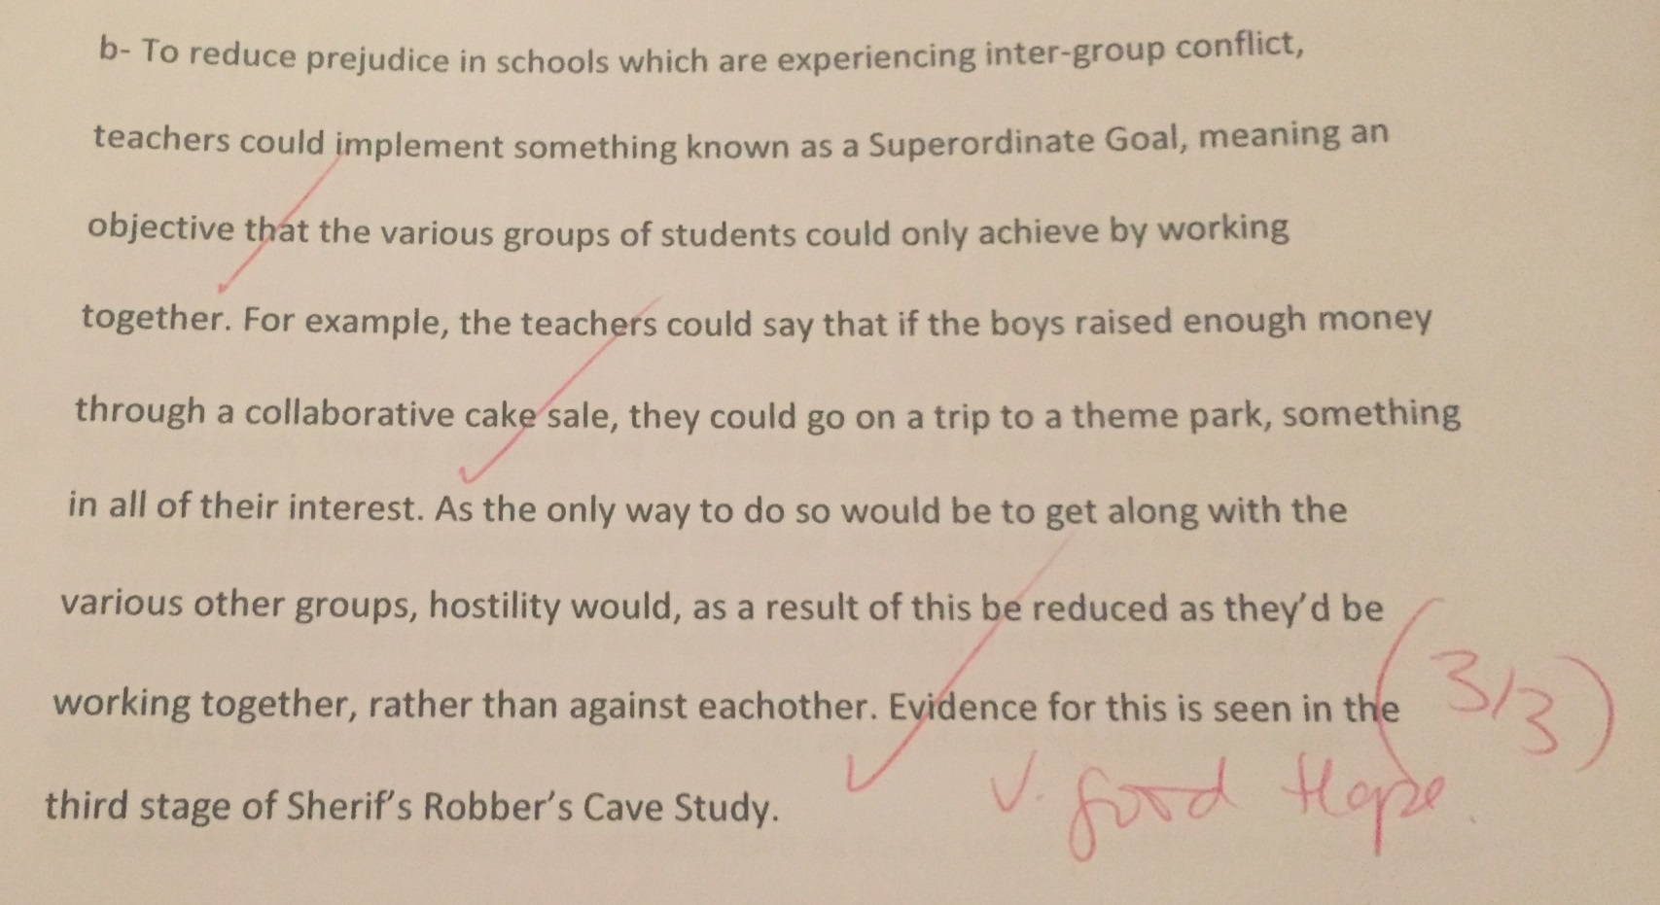


Slide 38
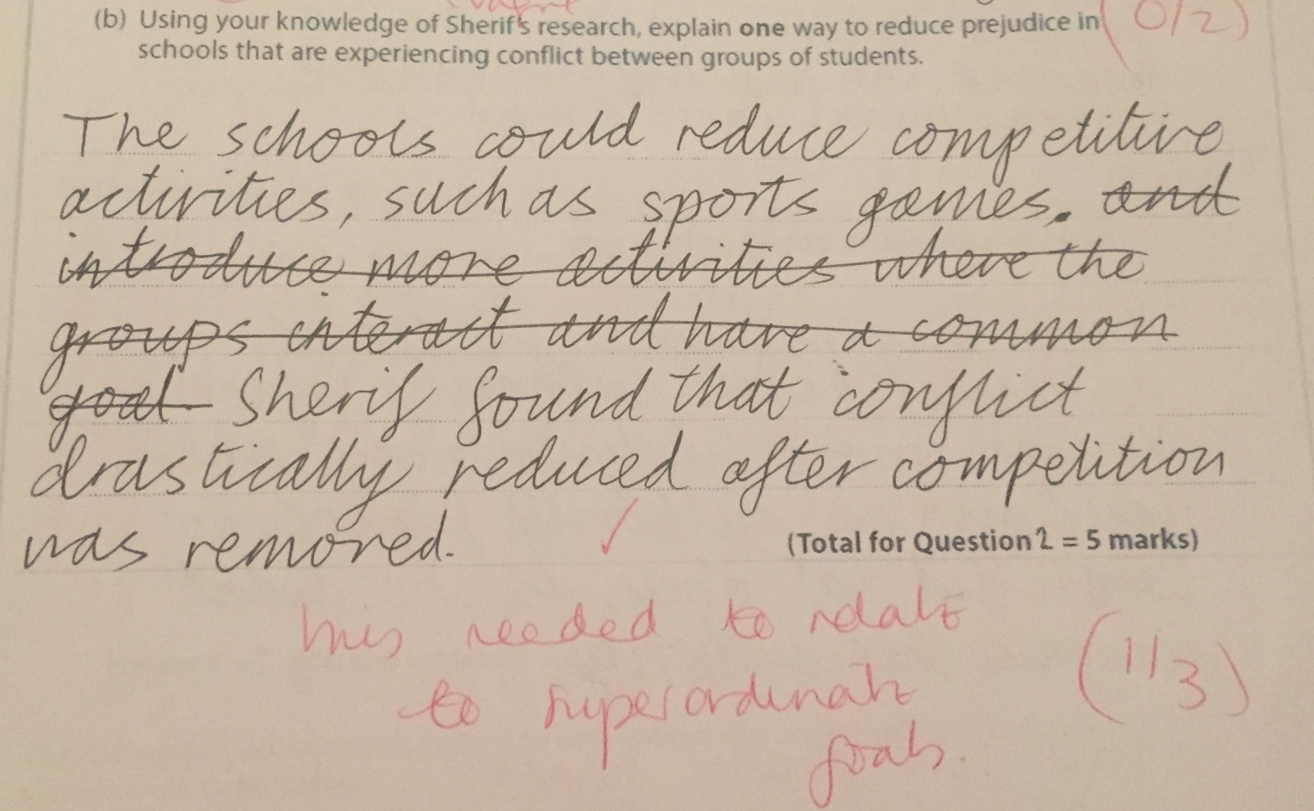

Slide 39
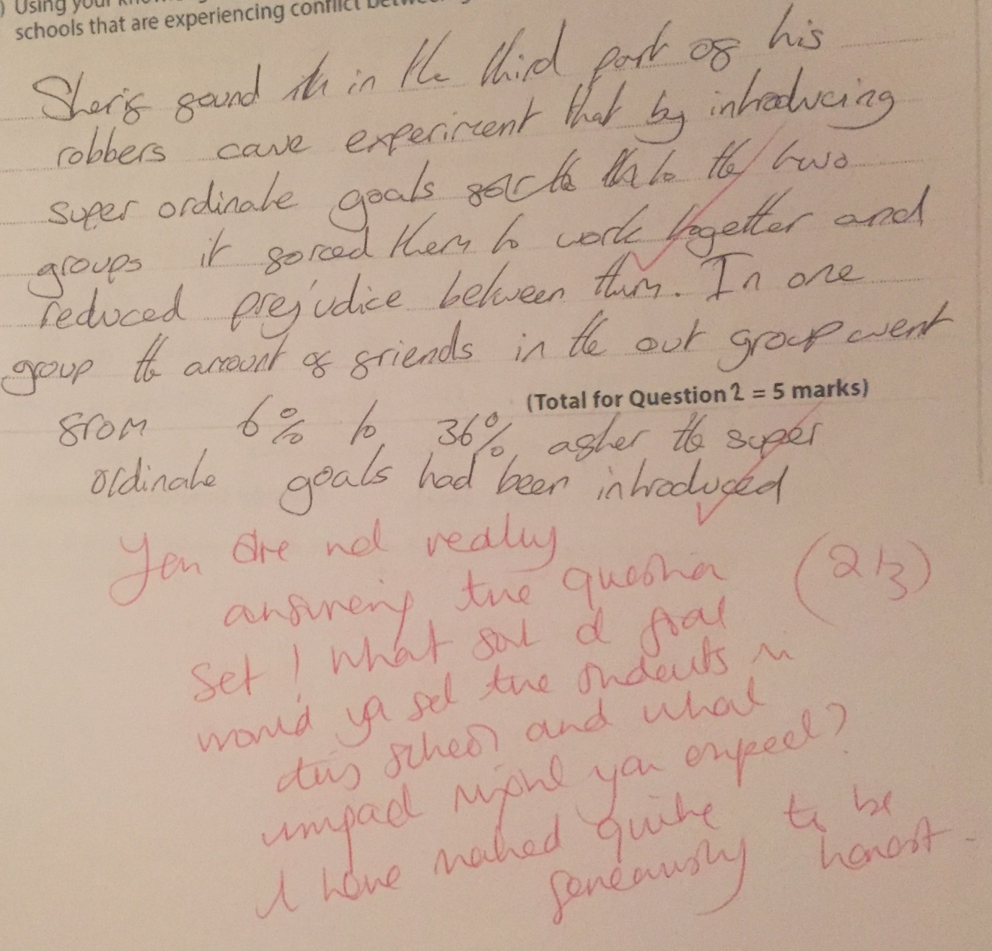


Slide 40
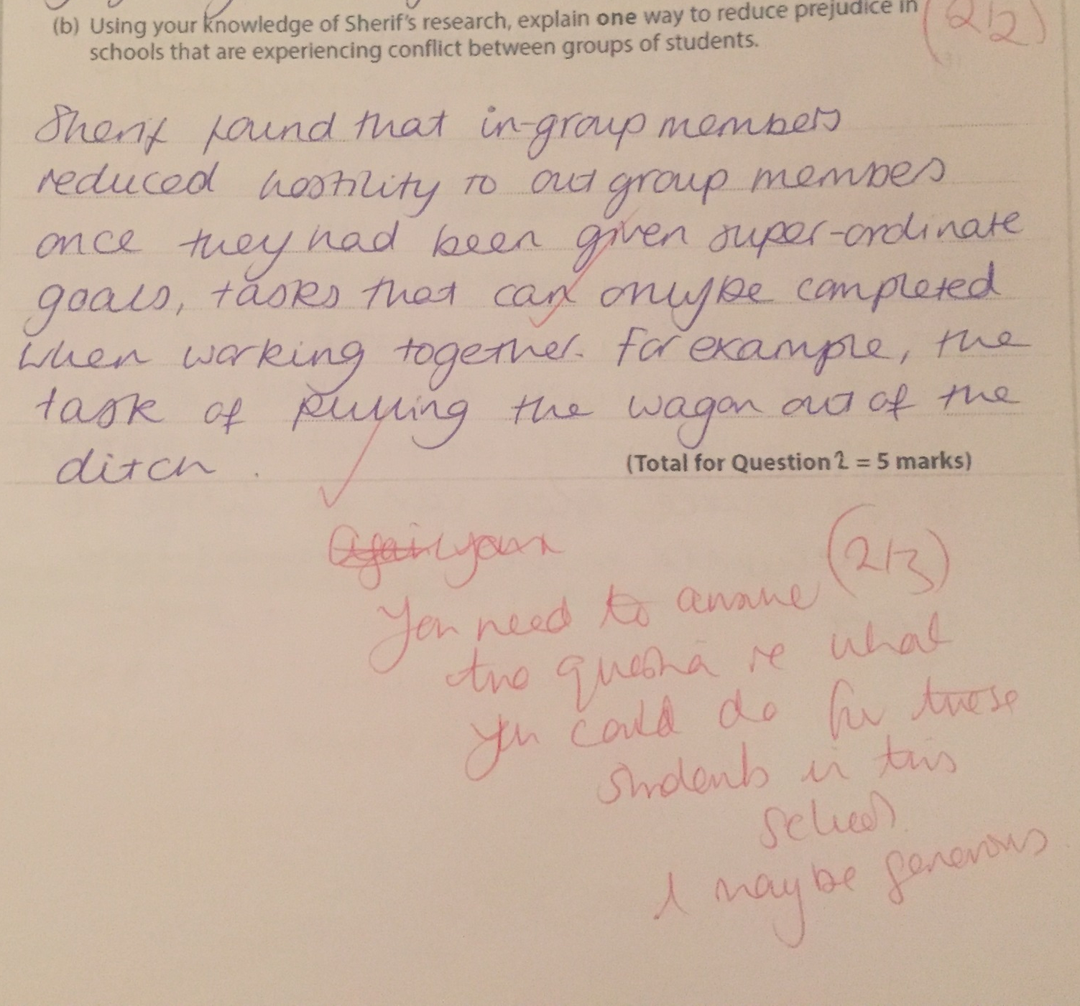

Slide 41
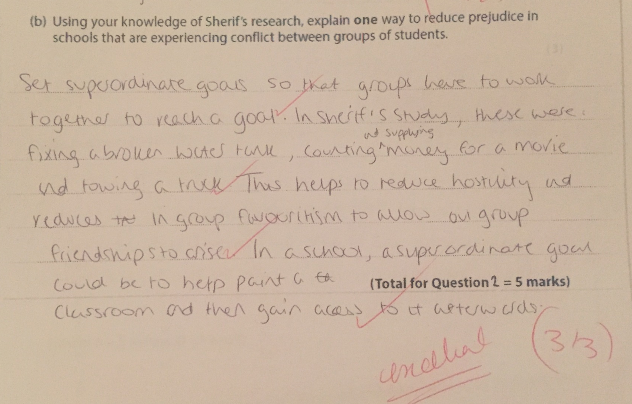

Slide 42
Question 3: Dr Foster and the library
Quite a long extract; highlight and annotate (make notes) picking out any “give-aways/hooks”
Anna and Beth are confederates (in with the experimenter) they are NOT Pps.
What was the IV and DV in this study?
How did she collect her data?

Slide 43
3a. Explain ONE ethical issue that Dr Foster would face BEFORE conducting this study
Check the mark allocation and command term
Now think of all the ethical issues that you can
Now select ONE which you can match to the demands of the command term EXPLAIN (how and why) for the number of points on offer.
Issue - something is important for one reason but meeting this requirements would jeopardise something else?
Consent
Deception
Right to withdraw
Protection from harm
Confidentiality
Debriefing

Slide 44
3b What is meant by the term qualitative data (1)
Instead of just saying what it isn’t please try and say what it actually and also give an example
It may only be 1 point but you need to fight for every mark
There is no where to hide in a one marker, it’s a nominal response 0 or 1. If they think you remotely haven’t got what they are looking for it will be zero.

Slide 45
3c. Explain one issue that might affect the validity…
Command term EXPLAIN (how and why)
Issue – why is this difficult possibly to achieve, something that could be argued as a good thing or a bad thing?
Validity – what does this term mean? (UMA: useful, meaningful, accurate)
Interviews with pupils: this question was a bout VLAIDITY of the qual data collected in the interviews NOT the validity of the data collected in the observation of the [pupil in the library where they record whether they were quiet or not (quan)

Slide 46
3d. Experimental design
Explain (how and why)
Experimental design; what does this term mean?
  Independent measures
  Repeated measures
  Matched pairs
Think what did Dr Foster ask the confederates to do…
  Anna – work quietly , politely discourage her friends form talking
  Beth – try and engage her friends in conversation
There are two different friendship groups (different pps) in each condition and so…it’s independent measures
Make sure you say how Dr Foster has created this design and why it is usefil to this study (e.g. what would be the problems if she has done repeated measures

Slide 47
3e. Percentages
Making a noise when Anna was present: find the correct column and row = 3
How many pupils were there making a noise and being quiet when Anna was present = 15
3/15X100= 20%
Making a noise when Beth was present: find the correct column and row = 6
How many pupils were there making a noise and being quiet when Beth was present = 14
6/14x100= 42.8571428etc
Round to ONE decimal places as directed: 42.9

Slide 48
Evaluate social identity theory (8)
Stick to the time allocation 8-10 minutes
Plan very quickly first – scribble down
  key words to hit in the description
  Evidence; what studies do you want to include
  Applications; what real world event could you tie it to
  Alternative theory; can you compare to another theory of prejudice
Its an essay think abut the banding criteria:
  ATCHOO (BC)
  Making sure you develop your chains of reason so they are logical, coherent and clear
  Make sure you introduce competing arguments , although some psychologists say X , many in fact agree that ….
  Whilst this study may seem to support X , the reality is that the evidence could be seen as lacking credibility because…
  Don’t forget without a balanced conclusion, your final score will be sorely affected
If you are running out of time write one line description, one line evaluation, one line description, one evaluation alternatively until you run our of time ☺

Slide 49
Problems in the essays – AO1
Poor AO1; incorrect use of the three key terms
Leaving out essential AO1: e.g. mere existence, self esteem
Muddling up Social Identity Theory and Realistic Conflict theory; referring to social identity theory as social impact theory!
Unbalanced not enough AO1 compared with AO3; sort your timings out

Slide 50
Problems in essays – AO3
Make sure it is clear whether you are presenting a strength or a weakness
Don’t give too much procedural detail of studies used to support the theory; go for the findings (make them specific and accurate)
Getting the Tajfel’s minimal groups paradigm mixed up with the bean hunt task in Sherif (if the over/under estimators bit confuses you, think about Sherif dividing boys into two groups based on whether they prefer Kandinsky or Klee’s paintings)

Slide 51
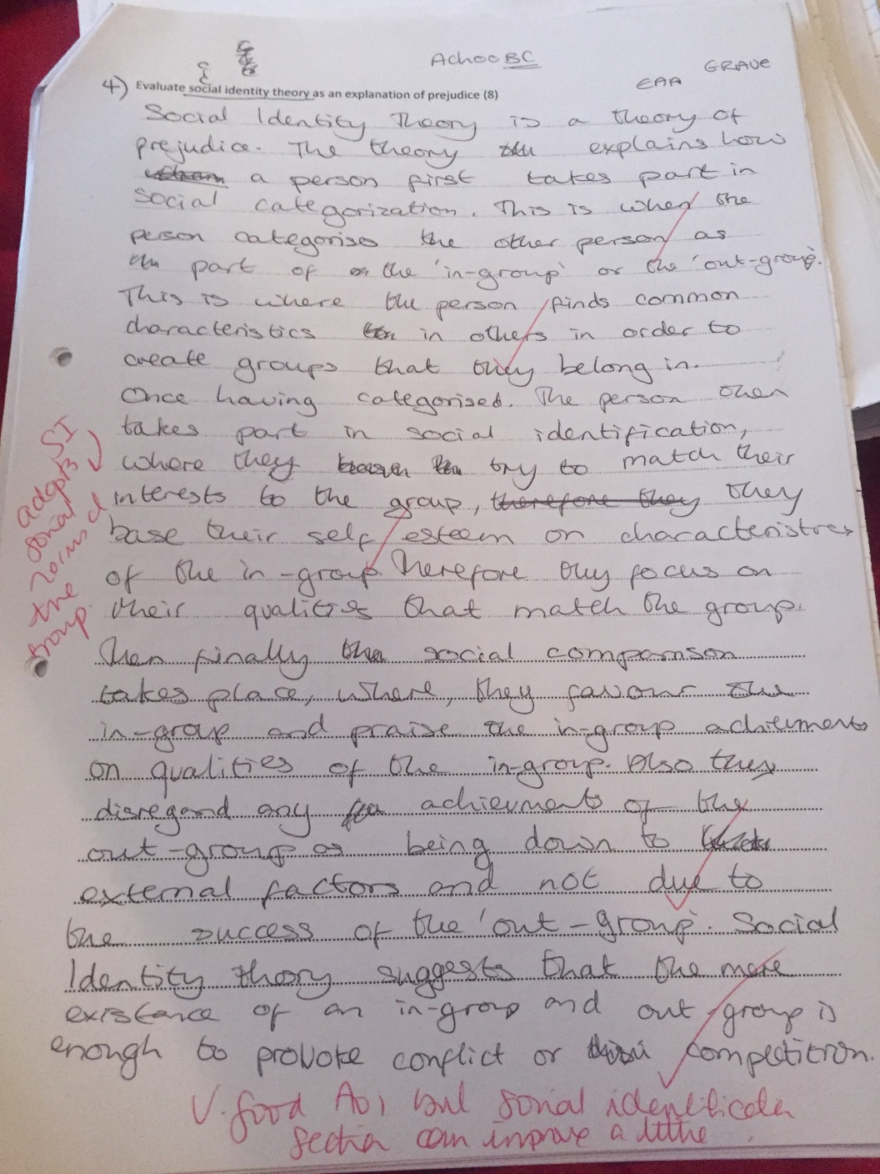

Slide 52
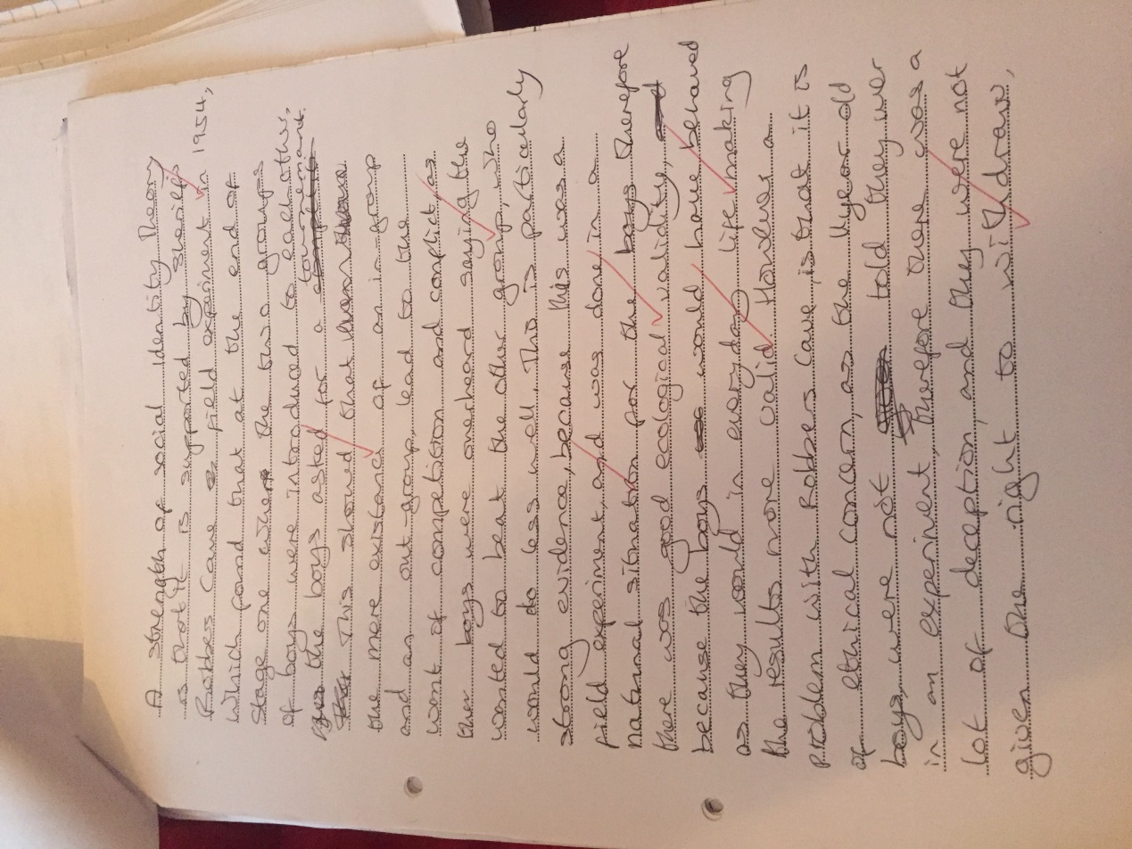

Slide 53
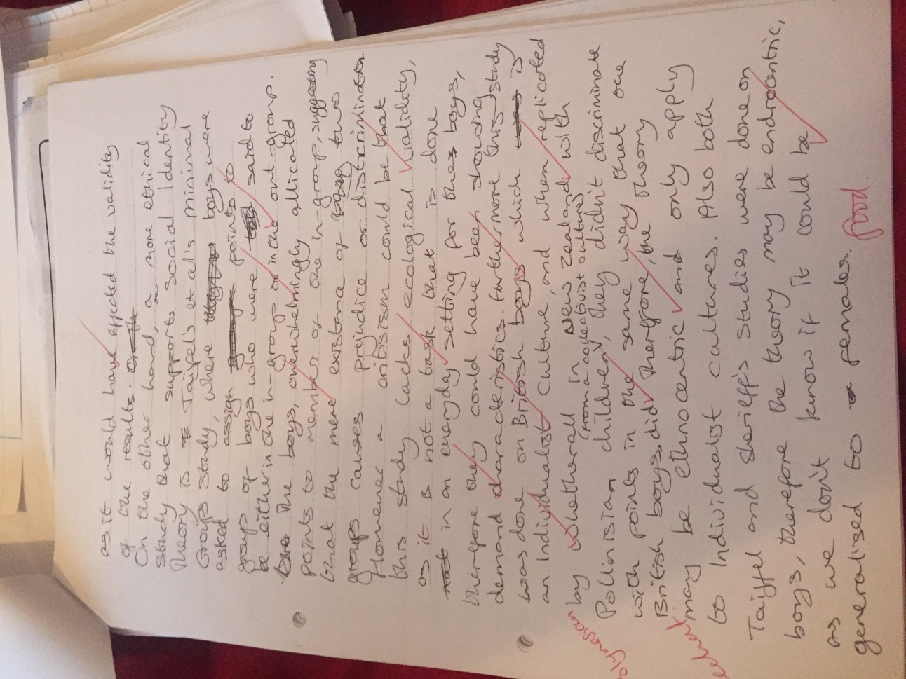

Slide 54
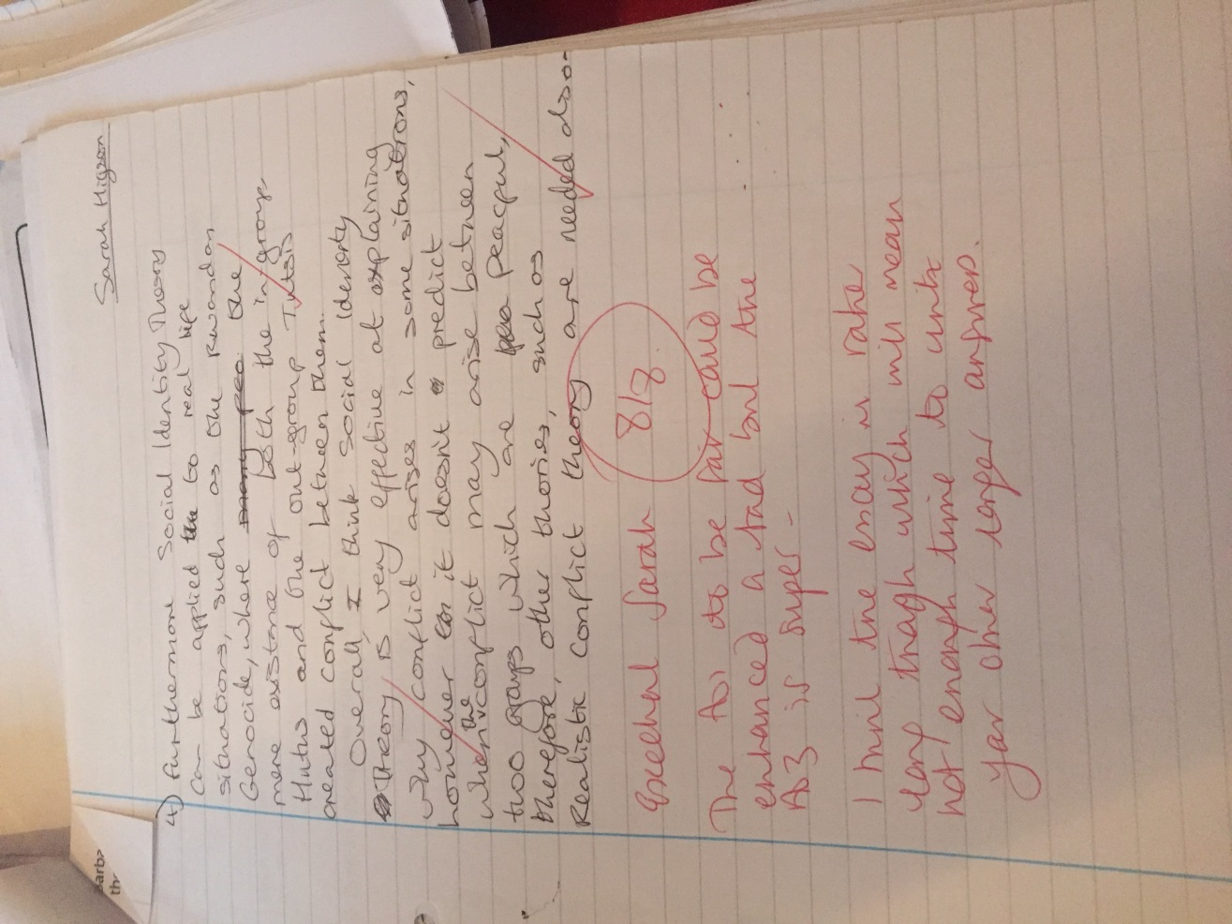

Slide 55
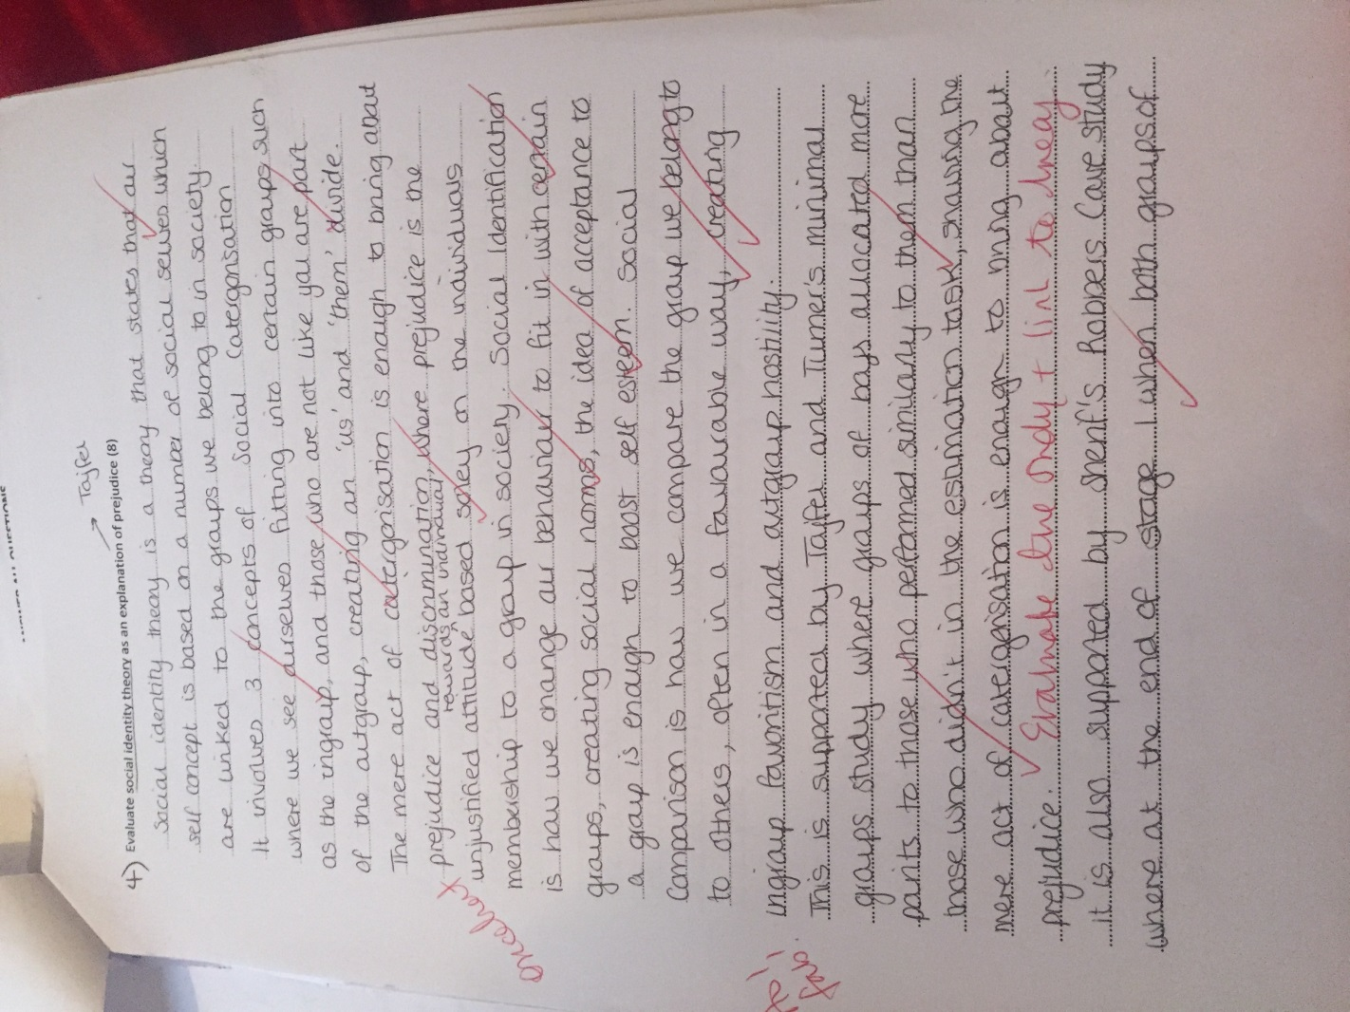

Slide 56
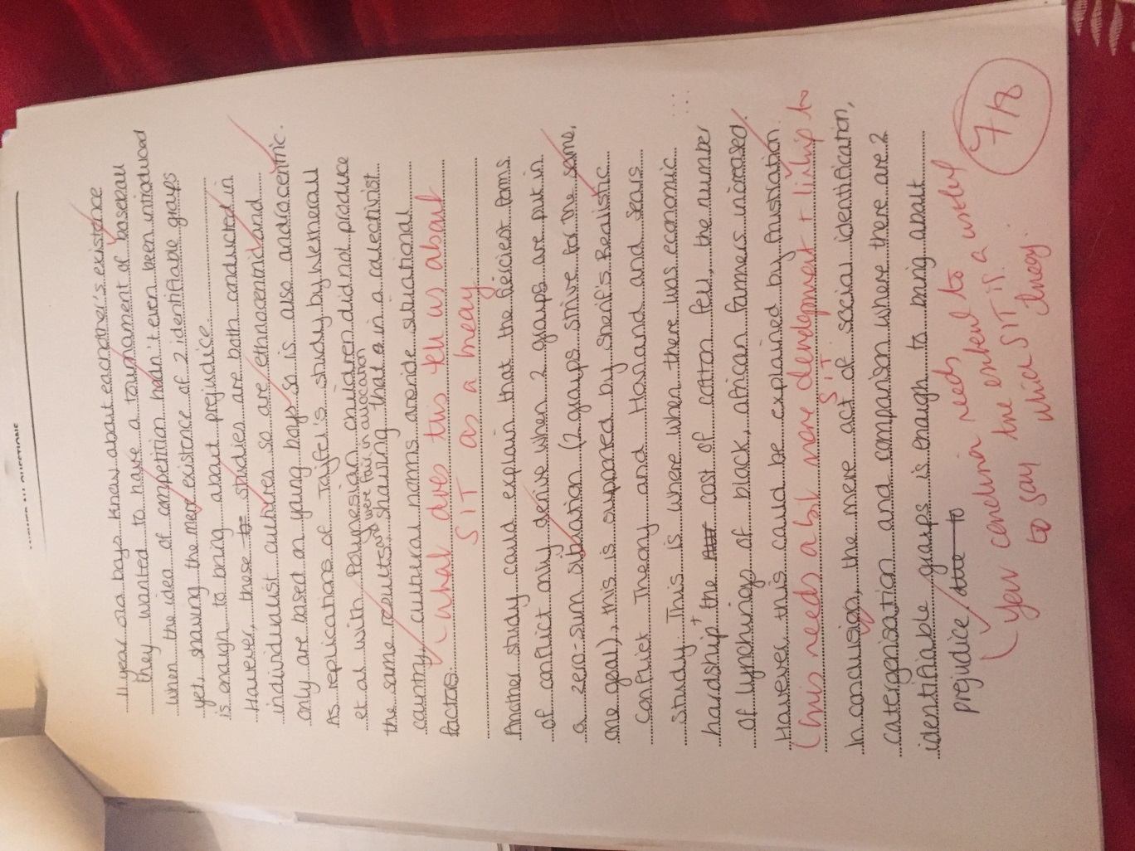

Slide 57
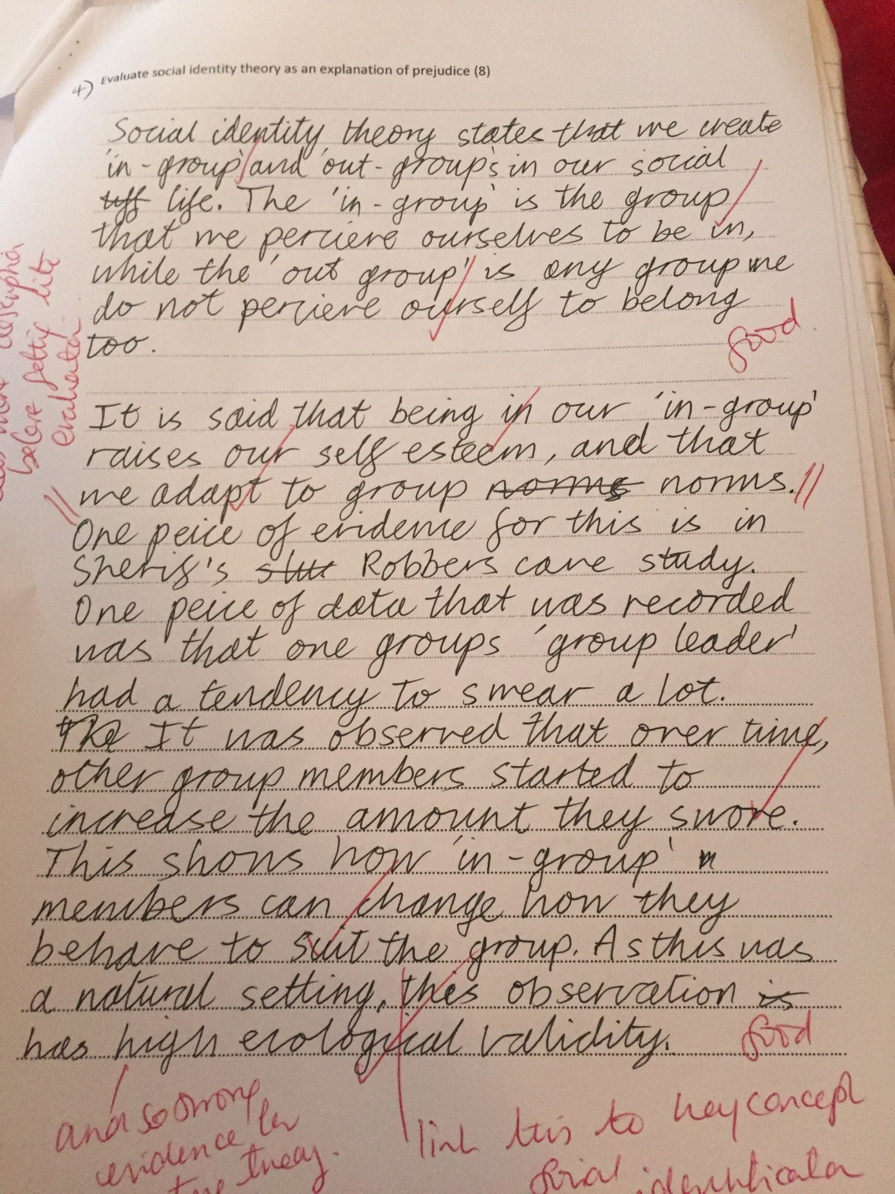

Slide 58
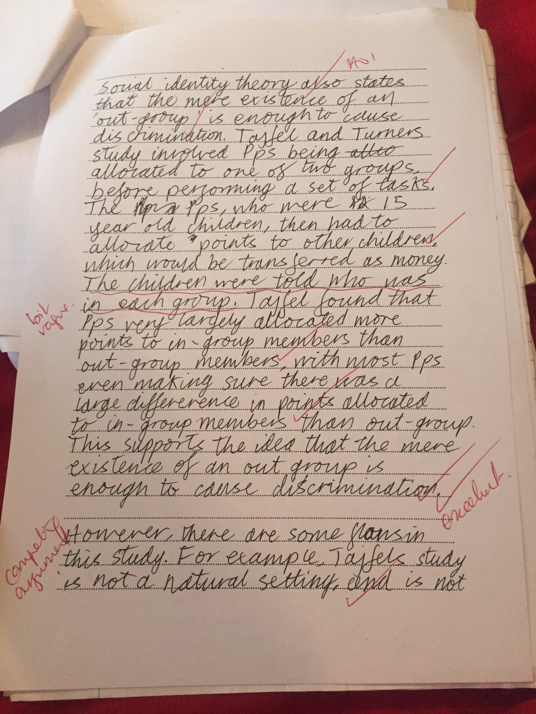

Slide 59
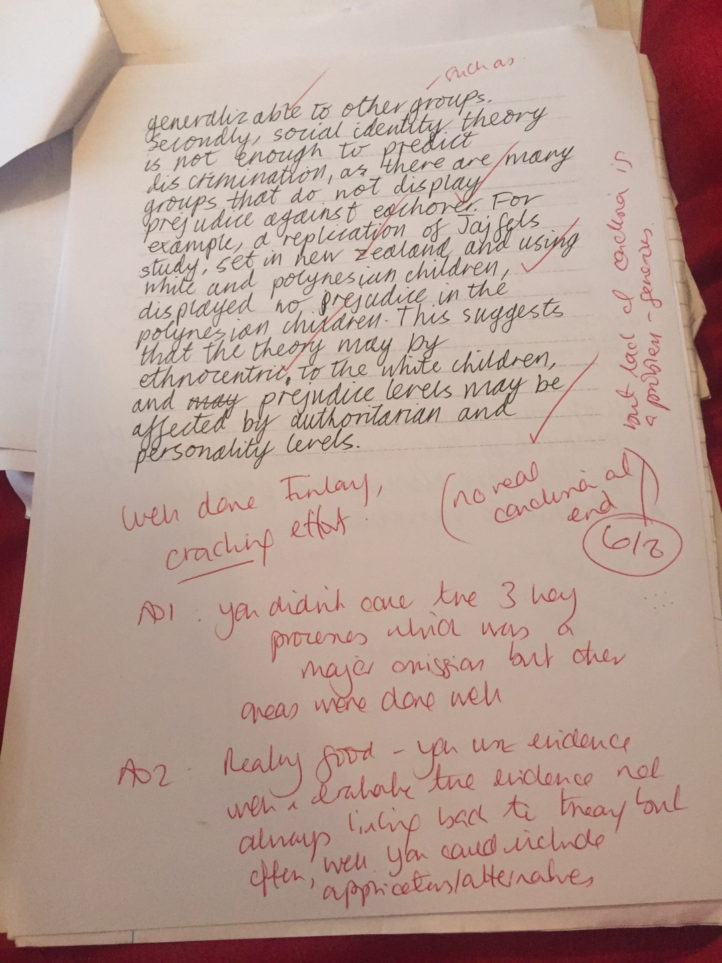

Slide 60
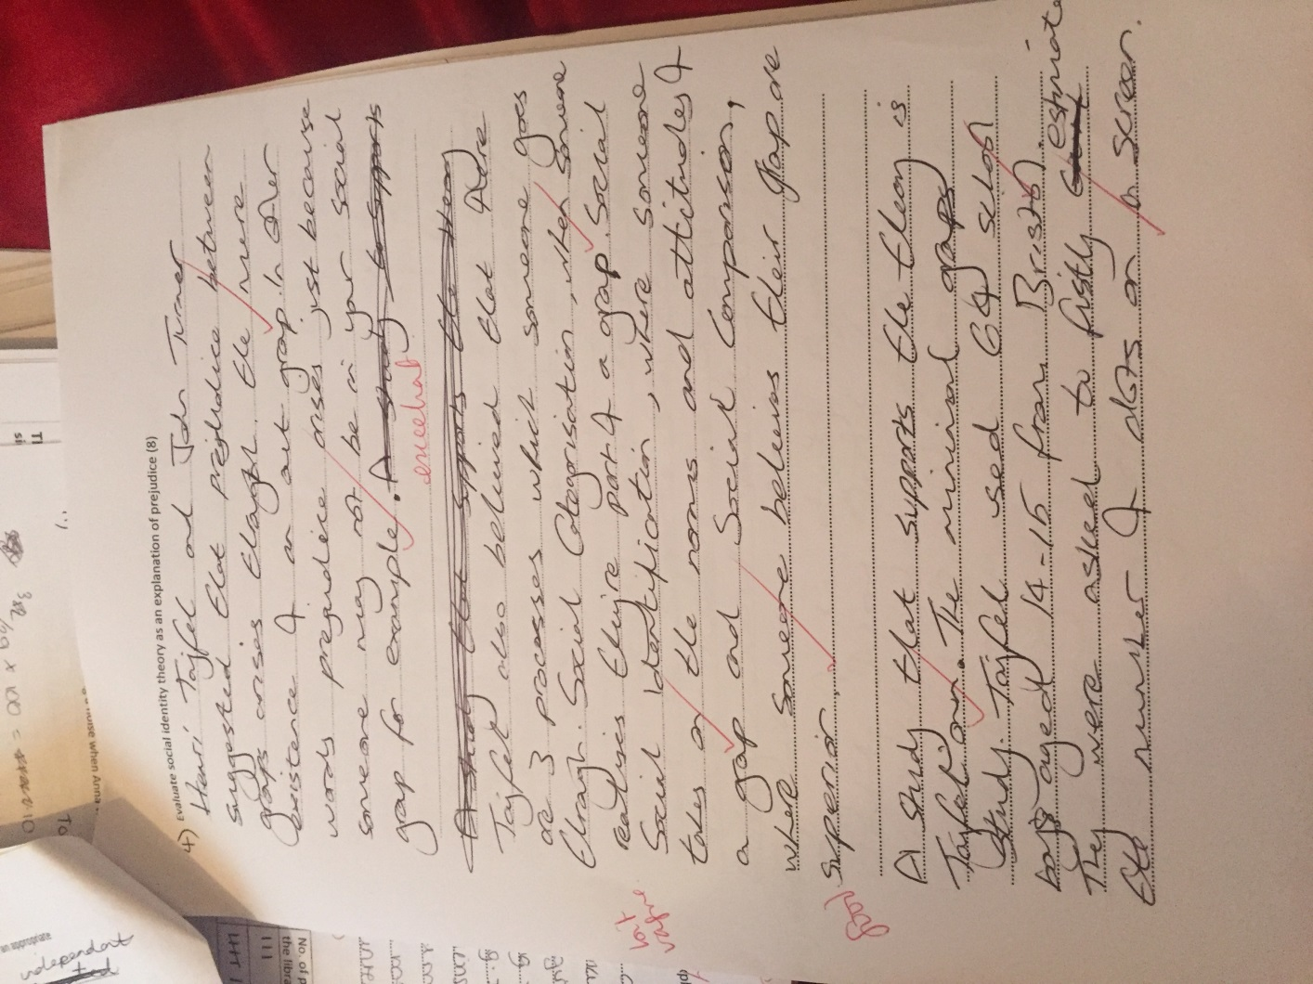

Slide 61
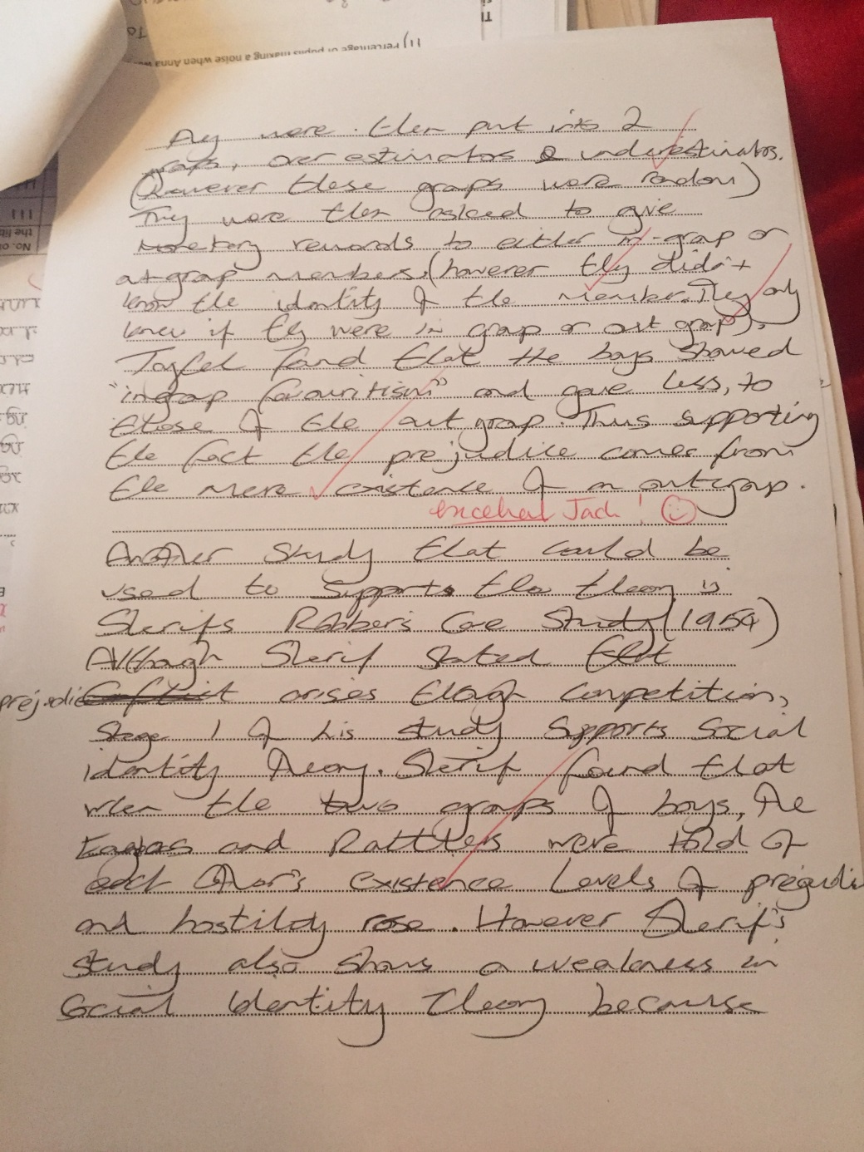

Slide 62
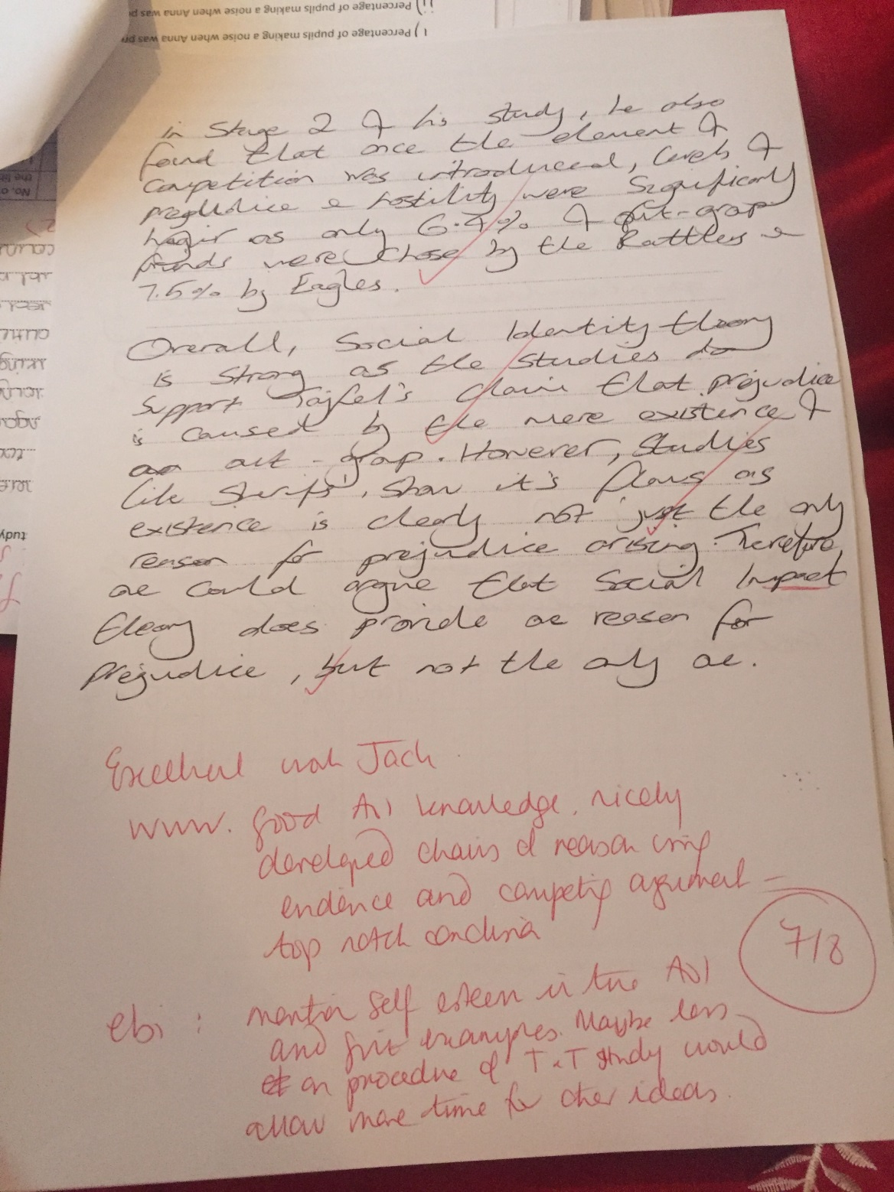

Slide 63
Section D: Learning
13a. Explain ONE reason by experiments such as Pavlov’s are considered to be scientific? (2)
  EXPLAIN means tell us HOW/WHY is his work considered scientific
  Make sure you don’t give two reasons
  Choose ONE reason that you can elaborate for 2 sentences
  Make sure you second sentence builds ion the idea picked up in the first; do not write about a new reason why the work is considered scientific.
  THINK: What are the key features of EXPERIEMTN as a research method links these to “scientificness”

Slide 64
So what is it that’s makes a study scientific?
Replicability; does it use standardised procedure
Does it isolate just one variable at a time (IV) and look at its effect on the DV whilst controlling all other variables that might have an impact on the DV?
If so, we can make causal statements/conclusions linking the IV and the DV (internal validity)
Pavlov does not focus on mental events (thoughts) things that cannot be seen
  his DV, he focuses on an objective/empirical (can be observed directly through the senses)
  He measured salivation, measured in droplets in a cannula; this sort of quantitative data does not need any interpretation be the researcher, you just count the droplets and whoever counts them should easily find the same number (reliable, objective, scientific)

Slide 65
13b Helena and the dodgy shower
EXPLAIN Helena’s behaviour using the theory of CC? (4)
  Write out the stages of CC first in the margin
  THINK; Stimulus, responses, unconditioned, conditioned, neutral
  What ewas the stimulus that made her jump out the shower initially (UCS)?
  What was her UCR?
  What came before the UCS and became associated with it (NS)?
  What does she now do when she hears the NS?
  What is the NS called now? (CS)
  Answering all these questions would have easily got you the marks.

Slide 66
Pavlov’s ‘Principles’ of CC
Extinction
Spontaneous recovery
Stimulus generalisation
13c should have been easy if you had revised carefully and also you read the question with care; the funny noise had stopped, she had stopped jumping out the shower (extinction had taken place cos CS was no longer being followed by UCS cos she had had the shower fixed) but then suddenly she heard the funny noise again and the CR reappeared…
You also had to know that the three things above are called “principles”.

Slide 67
Section C/E: Synoptic Essay
Ed and Najeeb are researching the effects of individual tutorials on student wellbeing. Ed wants to carry out a lab experiment and collect quantitative data whereas Najeeb feels they should use interviews to collect qualitative data. Evaluate the use of quantitative and qualitative data when conducting research into psychological issues. You must make reference to the context in your answer (12)

Slide 68
12 marker
8 marks plus; its band marked ATCHOO(BC)
The question has an extract, e.g. it talk about Ed and Najeeb and their plans for their research project- this means it an APPLIED essay
You are expected to include AO1 (description; knowledge and understanding), AO2 (contextualisation; application of knowledge to the extract), AO3 (evaluation, analysis, synthesis, critical thinking)
AO1, 2 and 3 need to be roughly equal.

Slide 69
Plan carefully; 16 mins to inc. planning
(1 min 20 secs per mark)
Describe: quan and qual data making reference to what is is, (examples) how you might collect it, how to ‘code’ it and analyse it.
Apply: think about Ed and Najeeb;
  Ed wants to collect quan. in an experiment; what might Ed IV and DV be? What design would he use? How would he analyse his data (which descriptive and inferential stats, what sort of graph)?
  Najeeb wants to collect qual form an interview; what sort of interview, can you give examples of some relevant closed and open questions? Open questions will gain the qual. that Najeeb wants.

Slide 70
The 12 marker… cont’d
  This will give you a nice array of AO1/AO2 and should provide lots of jumping off points for you with regard to the AO3
  Don’t forget for this banded essay your AO1 needs to be thorough and accurate
  You will need to keep referring back to the extract and using the information for it to score well for AO2
  The AO3 can be structured similarly to what we normally do…
  “One strength of quantitative data is that…(drop in what every you like here re reliability, validity, objectivity, ease of analysis, communication of patterns and trends) ; develop the chains of reason with care (“pepper” in examples if necessary, explain points carefully)
  Make sure you have competing arguments (one the one hand , one the other hand), “This said, other psychologists believe that…
    This is where you can debate the points that you have made, bring in weaknesses, show how qual. may be better than quan. for certain reasons etc…)
  Be sure to finish with a balanced conclusion that relates back to Ed and Najeeb and perhaps how they could find a compromise.

Slide 71
Good luck everyone!
Some of you now need to revise every section with great care as you are retaking the whole paper, 2 hours, no sources
Don’t forget clinic every TUESDAY 4-5 PM; be there or be square; we will provide TEA and BISCUITS!
Some of you need to prioritise your weakest answers and redo them
All of you have the opportunity to take another mock in September on Soc, Cog, Bio and Learning; the next one will include more maths!

