Slide 1
Vallentine et al
(2010)
Psycho-educational group-work for detained offender patients: understanding mental illness

Slide 2
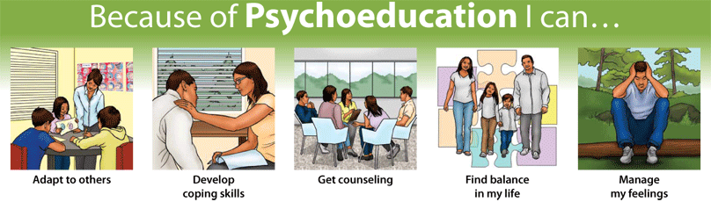
Psychoeducation
systematic, structured teaching by professional bodies, of information relating to …
  Symptoms
  Aetiology
  Treatment
  related difficulties and coping skills
  (Glick, Burti, Okonogi, & Sacks, 1994).

Slide 3

Psycho-education for families
important component in successful treatment outcomes across a range of different mental health settings (e.g. Atkinson, et al 1996)

Slide 4

Psychoeducation for people with a diagnosis
a prerequisite for people being able to give informed consent to treatment.
The Patients’ Charter for Mental Health Services (DOH, 1997) states that everyone is entitled to information that aids their understanding of diagnosis

Slide 5
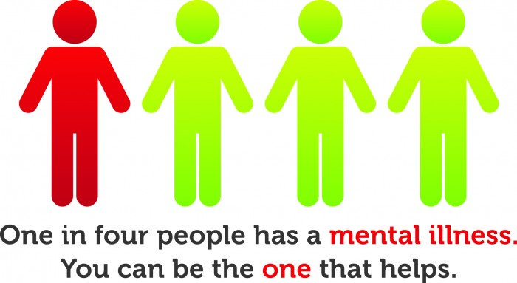
Research into psychoeducation
increasing patients’ knowledge of their problems and treatment is associated with …
  higher compliance with both pharmacological and psychosocial interventions, (Poplawska et al. 2004)
  a reduction in relapse and re-admission and increased quality of life (Bauml, et al, 2006).

Slide 6

Downsides to psychoeducation
  increasing insight into mental illness can be detrimental, (e.g. Hasson-Ohayon, et al 2006).
  lowered self-esteem
  increased hopelessness

Slide 7

Why is it useful?
Brief and inexpensive
non-compliance probable cause of 50% of re-hospitalisations
increasing compliance could therefore impact on reducing the frequency of re-admissions.

Slide 8

Issues relating to high security settings
Evidence is mainly from community/low security in-patient settings
evidence from long-term, high-security settings is less well established

Slide 9

Outcomes may differ as Pps may have…
  more severe symptoms and medications may impede learning and retention
  associated risks of violence to self and others linked to lack of insight
  high co-morbidity with other disorders complicates matters
  not able to work with family members in the same way

Slide 10

How could it help?
Developing an explanation of their experiences through psycho-education could serve to reduce associated anxiety and distress.
identification and communication of relapse signatures at the earliest opportunity could also reduce the severity/length of relapse

Slide 11
Aims of the study
to determine the usefulness of group psychoeducation for offenders in a high security forensic psychiatric hospital.
Predictions; offenders will
  show improvements in general well-being and mental state
  describe benefits with regards their level of understanding and willingness to comply with other suggested treatments

Slide 12
Procedure
a multidimensional approach was used to investigate the impact of psycho-education
  relapse (inferred from changes in medication)
  level of care (e.g. high vs. low dependency wards)
  engagement in therapy
  number of violent incidents
  post-group evaluation from the patients’ perspective via semi-structured interview

Slide 13

The semi-structured interview
Relationships with staff are seen as a key factor in providing a suitable therapeutic environment for psychoeducation and treatment
The interview schedule included questions about experience of relationships with group facilitators

Slide 14
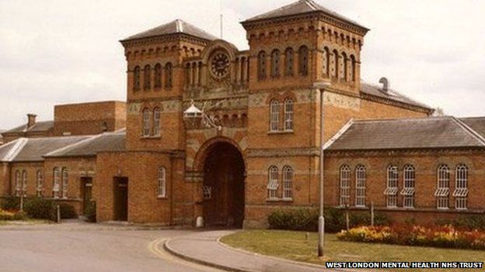
Broadmoor
The setting differs to community settings in many ways:
  the average length of stay for a patient at Broadmoor has been up to 8 years (now reducing);
  reduction in relapse is not easily accessed by outcomes such as re-admittance to the service.

Slide 15
Procedure: Participants
42 male Broadmoor patients detained under the Mental Health Act (1983) for homicide, violence, sexual offence, arson and kidnap etc
assessed by a multidisciplinary clinical team as
  having the potential to gain from information about illness
  and/or lacking insight or information about their diagnosis
referred for an ‘Understanding Mental Illness’ (UMI) psycho-educational group
Mainly diagnosed using ICD-10 as having schizophrenia, schizotypal and delusional disorders (80%), principally, paranoid schizophrenia (64%)

Slide 16
More about the Pps
Later they were categorized as ‘completers’ (mean age 40) and ‘non-completers’ of the psychoed. group (mean age 41)
Completers = shorter period of admission (6 years) compared to the non-completers (9 years)
31/42 patients completed the UMI group; 7 dropped out, 3 refused and one left the hospital.
lead researcher interviewed 21 ‘completers’ post-group: seven had left the hospital since participating in the group and three refused to be interviewed.

Slide 17
Outcome Measures
The measures were taken before and after the intervention; questionnaires, interviews and other measures were used.

Slide 18
The Self-Concept Questionnaire
a 30-item self-report questionnaire measuring self-esteem.

Slide 19
Clinical Outcomes in Routine Evaluation – Outcome Measure; (CORE-OM)
  Questionnaire to assess effectiveness of psychological therapies; covers 4 areas:
    ‘subjective well-being’
    ‘problems/symptoms’
    ‘social/life functioning’
    ‘risk to self/others’

Slide 20
Semi-structured interview
to evaluate Pps’ experience of the group, e.g. positive and negative aspects, feedback on how they felt the group could be improved and what they felt they had gained
Conducted by the lead researcher (VV)
The interview schedule was based on previous work by Morris & Moore, (2009)
All data was transcribed verbatim and stored electronically.

Slide 21
Additional variables
number of incidents (from minor verbal altercation to acts of interpersonal violence)
ward-based hospital staff evaluations using a standard format
changes in prescribed medication; data relating to patients’ type and dose of medication over 3, 6 and 12 month following completion of the group; including whether they were being prescribed more than the BNF limits
additional demographic, forensic and clinical information was collected from patient case files.
changes in staff, patient ratio level of care (e.g. ward placement or discharge)
ongoing engagement with other therapies.

Slide 22
What did they do?
4 x 20-session UMI groups over 3 years
Groups provided information schizophrenia, depression and anxiety, emphasis on future relapse prevention.
Modules included symptomology, treatment options and coping skills
aimed to improve understanding and personal insight.
Sessions included presentations, discussions and small group activities using case studies to explore personal issues in a safe/contained way.
tasks designed to encourage spontaneous discussion and reflection on issues concerning mental illness and its treatment in both hospital and community settings.

Slide 23
Group make-up
typically up to nine patients at the outset.
facilitators included nurse therapists and assistant psychologists
senior clinical psychologist(s) provided weekly supervision.
Group participants were categorised as either ‘completers’ (those who attended sessions until the completion of the group) or ‘non completers’ (those who dropped out before the completion of the group)

Slide 24
Data analysis
questionnaire scores were compared for the ‘completers’ versus ‘non-completers’
content analysis (Stemler, 2001) was used to extract themes from the semi-structured interview data.
units of coding were generated inductively from the data and then allocated to descriptive categories
to ensure consistency of coding an independent second rater (JT) (no involvement in the delivery of the groups) coded the data.
inter-rater reliability was calculated using Cohen’s Kappa - 60% average level of agreement; ‘substantial’ level of agreement

Slide 25
Findings
CORE-OM and SCQ indicated no significant differences between pre- and post-group scores.
Individual patients did show “clinically significant change” on the CORE-OM
  Subjective well-being (N = 5)
  Problems/Symptoms (N = 5)
  Social/life function (N = 6)
  Risk (N = 3).
Two Pps showed clinical significant change on the SCQ.
Only one Pp showed reliable change on the subjective well-being scale of the CORE-OM.

Slide 26
More findings
on the SCQ nearly half (N = 5) achieved significant reliable change
more than half of the participants showed a positive shift in scores.
A proportion of participants demonstrated no change from pre to post scoring.
some achieved a higher score reflecting a negative shift.
two Pps reported negative reliable significant change.
Similar to the CORE-OM, over 50% of the participants also reported an improvement in self-esteem, with some reporting no change or a decrease in self-esteem; one participant reported negative reliable significant change.

Slide 27
Incidents over 3 and 6 months periods pre-and post-group
no significant differences were found
within the completed group, the number of incidents was lower (N = 21) than pre group (N = 48), but this difference was not significant.

Slide 28
Medication
The prescribed medication regime changed very little over time
Post scores on the CORE-OM Social Functioning scale were comparatively higher for participants over BNF limits for their prescribed medication.
participants described themselves as having worse social functioning following completion of the group

Slide 29
Placement
Ward placement post-group was recorded at 3, 6 and 12 month
Taken as indirect measure of perceived level of risk posed by Pps
‘Progress’ = move to lower levels of external/staff security.
Improvements observed - four completers moved to medium secure units, although two non-completers also moved on.
The other completers remained on their respective wards over the time period indicating stability (i.e. not getting an worse!)

Slide 30
Qualitative data:
What Pps valued
‘Knowing [about my illness] helps me understand my past behaviour and why it happened – it shone a light on my past’
‘Knowing about my illness is important for recovery’
‘What I learnt related to my own experiences in the past and I can use it in the future to identify relapse’
‘Discussions made me think about things in-depth and express my experiences’
‘Hearing other people’s experiences made me feel better about my own’
‘Sharing ideas with other people with similar and different diagnosis was good’
‘Knowing the basic stuff gives you piece of mind that you can get out, it gives you hope’

Slide 31
How the information helped
‘Knowing about my illness is important, a lack of understanding about mental illness, is an illness, you don’t know what is happening – I had not been told about this before’
‘It helped me understand the symptoms I’ve got and how different treatments help’
‘If you don’t know your diagnosis then you’ve got no chance of improving yourself’
‘Knowing about my illness helps me understand the things I am facing and get help, now I can recognise and cope when I get ill’

Slide 32
Clinical implications identified by patients
‘If you know what is happening it helps you to understand and calm down’
‘If you don’t know what is happening you may be violent because you are afraid of what is happening or you may get depressed because of it’
‘Some information was scary, being diagnosed is a really difficult thing to be told and is hard to accept’
‘Not knowing your diagnosis can be confusing, it is helpful for people to know so that they can help themselves’
‘knowing means you can improve yourself’
‘it gives you piece of mind’

Slide 33
What was unhelpful
‘It was difficult sharing experiences, sometimes I did not want to talk’
‘It made me feel guilty about my past’
‘It was difficult talking in front of the group’
‘Problems with memory, remembering what we had done and what we were supposed to be doing’
‘Getting up early in the morning is difficult, I feel very lethargic in the morning’

Slide 34
Group-work experiences
To examine engagement in group-work following the UMI group data on groups completed, refused or dropped out of by participants were collected.
Completers later engaged in more treatments than non-completers
Insufficient cell counts restricted any statistical comparisons.

Slide 35
Structured interview material
21/31 completers, seven patients had been transferred and three refused to be interviewed.
All stated that they felt the group was ‘valuable’ and contained useful information that would be of benefit to people diagnosed with mental illness.
All reported a lack of understanding when first diagnosed either due to not receiving an explanation of their diagnosis or not understanding the explanation given.
it was information they wanted and felt they should be entitled to.
All reported that the visit from the pharmacist was helpful in explaining medication and recommended keeping it in future groups.

Slide 36
Semi-structured interview findings cont’d
All those interviewed stated that they would recommend the group to others.
four themes were identified
  What participants had valued and why (understanding past experiences and understanding symptoms/diagnosis/medication)
  What was helpful about the group (sharing experiences, relapse prevention/empowerment, reassuring/anxiety)
  Clinical implications identified by the patients
  What was difficult/unhelpful (Disclosure, practical problems).

Slide 37
What else did Pps say?
the information allowed them to gain further understanding of their past in terms of how they became ill and how illness had affected their behaviour.
Being able to discuss experiences with others in a similar position was highlighted as important.
information gained enabled Pps to feel a sense of agency about their situation and improved confidence about coping in the future.
Some said talking about their experiences in a group setting was difficult.

Slide 38
Discussion
both positive and negative change; consistent with mixed findings in other research
no group significant changes in the CORE-OM and SCQ were found, BUT “clinically significant shifts” were reported.
possible bias of measurement error; over 50% showed a general improvement on the subscales of subjective well-being and social functioning on the CORE-OM as well as the SCQ, with few participants reporting no change in functioning.

Slide 39
Thinking about the findings…
the severity of problems of this offender population (highly complex needs) - change may be more gradual
some patients’ self-reported self-esteem (SCQ) was found to be lower post-group.
Psychoeducation designed to empower should encourage patients, but may also highlight realities of lost potential

Slide 40
Further discussion
Group changes may mask a range of important individual differences
Someone with limited insight who shifts in the direction of acknowledging distress will obtain a different score profile to a patient who was insightful prior to the group
Future research could focus on the types of assessment used to measure the nature of changes and levels of ‘insight’.
Levels of aggression reported in standard incident documentation were observed to decrease following the group, although this was not significant.

Slide 41
Further discussion
lack of insight can be associated with hostility and aggression ; increased awareness seems to be associated with a reduction in aggression
Patients linked confusion/anxiety with aggression in their interviews.
No significant increase in medication, incidents or level of care was found
up to 6 months post-group suggesting no significant relapse during this period for completers
However, as there was no control group, this cannot be linked conclusively to participation in the group.

Slide 42
Discussion of Qual. analysis
highlighted the value that participants placed on knowing about their mental illness and the sense of hope and empowerment they felt it provided.
They identified a lack of information they felt they had received previously.

Slide 43
Conclusions
important feedback on what was helpful and difficult and this has been acted on for future groups
Future research could investigate the type of information given to patients at first diagnosis and throughout their treatment.
Offender patients have an identified need for information; this was universally endorsed by participants.
helpful in designing useful ways of relaying information to patients at various stages of their admission.
development and distribution of easy reference handouts for patients to refer back to might be of benefit in the retention of information.

Slide 44
Conclusions
The material presented within psycho-educational groupwork on diagnosis had a positive impact for the majority of patients.
Limited positive change on qualitative measures and problems with retention of the information was highlighted by patients in post-group interviews, and suggests a need for future booster sessions or further therapy work in this area (e.g. CBT for psychosis) for this client group.
Feedback from patients emphasised the positive impact of the intervention on their sense of agency and empowerment.
Future research should focus on identifying the most effective way of targeting those patients who will benefit positively from this group and ways of relaying the information in a user-friendly format.

