Slide 1

Paper 1: Learning Theories
Contemporary Study:
Bastian et al (2012)

Slide 2
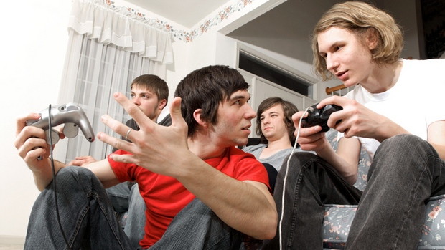
Aims
Do violent video games reduce our perceived ‘humanness’ of ourselves and co-players.

Slide 3
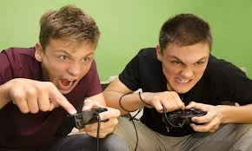
Are perceptions of humanity of a co-player dependent on whether you play competitively against them or collaboratively with them against a third party.

Slide 4

Is dehumanisation affected by whether you are playing a computer controlled avatar or a character controlled by another human?

Slide 5
Introduction
Concern about violent video games are nothing new
but, graphics are now so realistic; anxieties have intensified
negative effects are well documented and appear more significant than those associated with other forms of violent media.
Research focuses on violent gaming leading to increased aggression but research shows players are also
  more likely to endorse violence in real-life
  more likely to see others as more hostile
  less likely to experience empathy
  less likely to engage in pro-social behaviour
  have reduced sensitivity to real-life violence, numbing them to the pain and suffering of others.

Slide 6
Why is violent gaming more influential than other violent media?
Players identify with and feel somewhat responsible for the violence actioned in virtual environments
They become personally engaged with video game content
They personally identify with video game avatars
They see themselves as more aggressive after playing violent games
moral disengagement strategies facilitate enjoyment of virtual violence

Slide 7
Dehumanisation
“Dehumanisation of victims, may lead to increased aggression towards them due to “the process of moral disengagement, which reduces empathy and restores psychological equanimity”
(Castano & Giner-Sorolla, 2006)
“dehumanization oils the wheels of aggression and violence against others”.

Slide 8
Writing hypotheses
Write full 3 mark directional experimental hypotheses for the study
Hypothesis 1: IV violent or non-violent video game, DV self-perception of humanity
Hypothesis 2: IV violent or non-violent video game, DV perception of opponent’s humanity
Hypothesis 3: IV co-player takes role of co-perpetrator or opponent in violent video-game play, DV self-perception of humanity
Hypothesis 4: IV co-player takes role of co-perpetrator or opponent in violent video-game play, DV perception of co-player’s humanity

Slide 9
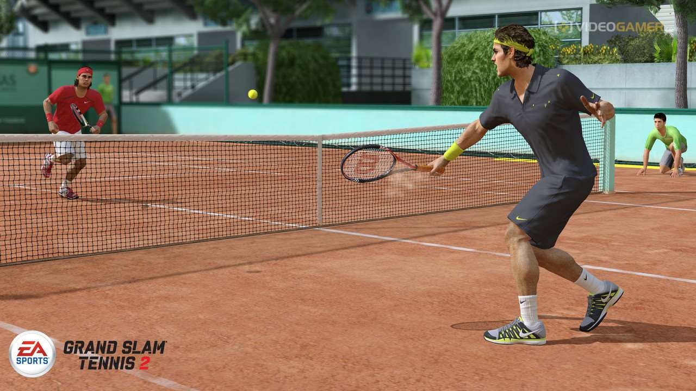

Method: Design
IV₁ – Violent or non-violent video game play
IV₂ – Co-player is a competitor or collaborator
Pps were randomly assigned to groups in an independent measures design.
DV₁ – Perception of humanness of self
DV₂ - Perception of humanness of co-player

Slide 10

Measuring humanness; Human Nature
7 point rating scales from 1 (not at all) to 7 (very much so)
- lack of ‘Human Nature’ the self/other is seen as object or machine-like: cold, rigid, inert, and lacking emotion.
  “I felt like I was open minded, like I could think clearly about things”
  “I felt that I was emotional, like I was responsive and warm”
  “I felt superficial like I had no depth”
  “I felt like I was mechanical and cold, like a robot”

Slide 11

Measuring humanness; Human Uniqueness
7 point rating scales from 1 (not at all) to 7 (very much so)
likening the self/other to an animal; immature, coarse, irrational, or backward.
  “I felt like I was refined and cultured”
  “I felt like I was rational and logical, like I was intelligent”
  “I felt like I lacked self-restraint, like an animal”
  “I felt like I was unsophisticated”

Slide 12
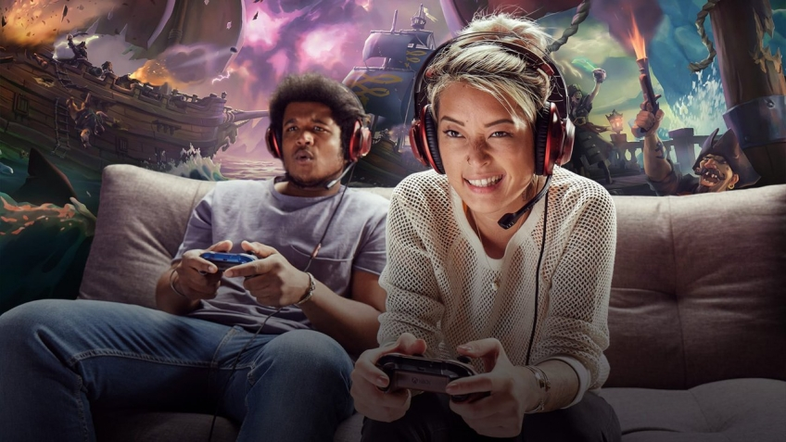
Participants
106 undergraduates, 74 women, 32 men
course credits
Age 17 to 34 (M=19.28, SD=2.39)
Participation was in groups of two with random assignment to conditions.

Slide 13

Materials
seated in front of a video screen with an X-box video game console
Each had a wireless X-box controller and separate head phones
both participants were looking at the same screen
a portable dividing wall obscured their view of each other

Slide 14
Procedure
Pps were instructed not to interact
interaction between participants was fully mediated by the video game
Pps played either two-player Mortal Kombat (n=52) or Top Spin Tennis (n=54) for 15min.
After playing the video game Pps were given a questionnaire to complete.
Pps also rated enjoyment, excitement and frustration whilst playing the games, on a 7 point scales, where 1 was low and 7 was high
Afrerwards, Pps were asked about the possible purpose of the study, none indicated that they suspected any links between video game violence and dehumanization.

Slide 15
Findings
Participants found both games equally frustrating
  violent: M=3.27, SD=1.42
  non-violent: M=3.04, SD=1.59
Mortal Kombat was marginally more enjoyable than Top Spin Tennis
  violent: M=4.86, SD=1.57
  non-violent: M=4.35, SD=1.39)
Mortal Kombat was significantly more exciting
  violent: M=4.52, SD=1.51
  non-violent: M=3.46, SD=1.25

Slide 16
Controlling other variables using statistical tests
An ANCOVA statistical test was used to control for frustration, enjoyableness, excitement and participant gender which might have affected the DVs
the effects of both perceived humanity of self and of the co-player were still found to be dependent upon the violence of the game.

Slide 17
Humanity of self ratings
 | Violent game | Non- Violent game
Mean | 3.74* | 4.35*
Standard deviation | 1.02 | 0.86
* Significant difference p<0.05

Slide 18
Humanity of co-player ratings
 | Violent game | Non –violent game
Mean | 4.43* | 4.93*
Standard deviation | 1.02 | 0.82
* Significant difference p<0.05

Slide 19
Conclusions
Playing a violent game, compared to playing a non-violent game, against another player leads to reduced perceptions of one's own humanity as well as the humanity of their opponent
these effects cannot be accounted for by how enjoyable, exciting, or frustrating the game was and are not accounted for by any effects of gender

Slide 20
Study 1 problems
Would playing against a computer controlled avatar affect dehumanisation i.e. no real life opponent controlling the character/avatar?
Was the reduced perception of humanity underpinned by negative emotion created by the game (feeling bad after playing the violent game) and reduction in self-esteem?
Was the reduced perception of humanity down to the fact that Mortal Kombat uses non-human characters. Uncontrolled variable; top spin tennis was non-violent but used a human opponent. MK is violent nd uses a non-human opponet.

Slide 21
Aim
Would players feel less human after committing acts of cyber-violence against a computer generated/controlled avatar?
Would there be less dehumanisation of the co-player when playing co-operatively as opposed to competitively
Was reduced perceived humanity caused by decreased self-esteem and negative mood.

Slide 22
Design
IV₁: playing either …
  Call of Duty 2 (violent, ‘first-person shooter’, warfare game with human characters, n=20)
  Top Spin Tennis (non-violent) (n=18)
IV_{2:} playing …
  competitively against the co-player
  co-operatively with the co-player against a computer-generated and controlled avatar.
DV: self-esteem, negative emotion, self and other perceptions of humanity (measure as above)

Slide 23

Participants
38 undergraduates, 28 female and 10 male
mean age=20.13
course credit or $10.
groups of two with random assignment to conditions.

Slide 24
Materials
same as Study 1 but played Call of Duty 2 or TopSpin Tennis (playing doubles)
screen was split so players could see their own viewpoint and that of their co-player
Pps completed the PANAS a measure of current positive and negative emotions and the SSES to measure self-esteem.
items relating to what they “feel is true of themselves at this moment” on a scale from 1 (not at all) to 5 (extremely). Items include:
  ‘I feel confident about my abilities’
  ‘I feel that others respect and admire me’
  ‘I feel displeased with myself’

Slide 25
Procedure
Played for 20 mins
rated how frustrating, enjoyable and exciting the game was
rated themselves and the other person on the measures of humanness using the exact same standardised instructions as before
then they completed the PANAS and SSES
When asked Pps were unaware of the purpose of the study; none guessed it was about dehumanisation

Slide 26
Findings
games were equally enjoyable and exciting but Call of Duty 2 was more frustrating than Top Spin Tennis
no difference in
  self-esteem
  positivity of mood
  negativity of mood

Slide 27
Ratings of Humanity
Humanity of self
 | violent: | non-violent
Mean | M=3.82* | M=4.48*
Standard | SD=0.89; | SD=0.56
*P<0.05
But…there was no effect of condition on ‘Other Humanity’ (violent: M=4.89, SD=0.74; non-violent: M=4.86, SD=0.71)

Slide 28
Outcomes of the ANCOVA
none of the following variables significantly affected perceived humanity; the result for perceived dehumanisation of self remained significant, (p=.037) and the effects of Other Humanity remained non-significant, (p=.929):
  self-esteem
  positive and negative affect
  Gender
  frustration, excitement or enjoyment of the game

Slide 29
Conclusions
Playing a violent video game reduces perceptions of one's own humanity even when participants play the game as a first person shooter targeting computer-generated avatars and when playing in collaboration, rather than against, another co-player
this cannot be accounted for by reduced self-esteem or changes in mood
engaging in violent media does not necessary make us feel bad, or see ourselves more negatively, but it does affect how human we feel

Slide 30
Overall conclusions
people view themselves as less human when engaged in video game violence compared with equally competitive non-violent games
equally true when the opponent is controlled by the computer as games where you are attacking another co-player
dehumanization extends to perceptions of opponents in violent compared to non-violent games
this dehumanisation of co-players does not occur in cooperative game play
these effects are not down to mood, negative self-evaluation, gender, or qualities of the games such as enjoyment, excitement or frustration

Slide 31
Evaluating Bastian et al (2012)
Generalisability:
Are there any issues relating to the sample for this study, e.g. sample size, sampling technique, characteristics of the Pps.
How could these issues be improved?
What ideas do you have for recruiting a better sample
How would this affect the results?

Slide 32
Reliability
With regard to the questionnaires used to collect data for the DVs, can we be sure that this data is reliable. i.e. these questionnaire return consistent results?
Could the study be replicated?
How does this affect reliability?

Slide 33
Applications to society
How do you think this research could be used by the following groups in society?
Parents, schools, game designers, government.
If violent video games lead to decreased humanity, could the reverse also be true that pro-social games could lead to an increased sense of humanity?
How could social norms be modified in a gaming situation to enhance behaviour in the real world?
What research can you find that looks at this (e.g. Gentile et al., 2009; Greitemeyer & Osswald, 2010)?
Can you think of any groups of people who may benefit particularly from these sorts of games?

Slide 34
Validity issues
How did they ensure that variables that could not be controlled did not affect the conclusions?
Were there any problems in study 1that might have decreased the usefulness, meaningfulness or accuracy of the conclusions drawn?
Think about internal and external validity of both the set up (manipulation if the IV) and the way in which the data was collected.
What problems are there with the way in which perceived humanity data was measured? (Think demand characteristics, self-reports, quantitative data, ordinal data, social desirability)

Slide 35
More validity
Can you think of any other factors relating to what happens to you in the game that might have affected the players’ cognitions/feelings (affect)? Think: Victim. How could you control for this?
In this study, players could be seen not only to control the enactment of violent acts against others but also to observe violent acts being performed. This muddies the water with regard to what exactly is responsible for the dehumanising effects; how could the study be improved to control for this?

Slide 36
Ethical Issues
Are there any issues here regarding deception, debriefing, consent, physical or psychological harm, invasion of privacy, competence of the researchers, respect for the Pps.
To what extent could you argue the benefits of the study outweigh any possible costs to Pps?
Are there any possible costs to society that could result from this study?

Slide 37
Issues and Debates
Ethics
Issues of social control
Psychology as a science
Practical issues in the design and implementation of research
Reductionism
Culture and gender
An understanding of how psychological understanding has developed over time; you should use other sources to see how this field has developed, e.g. since psychologists first became interested in how behaviour might be affected by the violence on TV
The use of psychological knowledge in society
Issues related to socially-sensitive research

Slide 38
Extension Task
Read the following article and add further notes based on this to your evaluation and issues and debates.
http://www.sciencedaily.com/releases/2015/05/150508105656.htm

