Slide 1
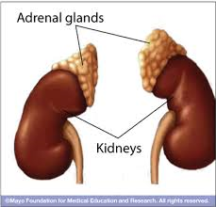
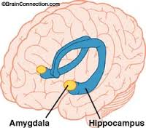

Explain how BIOLOGICAL FACTORS affect memory
Adrenaline, cortisol and the role of the amygdala

Slide 2


Newsflash! Cortisol makes memories more vivid and accurate
Stressful situation; release of hormones; impact on how we lay down new long term memories
adrenaline and cortisol from the adrenal gland
influence brain regions such as the amygdala
amygdala is in communication with other brain regions where memory creation occurs, e.g. hippocampus

Slide 3
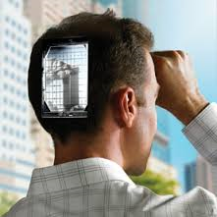
Emotional Memory
If amygdala is activated whilst a new memory is forming, a stronger memory may be made - flashbulb memories
brain’s way of ensuring we remember emotionally arousing experiences - survival value
emotional experiences leave an “indelible impression on the mind” (James McGaugh)
no survival value in remembering trivial experiences - they are forgotten as no hormones released

Slide 4
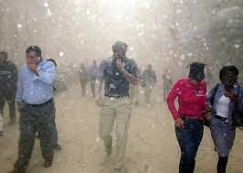
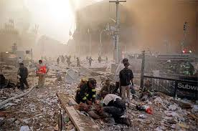
Sharot and Phelps (2006)
to explore neural basis of emotional memories
24 participants asked proximity to towers (Downtown or Midtown) - asked to retell their stories fMRI scanner
Word cues “summer” or “September” signal whether to recall events either from the summer or from 911
other autobiographical events from the same summer - baseline to compare brain activity when recalling 911 experiences
examined activity in amygdala and hippocampus.
Pps rate memories for vividness, level of detail, confidence

Slide 5
Findings
Pps near the WTC exhibited selective activation of the amygdala when recalling 9/11, but not while recalling control events (preceding summer.)
memories were more vivid, specific details of sounds and smells, than Pps in midtown, (experienced 911 via television or web)
positive correlation between proximity (how near people were to WTC) and activation of the posterior parahippocampal cortex (i.e. the smaller the distance between the person and WTC, the less activity in the parahippocampal cortex r = 0.59, P < 0.002
negative correlation between proximity and the amygdala (i.e. , the nearer they were the greater the activity in the amygdala, r= −0.50, P < 0.02) suggesting greater emotionality which seemed to enhance the vividness of the recollections but may have degraded the validity of the peripheral details of the memory due to decreased hippocampus activity.
results suggest close personal experience critical in engaging the neural mechanisms underlying emotional modulation of memory and producing vivid recollections as in FBM

Slide 6


McGaugh and Cahill
two groups are shown 12 images, each accompanied by a single sentence of narration.
IV: Uneventful/boring: woman and son visit the boy’s father in hospital where he works. On the way, they witness a disaster preparedness drill featuring a simulated accident victim. The boy stays with his father and the mother goes home.
Dramatic and arousing: boy is involved in a car accident in which his feet are severed. He’s rushed to the hospital, where surgeons reattach the injured limbs. The boy stays in the hospital and the mother goes home.
DV: Two weeks later both groups tested for recall of specific details.
Findings : Pps who viewed the emotionally arousing story had significantly stronger memories for the emotional parts of the story and were therefore able to recall more specific details from the story.
Conclusions - McGaugh concludes that “the more active the amygdala at the time the memory is encoded, the better the recall will be for this information.”

Slide 7
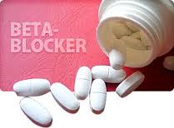
More McGaugh!
Aim: what happens if you are able to stop the activation of the amygdala during emotionally arousing events by decreasing levels of adrenaline.
Procedure: two groups are told the emotionally arousing version of the story, but one of the groups was given beta-blockers, widely used to treat heart disease, beta-blockers interfere with the effects of adrenaline on the body
Findings: people taking beta-blockers did not show stronger memories for the emotional aspects of the story. “They remembered a lot of what they saw, but they didn’t have a selectively stronger memory for the emotional content”.
Conclusions: taking these drugs during memory consolidation, i.e. after traumatic events could possibly help to minimise symptoms of post-traumatic stress disorder

Slide 8
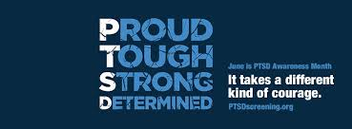
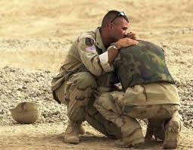
PTSD
intense, vivid, intrusive flashbacks
nightmares of traumatic events
extreme anxiety
Emotional numbness, excessively jittery and over reactive
go to great lengths to avoid reminders
develops after military combat, rape, violent assault, natural disasters (earthquakes or hurricanes), car accidents.
Anything that can be done to minimise the negative impact of the retrieval of such emotional memories has excellent potential benefits to society
improved quality life, less work days lost through poor mental wellbeing and less financial cost on the health service in providing support if preventative medicine can stop PTSD before it has started.

Slide 9
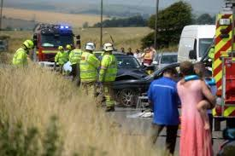
Pitman (2002) - Harvard psychiatrist and PTSD expert
gave beta-blockers to ER patients within hours of traumatic car accidents; received drugs for19 days.
month after trauma, medicated Pps showed fewer PTSD symptoms
another similar study in France had same basic findings.
beta-blockers can be harmful - further research required
Ethical minefield: controlling another person’s emotional experience, particularly in no fit state to give consent about whether they want to take a drug to obliterate their memories
potential negative implications of the production of such drugs with regard to the possibilities of them being used to interfere with eye witnesses ability to recall crimes is also most concerning.

Slide 10
President's Council on Bioethics
advisory group of doctors/scholars formed in 2001
Dampening or even erasing painful memories may disconnect people from reality or their true selves.
"memory-blunters could interfere with the normal psychic work and adaptive value of emotionally charged memory,“
"A primary function of the brain's special way of encoding memories for emotional experiences would seem to be to make us remember important events longer and more vividly than trivial events."
however painful, emotional memories serve a purpose; they help us learn, adapt, survive; we learn to avoid bad things by remembering bad experiences.

Slide 11
Against memory blunters
beta blockers could short-circuit "the normal process of recover; the drugs risk "falsifying our perception and understanding of the world. It risks making shameful acts seem less shameful, or terrible acts less terrible, than they really are."
"It's the morning-after pill for just about anything that produces regret, remorse, pain, or guilt,"
what if somebody committed an act of violence and then took propranolol to dull the emotional impact. Would they come to think of violence as more tolerable than it really is? Would rape victims, having taken memory-altering drugs to ease their trauma, forget key details vital to the prosecution of their attackers?
More broadly, is there a social obligation for people to remember the past events for the communal good, such as victims of the Holocaust?
But the reality is a pill-to-forget hitting the market anytime soon are nil.

Slide 12
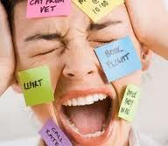
Cortisol can also impair memory
Cortisol belongs to a family of stress hormones called glucocorticoids and these can interfere with the energy supply to certain brain cells involved in memory.
this what happens if we are stressed out when we are trying to remember something ands this is different to the effects of stress when we encoding new emotional memories…

Slide 13
How does cortisol impair memory?
adrenal glands release adrenalin, and cortisol if threat still severe after a few minutes.
cortisol increases levels of blood sugar and stores of glycogen in the liver; remains in brain much longer than adrenalin - adversely affects brain cells over time
interferes with neurotransmitters
Excessive cortisol makes it harder for brain to process information/retrieve data from LTM
How? cortisol diverts large amounts of blood glucose to the muscles, away from the hippocampus
results in an energy shortage in the hippocampus, compromising its ability to access or create memories

Slide 14
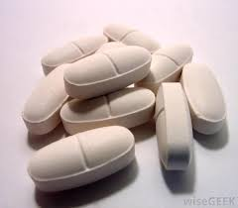
Newcomber et al (1999)
Pps: 25 men and 26 women aged 18 - 30
IV:
  Group 1 - high dose cortisol capsules twice daily for four days (similar to the stress of abdominal surgery)
  Group 2 - lower dose cortisol capsules twice daily for four days (similar to the stress of getting stitches or having a skin growth removed)
  Group 3 - placebo group; inactive substance
  They examine effects of the cortisol before taking, after 1 day, after 4 days of capsules and then after six days of ceasing capsules
DV: listen to and recall parts of a paragraph to assess verbal declarative memory; involves several brain regions, including the hippocampus

Slide 15
Findings
14/15 individuals taking the high dose experienced a decrease in memory performance after four days of treatment. No effects were found on the other cognitive tests.
"We saw memory impairment only in the individuals treated with the higher dose and only after four days of exposure. The good news is it appears that it would take several days of stresses like major surgery or severe psychological trauma in order for cortisol to produce memory impairment. And after a one-week wash-out period, memory performance returned to the untreated levels."
The cortisol levels were high in this study but Newcomber believes there may be some effects from long-term exposure to slightly lower levels

Slide 16
The effects are reversible
Newcomer does not believe the memory effects demonstrated in this study are part of any process associated with loss of neurons or permanent damage in the hippocampus or other brain structures.
"The evidence suggests that these kinds of cortisol levels are not neurotoxic themselves, perhaps sustained, high levels make neurons vulnerable to other types of injury, but we don't believe the memory impairments we saw in this study are in any way associated with an irreversible process. In fact, our evidence shows that this memory impairment is quickly reversible."

