Slide 1
Describe one research method used to investigate schizophrenia (6)
MZ/DZ Twin Studies

Slide 2

Why do Researchers do MZ/DZ twin studies?
MZ/DZ twin studies are useful in determining the extent to which schizophrenia is caused by our genetic makeup or our environmental experiences; the nature/nurture debate.

Slide 3

Who are the Pps?
Researchers will use secondary data in the form of hospital records to find a sample of MZ and DZ twins where one twin has already been diagnosed with schizophrenia.
They may wish to check the diagnosis to ensure that the diagnosis is valid.

Slide 4

What happens next?
The researchers will then conduct a longitudinal study, monitoring the frequency with which the co-twin is also diagnosed with schizophrenia.
It will be important to ensure that the same version of the DSM is used to diagnose the co-twin as was originally used with the first twin.

Slide 5

How are the findings expressed?
The researchers work out the concordance rate, that is the percentage of co-twins who go on to also develop schizophrenia for each type of twin, MZ and DZ.

Slide 6
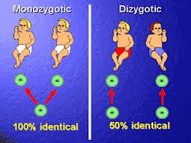
What Does MZ/DZ mean?
Monozygotic twins are genetically identical and come from one sperm that has fertilised one egg; they share 100% of their gene
Dizygotic twins share only 50% of their genes as they comes from two fertilised eggs.

Slide 7

How do you know if the Pps are MZ or DZ?
Twin researchers may complete zygocity tests as just because twins look the same does not necessarily mean they are definitely MZ twins. It is important to check this otherwise the results will not be valid.

Slide 8
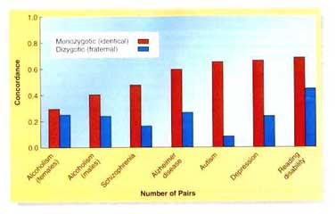
The concordance rates for MZ and DZ twin pairs can then be compared.

Slide 9
WHY ARE MZ?DZ TWIN STUDIES SO USEFUL?
All twins reared together, regardless of zygocity, share the same environment, however only identical (MZ) twins share the same genes.
This means that if the concordance rate for schizophrenia is higher for MZ twins than DZ twins, schizophrenia must have a genetic component.
If the concordance rates are similar then environmental factors may be more important in triggering schizophrenia.

Slide 10
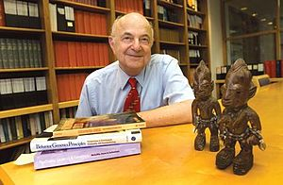
Illustrative example:
Gottesman and Shields (1966)
conducted an MZ/DZ twin study
concordance rate for MZ twins was 42%
concordance rate for DZ twins 9%,
suggests that schizophrenia does have a genetic component.

