Slide 1
Gottesman and Shields (1966)
An of an MZ/DZ Twin Study of Schizophrenia

Slide 2
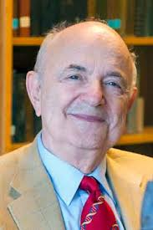
Aim
To explore the extent to which schizophrenia is a heritable condition, comparing concordance rates for MZ and DZ twin pairs, where one of the twins already has a diagnosis of schizophrenia
To explore the extent to which the co-twin of individuals with schizophrenia suffer from other psychiatric disorders or at least form some psychological abnormality, and to see whether this varies between MZ and DZ twin pairs

Slide 3
Procedure: Collecting secondary data
Hospital records - 16 years, Maudsley and Bethlem Royal Joint Hospital (London)
392 patients were same-sex twins; 47 of which had been diagnosed with schizophrenia
The researchers also identified some more twin pairs, where the patients had left the hospital but subsequently been diagnosed with schizophrenia
Final ample comprised:
  57 twin pairs in total: 24 MZ and 33 DZ pairs
  31 of each gender; aged between 19-64, mean average 37
  6 extra twin pairs not allowed in sample; 3 from overseas (might have invalidated the diagnoses of schizophrenia), three more with unclear zygocity
Further secondary data was collected using the hospital records of the twins to find out about their case histories and identify references to diagnoses of schizophrenia

Slide 4
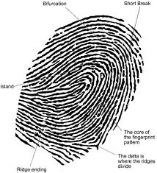

Procedure: Collection of primary data
Researchers conducted semi-structured interviews from which verbal behaviour was analyzed, personality test and tests of thought disorder.
Validity of MZ/DZ diagnosis: Blood tests, fingerprint analysis, assessment of physical resemblance used to assess zygocity

Slide 5
Findings
 | MZ(%) | DZ(%)
Both schizophrenic | 42 | 9
Co-twin either schizophrenic or has another clinical disorder | 54 | 18
Co-twin either schizophrenic, has another clinical disorder or is psychiatrically abnormal | 79 | 45
One twin has schizophrenia and the other is ‘normal’ | 21 | 55

Slide 6


More findings
Researchers found a gender difference; concordance rates were slightly higher for females compared with males, but sample size very small
In the most severe cases of schizophrenia, the concordance rate was much higher, between 75% and 91% in MZs but only 22% for DZs.

Slide 7
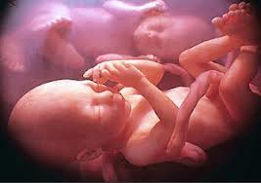
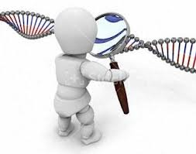
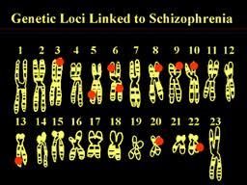
Conclusion
Genes appear to play an important role in schizophrenia because the concordance rate is higher in MZ twins than DZ twins. However environmental factors must also be important
Gottesman and Shields (1966) support a diathesis-stress model of schizophrenia where by a predisposition is inherited but is only triggered under certain environmental circumstances;
They also believed that certain types of schizophrenia may have a greater environmental component; this conclusion is based on the fact that in 21% of MZ twin pairs, one had schizophrenia yet the other was absolutely fine despite sharing the exact same DNA.

Slide 8
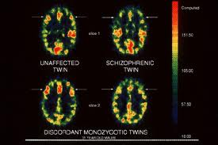

Further conclusions
further research needs to be conducted on MZ twin pairs where one has no psychological abnormality whatsoever
G and S believed that…
  the initial diagnosis of schizophrenia may have been inaccurate
  the lack of diagnosis of disorder in the co-twin was inaccurate
  the co-twin may be yet to display symptoms
  environmental triggers might have caused one twin to manifest schizophrenic symptoms and the other to be protected

