Slide 1
Olsson et al (2007)
Brain functioning and the acquisition of fear

Slide 2
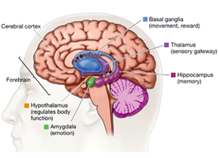
Fear Acquisition and the brain
Olsson et al (2007) investigated the role of the amygdala in the observational learning of fear
They found that the amygdala became active when the learner observed the model becoming fearful
They also found the amygdala to be active when the learner encountered the same situation in the future and became fearful

Slide 3
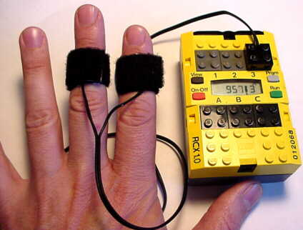


The Method
11 right-handed male Pps
They watched a 3 min film which they were told would explain the procedure of the experiment
In the film a person was looking at a screen where blue and yellow squares appeared.
The person would get a small electric shock every time a blue square appeared but not when the yellow square appeared
Skin conductance (GSR) was measured in the Pps as they watched the film

Slide 4
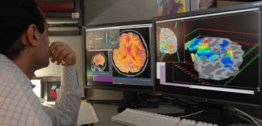
Method cont’d…
An fMRI scan was used to measure brain activity whilst they were watching the film
Next they were put in front of screen and told that they were going to see shapes appear
The Pps were anticipating that they would be shocked when they saw the blue squares

Slide 5

Results
The Pps showed a change in their GSR when they watched the film
as they learnt that blue was associated with the shock, their GSR would go up when they saw a blue square but not when they saw a yellow square
Similarly, the fMRI scans showed greater activity in the amygdala when they watched someone else being shown a blue square
Results fro GSR and fMRI were similar when they themselves were later shown blue and yellow squares

Slide 6
How to use this study: issues and D
As evaluation of SLT and how it relates to humans
But also Issues and Debates:
  To compare differing approaches to explanation, e.g. this study combines ideas from biological and from learning approach
  To show how scientific methods are used to investigate psychological processes
  To show how understanding has developed over time
  To explain individual differences, with regard to amygdala activity differing between individuals (with due to genetics or environmental circumstances in early development)
  Interaction of nature and nurture

