Slide 1
IB: Paper 3
Reflexivity in Qualitative Research

Slide 2

The Construction of Meaning
qualitative researchers need to be aware of their role in the "construction of meaning" in the research process
reflexivity takes into account the subjective nature of perception; top down processing

Slide 3

To promote credibility, researchers….
need to reflect on ways in which bias can enter into the research process
  e.g. how their own background and beliefs can influence the way research is conducted
they may need to reveal their own political ideology for example when introducing their research as this may have shaped
  their research question
  manner of data collection
  sample, coding, analysis etc.

Slide 4

Willig (2001)
Personal reflexivity
the researchers values, beliefs, experiences, interests, and political stance may influence the research
researchers need to consider how the research process has affected them personally and professionally

Slide 5

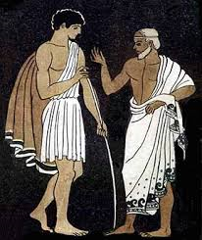

Willig (2001)
Epistemological reflexivity
Epistemology refers to the way in which knowledge has been gained
the phrasing of the research question may have limited what has been discovered
the design may also have affected the finding and analysis
it is possible that a different approach may have brought about different conclusions
Willig points out that researchers must think critically about their findings and not accept them at face value

Slide 6

How can researchers be reflexive?
Qualitative research reports often include information about the researcher
This enables the reader to gain some sense of the context in which the data was collected
their training, experience, status, self-presentation to the Pps will all affect the data collection and a reflexive researcher must be aware of the way in which this will have affected the data collected, and the analysis and interpretation of this data

Slide 7

What traits does a good reflexive researcher require?
self-awareness
critical self-reflection
ability to think about how your own potential biases may have affected the research process and the conclusions drawn

