Slide 1
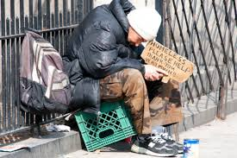
Paper 2: Clinical
Key Question
Why do so many people who are homeless also have mental health problems

Slide 2
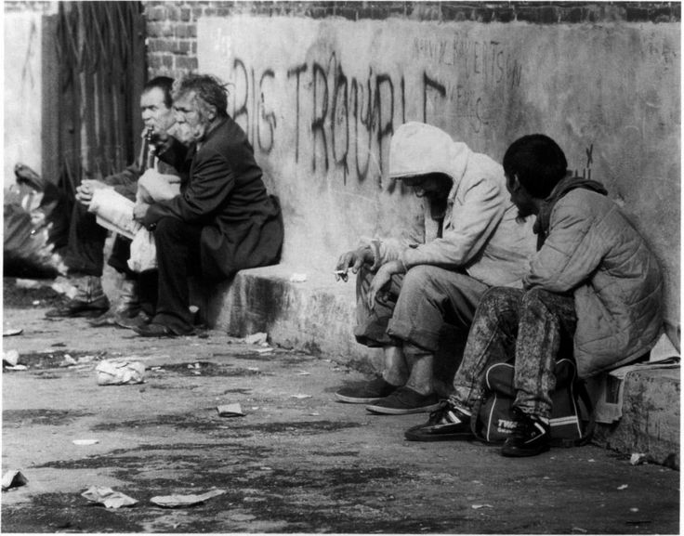
Stop the Scandal
February 2016
homelessness charity St Mungo’s produced a report called “Stop the Scandal
an investigation into mental health and rough sleeping
4/10 rough sleepers have a mental health problem
this is a growing problem.

Slide 3
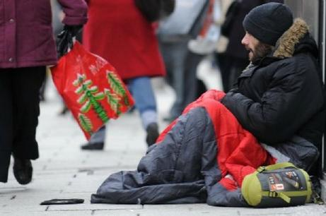
London
In London the number of people recorded as sleeping rough with an identified mental health support need has more than tripled over the last five years from 711 in 2009-10 to 2,342 in 2014-15.1

Slide 4
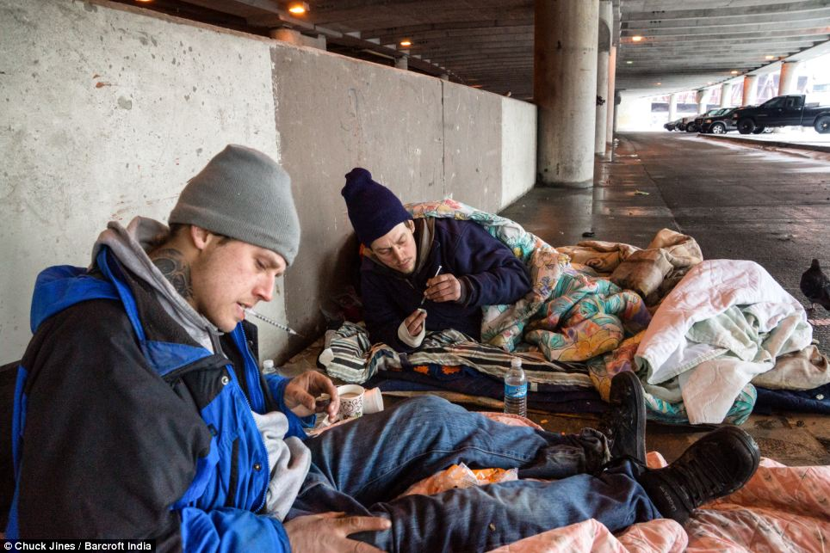
Substance abuse
Many homeless people use drugs and alcohol to self-medicate and to help them sleep and not feel the cold.
In Oxford, 65 per cent of people sleeping rough with a mental health need also have a substance use needs
Only 27 per cent of those who are homeless who do not have a mental health need have substance abuse problems

Slide 5
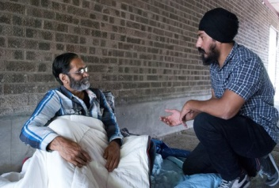
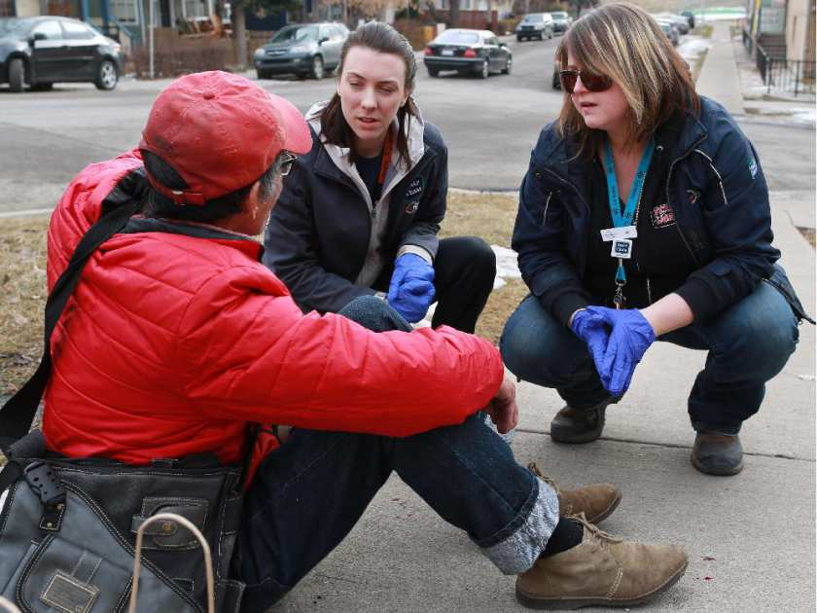
Failure to connect with outreach workers
People struggle to escape the street because mental health problems make it harder for them to engage with homelessness services
The case of Brian (not his real name), who has schizophrenia, failed to engage with homelessness services due to his delusional beliefs and anxieties about persecution
In the winter of 2013-14 Brian started sleeping on buses, making it harder for the people he relied on to find him.

Slide 6
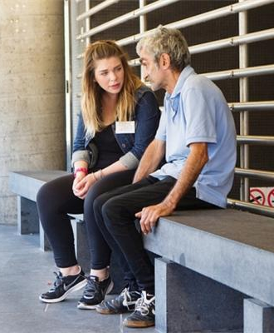
Recently discharged from mental health hospital
78 per cent of the homelessness professionals who responded to St Mungo’s national survey said that in the last 12 months they had met at least one person sleeping rough who had recently been discharged from a mental health hospital.

