Slide 1
The use of non-human animals in psychological experiments
Practical and Ethical Issues

Slide 2
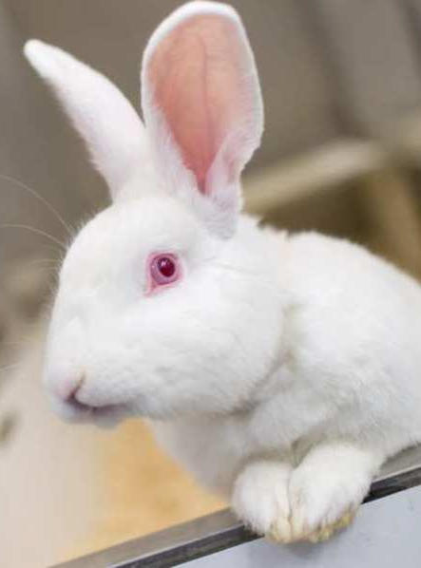
Why would psychologists consider using animals
From an ethical point of view:
Responsibility to our own species to learn as much as we can about ourselves by what ever means we can (Gray, 1991 pro-speciesism)
The research could be considered to be “for the greater good for the greater number”
  (Utilitarian Ethics)
Ethical guidelines for humans rule out certain procedures; animal research may be the only alternative (this does not really justify animal research though)
Ethical safeguards are extremely detailed and stringent meaning animals suffering is minimsed

Slide 3
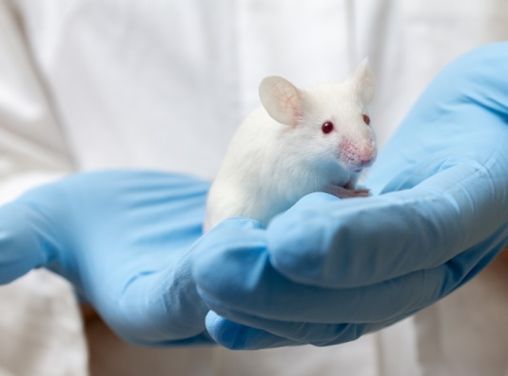
Practical reasons for using animals
Evolutionary continuity; studying animals is useful for learning about humans
Shorter life/breeding cycles; certain issues can be researched more quickly than with humans
Animals are small and can be handed easily; certain research is more practical
Animal research more objective; higher levels of control that can be established; validity/credibility

Slide 4
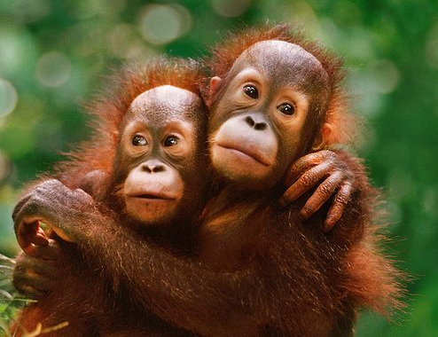
Ethical Reasons NOT to do animals research
Absolutism; animals should never be used in psychological; making research more humane is not good enough
Study animals is “speciesim”; putting one species above another is wrong; it fails to recognise we are part of a interdependent eco-system
We are morally obliged to protect other species
Findings from animals are not useful and therefore not ethical – too many differences, e.g. impact of culture, language

Slide 5
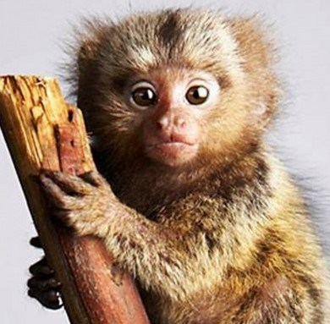
Evolutionary continuity and the argument against animal research
The evolutionary continuity argument is used to legitimise animal research from a practical point of view
It can also be used to argue that animals also experience pleasure/pain as CNS works in a similar way
therefore studies that should not be allowed on humans should not be allowed on animals either.

Slide 6
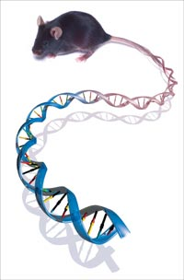
Practical reasons not to use animal research
Many dispute the evolutionary continuity argument meaning animal research may not be usefully extrapolated to humans
  e.g. mice only have 20 pairs of chromosomes (not 23 as in humans) and only share 90% of their genes with humans
  Mice and rats show interesting differences in their biochemistry and behaviour, so surely rodents and humans would potentially show vast differences

Slide 7
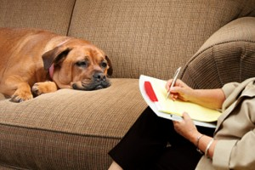
BPS Guidelines for Psychologists Working with Animals (2012)

Slide 8
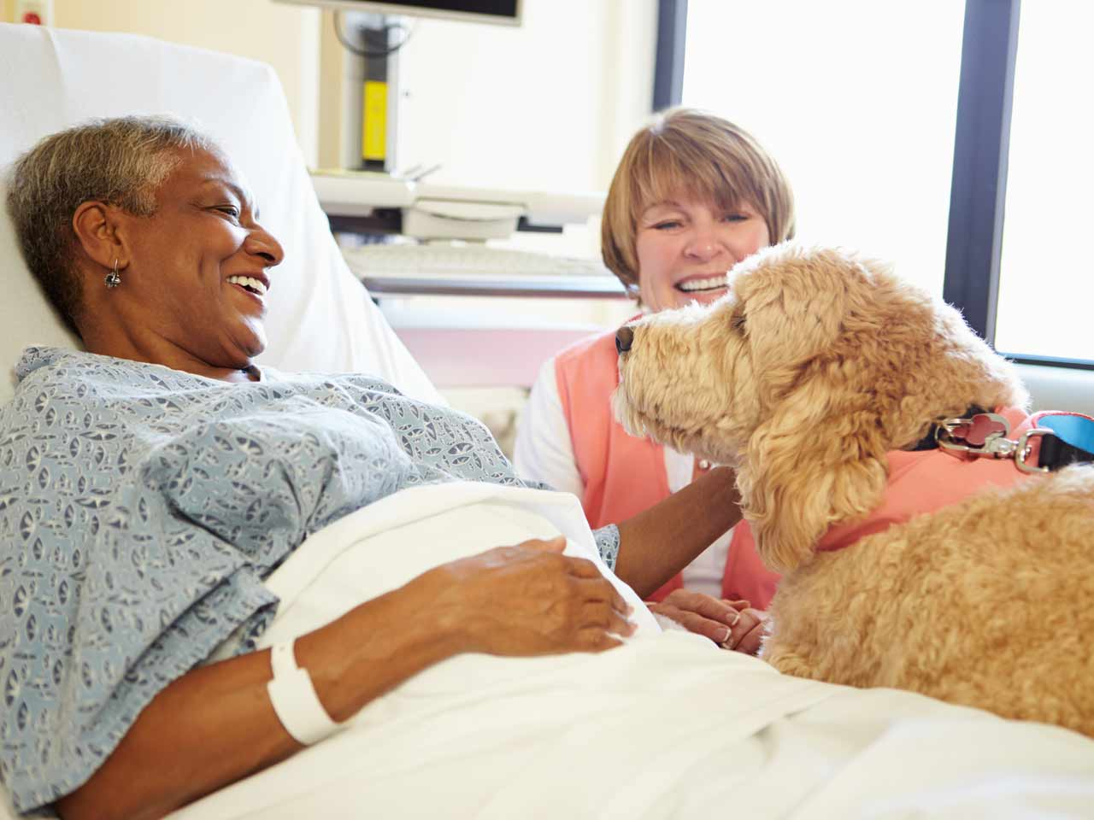
Psychologists and animals
Research and Teaching
Therapy
  with people (companion animal visiting schemes – e.g. pat dogs)
  animals with anti-social, anxious or distressed behaviour
Training animals for commercial purposes

Slide 9
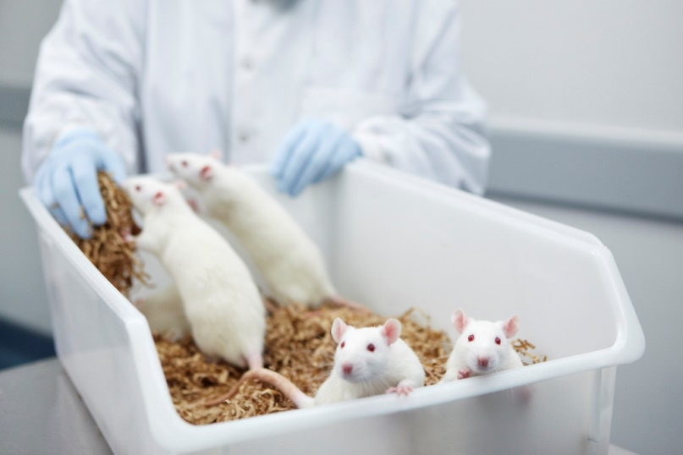
The Three Rs, (Russell & Burch, 1959)
Before thinking about an animal experiment, researchers must the following before seeking permission to perform a regulated procedure:
  Replacing animals with non-sentient alternatives whenever possible
  Reducing the number of animals used
  Refining procedures to minimise suffering (The three R’s:)

Slide 10
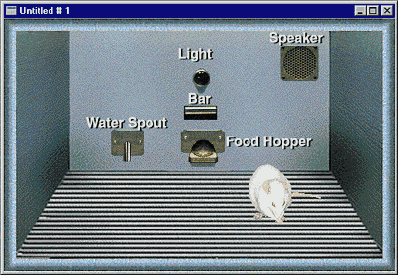
Replacing the Use of Animals
Research may well require the use of living animals however, alternatives such as videos and computer simulations may be useful, esp. in teaching contexts
e.g. ‘Ratlife’ project and ‘Sniffy the virtual rat’.

Slide 11
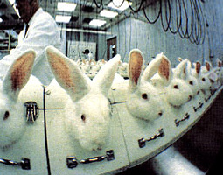
Reduce the number of animals
Researchers must use the smallest number of animals sufficient to accomplish the research goals
This requires pilot studies, reliable measures of behaviour, sound experimental design, appropriate use of statistical tests
Guidance on “statistical power” based on number of Pps is ongoing in America and the UK

Slide 12
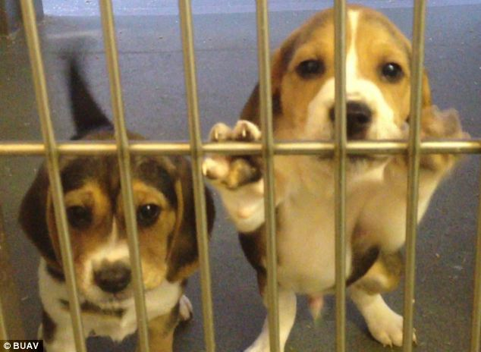
Refining procedures to minimise suffering
There are lots of ways that this can be achieved that are discussed on the following slides

Slide 13
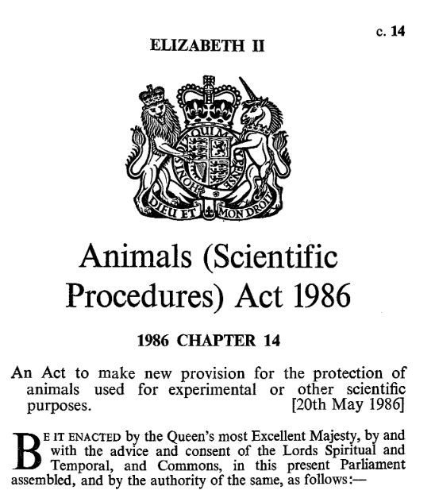
Legislation
BPS Members must familiarise themselves with the relevant UK laws on animal welfare
Animal research submitted for publication in BPS journals, must include cover letter explaining how legal requirements have been met

Slide 14
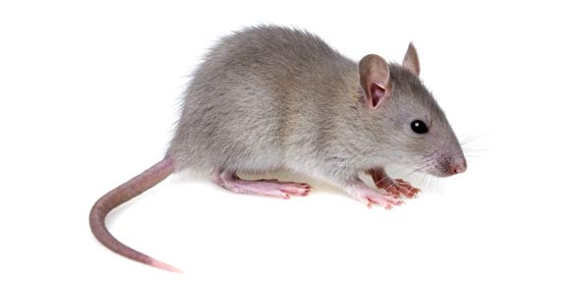
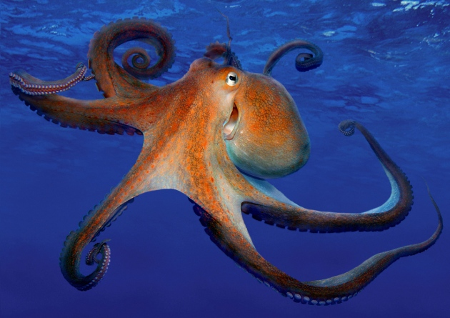
Animals (Scientific Procedures) Act 1986
Scientific procedures that may cause pain, suffering, distress or lasting harm
Protected animals: all non-human vertebrates and a single invertebrate species, e.g. octopus
Permission to perform procedures regulated under the 1986 Act will not be granted unless the researcher can justify the costs to the animals in relation to the likely benefits of the research

Slide 15
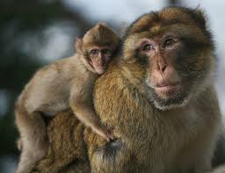
Choice of Species and Strain
choose a species that is scientifically/ethically suitable for the intended use.
Detailed knowledge of the species esp re. level of sentience.
Knowledge of an individual animal’s previous experience, e.g . bred in captivity?
species deemed to experience least suffering whilst attaining the scientific objective, should be chosen
choice must be justified in Project Licence application.
Non-human primates very careful consideration - high level of sentience

Slide 16
Rodents
Different strains of lab. rodents have very different physiological and behavioural characteristics that may make them more or less suitable for psychological research.
Many studies now use transgenic (genetically manipulated) mice and there are no suffering issues apparent although this needs monitoring in novel test situations

Slide 17

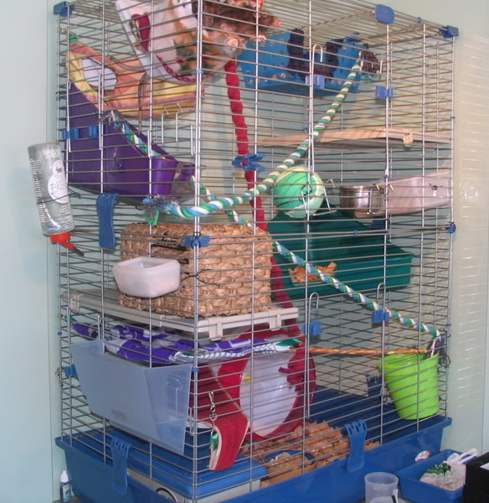
Regulated Procedures
Any scientific procedure that may cause pain, suffering, distress or lasting harm is regulated under the Animals (Scientific Procedures) Act 1986
  causing death, disease, injury, physiological or psychological stress, significant discomfort, or any disturbance to normal health, whether immediately or in the long term.
Researchers should consider designs that avoid regulated procedures,
  e.g. enriching rather than impoverishing the environment
  observing naturally occurring instances of deleterious conditions

Slide 18

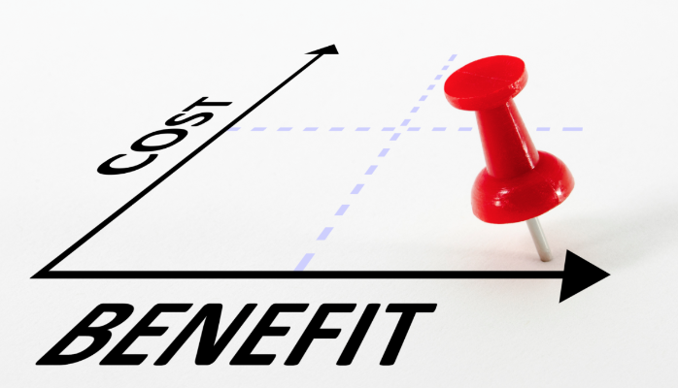
Home Office Licenses
a Project Licence is required to perform regulated procedures specifying the species, numbers of animals and procedures
licence only granted after weighing the benefits of the research against welfare costs to the animals
regulated procedures usually have to be carried out at a Registered Establishment

Slide 19
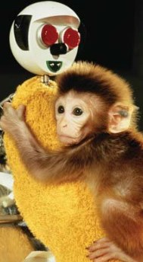
Personal Licence
Regulated procedures also require a “Personal Licence”
Requires successful completion of appropriate training to demonstrate competence
Licence holders are responsible for recognising , assessing and taking immediate action should any adverse effects on the animals occur
a Named Animal Care and Welfare Officer (NACWO) with responsibility for day-to-day care of the animal and a Named Veterinary Surgeon (NVS) will also be available to give advice on animal health and welfare.

Slide 20


Local Ethical Review
investigators must discuss the cost-benefit analysis of proposed regulated procedures with local colleagues/others including…
  academics
  veterinary surgeon
  lay people
They must approve project and personal licence applications before they are passed to the Home Office
various models can be used to assist in the decision-making

Slide 21
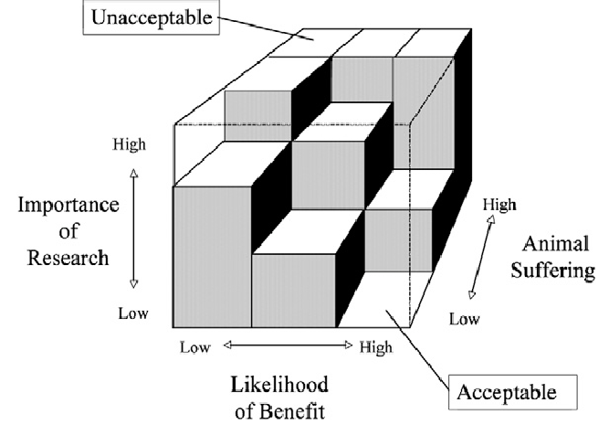
Cost-benefit Analysis
How do local ethics committees decide whether to approve a study?
Bateson (1986): The decision-making cube
  The Cost to the animal; suffering
  Potential Benefits of the research to society
  The Scientific Quality of the suggested research

Slide 22
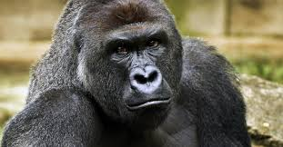
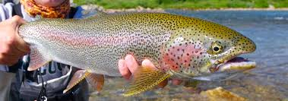
  The Cost to the animal; Suffering
What does suffering even mean?
  Sentience
  behavioural indicators of pain are not the same as suffering
  Suffering is longer term?
  Suffering is a feeling?
  Feelings are not emotions, feelings requires consciousness and self awareness?

Slide 23

Assessing animal suffering
Need to know different species well in order to make a good reasoned judgment about the degree of suffering
  Need to think about ways in which suffering can be minimised (3 Rs: Refine)
  If suffering will take place use least number of animals still give statistical power to the findings (3s Rs: Reduce)
  Is there any way that you could replace animals altogether? Computer modelling?
  Can we really know the cost to the animal?

Slide 24

Benefits to society
Psychologists need to think through their aims carefully and consider the implications with care
  How serious is the question they are studying in terms of the costs to society if this topic is left unexplored?
  What other literature already exists on this topic? How will this proposed study add to this? Is it a replication – how many times has the study been previously replicated?

Slide 25
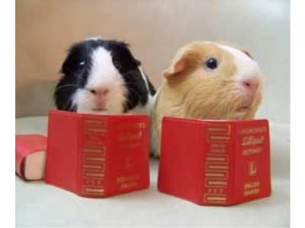

Scientific Quality of the Research
Generalisability to humans (extrapolation);
  evolutionary continuity
Reliability
Validity (internal/external)

Slide 26
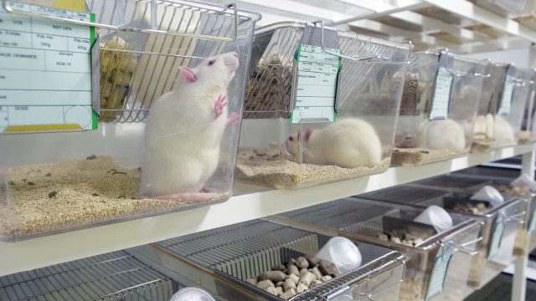
Housing
Consider the social behaviour of the species
  isolation may be stressful to social animals
  overcrowding may also cause distress or harm through aggression
  stress can vary with species, age, sex, reproductive condition, developmental history, depression of the immune system and social status
the Animals (Scientific Procedures) Act 1986 gives minimum standards for the housing of laboratory animals

Slide 27
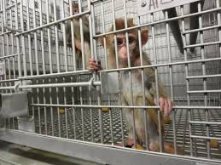
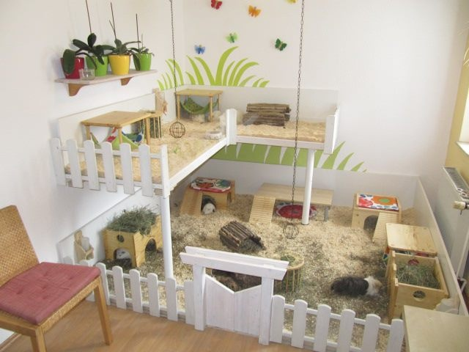
Animal Care and Welfare
the accommodation must allow at least a minimum of freedom of movement, and necessary food, water and care for wellbeing
natural living conditions as far as possible, e.g. using natural materials, refuges, perches and dust and water baths.
cage cleaning: compromise; level of cleanliness necessary to prevent diseases and amount of stress imposed by cleaning

Slide 28
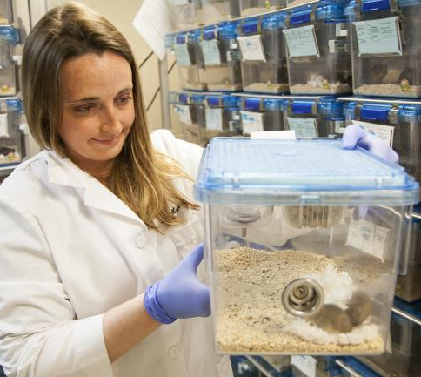
Animal care cont’d
Companions are needed for social animals wellbeing
adequate exercise and cognitive stimulation
human-animal interactions should be considered; special training needed to minimise stress
training animals to co-operate with handlers and experimenters also minimise stress

Slide 29
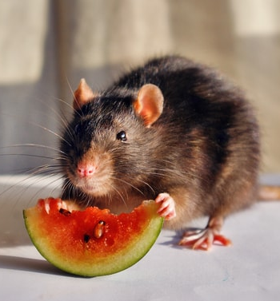
Reward, Deprivation and Aversive Stimulation
deprivation studies; consider the animal’s normal eating/drinking habits; short period of deprivation for one species may be unacceptably long for another.
if using deprivation researcher must ascertain that there is no alternative way of motivating the animal; levels of deprivation must be no greater than necessary
alternatives to deprivation include the use of highly preferred foods and other rewards which may even motivate a sated animal.

Slide 30
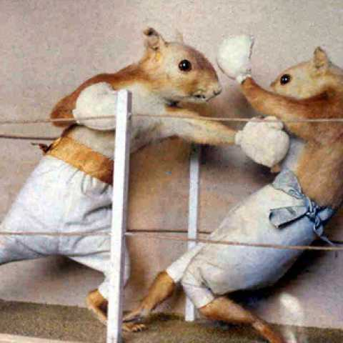
Aggression and Predation
field studies of natural encounters should be used in preference to staged encounters
Where staged encounters are necessary, the use of models as targets should be considered
If live animals are used as potential targets for aggressive behaviour then there must be continuous observation and intervention; protective barriers/escape routes, recommended

Slide 31
Anaesthesia, Analgesia and Euthanasia
After surgery; there must be proper post-operative care and monitoring
if at any time an animal is found to be suffering severe pain/distress that cannot be alleviated it must be killed humanely using an approved technique
procedures that are likely to cause pain or discomfort should be performed with adequate anaesthetic
analgesics to be used before and after procedures to minimise pain and distress

Slide 32
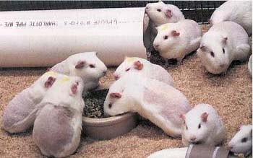
Procurement of Animals
common lab species must come from Home Office Designated Breeding and Supply Establishments
other species should only come from high quality suppliers
guidance relevant to wild-caught animals is provided by the Association for the Study of Animal Behaviour

Slide 33
Disposing of Animals
reuse is tightly controlled; requires specific Home Office approval
animals can be given to colleagues for further study, breeding or as companion animals
appropriate measures must be taken to ensure continued high quality care
Euthanasia: must be done as humanely and painlessly as possible
Death of the animals must be confirmed before their bodies are disposed of

