Slide 1
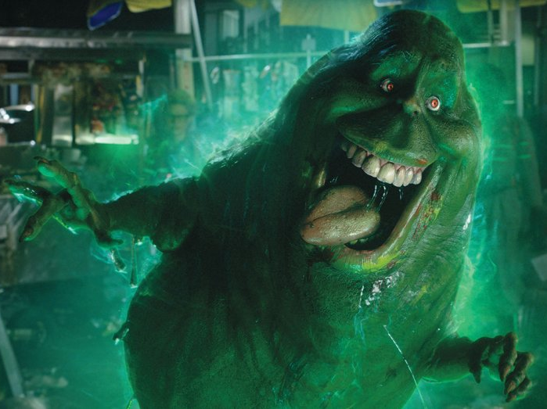
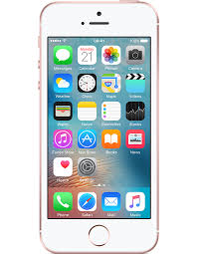

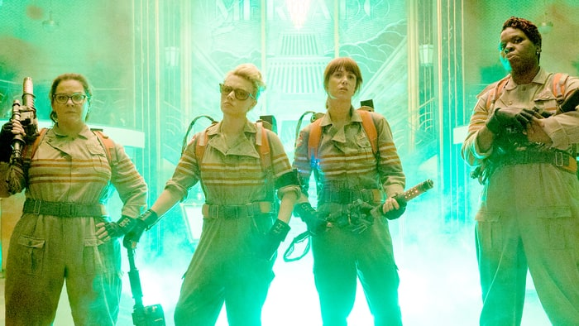
Do methods drive you mad! Do stats get you in a state?
Who you gonna call?!
STATS BUSTER:
HUGH COOLICAN!

Slide 2
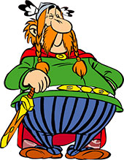
HUGH AKA
Vital Statistix
Complete the true and false quiz, can you spot the fact and the fiction?! You have as long as the ghostbusters theme tune!

Slide 3
In this session…
Fact or fiction; top 5 most misused concepts in sixth form psychology
Selecting a test? Which test and why?
Running and reporting stats tests: guiding your students to statistical success
Grow your own; using the BPS research digest to stretch your G and T pupils and get them creating sets of stats questions of their own.

Slide 4
Introductions: Who are we?
Mandy Wood: Edexcel teacher, taught since Curriculum 2000, with a brief spell in AQA, 11 years at PGS, as lone teacher and then Head of Department, have been an Edexcel CW examiner and learnt a lot about methods and stats the Edexcel way from Dawn Collis.
Met Hugh through Cara at a training day; the training day was a challenge and led me to realise a few things even as a seasoned pro, or so I thought ☺
enjoyed the privilege of being able to ask Hugh questions for the last 2 years
Hugh; the stats man ☺

Slide 5
Fact or fiction; you choose!
Orwellian Newspeak and A Level methods vocab ☺
Are our differing lexicons bound to the era in which we were taught?
The evolution of language; survival of the fittest; using the terms which fit the niche in which we find ourselves!
Let’s look at 5 popular methods terms and revisit the niche from whence they came;

Slide 6
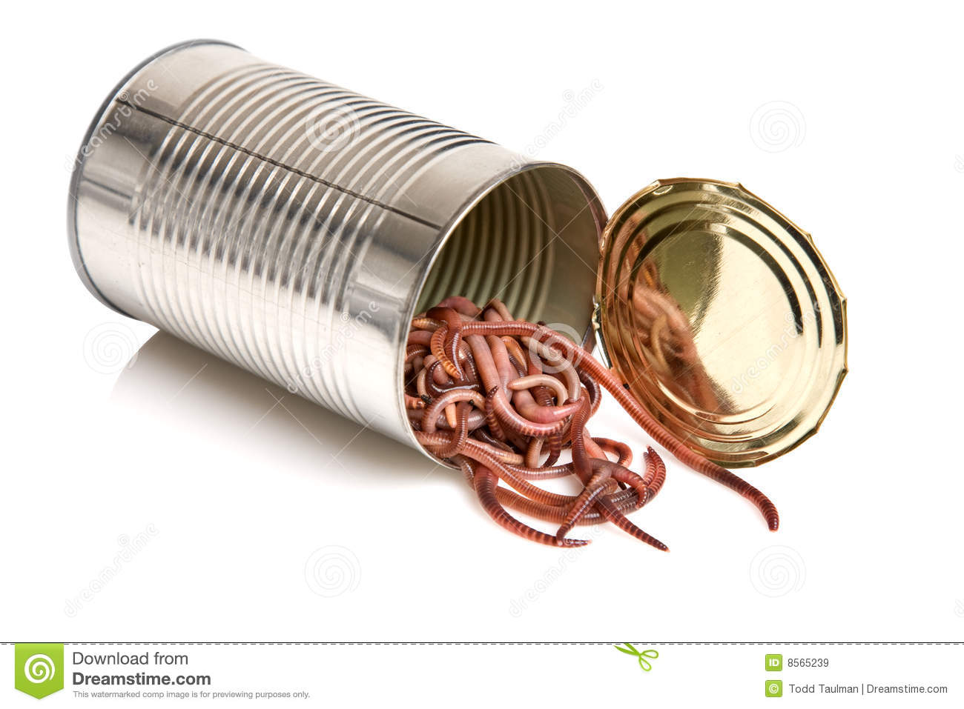
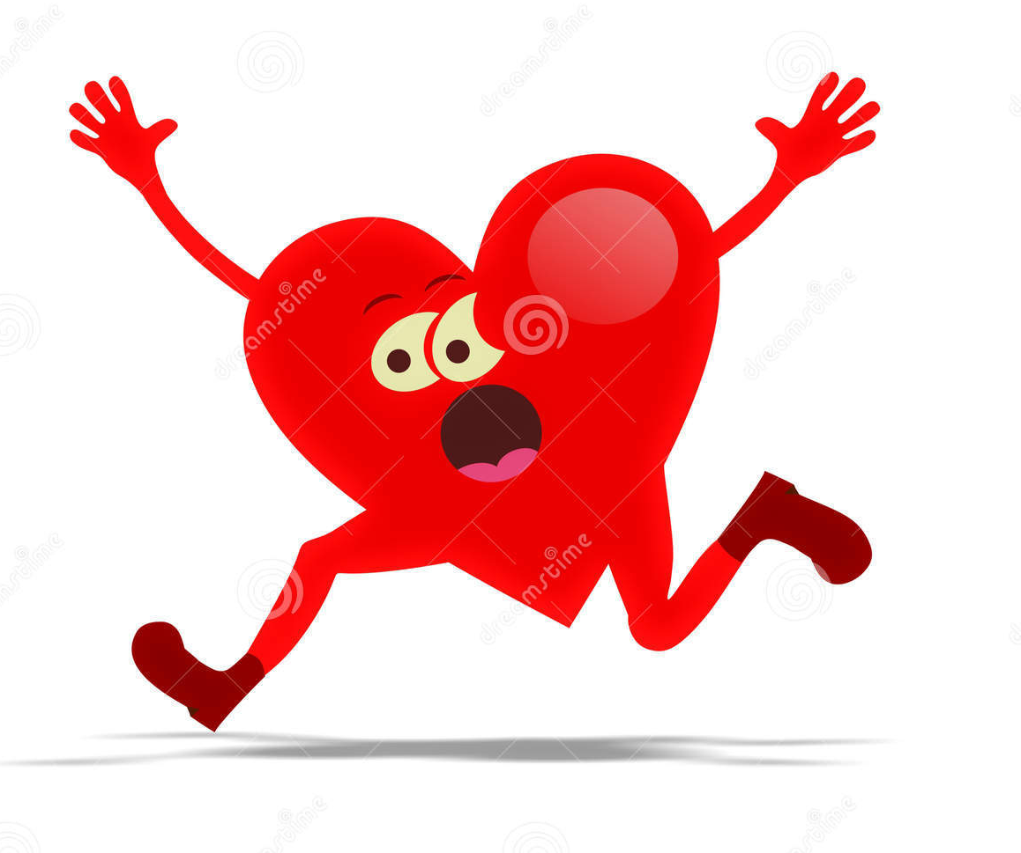
Be prepared the next section is not for the faint hearted!

Slide 7
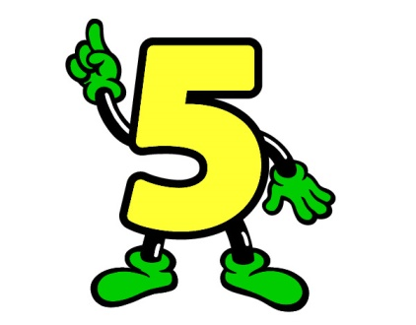
Anonymity and confidentiality
Data taken in a study do NOT remain confidential
The source MUST be anonymous
‘If data were confidential’, said a qualitative researcher recently, ‘I could never publish any research articles’.
Even some raw quantitative data are published (e.g. rogue scores).
Notes:
In at 5, its…

Slide 8
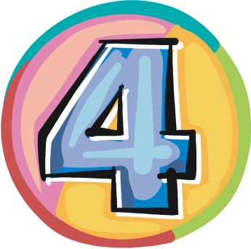
Demand characteristics
The totality of cues that convey an experimental hypothesis to the subject become significant determinants of the subject’s behaviour. We have labelled the sum total of such cues as the ‘demand characteristics of the experimental situation’. (1962)
The term ‘demand characteristics’ does NOT imply that participants will use these to please the experimenter.
The cues and what participants do with them are entirely separate matters.
They may well exhibit the ‘screw you’ effect.
Notes:
It’s a non mover at 4

Slide 9
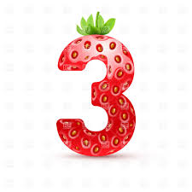
The Hawthorne Effect
Generally seen to mean: People’s behaviour changes solely as a result of being observed (observer effects – this is a specific threat to validity)
It is often taught and thought that, in the studies at the Hawthorne electrical plant in the 1920s (Roethlisberger and Dickson, 1939) workers improved their productivity rate no matter what changes were made to the lighting.
In fact, overall there was no reliable relationship between lighting conditions and productivity though it was maintained and even increased under very low lighting conditions, but no more than the researchers had predicted.
The studies were carried out on very low samples of workers and effects were confounded by researchers changing pay and incentive systems partway through the experiment and removing two of the ‘least co-operative’ of the five workers from the rest break conditions. Changes to rest breaks did generally improve productivity but there were several dips.
Olson, R., Hogan, L. and Santos, L. (2006) Illuminating the history of psychology: Tips for teaching students about the Hawthorne studies. Psychology Learning and Teaching, 5(2), 110–18.
Notes:
Thundering in to the chart at 3

Slide 10

Quasi experiments
Cook and Campbell (1979) worked in applied field and wanted to raise status of non-experiments to near that of true experiments providing that extra controls were put in place to diminish possible threats to validity.
They say quasi-experiments are not true experiments due to one or more of the following criteria:
  No random allocation of participants to conditions
  Researcher does not control IV manipulation
BUT in a quasi-experiment there needed to be a definable IV which could be considered as a time constrained treatment and it should be very close to an experiment in being able to minimise threats to validity.
This means that sex or other group difference studies are not quasi according to the original usage of the term
Hence you will see the term “group differences studies” used in some texts
Further reading: Cook, T.D. and Campbell, D.T. (1979) Quasi-experimentation: Design and analysis issues for field settings. Chicago, IL: Rand McNally.
Natural experiments are a type of quasi experiment; need to lobby AQA and the IB to clarify what they perceive the difference to be!
Notes:
Its new entry at 2

Slide 11
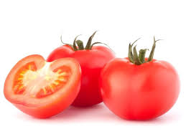
To-may-to/To-mar-to!
Kwayz-eye/Kwarz-eye or indeed Kwar-zeeeee!
Frankly my dear….

Slide 12

Ecological validity
Student: “It was carried out in a laboratory so it is low in ecological validity”
Hugh: Balderdash!
Originally used by Brunswik (1947) when discussing the psychology of perception
  ‘the degree of correlation between a proximal (e.g. retinal) cue and the distal (e.g. object) variable to which it is related’. More realistic = ‘representative design’
  e.g. set of lines decreasing in size has high ecological validity – e.g. relates to telegraph poles. So CUES have ecological validity.
However, the term has morphed over the years and this is why examiners require pupils to use it a little more discriminately, i.e. to justify, with regard to elements of the design of the specific study they are evaluating
Nowadays the term is used to describe how far the effect/conclusions of studies can be generalised to other situations
Hence EFFECT has ecological validity. We can talk of threats to the validity of the effect.
Notes:
And at number 1 after a record breaking 70 years since it s first use, it’s the I will always love you of the methods chart…

Slide 13
Bandura, (1978) "the slighting of experimentation by recourse to the. . . ready invocation of ecological validity. This notion has lost much of its identity from its earlier parentage, (and) is in danger of being transformed into a cliche through indiscriminate use.“
Where do we go from here? What has eco validity come to refer to in A level speak?
The extent to which research findings can be said to apply to other places or conditions, from the artificial lab environment to the more natural real world environment
Get students to think analytically about threats to validity.
WHY is it low in ecological validity? What threats are you talking about?
Can get highly valid effects in lab – e.g. Milgram – generalises far and wide – recent replication in Poland - Dolinski et al (2017)
  WHY is Milgram artificial? Participants not subject to any sanction unlike real life.
  Would not normally get told that someone else is responsible.
  Why hide the learner?
Hofling (1966) in natural setting – failure to replicate, e.g. Rank and Jacobsen

Slide 14
More information…
Hammond (1998) http://www.brunswik.org/notes/essay2.html
Kvavilashvili, L. and Ellis, J. (2004) Ecological validity and real-life/laboratory controversy in memory research: A critical and historical review. History of Philosophy and Psychology, 6, 59–80.

Slide 15
The True and False….
Sorry it was kind of a trick question…..
An activity to encourage critical thinking, what if this were true, what argument could you put forward?
Could this be false, how would you argue this point?
Competing arguments (Edexcel), on the one hand, one the other hand; some psychologists would argue that, this aside, however...
Language determines thinking; careful thought goes into the choice of words that psychologists use; being critical of our use of language, train pupils to consider very carefully each and every word that they choose to convey their meaning
Each of these terms tend to be used to evaluate research; therefore it is more about pupils citing well informed accurate knowledge of aspects of the studies design, procedure, materials , task participants etc. in order to arrive at their decisions.

Slide 16
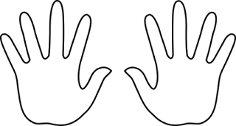
On the one hand…on the other hand
Many psychologists would argue that…
However it is also possible that..…

Slide 17
Selecting the correct stats test
What do pupils need to understand before you cover this…
  The difference between correlational and experimental designs
  The levels of measurement of data
  The difference between independent and repeated measures designs
Depending on your spec you will need to think carefully about how to sequence the topics; possibly building a crash course in quan. methods into the induction?

Slide 18
Non-parametric tests
Difference?
Correlation?
Spearman's rho
Categorical data
(Nominal)
Chi Square
Related design or Matched Pairs?
Wilcoxon matched pairs
Measured data?
Treat as ordinal?
Unrelated design?
Mann-Whitney U

Slide 19
Parametric tests
Difference?
Correlation?
Pearson
Related design or Matched Pairs?
Related t test
Unrelated design?
Unrelated t test

Slide 20
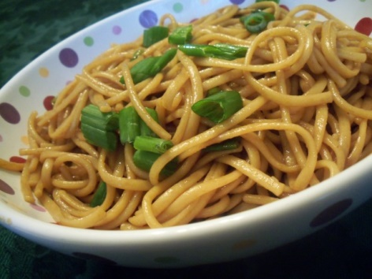
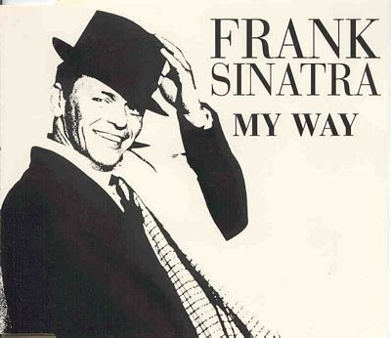
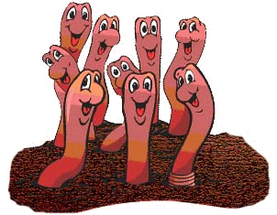
CH-Inese Noodles:
Chi Square:
Independent Measures
Nominal Data
MyWayIsOkay:
Mann Whitney:
Independent Measures
Ordinal Data
W-ORMs:
Wilcoxon’s:
Ordinal Data
Repeated Measures
HUGH’S WAY is also OKAY ☺
Mr and Mrs Wilcoxon are a married couple, they are related, next door Mr Mann and Ms Whitney are living together in sin (unrelated)
Personally I think the Wilcoxon's relationship is a bit dodgy if they are related ;)

Slide 21
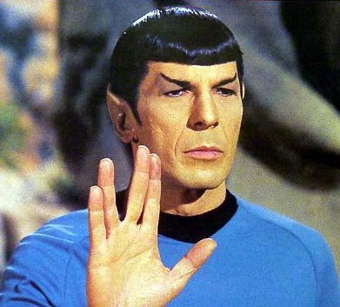
SPOC:
Spearman’s
Ordinal
Correlation

Slide 22
Justifying stats test
Circle the mark allocation and match your answer to it
Make sure that you use the extract to contextualise every point that you make, e.g. don’t just state that the design is repeated measures, relate this to what ever the extract is about
If its out of 2, avoid stating that it’s a test of difference as if you have already stated that’s its independent/repeated measures as your other mark, then the first comment is a given; focus on the design and LoM of the data

Slide 23
Justifying t test
We have interval level data
(because.....(e.g.) each person has a score OR question says so)
Data are normally distributed
We have homogeneity of variance (not more than 1:4) OR irrelevant because
similar participant numbers or repeated measures.
We have a related design (repeated measures or matched pairs)
Hence related t
We have an unrelated design (independent samples)
Hence unrelated t

Slide 24
Justifying Mann-Whitney or Wilcoxon
We have an unrelated design (independent groups/samples/measures)
We’re treating data as ordinal
(because …. Human judgement OR parametric assumptions violated OR just because we want to! Or question tells you so.)
Hence Mann-Whitney
We have a related design (repeated measures matched pairs)
We’re treating data as ordinal
(because …. Human judgement OR parametric assumptions violated OR just because we want to! Or question tells you so.)
Hence Wilcoxon
The Wilcoxons are married unlike Mr Mann and Ms Witney

Slide 25
Justifying chi-square
We have categorical data – counts of categories only
We are looking for an association between categories
OR (e.g.):
We are investigating whether boys and girls differ across toy choice
Hence chi-square

Slide 26
Justifying correlation
We are looking for relationship/association between two sets of related scores
We’re treating data as ordinal
(because …. Human judgement OR parametric assumptions violated OR just because we want to! Or question tells you so)
Hence Spearman’s rho
We have interval level data (because.....(e.g.) each person has a score OR question says so)
Data are normally distributed
Hence Pearson’s r

Slide 27
A researcher asks students to complete a scale for anxiety and one for stress. She wishes to support the claim that anxiety is related to stress. On the stress scale, there are many more very high scores than very low scores.
State which statistical test should be used to support the researcher’s claim and why (3)

Slide 28
Participants have completed a risk-taking measure and have completed Bem’s androgyny scale. Each participant has been classified as either ‘masculine’ or ‘androgynous’. The hypothesis is tested that androgynous individuals are less risk-taking than masculine individuals. Data are considered suitable for a parametric test.
State which test should be used to test the hypothesis and why is it appropriate? (3)

Slide 29
Participants are asked to perform a wiggly wire task alone and then in front of an audience. When the participant’s hoop touches the wire an error is recorded. The researcher tests the hypothesis that an audience causes greater anxiety and hence lower performance. She expects errors in the audience condition to be higher than those in the alone condition. The mean number of errors in each condition is much higher than the median.
State which statistical test should be used to test the hypothesis? Explain why you chose this test (3)

Slide 30
Young children who are either 30 to 36 months or 37 to 48 months old are asked to perform the Theory of Mind Smarties test. They either get the answer right or wrong.
State which test can be used to show that significantly more of the older children get the answer right? Explain why this test is appropriate? (3)

Slide 31
Participants are given 25 ml of Coca Cola. They are then asked to respond by pressing a button whenever a red light appears. Reaction times are recorded. The participants are brought back again the next day and given 250 ml of decaff Coca Cola. Again reaction times for the same response task are recorded. Does caffeine enhance performance?
Which test can tell us this, assuming reaction times are suitable for parametric testing?

Slide 32
Participants were asked to rate an article written either by a woman or by a man using a scale of 1 – 10 for ‘quality’. The data are analysed using a non-parametric test.
State which test is appropriate and justify your choice (3)

Slide 33
Participants rate pictures of males and females on a scale of 1 to 10 for attractiveness. The males and females are actually members of couples. Ratings for the male and female in each couple are then paired together. The ratings are found to be suitable for parametric testing. Are couples well matched on attractiveness?
State which test can be used to find out and why? (3)

Slide 34
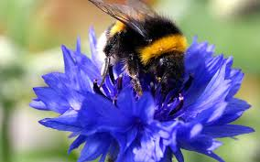
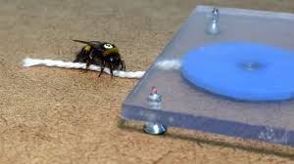
Creating scenarios questions
I found this fantastic clip on Facebook and it inspired me to write a chi squared question for my pupils’ mock exam.

Slide 35
Let’s tally the bees behaviour
 | Pulled the string to receive a treat | Did not pulled the string to receive a treat
Did not observe innovator bees before being faced with the string pulling challenge
Observed innovator bees before being faced with the string pulling challenge

Slide 36

We did not see the innovator bees before being faced with the string pulling challenge
I did not pull the string

Slide 37
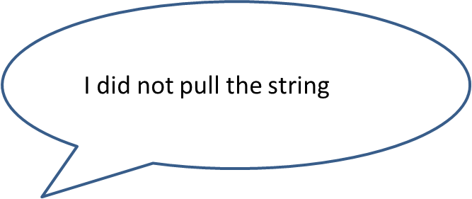
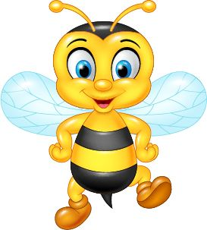

Slide 38
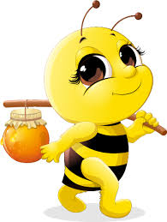

Slide 39
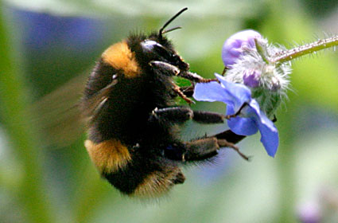
I DID pull the string
I am an
innovator bee!

Slide 40
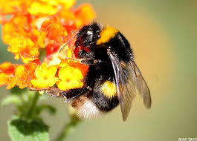

Slide 41
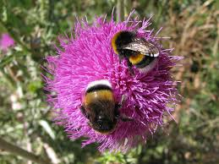
We BOTH pulled the string
We are
innovator bees!

Slide 42
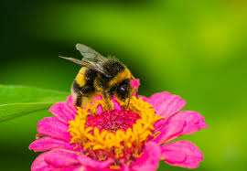
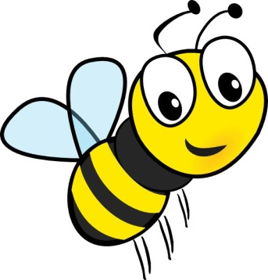
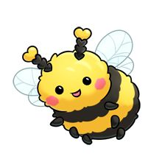
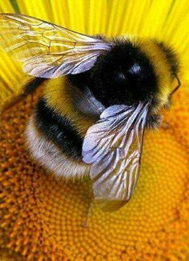
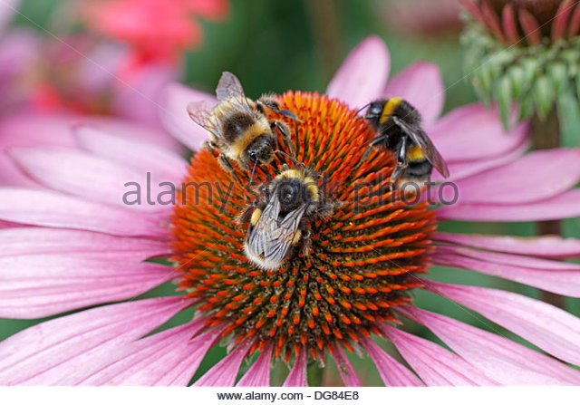
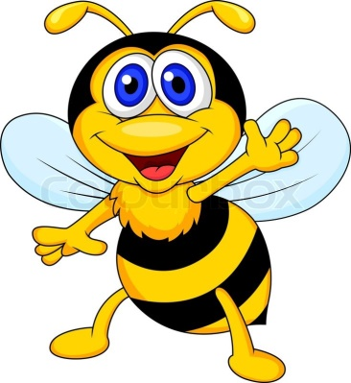
None of us pulled the string!

Slide 43
We saw the innovator bees before being faced with the string pulling challenge
None of us pulled the string!

Slide 44
We saw the innovator bees before being faced with the string pulling challenge
We ALL pulled the string

Slide 45
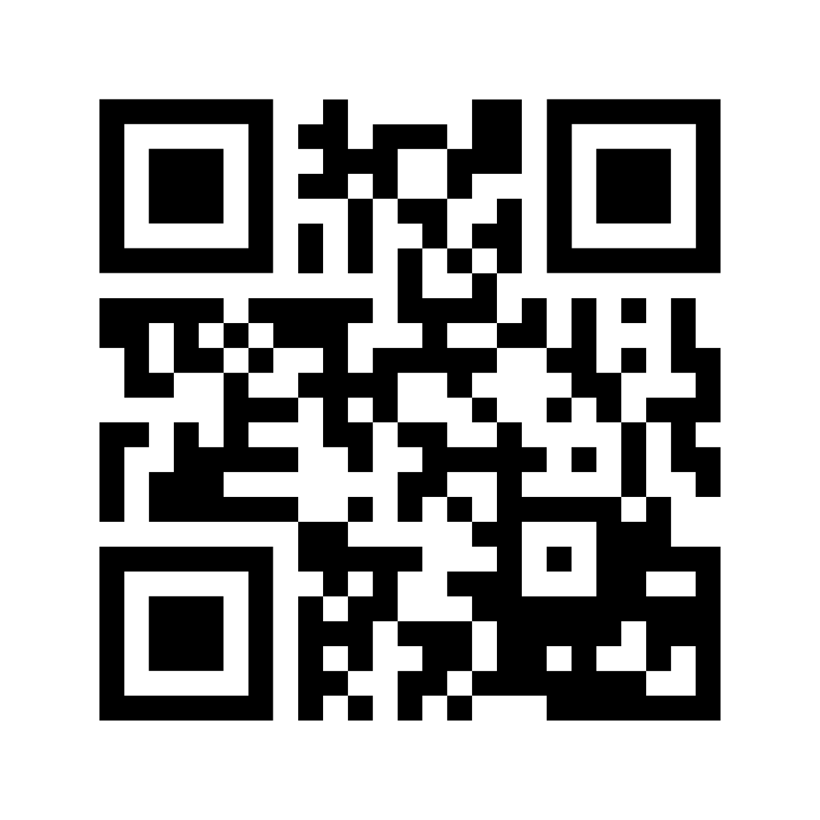
Help Professor Bea Swacks to find out whether her results are significant

Slide 46
Calculating expected frequencies
In the Edexcel exam you are given the formula for Chi Squared but this does not include how to work out the expected frequencies
This mock question was used to diagnose who could and who could not remember how to do this.
Row total X column total
Total number of observations

Slide 47
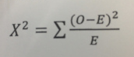
The Formula
We used the structured worksheet in the booklet to work through exactly how to conduct the Chi Squared

Slide 48
Using critical values tables
Please use the critical values table to work out whether Professor Swacks should accept or reject her hypothesis
Use the helpsheet for guidance on how to report the results of the stats test in order to access the marks in the exam

Slide 49
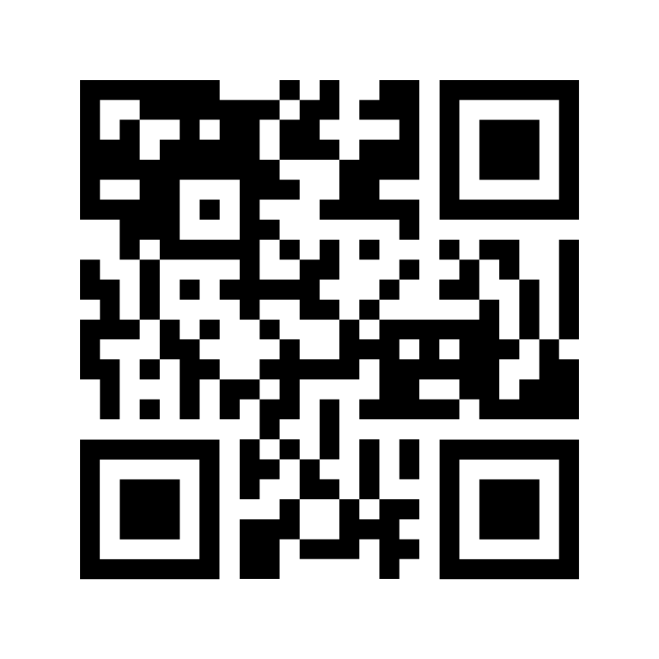
Conducting stats tests
Do you want to practise the Spearman’s Rho?

Slide 50
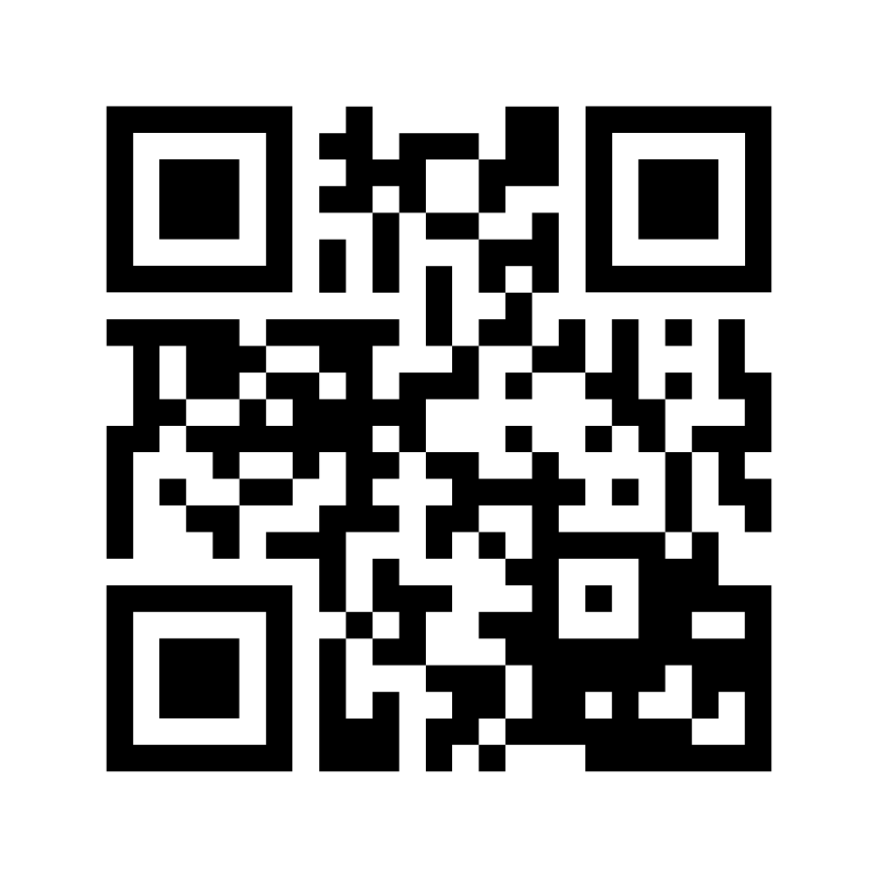
Do you want to practise the Mann Whitney U Test?

Slide 51
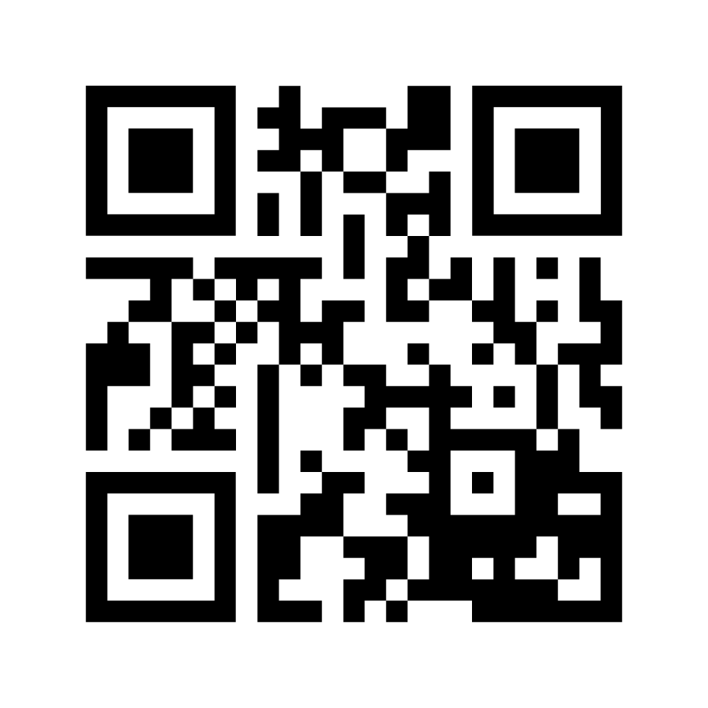
Do you want to practise the Wilcoxon’s Test?

Slide 52
Creating your own scenarios and getting your G and T pupils to do this for you!
BPS Research Digest
First article I found, mothers experience a dip in self esteem just after birth lasting around 3 years
IV: Before and after birth of first child
DV: Self esteem scores (ordinal data that can be collapsed to nominal – did self esteem go up, or down or stay the same?)

Slide 53
Self esteem and motherhood
The authors also looked at self esteem and relationship satisfaction as measured by questionnaires – correlation?

Slide 54
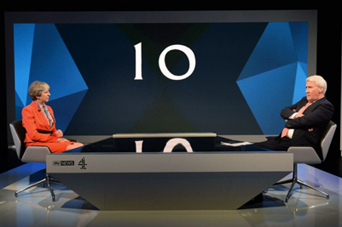
Clementson (2017)
Politicians – when you dodge the question, it makes you look dodgy

Slide 55
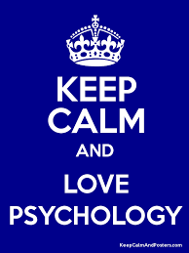
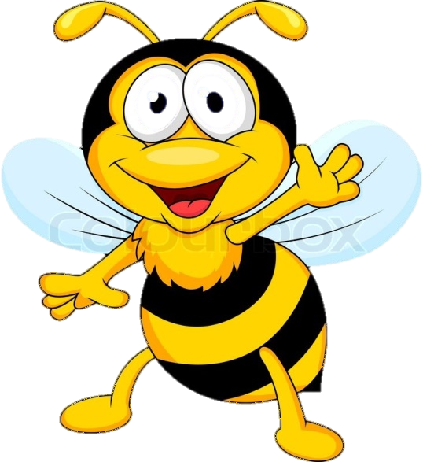
Thank you for listening and taking part!
Have a bee-utiful conference!

