Slide 1
Deviation from statistical norms as a definition of abnormality

Slide 2
Learning objectives
Deviance from statistical norms as a way deciding whether someone might need a diagnosis
  You should be able to….
    Describe
    Explain/discuss
    Assess/evaluate/to what extent

Slide 3
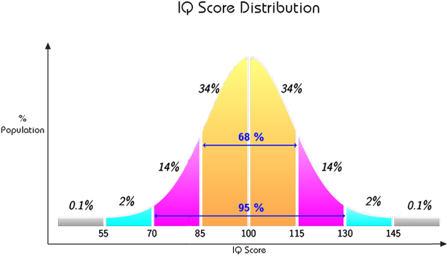
Deviation from statistical norms
Standardised tests used to measure traits, e.g. intelligence, aggression, empathy etc
Used to determine what is statistically normal/abnormal within a population
If you are within 2 standard deviations of the mean, you are normal
If you are three standard deviations or more from the mean you are abnormal

Slide 4


Strengths of this definition
The rules can be applied objectively with little training
You just have to get the person to complete the test and then work out their score and compare it with the mean
This is important as it means the rule can be applied fairly, regardless of age, gender, race etc.
This can be useful to prioritise cases when you need to work out who is most in need of treatment for example.

Slide 5



Limitations of this definition
Rare but socially desirable traits are also classed as abnormal, e.g. high levels of intelligence
The cut off points are arbitrary, meaning that it doesn’t take into consideration people’s subjective sense of distress or dysfunction
The norms may have been developed on a population of people to whom the individual does not belong and therefore it is not valid to compare them with these people.

