Slide 1
The 4Ds of diagnosis
Dysfunction

Slide 2
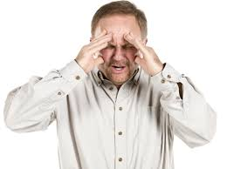
Dysfunction
Dysfunction is about not being able to cope with every day life including work and social activities
The Global Assessment of Functioning is a checklist which helps doctors to assess the extent to which functioning is impaired
This is an objective ways of measuring how a person is coping
A poor score on this test alone is not enough to warrant a diagnosis of any sort however it does help the clinician to get a better picture of whether the person would benefit form a diagnosis

Slide 3
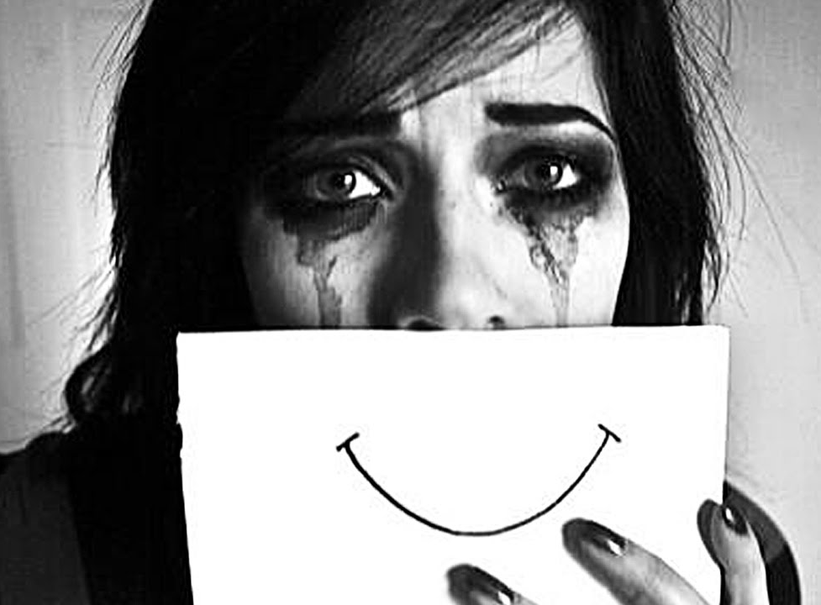
Example: Major Depressive Disorder (Recurrent)
Davis uses Major Depressive Disorder as an example of a disorder that can stop people from functioning as it can interfere with..
  Social relationships
  Work
  Self Care

Slide 4
Rosenhan & Seligman (1989)
Rosenhan and Seligman list 7 signs that may indicate failure to function and they all relate to one or more of the other Ds:
    Suffering (distress)
    Maladaptiveness (danger)
  The next 5 all link to deviance
    Vividness & unconventionality
    Unpredictably & loss of control
    Irrationality/incomprehensibility
    Causes observer discomfort
    Violates moral/social standards

Slide 5
Limitations
This D also crosses over with Danger as the GAF also includes:
  Persistent danger of severely hurting self or others (e.g. recurrent violence)
  Serious suicidal act with clear expectation of death
The GAF uses numbers to represent level of functioning and as such does not take account of WHY some one may achieve a certain score
  E.g. Some people may put themselves in danger by going on a hunger strike for example but this is not necessarily a sign of abnormality as such
  Sometimes people can function perfectly well but would be considered abnormal due to their lack of regard for others, as in anti-social personality disorder

