Slide 1



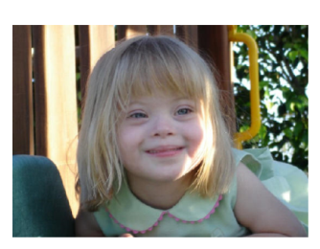
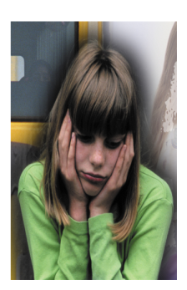

Slide 2
Research by Angst, (1992) showed that there is a 1 in 10 chance of becoming severely depressed at some po int in life and while research by Kessler et al, (1994) suggests that the chance of suffering at least one psychological disorder at some point is as high as 48%.
Mozart surely would have scored outside of two standard deviations on a test of musical ability
This concept relies entirely on the ability of practitioners and tests to return valid and reliable measures.
Statistical norms are generally set by a single population and therefore may not apply to other cultures, meaning that a person’s behaviour may appear abnormal compared with people from the population form which the norms were drawn, however the behaviour may not actually be that rare when it is viewed within its cultural context.
Some people may not obtain the necessary score to be classed as abnormal and therefore they may be excluded from treatment even if they need it. The cut-offs points are arbitrarily fixed and the same for everyone regardless of their circumstances.

Slide 3
This concept allows everyone to be treated equally and fairly, and allows practitioners to prioritize the most serious cases for treatment and this is important especially when finding is short and it may not be possible to treat everyone.
This concept allows practitioners to make objective, value-free judgements about who should be diagnosed and offered treatment
Down syndrome is statistically infrequent (approx 1 in 700) however cultural attitudes to Down syndrome a nd social norms are the major factor affecting outcomes for people with Down syndrome.
Statistical norms are generally set by a single population and therefore may not apply to other cultures, meaning that a person’s behaviour may appear abnormal compared with people from the population form which the norms were drawn, however the behaviour may not actually be that rare when it is viewed within its cultural context.
This concept relies on people receiving diagnosis from a clinical practitioner and many people may not seek professional help if there is stigma attached to their symptoms. This means that certain conditions may be far more common than the statistics suggest.

