Slide 1
Factors affecting Obedience: Personality
The Authoritarian Personality
ADORNO, T. (1950).

Slide 2
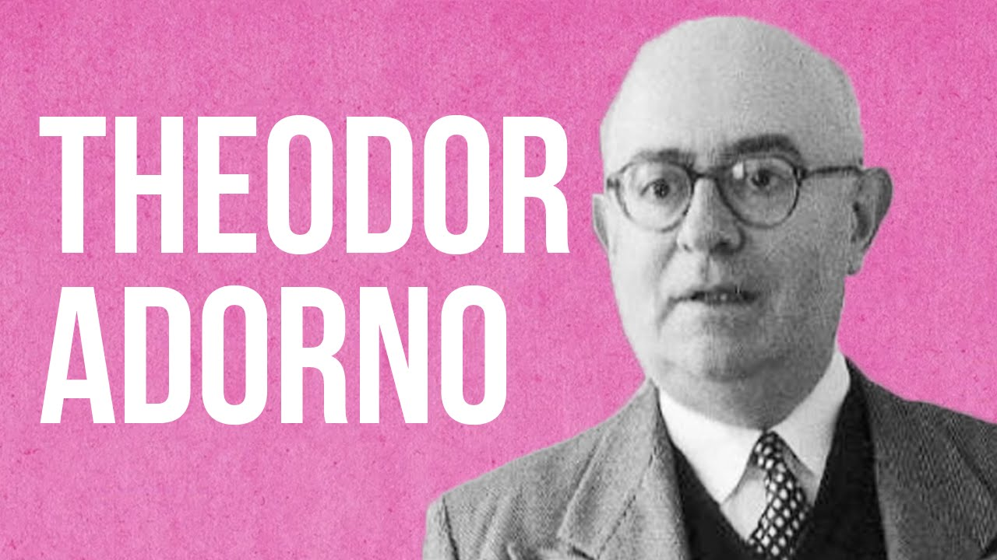
The Authoritarian Personality
ADORNO, T. (1950).
prejudice caused by a flaw in the personality
an ego-weakness or ‘maladjusted’ personality
Adorno was also Jewish; academic interest triggered by a desire to understand the Holocaust
his ideas fit with the “Germans as different” hypothesis

Slide 3


How did Adorno do his research?
Created questionnaires about upbringing, politics and prejudices
In-depth interviews of high and low scorers on the questionnaires, including Larry and Mack
analysed transcripts and used them to design another questionnaire (the F-scale) which measured “Authoritarian Personality”
AP predicts both obedience and prejudice to outgroups
But Adorno criticised for his subjective interpretation of the original transcripts

Slide 4
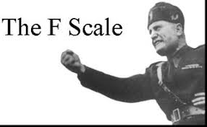
The F scale
many ‘items’ (questions) which assess amongst other things…
  Receptivity to fascist ideology
  Anti-Semitism
  Conservatism
  Ethnocentrism
http://www.anesi.com/fscale.htm

Slide 5

The development of the Authoritarian Personality in early childhood
Harsh and punitive style of upbringing leads to low self-esteem, self-loathing, anger and hostility in the infant
This hostility cannot be expressed towards the parents due to fear
Anger and fear are repressed (motivated forgetting) into the “unconscious”; the emotions still exist but are buried away from conscious awareness, protecting the person from undesirable impulses to hurt the parents
To resolve these inner feelings, the children identify with the parents and come to idealise them; they become overly subservient to those in power
This anger and fear is expressed through displacement; these people will act as though outgroups members are threatening, and respond with aggression, however the real target is the parents, but this knowledge is buried in the unconscious
Outcome – people with rigid, inflexible attitudes, highly obedient to those they perceive as higher status and brutal and discriminatory towards those seen as having lower status

Slide 6

AP and obedience
Alan Elms found that those scoring higher on the F-scale also gave higher shocks
Yet, AP is only be a partial explanation of Milgram’s study,; 65% obeyed up to 450 V and the percentage of people who score highly on the F scale is far lower than this.
However, it may help to explain why some people found it easier to resist obedience and showed higher levels of defiance/ dissent…
e.g. very low scores on fscale

