Slide 1
Classification systems for mental health
The specification says…
Classification systems (DSM IVR or DSM V, and ICD) for mental health, including reliability and validity of diagnoses

Slide 2

Key terms
Classification system
DSM IVR
DSM V
ICD
Reliability of Diagnosis
Validity of Diagnosis

Slide 3
Classification
How do doctors diagnose physical health problems?
What do you think the difference is between sign and symptoms?
How might this affect diagnosis?
Give example of signs and symptoms of meningitis
What happens once a person has been given a diagnosis?
What is meant by prognosis?

Slide 4
Classification of mental disorders
Many Westerners believe that mental disorders can be addressed in a similar way to physical disorders
There are two main classification systems used in the Western world
  ‘Diagnostic and Statistical Manual of Mental Disorders’ (DSM)
  the ‘International Statistical Classification of Diseases and Related Health Problems’ (ICD)
They provide checklists of symptoms that commonly cluster together.
The checklists can be sued to create semi-structured interview schedules that allow clinical practitioners to identify and diagnose hundreds of different disorders

Slide 5
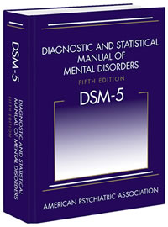
The DSM
Published by the American Psychiatric Association (APA)
originated from a system used to classify disorders experienced by World War 2 soldiers
first published in 1952; revised several times
used all over the US and much of the Western world
generates considerable revenue for the APA
DSM 5, was published in May 2013
contains over 300 disorders
divided into over 20 categories.

Slide 6
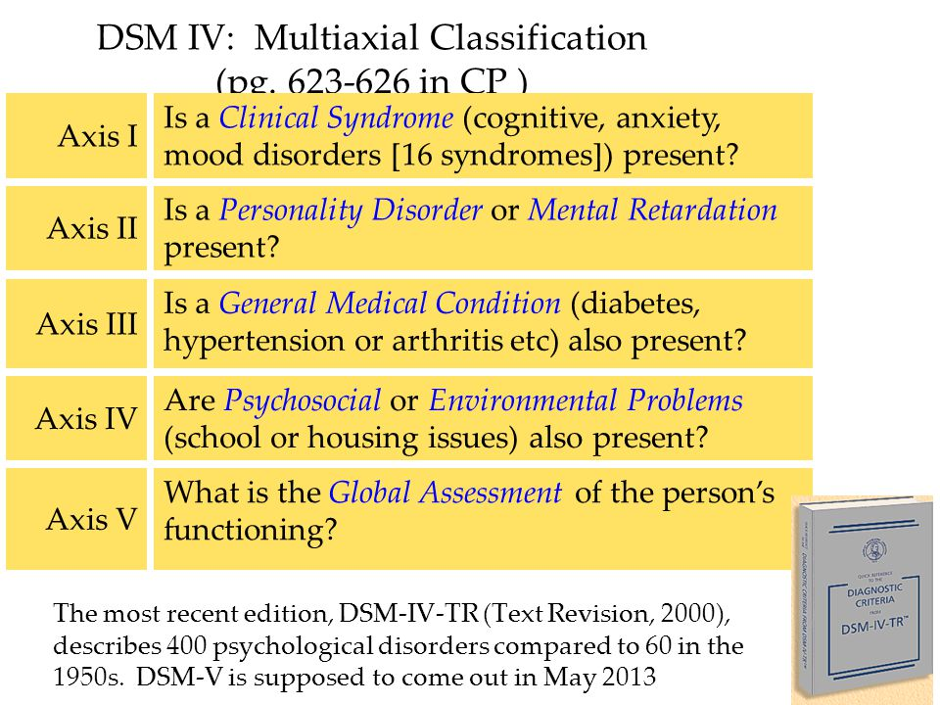
Some important changes to DSM5
removal of the ‘multi-axial’ system
This prompted a holistic approach to diagnosis
assessed general functioning and the impact of medical and/or psychosocial issues, such as bereavement or redundancy
Although, the multi-axial approach is no longer part of the DSM5, many of these issues will still be considered

Slide 7

‘Internet Gaming Disorder’, ‘Caffeine Use Disorder’ and ‘Selfie-itis’
Ever-changing society
DSM 5 section 3: suggestions for new disorders
sufficiently prevalent to deserve a place in the DSM, but insufficient research on reliability or validity
Some of the suggestions have caused controversy, e.g. Attenuated Psychosis Syndrome
Two of the suggestions above are real disorders from Section 3
one hit the headlines in 2014 but turned out to be ‘fake news’
Professor Mark Griffiths at Nottingham Trent University has shown that this may indeed be a real disorder, after all
Which disorder do you think Griffiths has been researching and what are your thoughts on whether this should be viewed as a disorder? See p.000 for the correct answer.

Slide 8
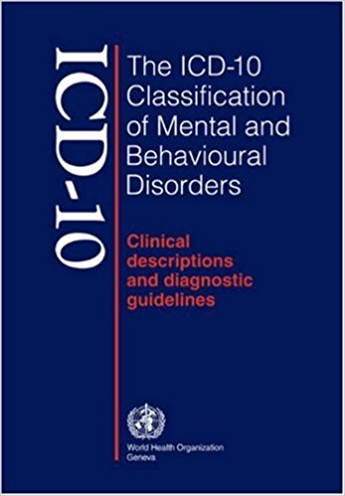
The ICD
published by the World Health Organisation
includes physical and mental disorders
originated from the International List of Causes of Death, produced in 1893 as a way of monitoring mortality and morbidity statistics
WHO became involved in 1948
many revision overs the years
ICD10 is soon to be replaced with ICD11, due out in 2018

Slide 9


ICD cont’d
Multilingual
freely available
used by physicians, nurses, researchers, policy makers and patient organisations
Used all over the world to monitor prevalence and incidence rates in order to allocate resources and manage healthcare.
Chapter 5 Mental and Behavioural Disorders (F00–F99) contains 11 subcategories, including mood disorders and schizophrenia, schizotypal and delusional disorders.

Slide 10
Evaluation: Strength
‘Not Otherwise Specified’
DSM IVTR had very narrow categories to improve reliability
practitioners had to decide whether specific symptoms were ‘present’ or ‘absent’
difficult to discern how severe a symptom should be in order to ‘count’.
Practitioners did not want to make type 1 errors
general diagnoses with the addition of NOS
e.g. ‘pervasive developmental disorder: (NOS).
Avoided ‘getting it wrong’
DSM 5 takes a ‘dimensional approach’
merging similar disorders and creating more spectrum disorders.
could make diagnosis more valid
focus on severity and impact of symptoms and the provision of appropriate treatment.

Slide 11

Competing argument
DSM 5 has also added some hotly contested new disorders
e.g. ‘Disruptive Mood Dysregulation Disorder’
distinctly similar to ‘Oppositional Defiant Disorder’, (applied to children who are uncommonly irritable, argumentative, and vindictive)

Slide 12

Concerns around lowered thresholds
‘lowering of diagnostic thresholds’
not as many criteria need to be met in order to be diagnosed.
‘Mild Neurocognitive Disorder’
misdiagnosis of people who are elderly, and displaying normal signs of ageing.
medicalisation of normal life stages

Slide 13

Application in the real world
the DSM5 Task force worked collaboratively with the WHO to ‘harmonise’ the DSM and the ICD.
previous lack of consistency made international research difficult, as well as treatment of people who have been diagnosed under different systems
people with similar symptoms may have been diagnosed with different disorders, depending which system was used
should lead to greater reliability

Slide 14

Issues and debates: Culture and gender
Black people are more likely to be diagnosed with schizophrenia than white people
women are more likely to be diagnosed with anxiety disorders than men
when a person presents with a certain combination of symptoms, the practitioner may be more likely to given a certain diagnosis as this fits with their schema for that disorder.
biases in the wording of the classifications can lead to invalid diagnosis which can mean the individual is unable to access appropriate support and/or treatment.

Slide 15
Conclusions
the two main classification systems have evolved over time
more detailed and meaningful diagnosis in some areas
But inherently biased; reliance on subjective symptoms
overlapping disorders
practitioners may be more or less likely to label a disorder in a certain way, depending upon their own experience and whether the person is male or female and their ethnicity.
harmonisation of the DSM and the ICD may be beneficial,
But also means that the weaknesses of one system may no longer be outweighed by the strengths of the other, leaving practitioners and researchers with less choice.

Slide 16
Reliability of Diagnosis

Slide 17
What is reliability?
What does reliability mean when we use it to think about research findings in psychology?
What would it mean to say a diagnosis was reliable?
How could we determine whether a diagnosis is reliable?
Why do you think it might be hard for practitioners to reach a reliable diagnosis?
How do we extract information from service-users?
Why might different people come to different decisions about the person?
If 100 is a perfect agreement between practitioners regarding a particular diagnosis and 0 is no agreement at all; what number do you think would be acceptable for us to say that a particular diagnosis can be made reliably?

Slide 18
How is reliability measured?
a reliable diagnosis should remain relatively constant over time, assuming the symptoms have not changed
‘test-retest’: same patient diagnosed twice
if symptoms are highly changeable, it may be impossible to make a reliable diagnosis
an individual should receive the same diagnosis when re-diagnosed by another practitioner, (using same version of the same classification system!)
psychiatrists gather information using unstructured, clinical interviews
patients may provide differing descriptions to different practitioners dependent upon many factors
diagnosis based on subjective interpretation of what a patient has said
understandable why this may lead to unreliable labelling.

Slide 19
Cohen’s Kappa
Robert Spitzer, the chairman of the DSM-III task-force introduced the use of a statistic called Cohen’s Kappa
Aimed to improve reliability of DSM- III
Cohen’s Kappa expressed as a decimal (between 0 and 1)
refers to the amount of people who receive the same diagnosis when diagnosed by two different practitioners
Spitzer and his colleagues suggested 0.7 would denote ‘good agreement’, (Spitzer et al. 2012)
While Cohen’s Kappa has been used in subsequent versions of the DSM, the threshold value has plummeted.
0.7

Slide 20
Positive Predictive Value
Probability of receiving the same diagnosis in ‘second round’ of diagnosis
Often expressed as a percentage but can also be a decimal.
70%

Slide 21
How reliable is DSM 5?
‘Mad in America’: not-or-profit organisation calling for ‘profound change’ to the ‘current drug-based paradigm of care’ which they say has ‘failed our society’
On their website, Rachel Cooper (2014) explains that the DSM III required much higher Kappa scores than the DSM 5
She explains that in the DSM 5 field trials, (where the checklists were checked to ensure reliability), figures which previously would have been deemed ‘poor’ or ‘unacceptable’ were now seen as ‘good’.
In DSM III some of the most common disorders seen in adults achieved values of 0.8 and over e.g. schizophrenia, mood disorders and substance abuse disorder
the DSM5 task force suggested that values as high as 0.8 would be miraculous’
values of 0.4-0.6 are ‘realistic’
values of 0.2-0.4 are ‘acceptable’.
This has led to concerns about the reliability of DSM5.

Slide 22
In clinical practice, does it really matter whether a diagnosis is reliable?
In clinical research, does it really matter whether a diagnosis is reliable?

Slide 23
Evaluating the reliability of the DSM
Diamond 9
Sort the studies

Slide 24


Creating chains of reason with evidence
Gambling disorder still reliably diagnosed with DSM 5
One strength the DSM 5 is that test-re-test data has shown high levels of agreement for certain disorders.
For example, Randy Stinchfield and colleagues have been researching gambling disorder for the past 15 years. Using patients recruited from a treatment programme in Ontario and members of the local community, they were able to accurately identify 91% of participants, as either having or not having gambling disorder, (Stinchfield et al. 2016).
This is an important study that shows the DSM 5 is highly reliable despite changes to the criteria for diagnosis, notably dropping the number of symptoms necessary from five to four.

Slide 25

Weakness of Reliability of DSM 5
One weakness relating to reliability of diagnosis is that, according to Rachel Cooper (2014) only 15% of the disorders evaluated in the DSM5 field trials achieved a Kappa score of more than 0.6 compared with the original 0.7 identified by Spitzer in the review of DSM III.
This is concerning as two of the disorders which were considered to be least reliable were major depressive disorder and generalised anxiety disorder, two of the most prevalent disorders in the US.
This suggests that the DSM may be distinctly less reliable than previous versions.

Slide 26

Competing argument
This said, it is not really appropriate to compare the reliability data for DSM5 and previous versions as different methods were employed to evaluate DSM III.
For example, David Kupfner the chair of the DSM 5 task force and Helena Kraemer, the chief methodologist responsible for the field trials (2012) explain that during the DSM5 field trials, practitioners were asked to ‘work as they usually would’ and ‘take patients as they come’ in order to ‘mirror’ normal practice whereas previously ‘test’ patients were carefully screened and practitioners were given detailed instructions and training.
Therefore, it is unsurprising that reliability data was less impressive than in previous trials.

Slide 27
Meanwhile, in the real world
One weakness of the use of the DSM5 in clinical practice is that is still highly likely to result in unreliable diagnoses.
Associate Professor of Psychiatry, Ahmed Aboraya and colleagues (2006) draw attention to many factors which prohibit practitioners from making reliable diagnoses including the fact they simply do not have sufficient time to spend on the necessary structured interviews and rating scales. They also note that practitioners prefer not to use these instruments as they interfere with the development of the therapeutic rapport necessary for successful treatment.
These issues demonstrate that although it may be possible to make a reliable diagnosis, in practice, there are many reasons why this may be difficult.

Slide 28
Issues and debates
One relevant issue is the use of psychological knowledge in society.
In order to improve the reliability of diagnosis in clinical practice Aboraya has developed the SCIP, (Schedule for Clinicians Interviews in Psychiatry) which has two phases, an unstructured phase to allow the practitioner to build rapport and a general picture of the patients symptoms, followed by a structured phase using 24 carefully chosen questions which ensure some standardisation across practitioners.
This has led to improved inter-rater reliability in clinical practice, (Aboraya et al. 2006).

Slide 29
Reliability - ICD-10: Ponizovsky (2006).
 | 1989 | 1996 | 2003
Schizophrenia | 68% | 82% | 94.2%
Affective (mood) disorders | 67.9% | 65.4% | 83.8%
Neurotic (anxiety) disorders | 75.1% | 69.1% | 82.9%
reliability has significantly improved for three of the main categories of disorder.
very large data sets
both genders
aged 11 to over 60
PPVs were compared for many disorders from three cohorts from 1989, 1996 and 2003
mood and anxiety disorders have been shown to have very low levels of reliability in the field trials of the DSM 5 (e.g. Kappas of 0.2 Rieger et al 2013)
Thus a significant strength of ICD compared with DSM 5

Slide 30
Competing argument
Despite the impressive PPVs for those three disorders the study did reveal some less satisfactory results for the category of ‘childhood disorders’ and ‘personality disorders’ where PPVs were as low as 55% and 56% respectively.
Also it should be noted that these PPVs may seem high in comparison with the some of the figures quoted for the DSM but these figures are based on agreement at the category levels whereas the DSM figures are for more specific diagnosis, e.g.

