Slide 1
Cognitive Approach
Cognitive Process
Thinking and Decision-making

Slide 2
I think, therefore I am…
See OUP, p150 - Definitions
Normative models, p150-151
Descriptive models i.e. what people actually do when thinking

Slide 3
Dealing with the Flood!
How do we cope with the relentless flow of sensory information?
What does MSM tell us about how we deal with this?

Slide 4
What happens when we pay attention?
Thinking is the process of using knowledge and information to make plans, interpret the world, and make predictions about the world in general, (Crane, 2018)
    Problem solving
    Creativity
    Reasoning
    Decision making

Slide 5
Decision making and problem solving
The process of identifying and choosing alternatives based on the values and preferences of the decision-maker
Decision making is needed during problem-solving to reach the conclusion
Problem-solving is thinking that is directed toward solving specific problems by means of a set of mental strategies.
The concepts of problem-solving, decision making and thinking are interconnected

Slide 6
The Dual Process Model of Thinking and Decision Making
Stanovich & West (2000)
System 1 and System 2

Slide 7
System 1
Automatic, intuitive and effortless
Often employs heuristics - that is, a ‘rule’ used to make decisions or form judgements
Heuristics are mental short-cuts that involve focusing on one aspect of a complex problem and ignoring others (Lewis, 2008)
Quick and potentially efficient but may be prone to errors

Slide 8
System 1 cont’d
Assumptions do not match the reality of a specific situation
Such errors can lead to grave consequences in day-to-day life
Often we feel very certain that we are right when we use system one thinking
When cognitive load is high, we may use System 1 (Gilbert and Gill 2000)

Slide 9
System 2
slower, conscious and rational
More effortful
thinking carefully about all of the possible ways we could interpret a situation
Gradual elimination of possibilities based on sensory evidence until we arrive at a solution

Slide 10
System 2 Cont’d
allows careful analysis of the world around us, allows us to think about …
  what is happening
  why it is happening
  what is most likely to happen next
  how we might influence the situation
Less likely to create feelings of certitude and confidence

Slide 11
Using both systems together
System 1 is activated first and will reach a quick conclusion
System 2 will then go into further analysis to hopefully reach a "more correct" conclusion
System 1 processing and its resulting ‘answer’ can often interfere with system 2 processing.

Slide 12
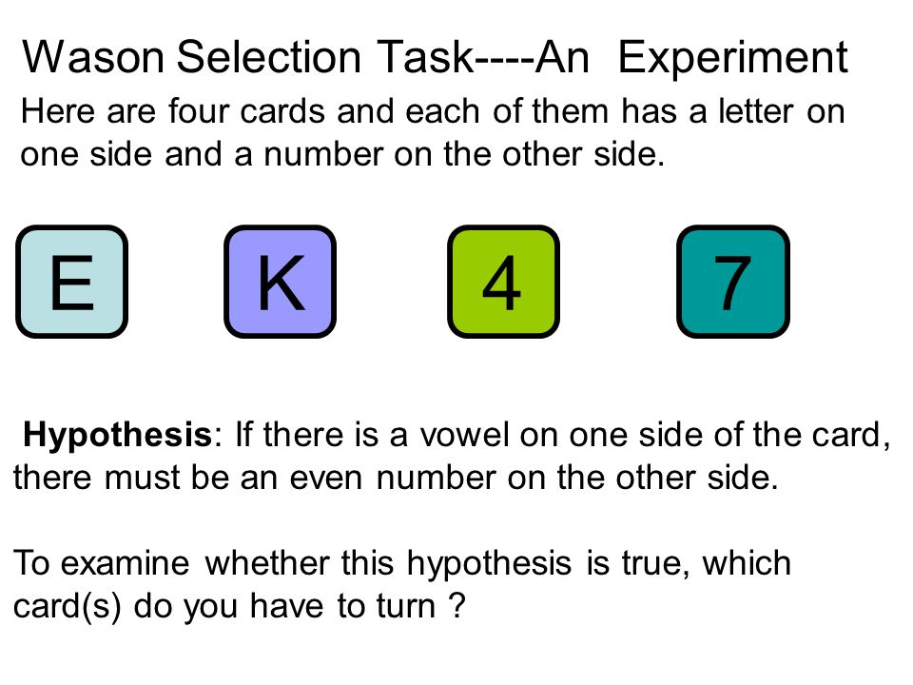
Wason’s card selection task (1968)

Slide 13
Most people say…
E
4
But they are only half right. E is correct but 4 is wrong.
The matching bias - in an abstract problem, we tend to be overly influenced by the wording (or context) of the question, e.g.

Slide 14





?
?
?
Odd
Even
Vowel
Consonant
?
Odd
Even
Vowel
Consonant

Slide 15
System 1 thinking
Evans and Wason (1976) found that when asked why they chose the cards that they did, they were not able to clearly explain their choices;
Suggests they were using system 1 thinking in this abstract task.
important evidence for the dual process model
Most people make the decision of which cards to choose without any reasoning - but as an automatic response to the context of the question (system 1)
Wason (1968) found that even when he trained people how to answer this question, when he changed the context, the same mistakes were made. For example, can you solve this one?

Slide 16

Abstract versus concrete/social
If you are drinking beer you must be at least 21
?
?
?
?
<21
>21
<21
>21
Beer
Coke
Beer
Coke

Slide 17
System 1 seems to work fine on non-abstract problems
However, it is possible the Bar/ID task is only easy because it is a familiar situation to many of the undergraduate students who were in the sample
what happens when you use an unfamiliar task?

Slide 18




Cassava root eating rule
In the Brazilian Jujube tribe, people who have served the tribe in a significant way are allowed to eat cassava root, otherwise this food is banned. Those allowed to eat the root have a facial tattoo to identify them. Everyone else eats things like cooked grubs/insects.
RULE: If you are eating cassava you must have a facial tattoo

Slide 19
Even though we are not familiar with eating grubs and may not even know what cassava is, most people were able to answer this one correctly.
?
?
?
?
No tattoo
No tattoo
Tattoo
Cassava
Grubs
Cassava
Grubs
Tattoo

Slide 20
Social rule enforcement
Cosmides and Toobey suggest that we can work out problems quickly and accurately using system 1 thinking if the task is about obeying social rules.
Abstract logic not so much use to us however social logic is important to the survival of the groups, e.g. we need to be able to detect and punish the cheaters, who don’t have the groups best interests at heart?
Potentially our brains have been shaped by this evolutionary demand
So if you want to solve an abstract problem turn it into a social one, e.g. the vowels promised they would ONLY take the even numbers to the cinema.

Slide 21
Heider and Simmel
https://www.youtube.com/watch?v=VTNmLt7QX8E

Slide 22
fMRI and Wason (Goel et al 2000)
Participants did logical tasks in an fMRI scanner.
IV: whether the task was abstract or concrete
DV: area of the brain that were active
Both tasks showed similar activity but there was a clear difference.
Abstract task: parietal lobe was active
Concrete: left hemisphere temporal lobe was active

Slide 23
Dijksterhuis (2004)
See additional sheets and practical activity

Slide 24
Ares et al (2013)
71 Pps
Shown pairs of yoghurt labels, i.e. info about sugar, fat content
Pps have to choose one in each pair
Eye movements tracked to see what they were looking at
System 2 thinkers searched more info in the time and analysed it more systematically than system 1 thinkers; individual differences

Slide 25
Evaluation of the Dual Process Model
Support:
  Wason (1968)
  Goel et al (2000)
Limitations
  Reductionist: does not clearly explain how (or even if) these modes of thinking interact or how our thinking and decision making could be influenced by emotion.
  The definitions of System 1 and System 2 are not always clear. For example, fast processing indicates the use of System 1 rather than System 2 processes. However, just because a processing is fast does not mean it is done by System 1. Experience can influence System 2 processing to go faster.

Slide 26
More evaluation
P78 Lawton book
  Evaluate the methodology of the studies used as support for the model
  Individual differences in decision-making, e.g. satificers versus maximisers
  Applications of decision-making research in the real word; psychology as a means of social control- unethical practice (BPS and APA membership).
  Reductionist as ignores the importance of biological and social factors in decision-making, e.g. majority influence (conformity) and biological factors such as emotion/hormones.

