Slide 1
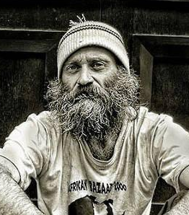
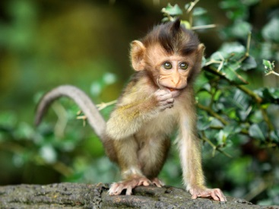

Slide 2
Jeremiah Steepek:
Pastor of a Large Church in the US
Jeremiah Steepek was about to take over as Senior Pastor of a congregation of nearly 10,000
On his first service, he came in dressed like a homeless man, and walked among the congregation.
Just 3 people replied when he greeted them, he received looks of disdain, when he asked if anyone could spare some change for food, no one gave him anything; we the service began, he was ushered to a seat at the very back

Slide 3
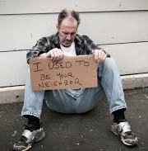
The Big Reveal….
Eventually, the Church Elders announced the introduction of the new pastor
the congregation became excited and start to clap joyfully
then the homeless man that they had rejected walked down the aisle, announcing that he was indeed, the new pastor.
He proceeded to quote from the bible, shaming their judgmental attitudes.
“Today I see a gathering of people, not a church of Jesus Christ. The world has enough people, but not enough disciples; when will YOU decide to become disciples?”
He then dismissed service until next week.

Slide 4
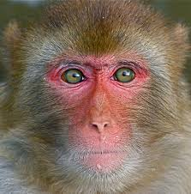
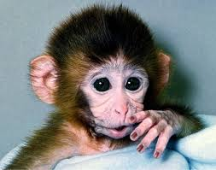
Rhesus Monkeys
Afghanistan, Pakistan, India, Southeast Asia, and China
Troops have been introduced and now live wild in Florida.
Intelligent and adaptable
Some live alongside humans, e.g. India, where Hindus regard them as sacred
Diet: roots, fruit, seeds, and bark, but also insects and small animals.
Live in social troops of up to 200
Medical and scientific research: blood types, went into space before humans

Slide 5

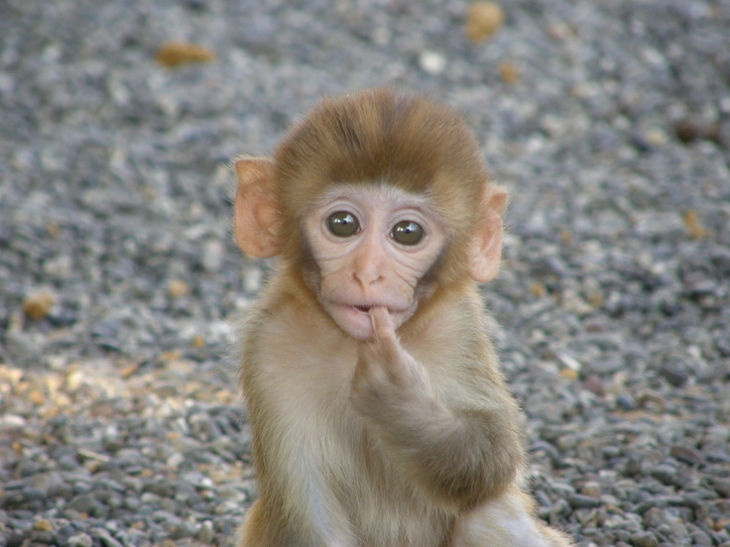

Slide 6
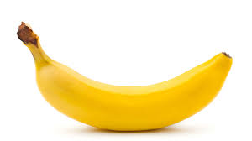
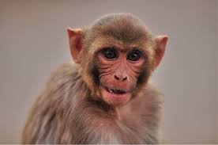

Slide 7
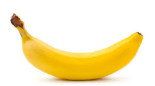
The researcher hangs a banana down from the top of the cage where the monkeys can’t reach it

Slide 8
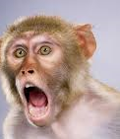

Slide 9
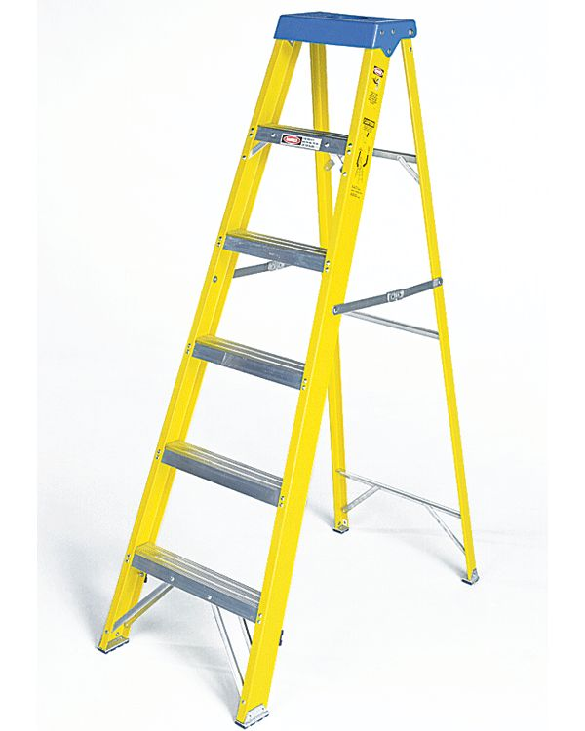

Slide 10
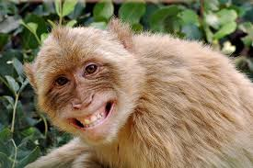

Slide 11
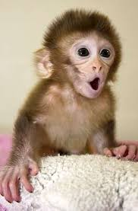
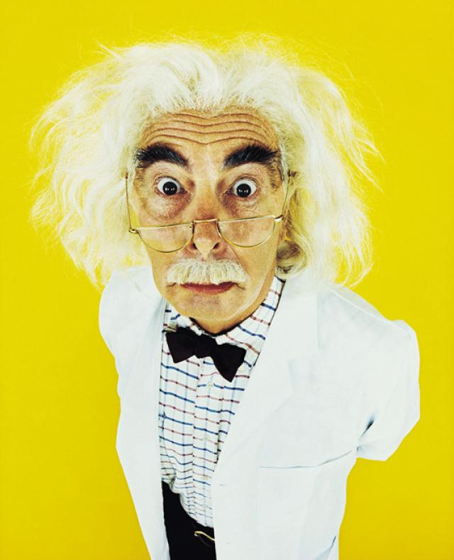
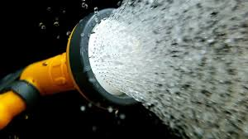
But the researcher was not a very nice researcher…every time a monkey tried to climb the ladder to get to the banana, the researcher sprays the monkey with freezing cold water, and he scurried back down the ladder…

Slide 12
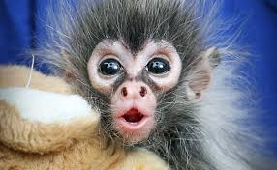
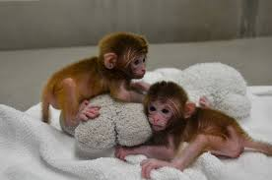
The researcher ALSO sprays the other four monkeys. Soon, all the monkeys learnt that none of them should go anywhere near the banana because they will all be sprayed with icy water.

Slide 13

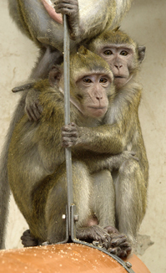

Slide 14
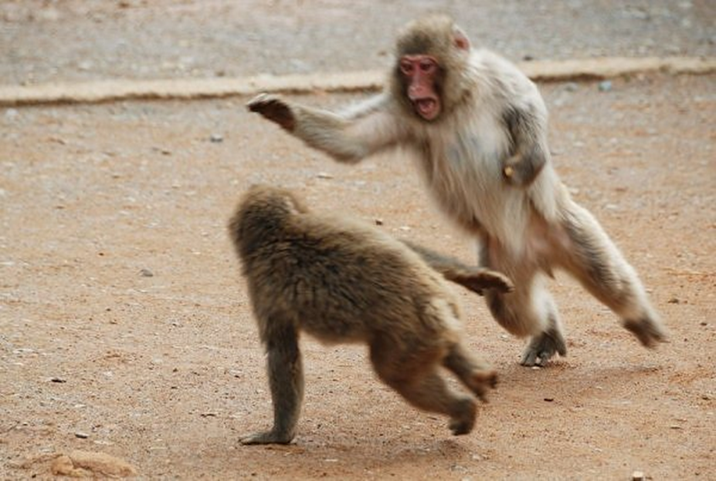
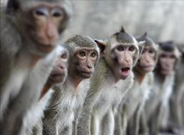
If an individual stubbornly tries to get the banana anyway, the other monkeys will vigorously intervene (i.e., beat him up). The monkeys not only have been conditioned into a state of learned helplessness but now actively engage in behaviors that reinforce that state.

Slide 15

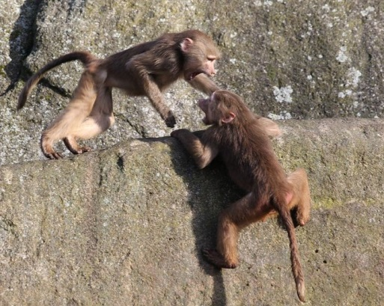
Stage 2
Monkey 1 is removed from the cage and Monkey A, is introduced to the group.
Monkey A has never been sprayed with cold water before so decides to try and grab the banana
Every time he moves toward the banana, the other four monkeys beat him up.
Monkey A has no idea why this happens, but pretty soon he too internalizes the idea that no one should try and get the banana.

Slide 16
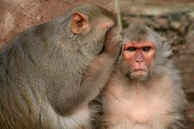
Stage 3
B. What’s he done?
Remove Monkey 2, introduce Monkey B
Monkey B experiences the same thing that Monkey A did: move toward the banana and the other four monkeys start beating you up.
Monkey A joins in the fighting even though he knows nothing about/never experienced the original punishing experience
A. Don’t ask me its…now let ’im ‘ave it!

Slide 17
Stage 4
Keep exchanging monkeys until you have all new monkeys in the cage
By this time, the original reason for staying away from the banana has long been relegated to the dustbin of history - none of the new monkeys have experienced the ice water
Yet, all the new monkeys riotously enforce the prohibition against climbing the ladder because, “that's how we do things around here”….
I wonder if humans behave this way?

Slide 18
“What monkeys can tell us about human behaviour: Michalko (2011)
the 5 monkeys experiment is all over the internet on many blogs, in books and in speeches
the idea that we have “a tendency not to challenge commonly held assumptions” has high currency in education, business and politics
the idea that this idea has scientific support makes it even stronger!
But …

Slide 19
Do you have a reference for that?
asked skeptical primatologist Frans De Waal
Michalko replied that the story was based on the work of Stephenson, (1967)
What he failed to say was that Stephenson actually found rather different results…and his study was rather different too!

Slide 20
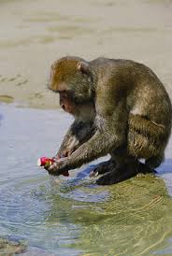
Stephenson (1967)
Potato washing: Japanese macaques on the Island of Koshima; not seen in any other Macaque troop
Learnt fear of cars; observational learning from monkeys who had witnessed humans shooting members of their group
Studies of wild and lab monkeys and fears of snakes;
Stephenson wanted to see whether he could investigate this phenomenon in the lab.

Slide 21
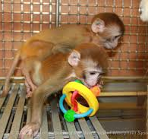
The Real Study
8 lab-reared monkeys (4 M and 4 F)
aged 3, raised with their mums, lots of play in first 2 years of life; socially normal.
1. observe through a one way mirror, in a cage with an object (e.g. plastic cup)
researchers recorded amount of interest shown in the object: touching it, picking it up, chewing it, etc…
Observed on their own with the object to see how often they tend to touch objects in general
2. Half the monkeys are then punished with a blast of air each time they started to touch the object; Two or three air blasts was enough to stop them touching it again!

Slide 22
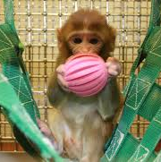
The Real Study
3. Observe with the object to see whether they had learnt/remembered not to touch it (learned response)
4. Observed with another monkey, who had not been punished. No more air blasting was done, to see what they would do if the other monkey went to touch the object.
5. Finally, second monkey observed alone with object to see whether there was any change in how much s/he touched the object having been paired with the monkey who had been punished.

Slide 23
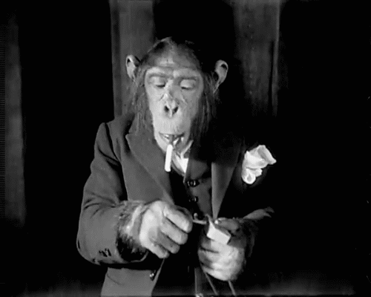
The Actual Results: Gender differences
monkeys varied a lot in how much they manipulated the object; females seemed more engaged with the objects than the males
punished males showed some evidence of attempting to scold the second monkey for touching the object
one actually dragged the other off the object
another made a face associated with threat and displayed certain body language which may have been an attempt to moderate the other monkeys behaviour
They also made sexual advances (maybe to distract them?!)

Slide 24
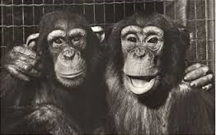
Reconditioning….
punished females watched the second female approach the object and let her explore it
over time the punished females actually showed less avoidance of the object themselves
they learnt from the experience of watching the other monkey explore the object unharmed.

Slide 25
Fiction and the facts; never let the truth get in the way of a good story
The Monkey Story: People accept certain beliefs and actions and conform with emerging norms, (or at least stand by and fail to intervene) even in the absence of any empirical evidence (no first hand experience);
It tells us the story of so called cultural transmission; of “enculturation”; how ideas take hold in the “collective imagination” through lack of questioning of our sources…
Paradoxically, the monkey story has become a cultural meme in its own right…bandied around on the internet, it took hold until a lone dissenter questioned the veracity of the tale…

Slide 26
More deception….
Jeremiah Steepek was made up too; another internet propagated meme, circulating in 2013 and outed earlier this year
The image was a real homeless man from the Richmond, that was copied from tumblr
Moreover, there are no other references to this man on the internet other than the story itself
It bears some resemblance to the story of a real pastor in Tennessee, Willie Lyle, who lived on the streets for 4 days to help empathise with the homeless in his town.

Slide 27
What can we learn from all of this? Learning to ask the right questions
So when, if ever, is it okay to be creative with the facts?
Is it okay, when the story’s message is for the greater good?
Who gets to decide what is “good” and what is bad?
Monkeys and pastors aside, what types of people are led and misled by the memes fed to us by the media?
Who decides which memes are allowed to take a foothold in our “collective imagination”?
Back to the monkeys and Pastor Steepek, why do we assume that newcomers and their actions are inferior, why do we snub them or actively shun them, why are we scared of things we have never experienced?

Slide 28
On a lighter note
“never let the truth get in the way of a good story” (Mark Twain; American author)
“Often, quotes not actually written or spoken by Mark Twain are attributed to him, because it lends those quotes an undeserved respect. Not this one, though. He must have said this one. I mean, look, it has his name after it and everything.”~ Mark Twain

Slide 29
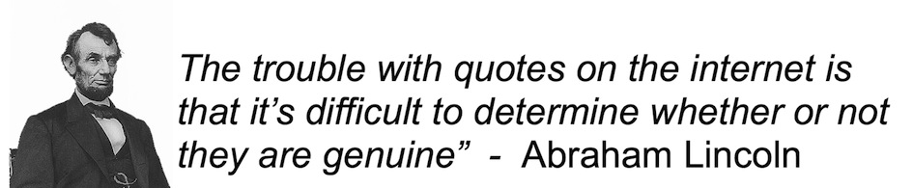

Slide 30
In conclusion…
“On loyalty and consensus”
Think about the monkeys and this…
Bona fide (in good faith) quotes from Mark Twain
"Loyalty to petrified opinions never yet broke a chain or freed a human soul in this world
- and never will.”
That banana could have been the start of something big ☺
The female monkeys in Stephenson’s study were freeing their souls!

Slide 31
Consensus
"Whenever you find that you are on the side of the majority, it is time to pause and reflect."
Think about the original monkeys and Pastor Steepek’s congregation…
Think about why you believe what you believe? Do you always need authentication?
What would you rather be without TRUST or REASON?
What are the benefits of TRUST?

Slide 32
Stephenson’s definition of Culture
“the constellation of behaviours characteristic of a single social group, behaviours which are transgenerational and socially learned by individuals as members of the group”
As we look back at …
Steepak and Stephenson
pseudo-studies and tall tales,
Monkeys, memes…

Slide 33
Let us become architects of a culture equipped to reflect and to question , to trust and to serve, in no particular order….
Thank you for Listening ☺

