Slide 1
Investigating genetic similarity
Twin Studies

Slide 2

Why do Researchers do MZ/DZ twin studies?
MZ/DZ twin studies are useful in determining the extent to which behaviours such as depression are caused by genetic makeup and/or environmental experiences; the nature/nurture debate.

Slide 3

Who are the Pps?
Researchers use secondary data such as hospital records to find samples of MZ and DZ twins where one twin has already been diagnosed with the condition of interest, e.g. depression.
They may wish to check the diagnosis to ensure that the diagnosis is valid.

Slide 4

What happens next?
Next, the researchers conduct a longitudinal study, monitoring the frequency with which the co-twin is also diagnosed with depression.
Researches need to ensure that the same version of the DSM or ICD is used to diagnose the co-twin as was originally used with the first twin.

Slide 5

How are the findings expressed?
The researchers work out the concordance rate, that is the percentage of co-twins who go on to also develop depression for each type of twin, MZ and DZ.

Slide 6
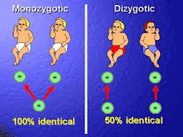
What Does MZ/DZ mean?
Monozygotic twins are genetically identical and come from one sperm that has fertilised one egg; they share 100% of their gene
Dizygotic twins share only 50% of their genes as they comes from two fertilised eggs.

Slide 7

How do you know if the Pps are MZ or DZ?
Twin researchers may complete zygocity tests as just because twins look the same does not necessarily mean they are definitely MZ twins. It is important to check this otherwise the results will not be valid.

Slide 8
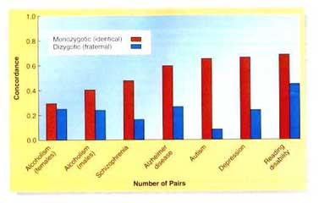
The concordance rates for MZ and DZ twin pairs can then be compared.

Slide 9
WHY ARE MZ/DZ TWIN STUDIES SO USEFUL?
All twins reared together, regardless of zygocity, share the same environment, however only identical (MZ) twins share the same genes.
This means that if the concordance rate for depression is higher for MZ twins than DZ twins, schizophrenia must have a genetic component.
If the concordance rates are similar then environmental factors may be more important in triggering depression

Slide 10
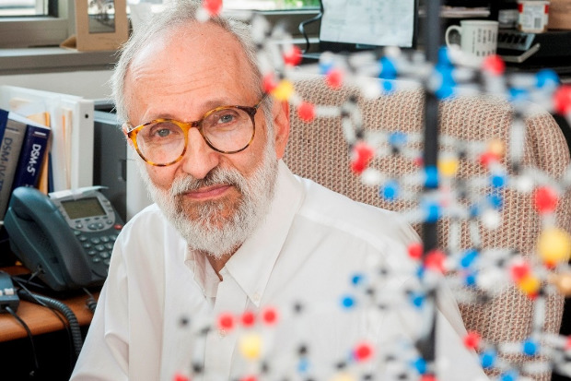
Illustrative example: Kendler(2006)
Aim
  to replicate previous findings regarding the heritability of depression (35-45%) in a large Swedish sample
  To explore whether there are gender differences in heritability of depression
  To see whether the relative influence of genes and environment differ over time, e.g. pre and post war

Slide 11

Kender (2006) -Sample
15,493 twin pairs
from the national Swedish Twin Registry
born between 1886 and 1958
only used twins where zygosity was verifiable.

Slide 12

Procedure:
I’ve made over 15,000 phone calls and forgot to save, noooooo!
Wow
Trained interviewers conducted telephone interviews over a period of 5 years
Interview schedule based on DSM IV to determine whether the participants had experienced major depression
8056 twins met the criteria for major depression at some point in their life
322 twins disclose that they had used antidepressants

Slide 13
Interviewers also asked about life events
  that both twins would have been exposed to when they had a "shared environment" (lived together)
  And as adult when they lived apart, i.e. the "individual-specific environment"

Slide 14
Findings
Correlation of Lifetime Major Depression and Zygosity
Sex and Zygosity | Number of Complete Twin Pairs | Concordance for Lifetime Major Depression
Female-Female, MZ | 2317 | 0.44
Female-Female, DZ | 3185 | 0.16
Male-Male, MZ | 1774 | 0.31
Male-Male, DZ | 2584 | 0.11
Male-Female, DZ | 5633 | 0.11

Slide 15
Conclusions
Depression does have a genetic component (approx. 38%)
Greater for women than men
no correlation between the number of years lived together and lifetime major depression.
no significant differences seen in the roles of genetic and environmental factors in the three cohorts spanning birth years 1900-1958. Even when they split the entire cohort into pre and post World War II, there was no significant difference

