Slide 1
The value of animal models in psychology research
The Biological Extension (HL only)
© Amanda J Wood, 2019
1

Slide 2
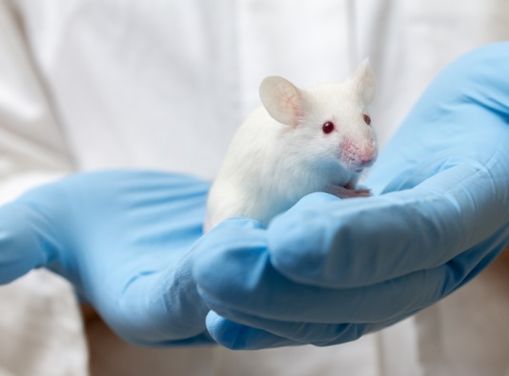
FOR the use of animal Models in psychology: Evolutionary continuity
Non-human animals are similar enough to humans to extrapolate results from one species to another
Green (1994) says the basic physiology of brain and nervous system are similar enough to warrant comparisons
Internal biochemistry works in same way through release of same basic hormones and similar chemical transmitters
Animal models are useful in exploring areas in which it would not be possible to use humans (practical and ethical reasons) and can help to reduce human suffering
© Amanda J Wood, 2019
2

Slide 3
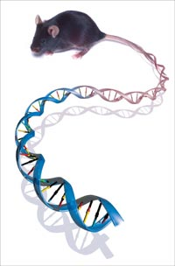
FOR the use of animal Models in psychology: Greater objectivity and control increases validity
  animals do not show demand characteristics and evaluation apprehension in same way as humans; increased internal validity
  can control for genetic inheritance across a sample through selective breeding
  can keep animals in controlled environments so all experiences are documented
© Amanda J Wood, 2019
3

Slide 4
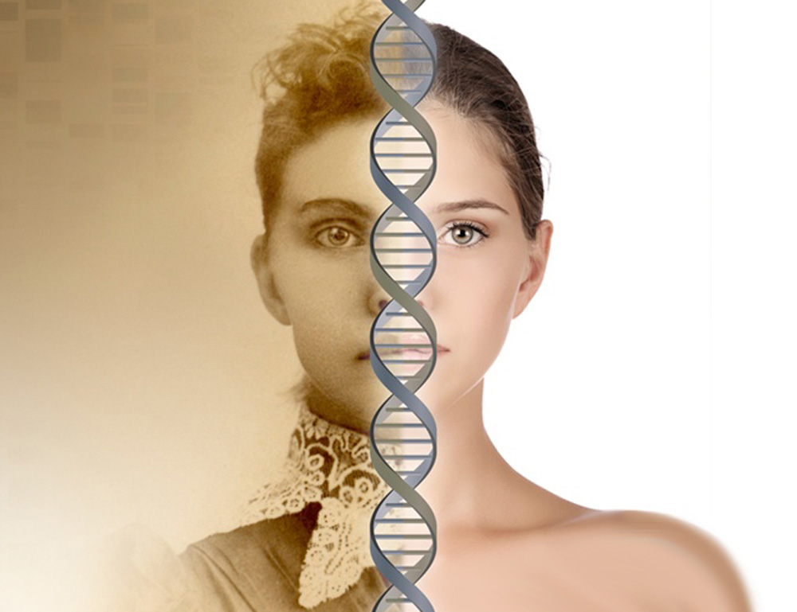
FOR the use of animal Models in psychology: species with short life spans
  Can quickly see effects of exposure to certain biological or psychological circumstances over the full lifetime
  full progress of a disease can be seen quickly
  breeding can occur quickly and inheritance of symptoms monitored over several generations, e.g. lick your rats epigenetic study.
© Amanda J Wood, 2019
4

Slide 5
AGAINST the use of animal Models in psychology: Subtle differences between non-human animal species are revealed every day
  extrapolating to humans must be done with caution;
  researchers are findings differences between the way male and female brains work and such differences within the same species emphasises even more the possible errors that could be made from generalising from one species to another
  Interesting differences in the biochemistry of mice and rats
Just because a part of the brain is used for a certain skills in one species does not necessarily mean it is used for the same function in another;
  human brains are much bigger relative to body size than any other species (encephalisation quotient) and the amount of cortex( the outer layer) is far more developed
© Amanda J Wood, 2019
5

Slide 6
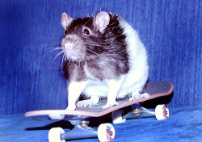
AGAINST the use of animal Models in psychology: Absence of Language
  Only possible to look at behaviours, not thoughts and feeling
  e.g. in depression research you can only observe behaviours such as lack of goal-directed activity and social withdrawal as opposed to feelings of hopelessness/guilt etc.
  Diagnosing the disorder is therefore not possible as they only display certain symptoms
  difficult to operationalise whether a creature is suffering with ‘hallucinations’ from behaviour alone
  need to be inventive in finding ways to assess cognitive abnormalities
© Amanda J Wood, 2019
6

Slide 7
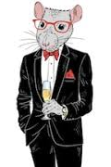
AGAINST the use of animal Models in psychology: Anthropomorphism
  attributing human qualities to animals; we might assume that an animal is behaving in a certain way for the same reasons as a human would behave in a certain way,
  thus we might believe that an animal appears ‘apathetic’ because it is wandering around its cage in a seemingly purposeless manner however it just be getting some exercise!
  we might perceive that an animal is ‘confused’ due to some behavioural sign whereas actually this is not the case
© Amanda J Wood, 2019
7

Slide 8
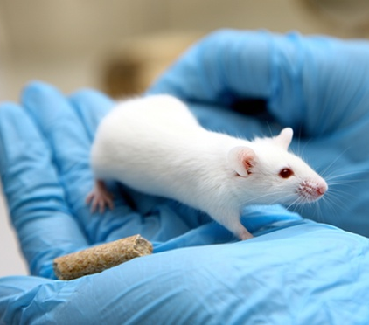
AGAINST the use of animal Models in psychology: Captivity
Being confined, handled and isolated alter the animal’s natural behaviour (thus affecting internal validity)
  it can be stressful for animals and can lead to increased autonomic nervous system activity;
  this could induce abnormal behaviours, e.g. schizophrenic symptoms (in humans there is evidence that environmental stressors may trigger underlying genetic predispositions)
  Research has shown that the gender of the experimenter can affect animal behaviour, e.g. Mogil showed that a male experimenter or even just his t-shirt (and other male animals) decreased a pain response in rodents; the smell heightened level of corticosterone(stress hormone) and this quashed the pain response!
© Amanda J Wood, 2019
8

