Slide 1
The Internal Assessment

Slide 2

How far have you got?
Ashley (HL) – Not started
Nikita (HL) – Not started
Astrid (HL) – Collected data
Chelsea (HL) – Started write up
Gustav (SL) – Started write up

Slide 3
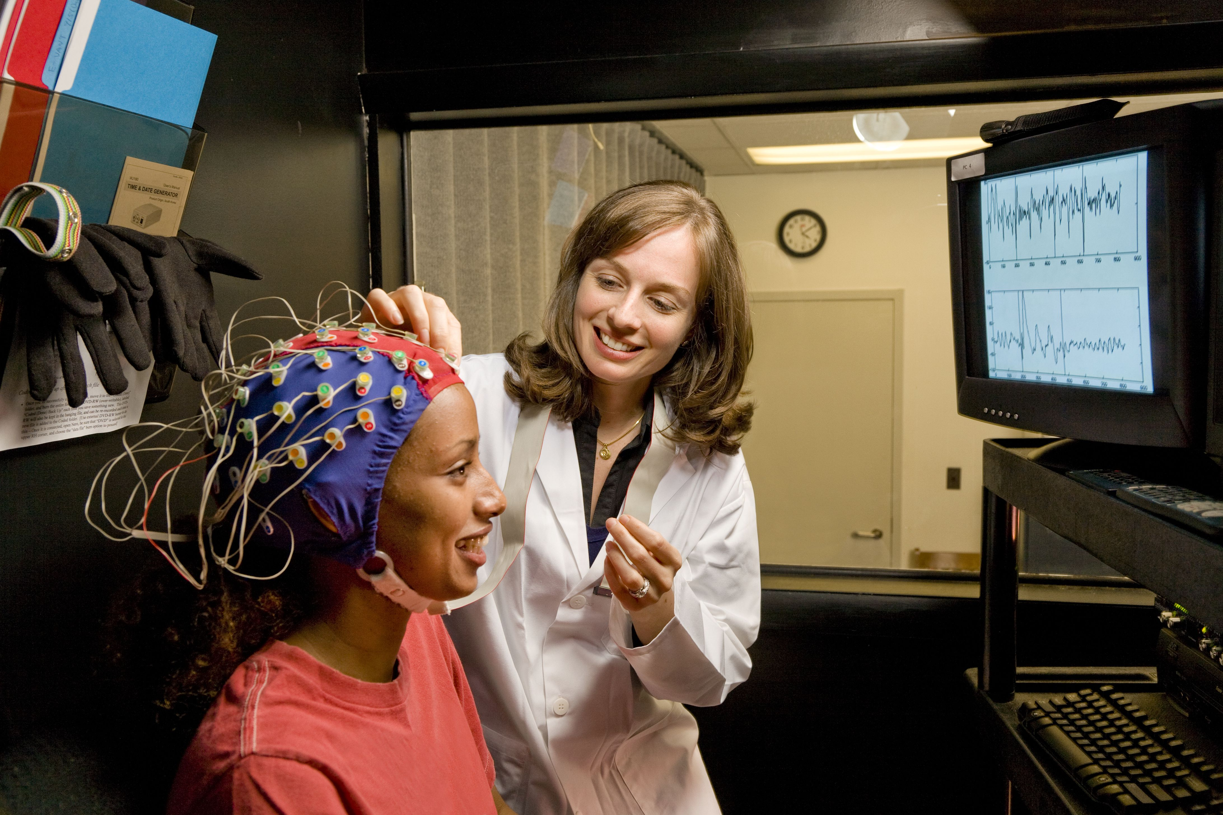
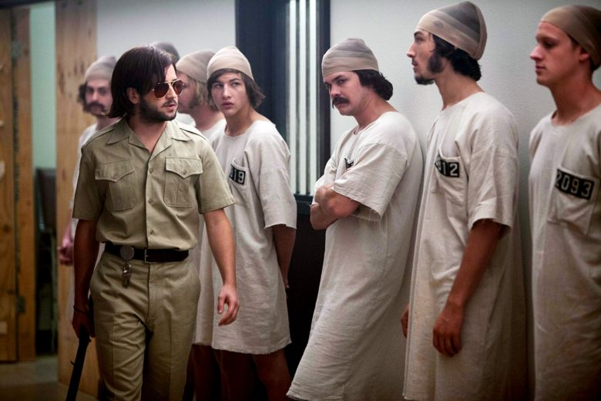

Your IA
Compulsory for both SL and HL students
Application of skills and knowledge in pursuit of personal interests
Requirements are same for SL and at HL
Investigation of a published study, theory or model
Conduct an experimental investigation and report the findings

Slide 4



Working as a group
You must work as a group not on your own; group – 2-4 students no more.
Groups can combine students from different world schools, non-diploma and/or non-psych students
Some aspects of your IA will therefore be the same, e.g. research method, participants, materials, operationalization of IV and DV
As soon as data is collected you are back to working alone again; analysing the data and writing the report
Academic honesty is CRITICAL; malpractice could jeopardise your entire diploma
It is also CRITICAL that your work is ETHICAL otherwise your report could be awarded zero!

Slide 5

Teaching time
Approx 20 hours covering….
  explanation of requirements of the internal assessment task
  Go through the assessment criteria
  review the ethical guidelines
  work on the internal assessment and ask questions
  collaborate in groups
  consult with the groups (and individual students as necessary)
  review and monitor progress, checking authenticity.

Slide 6

supervision
You must discuss your IA with your teacher
You should initiate these discussions and ask questions
Teachers can give advice/annotate ONE draft only before submission
Once report is submitted that’s it, you can’t get it back!
You teacher will be checking for ‘authenticity’;
  Oral viva
  comparing final draft with proposal and first draft, style of writing
  Looking up references
  Some schools use www.turnitin.com

Slide 7

Choosing your topic
investigate an area of interest from any area of psychology.
theory or model on which the investigation is based must appear in a peer-reviewed publication.
link between the study or model used and your aims and objectives must be clear.
the relevance/rationale/reason behind the experiment must be clear.
You don’t want to be bored to tears, but at the same token, keep it simple, follow advice and score BIG!

Slide 8
Off limits
Anything that creates anxiety, stress, pain or discomfort or involves deception, harm, invasion of privacy
Anything on conformity or obedience
Anything involving animals!
Any inappropriate use of ICT, email, internet
Partial deception permissible provided there is no harm, full debriefing and right to withdraw (prior general consent)
Anything involving ingestion, deprivation or placebos
Anything where you cannot manipulate the IV (e.g. quasi experiments on age, language, gender, culture, handedness)

Slide 9

More on ethics
Informed consent and consent forms (no proxi/ presumptive consent)
Right to withdraw at any time.
No under 12s; 12-16 need the written parental consent; if in school also teacher consent
Debriefing and reminder of right to withdraw
Guaranteed anonymity – storing data
Making results available
Any deception explained and justified
Sensitivity to local and international cultures.
Termination of trials
Data must not be used for other purposes
Whistleblowing
Avoidance of any of the many forms of harm

Slide 10

Presentation
The header should contain:
  Title of the investigation
  IB candidate code (alphanumeric, for example XYZ123)
  IB candidate code for all group members
  Date, month and year of submission
  Word count

Slide 11
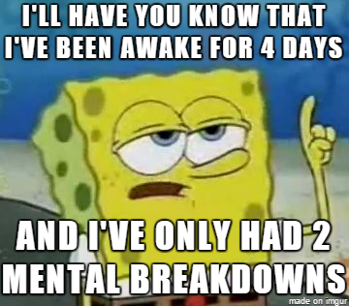
The report
Word count: 1800-2200 words
There will be 6 main sections:
  Introduction (6)
  Exploration (4)
  Analysis (6)
  Evaluation (6)
  References (not in word count)
  Appendices (not in word count)

Slide 12
Appendices
Raw data
Calculations
Consent form (unfilled)
Standardised instructions and debriefing
Materials

Slide 13
My IA booklet

Slide 14
Introduction
the aim of the investigation is stated
relevance is explained (how and why is this replication important?)
the theory or model upon which the student’s investigation is based is described and the link to the student’s investigation is explained.
the independent and dependent variables are stated and operationalised in the null or research hypotheses.

Slide 15
Command terms in the mark scheme
What does described mean?
“Give a detailed account”
What does explained mean?
“Give a detailed account INCLUDING reasons or causes”
This is important BECAUSE…
Why not colour code your introduction to ensure you have covered all areas? Remember to include a key for the colours you have sued to help you and your teacher.

Slide 16
Your Ias: Astrid, Chelsea and Gustav
What was your aim?
What theory are you basing your study on?
How will the finding support/refute this theory/model?
Why is your study important? (relevance)
Are you replicating a published study?
What is your hypothesis/null hypothesis? (t include IV and DV, operationalised)

Slide 17
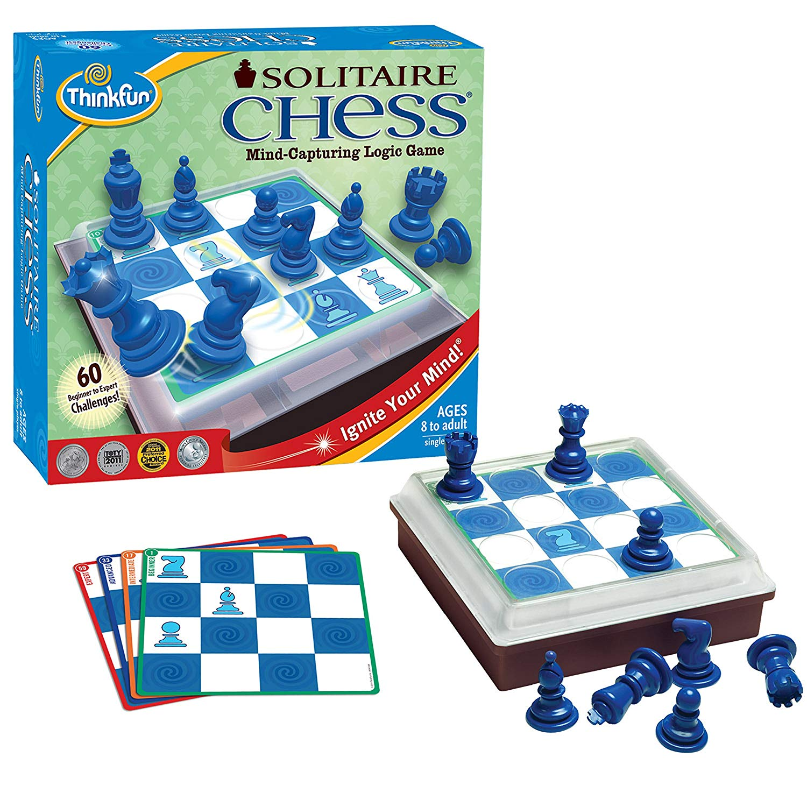
IDEA for an IA: Robbins et al
Idea: Why not build an IA practical based on Robbins et al using ‘solitaire chess’, a simplified chess game
Robbins used a variety of suppression tasks (visuo-spatial and verbal) to see whether they inhibited the ability to reconstruct a chessboard that the Pps has studied for 15 seconds.
Could you design a practical using this game? Take a look and think about its potential ☺

Slide 18
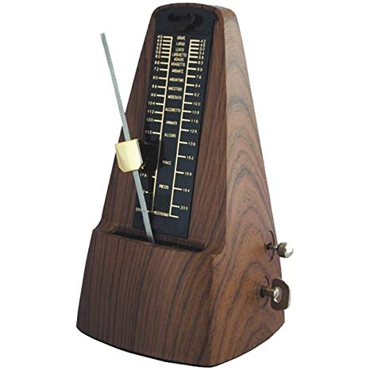
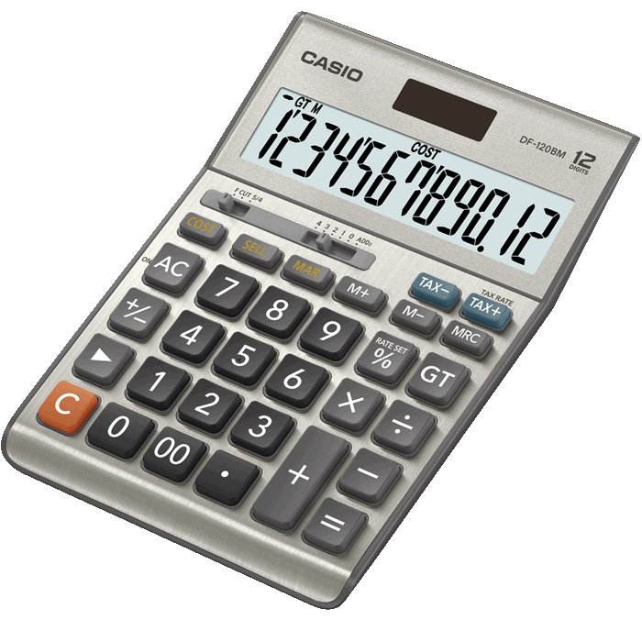
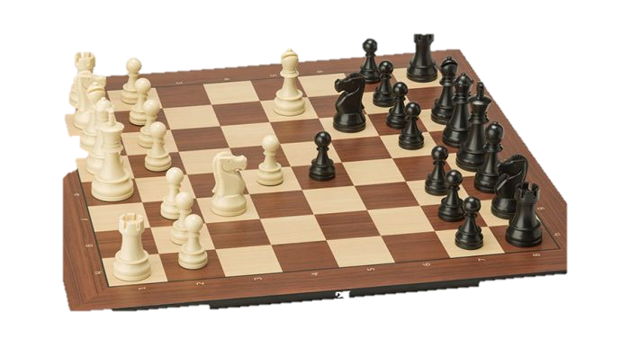
Some of the other things that Robbins needed
https://www.youtube.com/watch?v=wLEgYB6fafE (ticking metronome, 60 beats per minute)

Slide 19
What could you alter in this study? (changing the IV and DV)
They had four conditions of the IV: verbal suppression, visuo-spatial suppression, central executive suppression and control
Simplify to control group and one suppression task.
Think about the visuo-spatial task; could you make this a more visual task and less spatial?
Visual is about colour and shape
What could the person be doing whilst reconstructing chessboard that is visual but does not have a verbal or spatial aspect?
How would you score their reconstructed chess board? You need to get a range of scores so there must be opportunities to score something even for very bad reconstructions! (DV)

Slide 20
Exploration
The research design is explained.
The sampling technique is explained.
The choice of participants is explained.
Controlled variables are explained.
The choice of materials is explained.
What does explained mean?
“Give a detailed account including reasons or causes”
This is important BECAUSE…

Slide 21
Exploration section
Put in the procedure despite the mark scheme.
Roughly 100 words per section; as command term is explain ensure a blend whereby each time you describe something about the procedure, be sure to follow up with this was important because (or words t that effect)
This would mean that in each section you had a round 50 words on WHAT and 50 words on WHY
Try colour coding using RED for WHAT and GREEN for WHY and you will see whether you have achieved the necessary balance.

Slide 22
Analysis: Descriptive statistics
Descriptive statistics appropriate and accurate
Graph correctly presented and addresses the hypothesis.
Statistical findings interpreted with regard to the data and linked to the hypothesis.

Slide 23
Descriptive statistics
Start the section by referring the reader to the raw data and calculations
Include a summary table with one measure of central tendency and one measure of dispersion, e.g.
 | Control | Visual Suppression
Mean
Standard Deviation

Slide 24
Choosing the ‘right’ measure of central tendency
What level of measurement is your data? N.O.I.R.
  Mode - Nominal
  Median - Ordinal
  Mean – Interval/Ratio
Sometimes the mean is not a good measure even if you have interval level data; do you know when it might be better to use the median?
Once you have decided which measure of central tendency to use, you can choose your measure of dispersion, mean and standard deviation, median and range (or interquartile range if you know how to do this);
Unlikely but…if you have nominal data you will use the mode and variation ratio which is the proportion of non-modal cases.

Slide 25
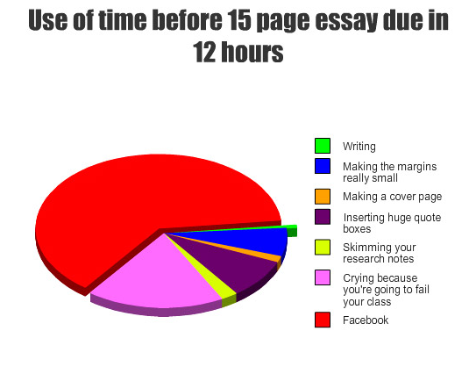
Graphs
The type of graph will also depend of the type of data you have collected, nine times out of ten a bar chart is likely to be absolutely fine, just plot the two means!
If you know how to draw a box and whisker plot this is also a nice way of showing the range, interquartile range and median for each group all on one graph.
Personally, I have always had my students hand draw the graph to show that you know how to do this

Slide 26

Why do we do a stats test?
To determine the probability that the null hypothesis is correct
If the probability is less than 5%, we accept the experimental hypothesis, as the chance that this is not the case is very slim, e.g. there is a significant difference in between x and y.
If the probability is 5% or more, we accept the null hypothesis.
Think! Publication Bias

Slide 27
What does the mark scheme say?
Inferential stats must be APPROPRIATE and ACCURATE
To prove to the examiner that you have chosen the appropriate test, some justification is necessary (why did you choose this stats test?)
Reasons include …
  Why you chose to do non-parametric as opposed to parametric
  Design
  Level of Measurement;

Slide 28
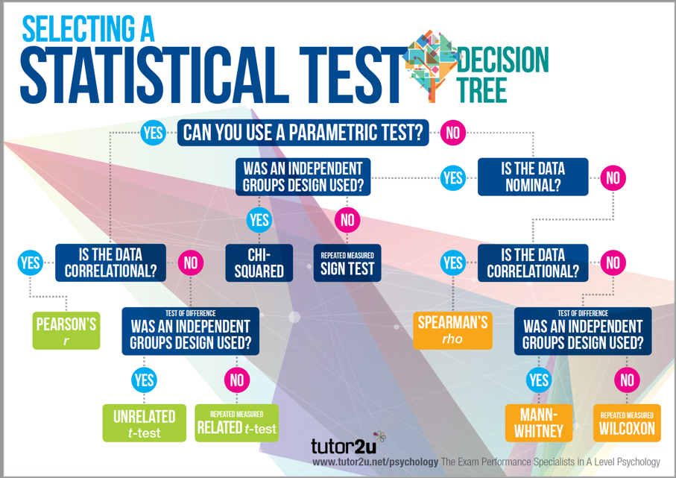
Inferential Statistics

Slide 29
Non-Parametric tests
Due to relatively small sample sizes we have always assumed that the data in the two sets is unlikely to be normally distributed so not done parametric tests.
You simply need to know …
  Do you need a test of difference or correlation? You are not allowed to do correlational research for IAs so this question is answered for you ☺
  Is your data is N or O or I/R
  Was your design independent or repeated? (if matched pairs, treat as repeated)

Slide 30
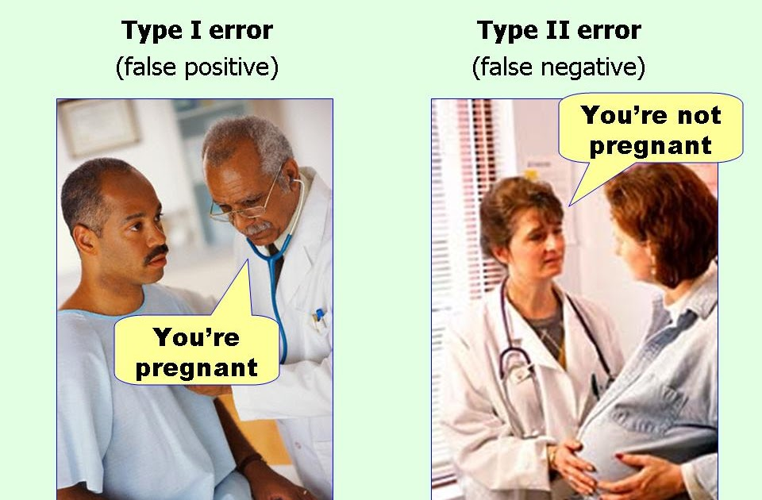
Why do psychologist use 5% as a cut off point?
To avoid type 1 and type 2 errors
  Type 1: accepting the experimental hypothesis when you should have accepted the null (false positive)
  Type 2: accepting the null hypothesis when you should have accepted the experimental (false negative)

Slide 31
Type 1 and 2 errors
What would happen if we set the bar at 1%?
Would we be more or less likely to accept our experimental hypotheses?
What types of error would potentially become more likely?
What would happen if we set the bar at 10%?
Would we be more or less likely to accept our experimental hypotheses?
What types of error would potentially become more likely?

Slide 32
If you have already collected your data…
Astrid, Chelsea and Gustav: What stats test are you going to use and why?
Have you conducted your stats tests already?
Do you need help to do this?

Slide 33
Interpreting the outcome of stats tests
Lets do a stats test to check that we can do this!
When you report the results of the stats test:
As the observed value of U=XX is greater/less than the critical value of XXX (for a one/two tailed test at the 0.05 level when N=XX), this means we can accept/reject the experiment hypothesis that “XX” and accept/reject the null. This means that the probability that the null hypothesis is true or that the results arose due to chance alone is more/less than 1 in 20, (p>/<0.05).
If you’re results are significant at the 5% level you may wish to check at the 2.5% or 1% level.

Slide 34
Evaluation: Mark Scheme
DISCUSS findings with reference to the background theory or model.
EXPLAIN strengths and limitations of the
  Design
  Sample
  Procedure
NB These must all be SPECIFIC and not GENERIC! Use your PETs(H) chain approach
Explicitly LINK modifications to and ensure they are fully JUSTIFIED
Offer a considered and balanced review that includes a range of arguments, factors or hypotheses. Opinions or conclusions should be presented clearly and supported by appropriate evidence.
Give a detailed account including reasons or causes.
P. One strength of the design of my investigation was ….
E. For example…
T. This is important because…
H. However, a limitation of the design was…

Slide 35
Evaluation: Tips
There is a lot that needs to be done here to meet the requirements of the mark scheme, in fact there are at least 10 things!
Firstly linking your findings to the model/theory
And then…
If you are going to make your points well they should be PET chains…and there are probably several things that you will want comment on in the procedure.
Advice: Save words in other places and USE THEM HERE!
 | Strengths | Limitation | Modifications
Design | PET | PET | PET
Sample | PET | PET | PET
Procedure | PET | PET | PET

