Slide 1
Research Methods
Approaches to researching behaviour

Slide 2

How will you be assessed?
In paper 1, you (SL and HL) may be asked about:
‘the contribution of research methods’ from any of the three approaches (bio, cog and socio-cultural) ‘to understanding human behaviour’
In Paper 2, you (SL and HL) may be asked about:
‘approaches to research’
Paper 3 is all about research methods and is only for HL students, we have a separate session for paper 3

Slide 3
Legitimate methods
Write down every single research method you can think of on your mini whiteboards; Circle the ones you think are okay to include in green and the ones you think are off limits in red; leave out any you are not sure of
Experiment (Laboratory, Field, Natural, Quasi)
Interview (semi-structured, structured, unstructured, focus groups)
Observation (naturalistic, covert-overt, participant./non-participant, structured/controlled)
Case study
Correlational
Questionnaires
Content analysis
Twin studies
Adoption studies
Kinship Studies
Brain imaging (fMRI, MRI, PET, EEG)
Animals Studies
Longitudinal and Cross-sectional
Cross-Cultural Studies
Meta-analysis

Slide 4
Research Methods
There have not been ANY methods questions (SAQs or ERQs) yet at all in any approach.
Methods questions can only be asked at the topic level.
In pairs, complete the grid sheets for each research method (features, strengths and limitations with example studies) – collaborative google docs
Each pair start with a different method; rotate features, examples, strength, examples, limitations, examples
Compare the two methods in terms of S and W; Venn diagrams
This will give you a methods ERQ (contrast, evaluate, discuss, TWE)

Slide 5
Bio methods 12 mins
Brain and behaviour – Experiments (Petersen, Draganski) and Case Studies ( Danelli, Burns and Swerdlow)
Hormones, Pheromones and Behaviour– Experiments (can’t find any other types of research method used in pheromone research (observation, interview, case study) Newcomer (cortisol and memory), Kosfeld et al (2005) and oxytocin.
Genes and Behaviour: Quasi-Experiment (Caspi et al)

Slide 6
Let’s check out kosfeld et al
Do you know this study on oxytocin and trust?
If not have a quick think; how could you set up an experiment to test how oxytocin influence trust?
  What would the IV and DV be?
  What would the design be?
  What would the hypothesis be?
  What would you need to control?
Card sort: match the info cards to the key features of an experiment to complete the sheet for biological; hormone and behaviour experiments.
There is a completed version of the sheet but please take on board that information in the boxes needs to be topped and tailed properly into proper PETSH when using the information in an exam answer.
SAQ HW: Describe how and why researchers use one research method to investigate hormones and/or pheromones and behaviour. (9)

Slide 7
Bio Method 2: Case Studies
For example: Burns and Swerdlow, Danelli, SM, HM
SAQ HW: Outline how and why one research method is used to investigate brain and behaviour. (9)

Slide 8
Cog Methods 12 mins
Cognitive processes (memory models, schema theory, thinking and decision-making):
  Experiments, e.g. Glanzer and Cunitz, Robbins
  Case Studies, e.g. HM, KF
Reliability of cognitive processes (reconstructive memory and cognitive biases)
  Experiments: Loftus and Palmer, Kahneman
Cognition and Emotion (FBM)
  Experiments; Cahill and McGaugh

Slide 9
Case Studies: what do you know about this research method?
Features
Strengths
Limitations
Examples from cognitive processes, reliability of cognitive processes and cognition and emotion
The main examples I can think of are from cognitive processes, e.g. HM, KF, LH, MV
Second method for reliability of cognitive processes:

Slide 10
Socio-cultural 12 mins
Individual and Group – (SIT, SCT, Stereotypes) – Drury
Cultural Origins of Behaviour and Cognition
Cultural Influences on Individual Attitudes, Identity and Behaviours (enculturation and acculturation) Focus groups – Lackey et al, Bertram

Slide 11
Interviews: What do you know about this method?
Features – different types of interview
Strengths
Limitations
Examples;
  Drury (SIT)
  Howarth (SIT) – focus groups
  Lackey (Abnormal) – focus groups (look at this in the Paper 3 slot as it also covers inductive content analysis)
  Bertram (Acculturation) – Semi-structured Interviewing

Slide 12
Let’s focus on Drury and Bertram; 2 studies using SSI
Model SAQ using Bertram
Check out the materials for Drury; detailed handout about the study and grid to fill in

Slide 13
Think ERQs!
A classic ERQ here could be something like contrast two research methods used to investigate …
  brain and behaviour
  cognitive processes
  cultural influences on individual attitudes, identity and behaviours

Slide 14
Contrast two methods
Interviews
Experiments

Slide 15
Ethical considerations
Relevance for Paper 1, 2 and 3 and the IA!

Slide 16
Ethical considerations
There have not been ANY ethics questions (SAQs or ERQs) yet at all in any approach
The ethics question that did appear was about animal ethics as part of the bio ext – not human ethics which are part of all three approaches.
Like methods questions, ethics questions can only be asked at the topic level
Lets decide how you might answer ethics questions for Bio, Co and Socio-Cultural

Slide 17
What do you know about ethical considerations
Let’s look at a brief introduction (PowerPoint on my website)

Slide 18

Cost/benefit analysis
Sometimes there might be a cost to society if research is NOT conducted in a certain area;
Sometimes there are hidden costs to society due to findings being used in unexpected ways, contrary to the intention of the original researches
Foreseeable and unforeseeable
Subjective
Cost to Pps
Benefits to Society

Slide 19
Ethics in relation to different methods
Experiments
Interviews
Focus groups
Observations
Case studies

Slide 20
Bio ethics
Brain and Behaviour
Hormones and Pheromones and Behaviour
Genes and Behaviour
Describe one ethical consideration related to one research study investigating hormones and/or pheromones and behaviour. (9)

Slide 21
SAQ Rubric quick Check
You won’t FAIL if you remember this!
Anyway there’s no such things as FAIL: First Attempt In Learning :)
  Focused (engage with command term)
  Accurate
  Informed (substantiated with a study)
  Linked back to question (explicit links between the study and how it explains the behaviour in question)

Slide 22
Quick idea!
remembering names of studies

Slide 23
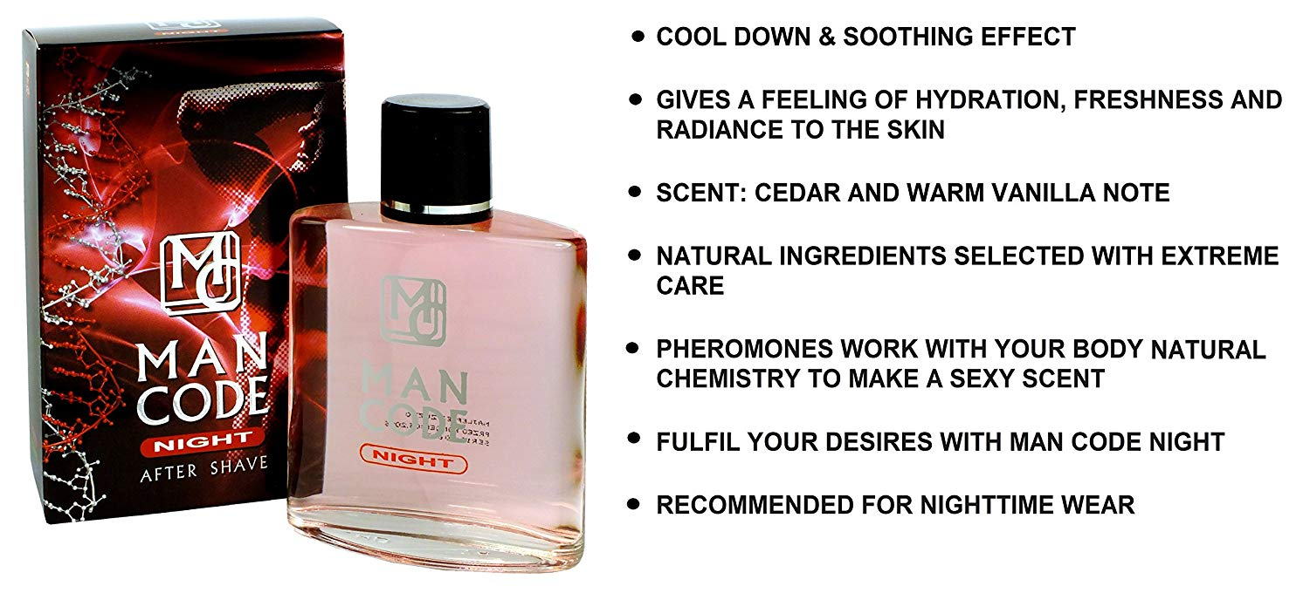
Cutler et al (1998)
So you stink like a cuttle fish, all new Man Code, for men couldn't be subtler? ☺

Slide 24
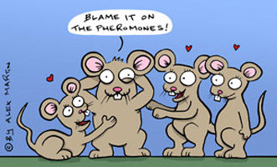

Slide 25

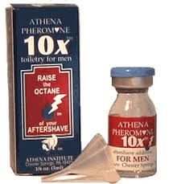
Cutler et al (1998)
A quick google search led me to this:
https://www.vice.com/en_uk/article/vvdkbx/i-wore-pheromones-to-become-a-sex-god
Dr Winifred Cutler, owns Athena Institute who make10x; Raise the Octane of your aftershave https://www.athenainstitute.com/10x.html

Slide 26
Cutler et al. (1988) and ethics
Read the abstract of the study and make notes on ethical considerations relevant to this study
What further information would you want to know about the study in order to answer the question
Which ethical consideration would you choose to go with for an SAQ asking for ONE?

Slide 27
Cog ethics
Explain one ethical consideration with reference to one research study on cognitive processes. (9) Try answering with HM
Explain one ethical consideration with reference to one research study on the reliability of cognitive processes. (9) Try answering with Kahneman et al. (1993)
Explain one ethical consideration with reference to one research study on emotion and cognition. (9) Try answering with Cahill and McGaugh (e.g. deception)
I have Methods SAQs on Experiment for Kahneman and Cahill and McGaugh if you don’t know the studies.
Complete a cost benefit analysis on each study ☺

Slide 28
Socio-cultural ethics
Individual and Group (SIT, SCT, Stereotypes)
Cultural origins of behaviour and cognition (cultural dimensions and effects on behaviour and cog)
Cultural Influences on Individual Attitudes, Identity and Behaviours (enculturation and acculturation)
Go through your studies table and select the best studies to use; match to deception, right to withdraw, informed consent, psychological harm

