Slide 1
IB Wise Psychology
Welcome to Vienna July 2019
Miss Wood

Slide 2
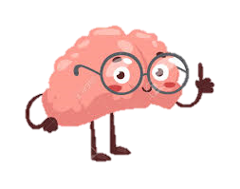

Who am I?
  Graduated 1997 BA (Hons) in Psychology – First Class
  Teaching psychology 22 years
  Brief spell as psychologist with families of children with Down syndrome – 3 years
  Head of Department -12 years (Edexcel, AQA and IB)
  Taught IB – 10 years!
  Trained in Athens, Berlin, Barcelona and Prague
  Good friends with John Crane
  All views expressed are my own (not the IB)
  started www.psychologyrocksblog.wordpress.com in 2016 150K+ views in 2018; 173 countries
  co-authored 4 textbooks for A level Psychology and run teacher training days for Hodder Education

Slide 3

Inthinking log in details
www.student.thinkib.net/group/JKQYZ46
I have created a class on ‘inthinking’ just for us and you should now have access to this resource for roughly one year.

Slide 4
Agenda
Days1-3

Slide 5

What will we be doing?
Day 1: Paper 1 - Biological, Cognitive and Socio-Cultural Approaches
Day 2: Socio-cultural Approach, Research Methods, Ethics and Internal Assessment
Day3: Options (e.g. Abnormal and Health) and Paper 3

Slide 6
Day 1
Paper 1

Slide 7
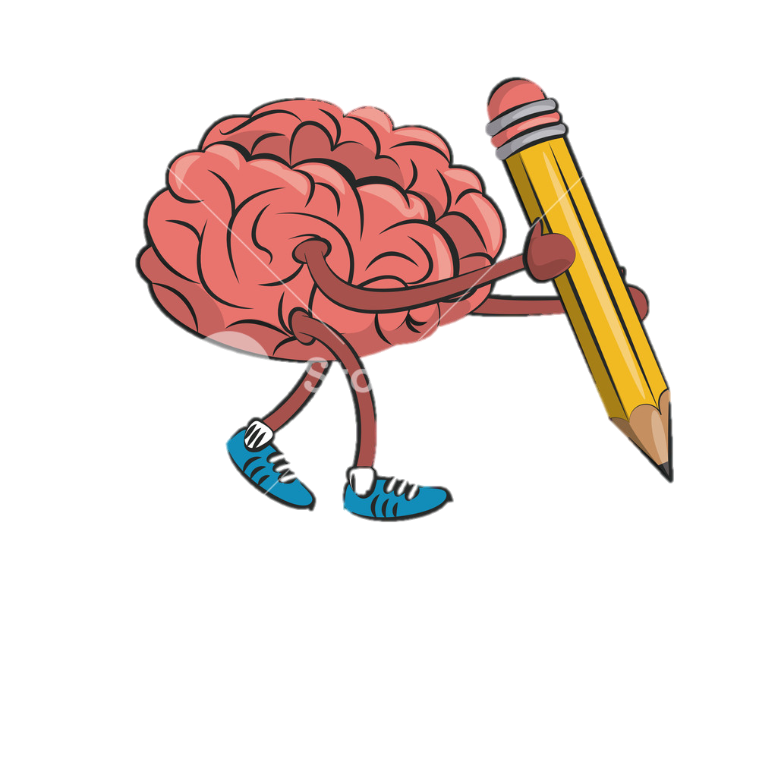
What are we doing today? (1)
9.15 – Biological Approach (HL and SL)
10.30 - Break
10.45 – Biological Extension (30 minutes) HLs only
11.15 - Cognitive Approach
12.15 – Lunch
1.15 – Cognitive Approach
1.45 – Cognitive Extension (HL only)
2.15 - Break
2.30 – Socio-cultural Approach
3.30 – Homework
5.00 – Free time

Slide 8

WHO Are you? Icebreakers
2 truths and a lie!
If I were a fruit I’d be a….
Course Outline: Card Sort
Paper 1: Section A and B

Slide 9
The Biological approach
Paper 1

Slide 10
The Biological approach
25 minutes on each topic
Three topics…
  Brain and behaviour
  Hormones and behaviour
  Genetics and behaviour
Can combine with methods and ethics (as both SAQs and ERQs); we’ll look at this sort of question tomorrow
HLs: topic headings can also be combined with aspects of the extension topic: The role of animal research (after break)

Slide 11

Brain and behaviour
Techniques used to study the brain in relation to behaviour:
ERQ 2019 TZ1 SL
Localization:
SAQ 2019 TZ2 HL and SL
Neuroplasticity:
has not come up yet ☺
Neurotransmitters and their effect on behaviour:
SAQ 2019 TZ1 HL and SL

Slide 12
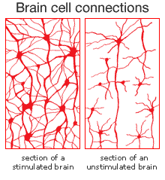
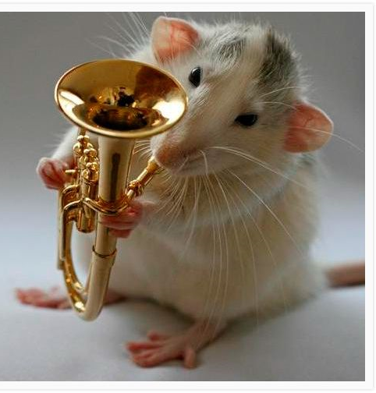
Brain and behaviour
Suspect it won’t come up as SAQ or ERQ as already had several questions on this topic
The only sub-topic that has not come up yet is neuroplasticity so we will focus on this
They also have not asked ANY methods or ethics questions biological approach, let alone this specific topic (we will focus more on this style of question tomorrow)
They might ask one of the new 2020 questions on the lists of specific terms: synapses (excitatory and inhibitory), agonists and antagonists
More likely to ask one of the 2020 key phrase/terms related to neuroplasticity, e.g. neural networks, neural pruning.

Slide 13
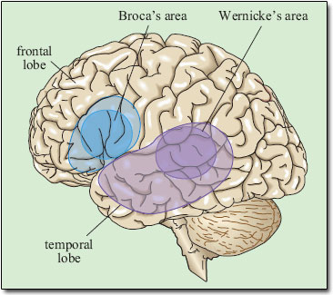
Localisation
Came up as SAQ (2019) TZ2 HL and SL a 9 marker; If it comes up most likely would be as ERQ; I have an example – graded by John!
What, when, who, where, why?!
What is localisation (write it on your whiteboard)?
Who discovered area of the brain linked to language?
Who initially said brain functioning is spread throughout the brain?
How has brain localisation been studied?
Which research methods?

Slide 14
Writing Essays: Level 3 Command Terms
Give an account of the differences between two (or more) items or situations, referring to both (all) of them throughout.
CONTRAST
Offer a considered and balanced review that includes a range of arguments, factors or hypotheses. Opinions or conclusions should be presented clearly and supported by appropriate evidence.
DISCUSS
Make an appraisal by weighing up the strengths and limitations.
EVALUATE
Consider the merits or otherwise of an argument or concept. Opinions and conclusions should be presented clearly and supported with appropriate evidence and sound argument.
TO WHAT EXTENT

Slide 15
Writing an essay: introduction
Let’s look at the rubric for Criterion A. Focus on the question (2 marks)
Markband | Level Descriptor
0 | Does not reach the standard described by the descriptors below
1 | 1 Identifies the problem/issue raised in the question
2 | 2 Explains the problem/issue raised in the question.
Criteria A is 9% of the marks
You should spend around 5 minutes on your introduction
around 125 words

Slide 16
My advice for writing intros
Define key terms
Be enquiring: (Use your W questions (plus How!): What, When, Where, Who, Why?
Make your choices: State which theories/studies you intend to cover
Set the agenda: Tell the reader how you are going to answer the question; this will involve analysing the command term, e.g. if it says evaluate you would think about strengths and weaknesses, to what extent would involve giving one than one perspective and so on.
NB: The intro should directly address the command term (see sheet)
Don’t worry more on how to evaluate etc later!

Slide 17
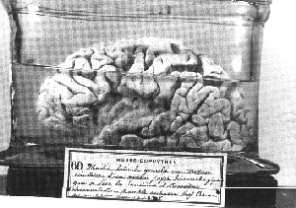
A note about historical research
Subject reports frequently comment that Broca and Wernicke’s research is too outdated and students should be concentrating on more contemporary material
However…in this essay we are asked about ‘the concept of localisation’ so these important historical figures who first conceived of brain localisation have been included alongside contemporary research
shame to leave them out especially where it is hard to see what would count as AO1 other than a definition of localisation and some brain regions which appear localised; otherwise you are going to get into research studies which will be credited in a different criteria

Slide 18
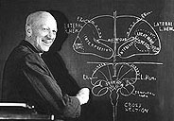
Other localised areas (AO1)
Motor area
Auditory processing
Visual processing
Somatosensory awareness - Parietal lobe, contains a ‘map’ of the human body. Each area of the body has a corresponding brain region which processes touch to the skin in this area. The hands and face have the largest areas dedicated to them as they are the most sensitive.
Frontal lobe
Temporal lobe
Occipital lobe
Parietal lobe, contains a ‘map’ of the human body. Each area of the body has a corresponding brain region which processes touch to the skin in this area. The hands and face have the largest areas dedicated to them as they are the most sensitive.

Slide 19
Remembering what section of the Guide you are in!
You are psychologists; psychologists study behaviour
Localisation is part of the ‘brain & behaviour’ sub-topic
In your essay be sure to remind yourself of the topic you are in and make this plain in the way that you write
Here you could talk about the ways in which damage to specific brain regions brings about changes in specific behaviours, e.g. damage to the frontal lobe can change a person’s personality, turning someone mild and reserved into some one aggressive and impulsive
Skim read the article and highlight specific examples of ways the man’s behaviour changed in one colour and the area of the brain that had been damaged in another
https://www.newscientist.com/article/dn2943-brain-tumour-causes-uncontrollable-paedophilia/
https://neuroscientificallychallenged.com/blog/know-your-brain-orbitofrontal-cortex

Slide 20
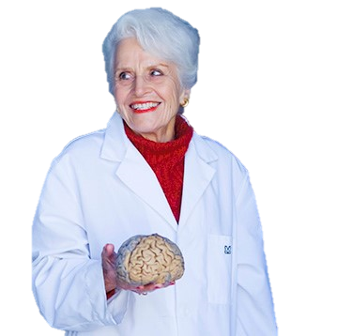
Neuroplasticity
Example SAQ, e.g. Describe one study of neuroplasticity. (9)
The 2020 exams may include SAQs that include some of the specialist terms from the guide’s dropdown menus
For this topic questions could include the terms neurons, neural networks and neural pruning however we are led to believe that this is highly unlikely at this stage
However you could get…
  Explain how neural networks are formed with reference to one research study. (9)
  Explain the process of neural pruning with reference to one research study. (9)
By choosing your studies carefully, you will find you can answer more general and more specific questions with the same study!
Lets focus on Draganski’s jugglers which shows synaptogenesis and neural pruning in the mid temporal region

Slide 21

DRaganski’s jugglers
Let’s have a practice!
Learn/revise key details; write on the juggling balls
  Aim (orange)
  Research Method and Design (yellow)
  Sample (yellow)
  Variables including controls (yellow)
  What did they actually do: procedure (yellow)
  Findings (green)
How do we turn this into excellent evaluation?
Chains of reasoning :) and the research rainbow!

Slide 22
Creating excellent evaluation (AO3)
Remember in your essays you will gain up to 6 marks for …
Criterion C: Use of research to support answer
Mark band | Level Descriptor
0 | Does not reach the standard described by the descriptors below
1-2 | Limited relevant psychological research is used in the response. Research selected serves to repeat points already made
3-4 | Relevant psychological research is used in support of the response and is partly explained. Research selected partially develops the argument.
5-6 | Relevant psychological research (studies) is used in support of the response and is thoroughly explained. Research selected is effectively used to develop the argument.

Slide 23
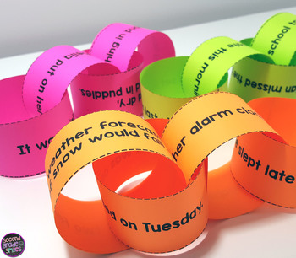
using our AO1 Study knowledge to support and develop an argument
PET/SH | Example | Link to rubric
Make a Point | One strength of x is that it is supported by research evidence | Criterion C – selecting and thoroughly describing relevant research evidence.
Give an Example: | For example Wood et al (2019) documented the case of X who…
Link to Title (key Terms) | This is important because it clearly demonstrates how… | Criterion C –show the examiner that we are using evidence to develop an argument, thoroughly and effectively explaining how and why the study’s findings back up the theory/concept.

Slide 24

And another 6 marks for …
  Criterion D. Critical thinking (6 marks)
Markband | Level Descriptor
0 | Does not reach the standard described by the descriptors below.
1-2 | There is limited critical thinking and the response is mainly descriptive. Evaluation or discussion, if present, is superficial.
3-4 | The response contains critical thinking, but lacks development. Evaluation or discussion of most relevant areas is attempted but is not developed.
5-6 | The response consistently demonstrates well-developed critical thinking. Evaluation or discussion of relevant areas is consistently well developed.

Slide 25

Criterion D: Extending the PET chain –SH!
PET-SH!
Strength of evidence | “This is particularly strong evidence because…” nice specific points drawing on procedural knowledge of the study: GRAVE | Criterion D: introducing well-developed critical thinking by embedding a PET chain about strengths of the study used as evidence. Avoid irrelevant stuff ,e.g. ‘empty’ remarks about ethics. Keeps it relevant!
However… | “Despite strong evidence to support neuroplasticity, it is important to consider research by XXX who suggests that…” AND/OR “This said, the study arguably lacks validity as…thus reducing the strength if the evidence it provides for the concept of neuroplasiticty” | Criterion D: Keeping the argument balanced, developing points using PET as above.

Slide 26


Let’s evaluate Draganski et al
GRAVE; An aide memoire for evaluating evidence from studies (see GRAVE terms handout)
Mix and match exercises; Generalisability, Reliability and Validity (ethics tomorrow)
Web-GRAVE – pair share
Use the writing frames to create three well-developed chains of reasoning using your APFC knowledge to evaluate the study
Now, add to your research rainbow!
“One strength of concept of neuroplasticity is support provided by research studies such as…”
‘topping and tailing’ properly PET-SH!
GRAVE

Slide 27
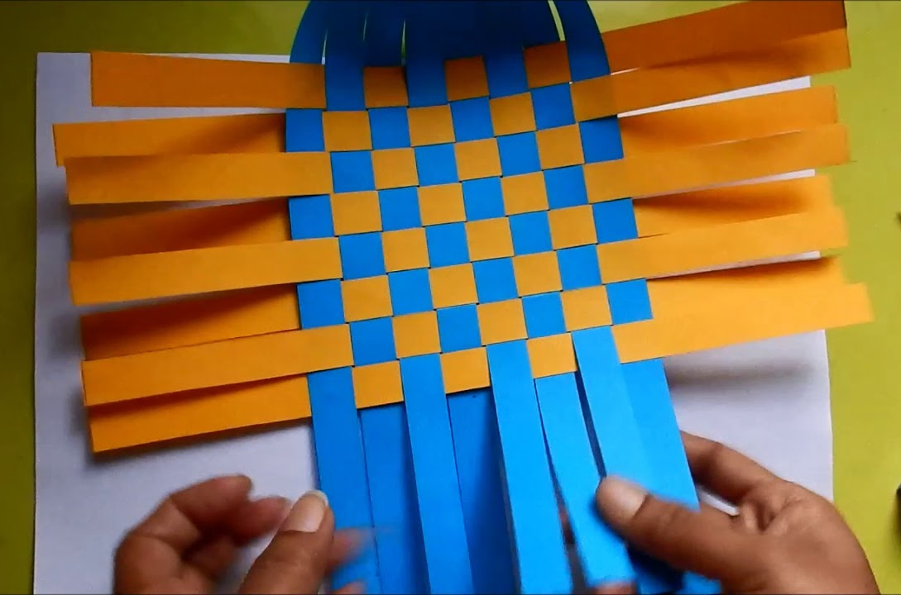
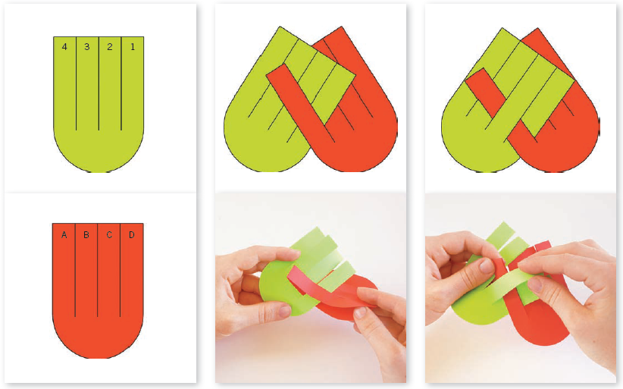
Bringing in Further Studies to develop your arguments
‘Weavily pleased!’ Weaving together an argument takes practice and careful thought
A special kind of essay plan; select two complementary colours (blue and orange, red and green, yellow and purple, bright pink and lime green! – opposites on the colour wheel)
One colour is supporting evidence and strengths, the other is conflicting evidence and weaknesses
Here we will see that when selecting studies for an essay its good to choose studies with different research methods or collect different types of data (qual vs quan) as weaknesses from one study are often outweighed by the other.

Slide 28
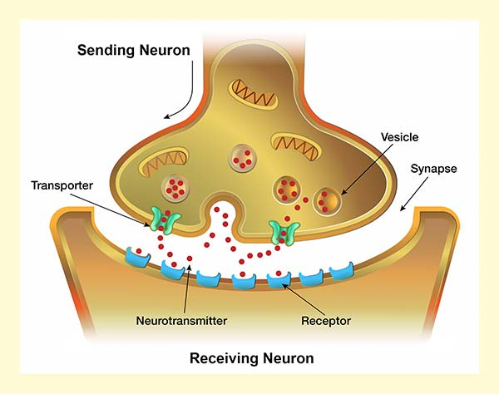
Neurotransmission
Came up as an SAQ in TZ1 both HL and SL
Some have expressed anxiety about writing a whole essay on this topic
We will go over this content again in the Bio Ext and on Day 3 in the Abnormal Option biological explanation of depression
However, for SAQ or ERQ paper 1, I would advice doing acetylcholine and its effect on memory and learning;
Animals studies in SAQs – should you risk it?! Arguments for and against.
We will do a bit on this topic after the break in the ‘biological extension’ slot!
SAQs could but are unlikely to include terms: synapses (excitatory and inhibitory), agonists and antagonists

Slide 29
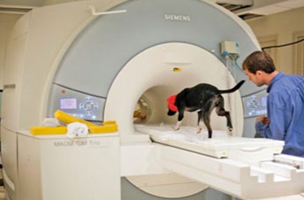
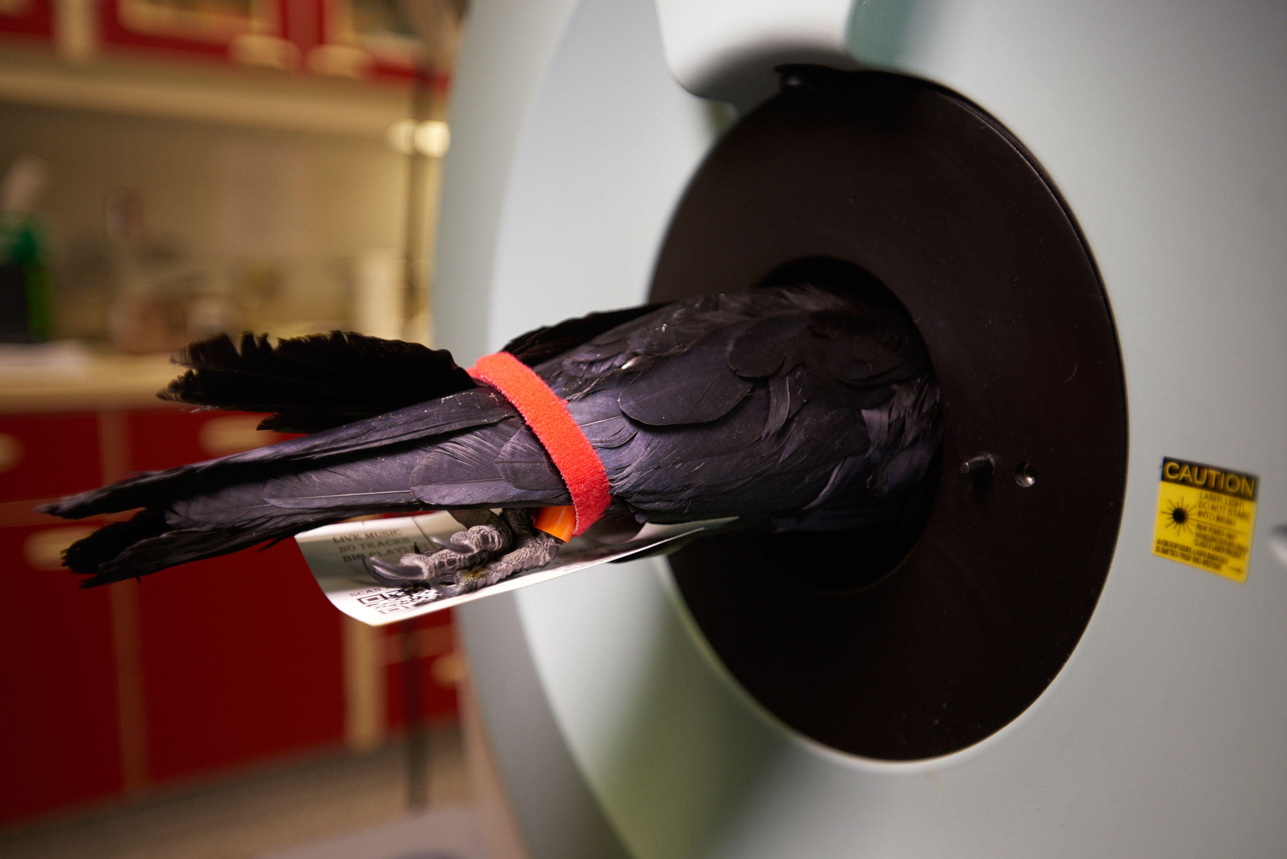
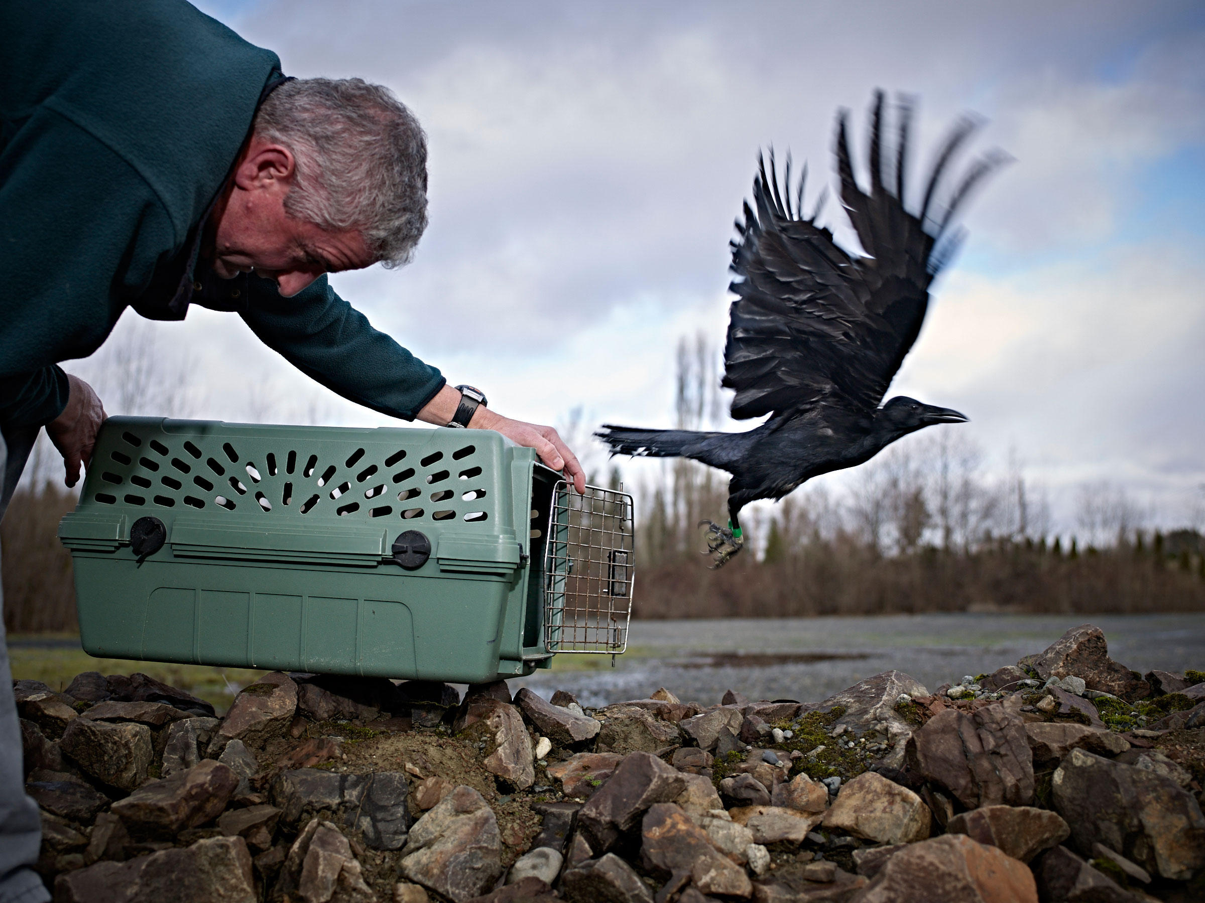
TECHNIQUES for studying the brain and behaviour
Came up as ERQ in TZ1 SL; check mark scheme when it arrives in September.
The IB tell us that “fMRI, MRI, EEG, CAT, PET are the most frequent techniques used to investigate the relationship between the brain and behaviour but observations from autopsy, stroke and accident victims have all contributed to understanding of the brain and behaviour”
“One or more examples of a technological technique used to understand the brain and behaviour can be used.”
Due to lack of time, I won’t spend time on this topic

Slide 30

Techniques versus research mEthods
Techniques for studying the brain are NOT research methods
Do NOT use any of these in a methods question! You will get ZERO!
The IB say you can study one which means they shouldn’t/cannot ask you to contrast two techniques.
Although, you may include two techniques in an essay depending on the question (you will know PET, fMRI and MRI from the studies covered in bio and cog)
Sharot and Phelps: Manhattan Memory Project

Slide 31
Hormones and PHEROMONES and behaviour
Content includes…
  Hormones and behaviour
  Pheromones and behaviour
Hormones have not come up at all as far as I can see!
Pheromones ERQ came up for SLs in TZ2

Slide 32
Hormones and Behaviour
The guide says you only need to study one so which one will you choose?
Are there any overlaps? Yes!
  Adrenaline, Cortisol come into cognitive, abnormal, health
  Melatonin could be useful for Abnormal (SAD)
  Oxytocin comes into relationships
Most of the books seems to focus on Oxytocin; John suggests cutting down the load and focus on ones where you can double up e.g. A and C for cognitive.
For time, we will look at hormones and pheromones in the Bio Ext AND tomorrow in Methods and Ethics and Day 3 in Options

Slide 33
Genetics and Behaviour
Genes and behaviour
Genetic similarity
Evolutionary explanations for behaviour
None of the three content areas have come up for this topic so it is highly likely to come up in the next set of exams! (November)
We will cover this topic on day 3 with relation to depression

Slide 34
The biological extension
The role of animal research in understanding human behaviour

Slide 35
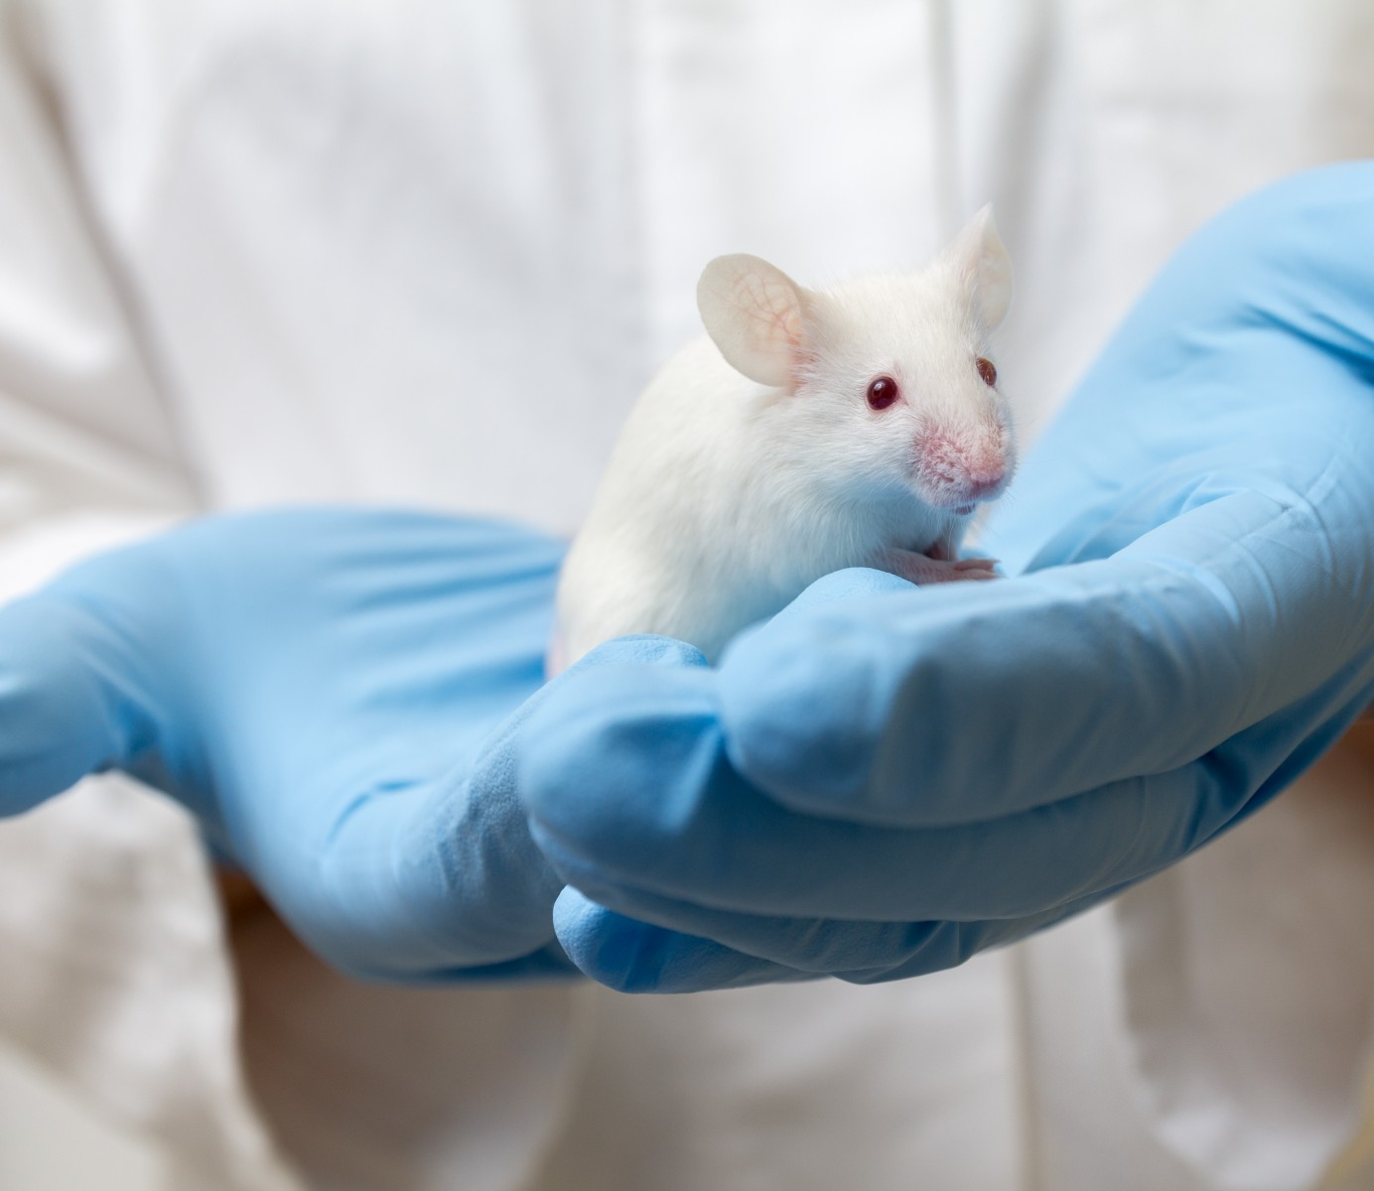
Extensions (HL only)
Paper 1 Section B may include an essay question drawn from one of the bio, cog or socio-cultural extensions, or there may be no extension question at all.
If you are thinking strategically, you could revise just one extension topic as worst case scenario if all 3 HL questions were on the extensions, you would be guaranteed one question per approach.
If you went for this rather risky strategy you would need to be certain that you could answer all possible ways that the question could be asked, e.g. each part of the extension applied to each of the three topics.
Combining bullet points with topics is allowed (but now unlikely), we don’t know about content (but highly unlikely)

Slide 36
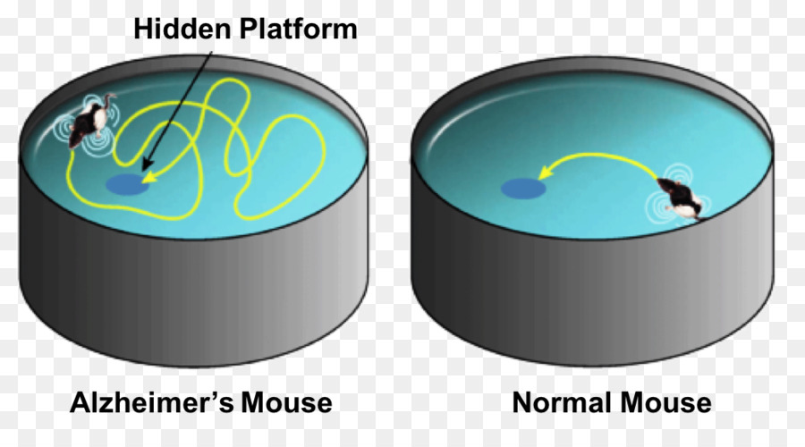
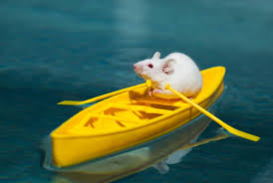
Exam questions so far..
Q4 on the TZ1 and 2 papers were both on the BIO Ext. (Q4 always bio, Q5 always cog and Q6 always soc)
  Discuss two or more ethical considerations in animal research when investigating the brain and behaviour. [22] 2019 HL TZ2
  Discuss how animal research may provide insight into human behaviour. [22] 2019 HL TZ1
As the bio approach extension came up this year, it seems unlikely to come up in 2010; however we can spend some time here analysing how questions might be asked in the other topics based on these questions.
Both questions include key phrase animal research that alerts us to the idea this question is about the bio extension

Slide 37
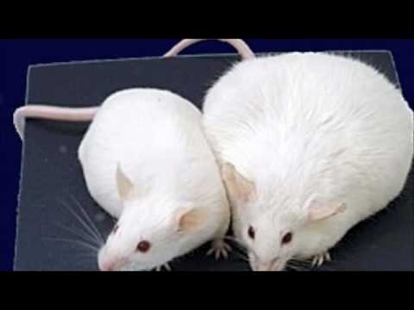
The BIO Extension: The role of animal research in understanding human behaviour
For all three topics in the biological approach, and with reference to research studies, HL students should study the following.
  the value of animal models in psychology research.
  whether animal research can provide insight into human behaviour.
  ethical considerations in animal research.

Slide 38
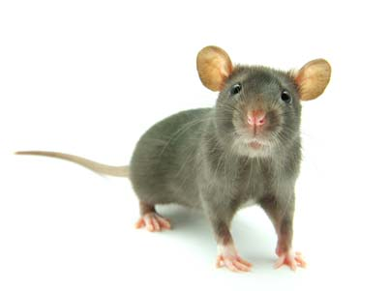
Analysing the exam questions
TZ2’s question was narrowed down to the TOPIC level – brain and behaviour
TZ1’s question was not narrowed down to topic level and was at the APPROACH level
So we know questions can be at approach and topic level;
we don’t know if they can be at the content level. We think not. And may not be at topic level again!

Slide 39
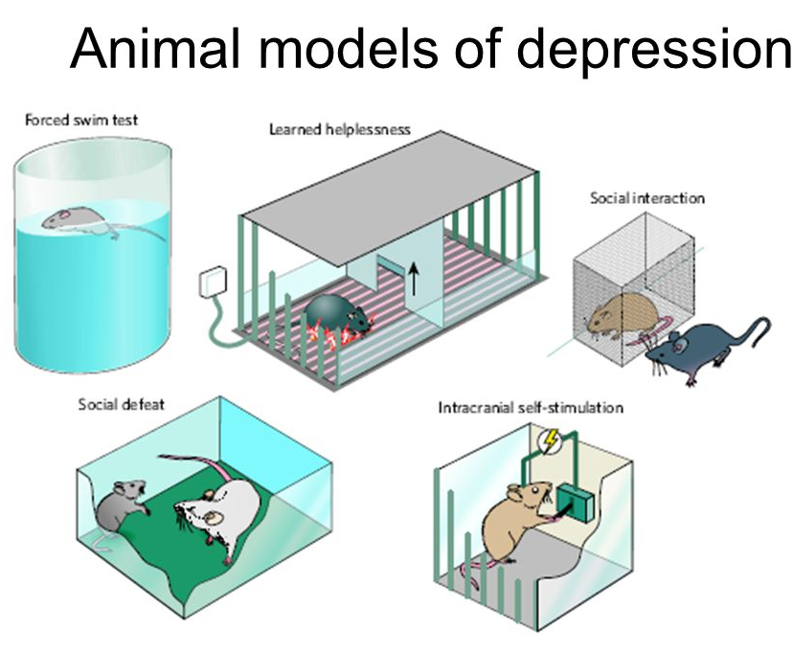
the value of animal models in psychology research
Most likely to come up as not been seen before in either TZ1 or 2.
What is meant by animals models?
Examples:
  B and B: localisation, neuroplasticity, neurotransmission
  H, P and B: hormones and pheromones and behaviour
  G and B: genetics and behaviour, genetic similarity and evolutionary explanations
See PowerPoint on my website

Slide 40

Over to you!
Two groups; each be responsible for one study; 15 minutes to create a short video to describe the APFC of your study
  Rogers and Kesner (2003) – has its own page on John's website
  Piccart and d'Hooge (2008) – see page about Antonova on John’s website
Create an edible image of the synapse to show why memory consolidation is inhibited.
The studies are about the role of acetylcholine (a neurotransmitter) which is important for memory consolidation; they also involve another substance:
  Scopolamine (an acetylecholine antagonist) – it blocks AcH receptors without activating them, meaning the impulse cannot be transmitted

Slide 41
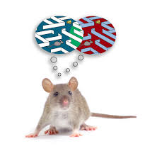
One More study: an acetylcholine ag0nist
Santucci (1989)
experimented on rats using a drug called physostigmine
an acetylcholine agonist
Physostigmine is amplifies acetylcholine transmission
  inhibits enzyme that breaks down acetylcholine; thus more is left in the synapse thus enhancing its effects.
Santucci (1989) demonstrated memory enhancement in rats trained on a passive avoidance task; he found that the drug enhanced memory only when given a short period after training (1.25 hours or 72 hours) but not when it was given 3 or 5 weeks later.
Administering the drug shortly before testing improved retrieval.
Also effective in improving memory in rats with ibotenic acid induced lesions in a brain region rich with acetylcholine receptors (nucleus basalis of Meynert).

Slide 42
whether animal research can provide insight into human behaviour.

Slide 43
ethical considerations in animal research.
Unlikely to come up as was in 2019 TZ2 exam.
Lengthy PowerPoint on my website

