Slide 1
Socio-Cultural Approach
Enculturation

Slide 2
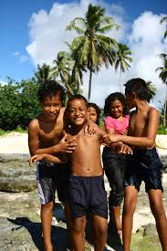
Defining ‘enculturation’
The process of acquiring a culture’s beliefs, values, attitudes, norms, expectations and language
The process by which children come to bear the knowledge, values and practices of the surrounding cultural environment.
Learning the rules (written and unwritten) about what is acceptable/desirable
Agencies of socialisation/enculturation: gatekeepers; parents, peers, education, media, religion, government
An ongoing process throughout life
Similar to cultural transmission

Slide 3

Enculturation: The Process of Becoming
Rogoff talks about enculturation as the process of becoming as opposed to culture acquisition
as children become enculturated they become increasingly able to participate in more and more activities relating to their culture
we become influenced and primed to behave in certain ways due to our experiences of prior experiences of participation.

Slide 4
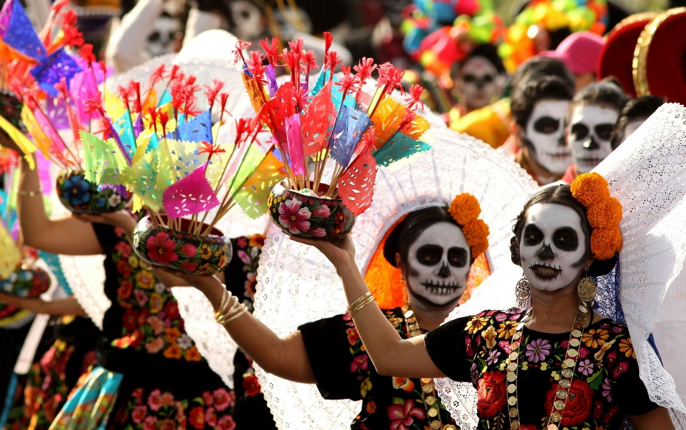
Effects of enculturation
On behaviour:
  Food, clothing, musical , leisure time preferences
  community rituals
  language use
On cognition:
  attitudes about social relationships
  stereotypes, including gender roles
  time orientation
  beliefs about health and illness
  morality

Slide 5

How does enculturation occur?
Enculturation can occur directly through explicit instruction; parents, teachers, employers, etc.
Can be through perspective taking, i.e. putting self in the shoes of other group members (Tomasello et al (1993).
Social learning , e.g. observation and imitation
  Participatory learning: children engage in an activity and transfer the learning to later situations.

Slide 6

SAQ: Study of enculturation: Odden and Rochat (2004)
An ethnographic approach is taken
The study examines the enculturation of children in a rural village in Samoa
The authors were interested in the idea of ‘participatory learning’ through which children become active participants in their cultural environment
  Learning that occurs as a result of increasing participation in culturally specific everyday activities of a given society

Slide 7
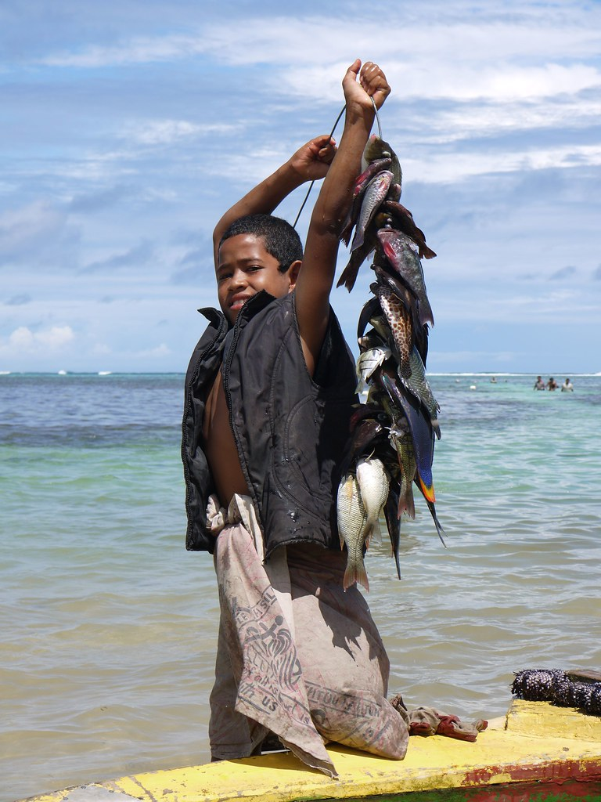
What did they do?
Longitudinal study (2 years) of enculturation of 50 children in rural Samoa through interviews and naturalistic observations.
  28 children aged 4-12
  22 5-12 year old boys and their male relatives were studied to see how they learnt to fish.
152 parent-belief questionnaires plus numerous semi structured interviews

Slide 8
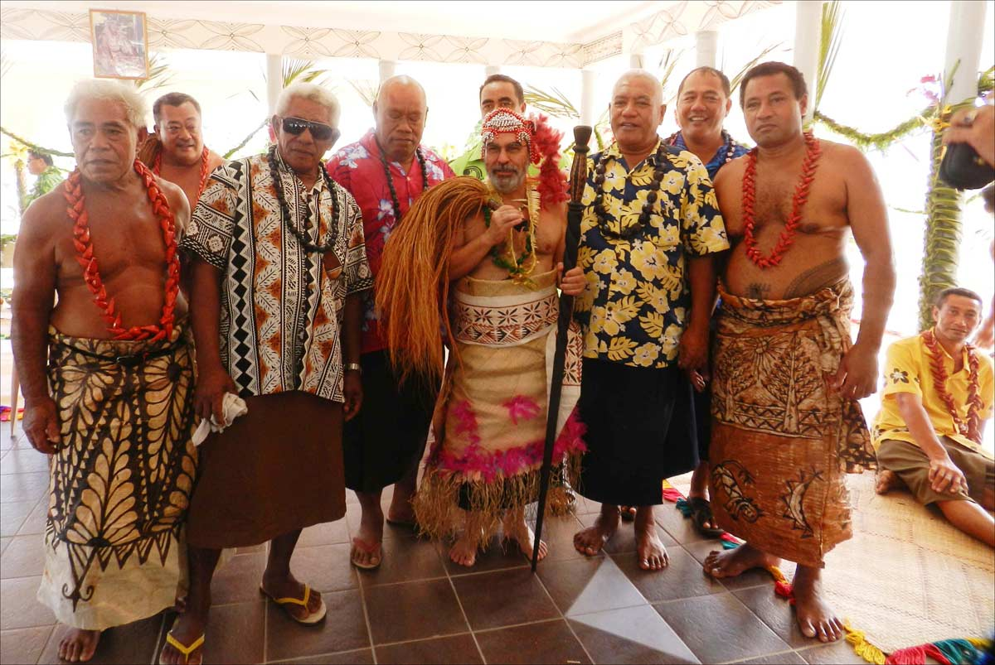
The Aim
to explore what the children understood about the chief system (e.g. their understanding of rank, hierarchy and status)
and how they learnt subsistence skills such as fishing and domestic tasks/chores

Slide 9
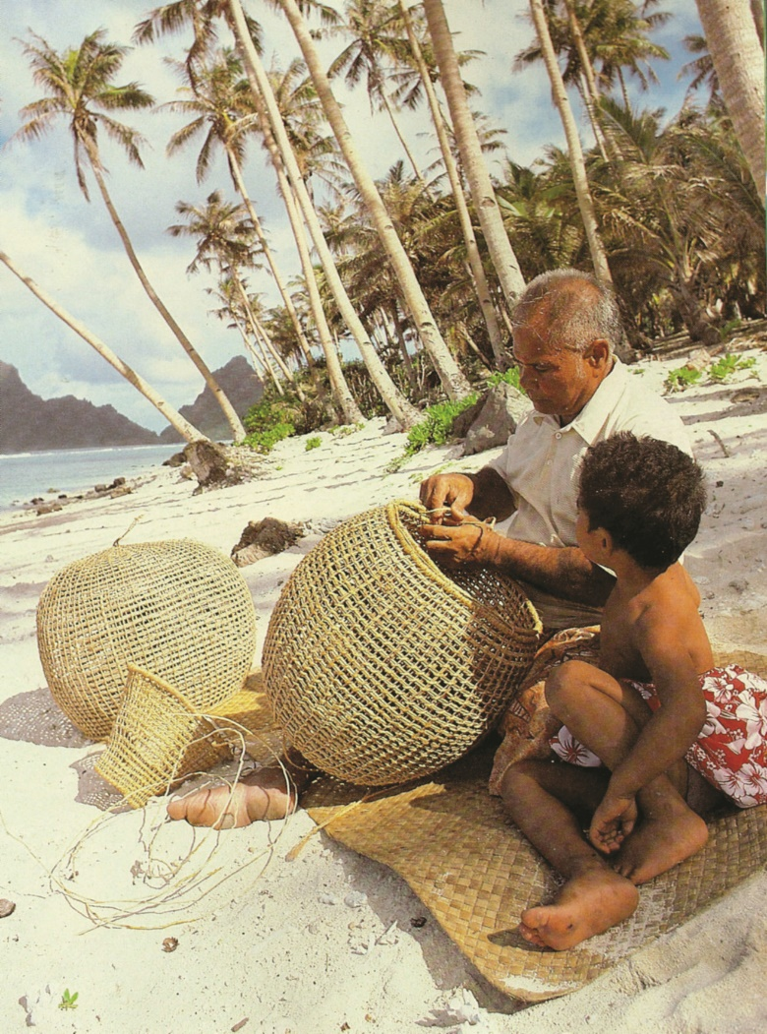
Findings: Fishing
50 examples of children watching adults as they fished
only one example of an adult inviting a child to take a turn.
Some of the children who could fish fairly well revealed that they learnt by watching skilled adults and borrowing their equipment to practice by themselves.

Slide 10
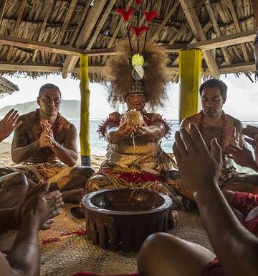
Findings: The chief system
Samoan communities are rigidly ordered by rank with villages chiefs (Matai) being important authority figures.
Interviews: even young children became knowledgeable about the chief system, (e.g. who drinks first at kava ceremonies) via, observation of social gatherings and listening into adult conversations.

Slide 11
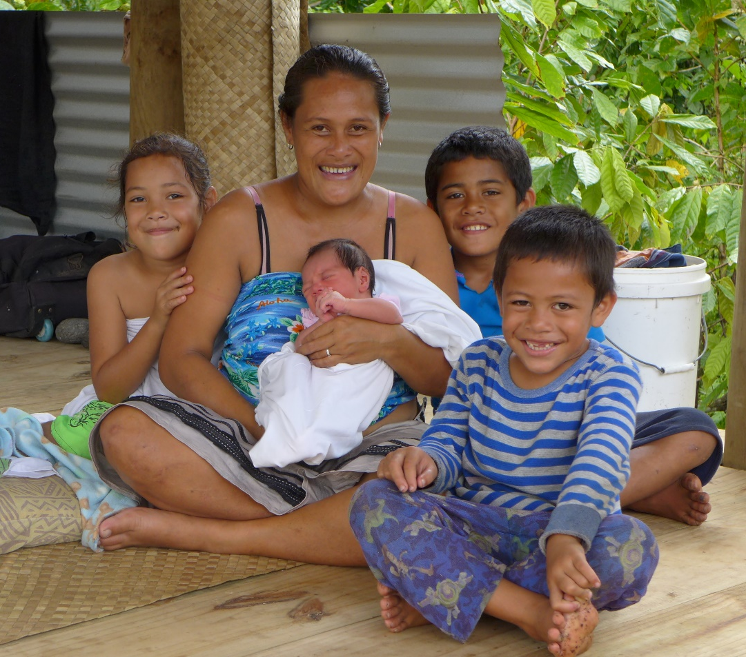
Overall finding
Children are voluntary, casual and peripheral observers
They have little direct involvement in adult activities
they learn their culture by observation and imitation
not through direct instruction

Slide 12
Conclusions
Observation is a potent and central mechanism in enculturation
Children are able to learn values, practices and beliefs, without social scaffolding or intense instruction
Previous focus on the participation aspect has overlooked the role of observational learning.
Education of children from non-Western backgrounds should take account of the needs of such children who may lack the skills to make progress in ways other than via observation;
  teaching strategies need to be differentiated accordingly

Slide 13
Linking Odden and Rochat to Enculturation
This study demonstrates enculturation as …
children successfully acquired culturally relevant skills (fishing) and abstract cultural knowledge (about the chief system) through observation and imitation.
over-hearing was deemed culturally appropriate and children learnt from watching and listening to adults.
due to Samoa’s rigidly ordered social hierarchies, adult/child communication is more limited than in many Western contexts meaning enculturation is more indirect.

Slide 14
This shows that ..
the way enculturation happens depends on cultural beliefs and values governing relationships between adults and children.
Samoan adults clearly have an important role to play in helping children become enculturated as they do in non-Western societies; however children learn in ways which are more passive and place them at the periphery of social gatherings, rather than centre stage as is often the case in more child-centric Western households.

