Slide 1
Socio-cultural Approach: Cultural Influences on Individual Attitudes, Identity and Behaviours
Acculturation

Slide 2
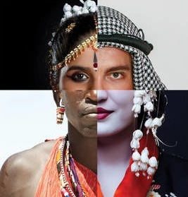
Acculturation
the meeting of cultures and the resulting changes
A process of social, psychological, and cultural change stemming from blending of cultures
effects can be seen…
  at different levels, e.g. societal and individual
  in the original (native) and newly adopted (host) cultures.
As enculturation is used to describe the process of first-culture learning, acculturation can be thought of as second-culture learning.

Slide 3

Formal definitions
Those phenomena that result when groups of individuals having different cultures come into continuous first-hand contact with subsequent changes in the original culture patterns of either or both groups (Redfield et al. 1936)
The progressive adoption of elements of a foreign culture (ideas, words, values, norms, behaviours, institutions) by persons, groups or classes of a given culture. (International Organisation for Migration 2004)

Slide 4

Problems with these definitions
IOM misses the idea that people might reject or resist certain aspects of the host culture and this is as interesting as adoption of elements.

Slide 5
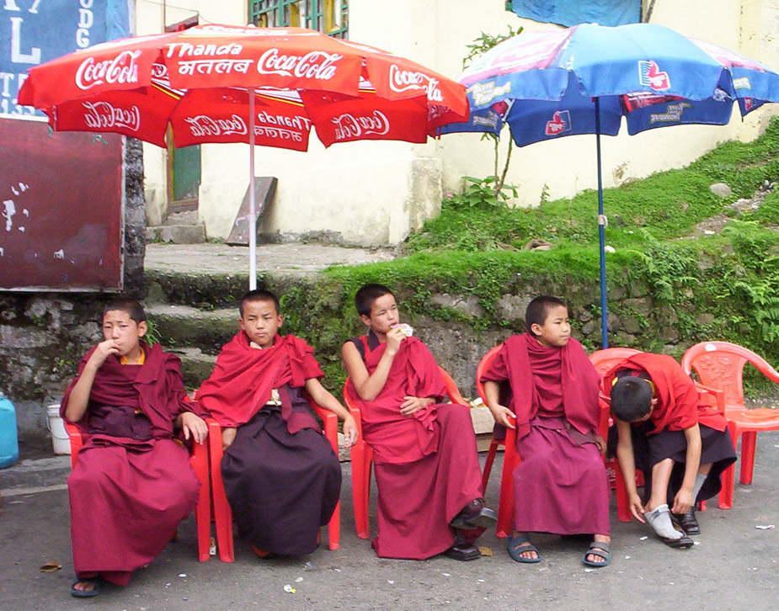
Similar concepts
Bi-culturalism
Multiculturalism
Neoculturation
Integration
Resocialisation
Ethnic identity
Globalisation
‘Westernisation’
‘Coca-colanization’

Slide 6

Primary interests in Acculturation Psychology
What happens when people take the behavioural repertoire they have learnt in their native culture to a different cultural context?
What are the possibilities?
  They don’t change and become maladapted
  They change and become adapted
  Some behaviours change and some don’t!

Slide 7

What is affected by acculturation?
Group level: customs, religious practices, diet, healthcare, education, food, clothing, language
Individual level: affects the socialisation process by which ‘non-native’ individuals adopt the values, customs, norms, attitudes, and behaviours of the dominant host culture
  May include changes in daily behaviour, plus numerous changes in psychological and physical well-being.

Slide 8
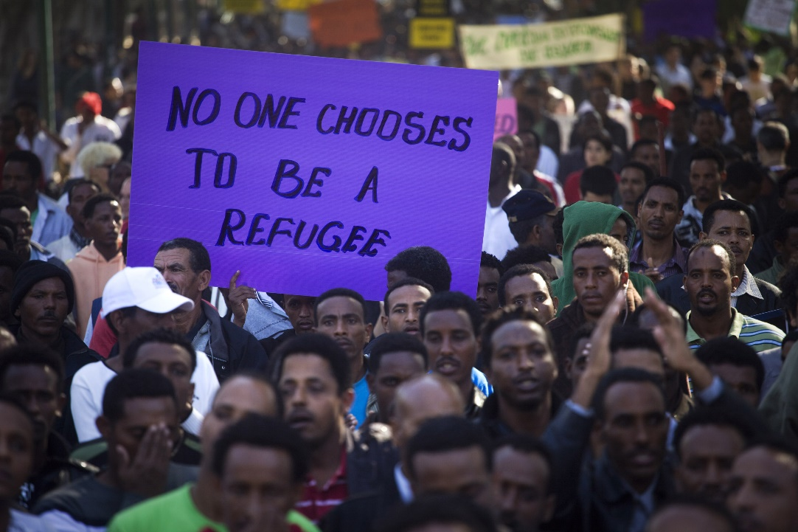
Why do people end up being exposed to second/multiple other culture(s)
Immigration; seeking a ‘better’ life
  financial reasons
  fleeing from a natural disaster
Seeking asylum from persecution or war
Sojourners (temporarily living in a certain place)
To trade, conquer or colonise another country
For an adventure or fun!
Indigenous people

Slide 9
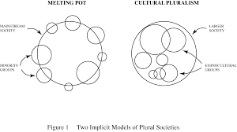
Plural societies
A society in which a number of cultural groups reside together within a shared social and political framework (Skelton and Allen 1999)
Maybe organised as…

Slide 10
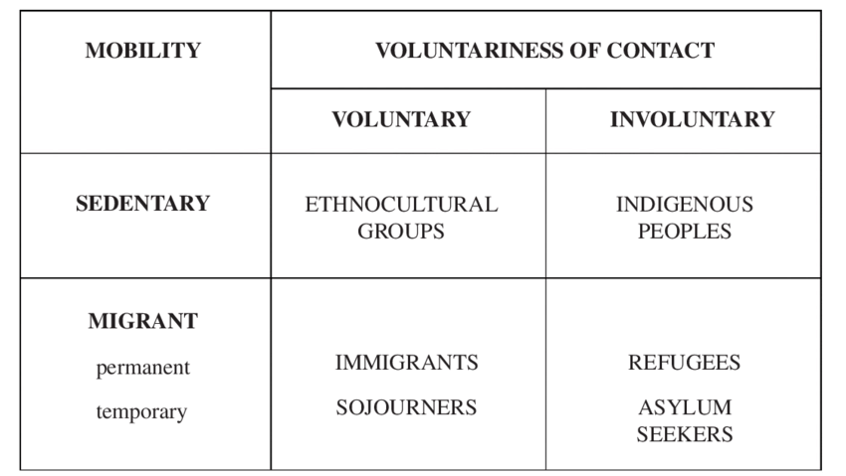
Varieties of groups in plural societies

Slide 11
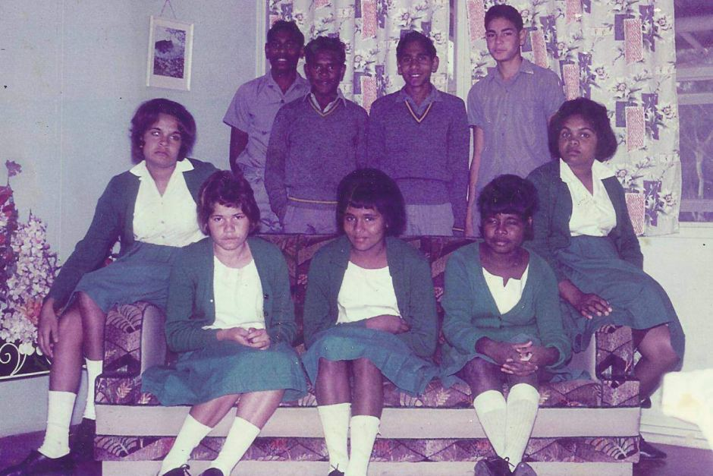
Factors affecting acculturation…
Is the contact with the new culture…
  Voluntary (immigrants) or involuntary (e.g. refugees)
  Sedentary (indigenous people) or migrant (refugees, immigrants)
  Temporary (e.g. sojourners) or permanent (indigenous people)

Slide 12
Three types of acculturation (Borgardus 1949)
Blind acculturation: two cultures affect each other on a chance basis
Imposed acculturation: forced imposition of one culture upon another as in colonisation
Democratic acculturation: members of each culture view the other with respect

Slide 13
History of acculturation research
Philosophy: Plato talked about the human tendencies to travel and to imitate strangers; acculturation not seen as a good thing - laws were put in place to preserve Greek culture
Ethnography: John Wesley Powell coined the term and in 1883 defined "acculturation" as the psychological changes induced by cross-cultural imitation.
Anthropology– interest in affect of colonisation of indigenous peoples
Sociology - studies of immigration

Slide 14
Psychology and Acculturation
Only in last few decades (1980s+)
  Vast increase in worldwide migration
    improved travel
    disasters (natural and manmade, including political, ethnic and religious violence)
    urbanisation; people moving from rural areas into cities
  Cross-cultural psychology has forced psychology as a whole to acknowledge the importance of culture as a critical determinant of human behaviour

Slide 15

Statistics
Find out…(this could be globally or in the UK)
  how many people are living in a culture other than the one they were born in?
  how many second generation immigrant children are there?
  how many people are studying in a ‘host’ country?

Slide 16
The ‘Building Blocks’ of Acculturation
1. Contact; ‘continuous and first-hand’ – living alongside people, internet communication, mass media
2. Reciprocal influence; groups differ in terms of power, e.g. economic/military/sheer number and this affects how much influence one group has on the other
  Often there will be a dominant group which is more influential
  Changes in the dominant culture are just as important to study
  Dominance is an important factor affecting rate and direction of acculturation

Slide 17
Building blocks of acculturation
3. Change: psychologists may study the ‘process’ by which change comes about and the ‘outcomes’, i.e. what the actual changes are.
  Cross-cultural studies useful to study outcomes, longitudinal studies necessary to study process
  not always possible to infer that a change is due to acculturation as it may well be an ‘ontogenetic developmental’ change (e.g. as a consequence of interaction with the environment in general not the new culture as such)
  Changes may be affective, behavioural or cognitive (Ward 2001)
    Short term; behavioural shifts and acculturative stress
    Long term; adaptation which can be psychological (to do with wellbeing and satisfaction) and socio-cultural (culturally appropriate skills to fit in with the cultural milieu

Slide 18
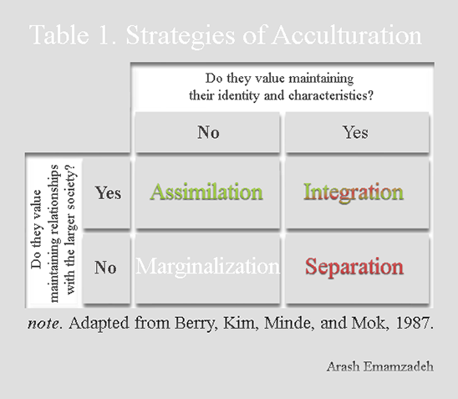
Acculturative possibilities
‘Bi-dimensionality’ term used to recognise the two dimensional nature of change, e.g.
  maintenance/loss of old culture
  adoption/rejection of new culture
4 possibilities
  To adopt the new culture and lose the old (assimilation)
  To adopt the new but also maintain the old (integration)
  To reject the new and maintain the old (separation)
  To reject the new and lose sight of the old (marginalisation)

Slide 19
The Process of Acculturation
Originally it was conceived of as linear and stage-wise (Gordon 1964 seven stages)
More recently it has been accepted that the acculturation may be ‘segmented’ (Portes and Rumbaut 2001)
Acculturation process is affected by..
  Social class differences between native and host
  Time of arrival
  Context of reception
It is now recognised people may be at different stages and using different acculturation strategies with regard to different social aspects of their lives (i.e. in terms of different sub-cultures within the host culture)
Also, publically and privately people may reveal different behavioural, affective and cognitive changes

Slide 20
Problems in acculturation research
Operationalising culture in the first place!
Assumptions that cultural differences exist between the groups
Assumption that representatives of the cultures will embody national values, etc. associated with cultural dimensions for the home country for example.
It is essential to understand the cultural context in which acculturation is occurring as the context of reception for example is a critical factor affecting the process and outcomes
There is little research on acculturation in cyberspace or via mass media, although the psychology of remote acculturation is taking off, e.g. Ferguson and Bornstein 2012
Snauwaert et al. (2003) when culture and related concepts are operationalised in different ways , different distributions of acculturation strategies were found

Slide 21
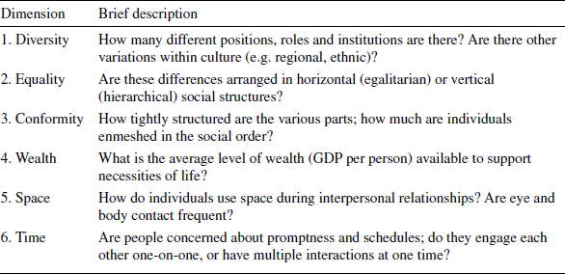
Factors affecting the acculturation process, (Berry 2004)

Slide 22
Cultural distance
When the two cultures are increasingly different to (distant from) each other, acculturation is likely to be more difficult and more likely to result in acculturative stress and difficulties in adapting long term.
Physical difference, e.g. skin colour can also affect acculturation strategies, e.g. people of a different appearance to the dominant group may be less likely to opt for assimilation due to fear of rejection/discrimination

Slide 23
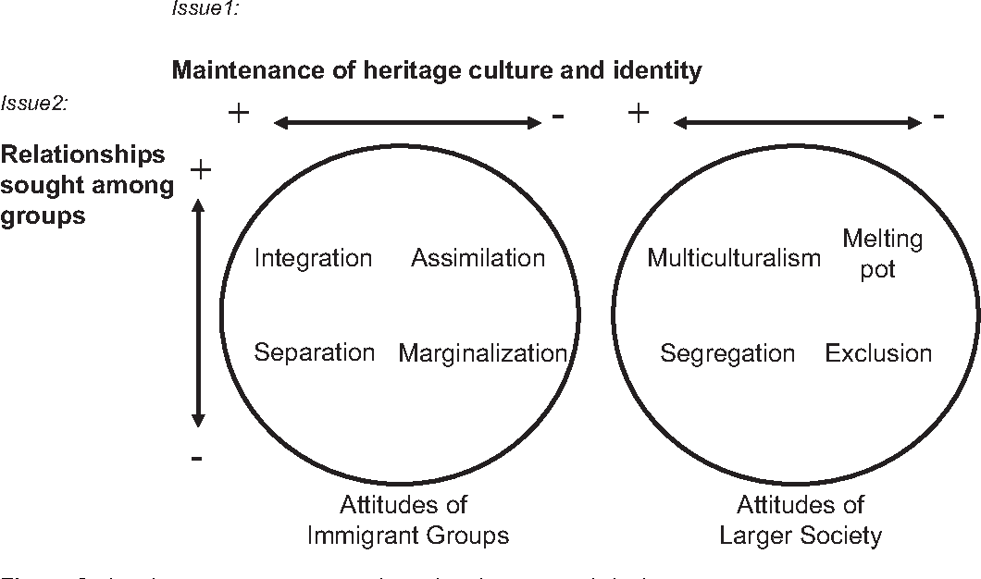
Factors affecting individual acculturation
Strategies adopted by the larger (dominant) society will affect the individuals from non-dominant society, for example if the society attempts to enforce assimilation or embraces and encourages multi-culturalism, e.g.

