Slide 1
Conformity
With reference to alternative studies, critically assess Asch (1955)

Slide 2
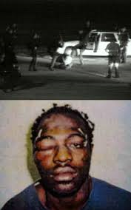

Slide 3
3 of the 4 cops were found
“NOT GUILTY”
The verdict stunned the nation and triggered a storm of anger leading to arson, looting and rioting in Los Angeles in 2002.
Virginia Loya believed the cops were guilty of the charges yet eventually went against what she knew to be right and changed her decision from guilty to not guilty in line with the majority (Eysenck, 2004)
She later said “ the tape was the big evidence for me. They (the fellow jurors) couldn't see. To me they were the people who were blind, they couldn’t get their glasses clean.

Slide 4

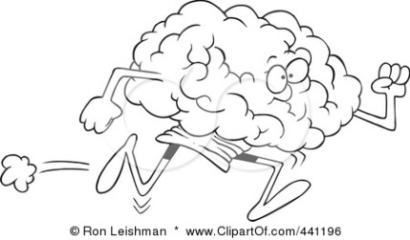
Learning Objective: With reference to alternative evidence, critically assess Asch’s (1955) research
First of all, I will ...
Select studies to evaluate Asch in terms of:
  Ethnocentrism
  Androcentrism
  Era
  Ecological validity
Accurately outline the findings (if you need to, create an image to remind yourself what they found
Next, I might ...
Compare results of these studies with Asch’s results;
(similarities/differences)
Can you make any GRAVE comments about the studies used as evaluation?
In time I will ...(maybe not today, maybe not tomorrow, but soon… ☺
Draw my own conclusions about Asch’s findings in the light of new information
Present my conclusions using core evaluative terminology

Slide 5
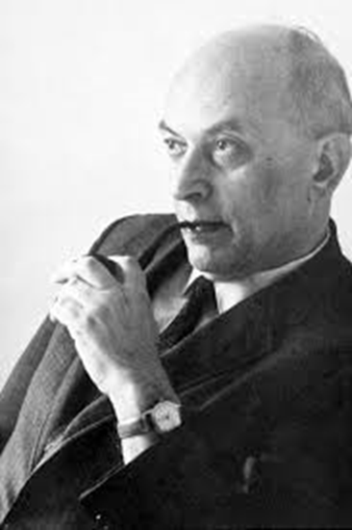
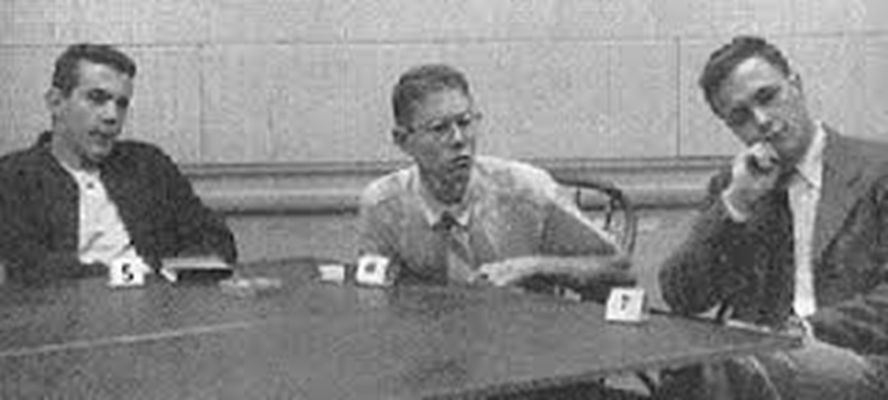
What can you remember?

Slide 6
With reference to alternative studies, CRITICALLY ASSESS Asch (1955)
Do you understand the question? What does this question mean to you?

Slide 7
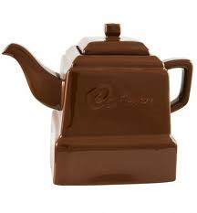
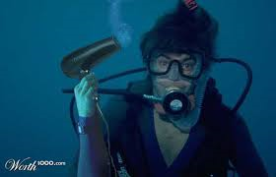
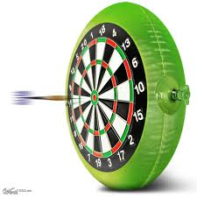
Discuss the following items
a chocolate teapot
an underwater hairdryer
an inflatable dartboard

Slide 8

What does ‘critically assess’ mean when we are talking about psychological research?
G
Are the findings GENERALISABLE?; do they tell us about people other than those in the study?
Are the findings RELIABLE? If we repeated the study would we consistently get the same results?
Are the findings APPLICABLE? Have they benefited society in any way, e.g. usefully explained a real world event or made life better for people some how
Are the findings VALID? Are they useful, meaningful, accurate?
Are the findings ETHICAL? What are/were the costs/benefits to the participants and to wider society?
R
A
V
E

Slide 9
Let’s look at the evidence!
Read about each study and match it to one of the four areas; ethnocentrism, androcentric, era-bound, ecological validity
If you think you might forget the findings create an image to remind you!
Complete columns 1 and 2 in the table
Complete column 3 in the table.

Slide 10

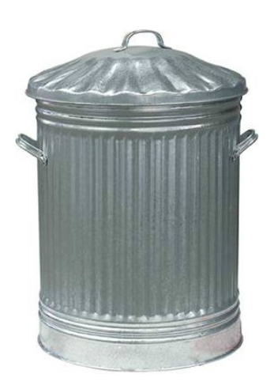

Show me, frame for good, bin for bad: if asked you must say why you think Asch’s findings are strong or weak, using terminology where possible and comparing with the findings of another research study
Rate him or slate him?

Slide 11
Learning Objective: With reference to alternative evidence, critically assess Asch’s (1955) research
First of all, I will ...
Select studies to evaluate Asch in terms of:
  Ethnocentrism
  Androcentrism
  Era
  Ecological validity
Accurately outline the findings (if you need to, create an image to remind yourself what they found
Next, I might ...
Compare results of these studies with Asch’s results;
(similarities/differences)
Can you make any GRAVE comments about the studies used as evaluation?
In time I will ...(maybe not today, maybe not tomorrow, but soon… ☺
Draw my own conclusions about Asch’s findings in the light of new information
Present my conclusions using core evaluative terminology

