Slide 1
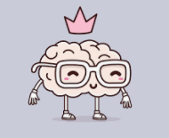
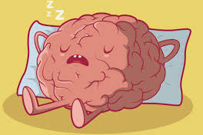
Paper 2
Revision
Biopsychology
The divisions of the Nervous System
The function of the Endocrine System
Fight or Flight and Adrenaline
Structure and function of sensory, relay and motor neurons
Synaptic transmission
Excitation and Inhibition
pp34-37

Slide 2
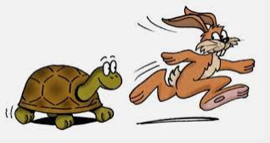
What do you know
about the Endocrine System?
A difference between the endocrine system and the nervous system?
Notes:
Maybe slow but widespread and powerful impact, longer lasting than nervous system

Slide 3
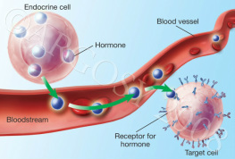
Hormones are
released from...
into the …………...
Notes:
🍐 This is a Pear Deck Text Slide
🍐 To edit the type of question, go back to the "Ask Students a Question" in the Pear Deck sidebar.

Slide 4
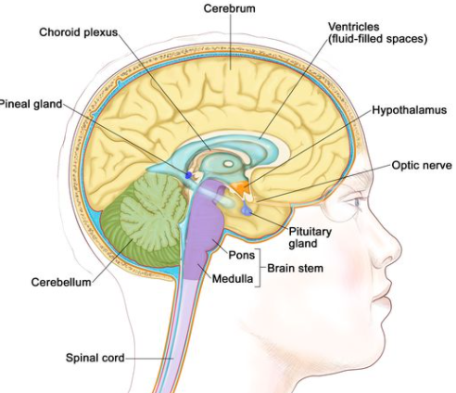
Which gland is the most
important?
P
Where can is be found?
Also known as the M…….. G……...
Notes:
🍐 This is a Pear Deck Draggable™ Slide.
🍐 To edit the type of question, go back to the "Ask Students a Question" in the Pear Deck sidebar.

Slide 5
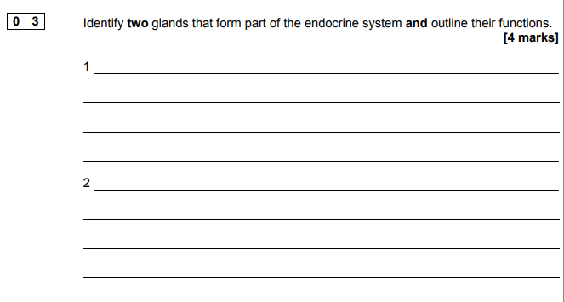
AQA AS June 2018 Paper 2
Notes:
🍐 This is a Pear Deck Text Slide
🍐 To edit the type of question, go back to the "Ask Students a Question" in the Pear Deck sidebar.

Slide 6
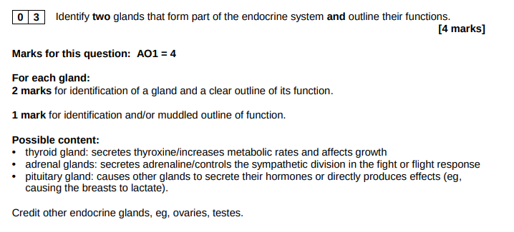

Slide 7
Stress response
Which brain region is activated first? (H)
Which branch of the ANS is triggered? (S)
Which is hormone is released and from where? (A A)
What impact does adrenaline have on the body?
What is this response commonly called? (F or F)
Which part of the nervous system restores the relaxed state? (P)
What is a common name for this state? (R and D)
Notes:
🍐 This is a Pear Deck Text Slide
🍐 To edit the type of question, go back to the "Ask Students a Question" in the Pear Deck sidebar.
Hypothalamus
Sympathetic
Adrenaline
Adrenal medulla part of adrenal gland (kidneys)
Fight or flight; increased heart rate, blood pressure, breathing rate, decreased rate of digestion, dilation of pupils, inhibits saliva, contracts rectum
Parasympathetic
Rest and digest

Slide 8
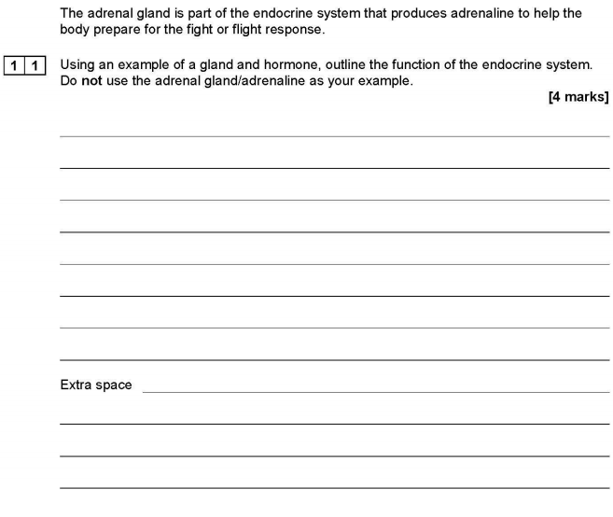
This question clearly demonstrates that you need to know another gland and hormone in relatively good detail, why not find out more about oxytocin? Good one to know about re. nursing :D, or melatonin (nature’s sleeping draught)
AQA June 2019 Paper 2
Notes:
🍐 This is a Pear Deck Text Slide
🍐 To edit the type of question, go back to the "Ask Students a Question" in the Pear Deck sidebar.

Slide 9
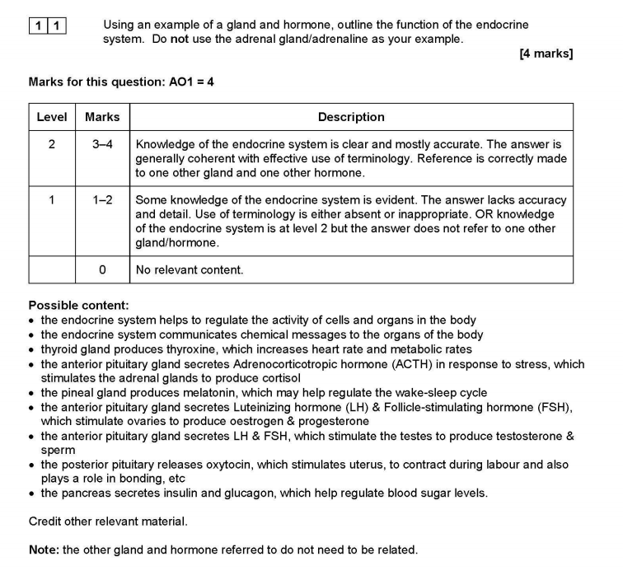

Slide 10
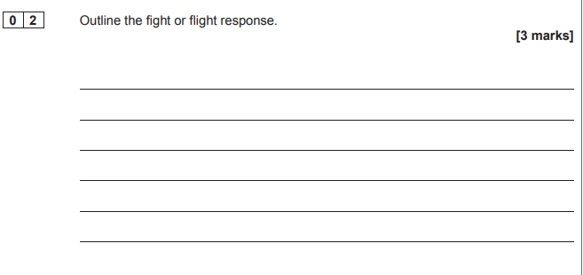
AQA Paper 2 AS 2017
Notes:
🍐 This is a Pear Deck Drawing Slide
🍐 To edit the type of question, go back to the "Ask Students a Question" in the Pear Deck sidebar.

Slide 11
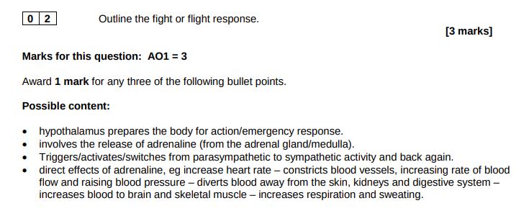

Slide 12
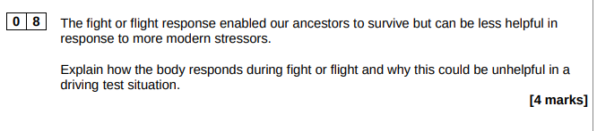
AQA June 2018 Paper 2
Notes:
🍐 This is a Pear Deck Text Slide
🍐 To edit the type of question, go back to the "Ask Students a Question" in the Pear Deck sidebar.

Slide 13
