Slide 1
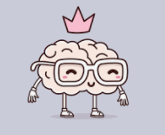
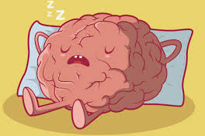
Paper 2
Revision
Biopsychology
The Divisions of the Nervous System
The Function of the Endocrine System
Fight or Flight and Adrenaline
Structure and function of sensory, relay and motor neurons
Synaptic transmission
Excitation and Inhibition

Slide 2
Neurons
Can you name three types of neurons?
S
R
M
Notes:
🍐 This is a Pear Deck Drawing Slide
🍐 To edit the type of question, go back to the "Ask Students a Question" in the Pear Deck sidebar.

Slide 3
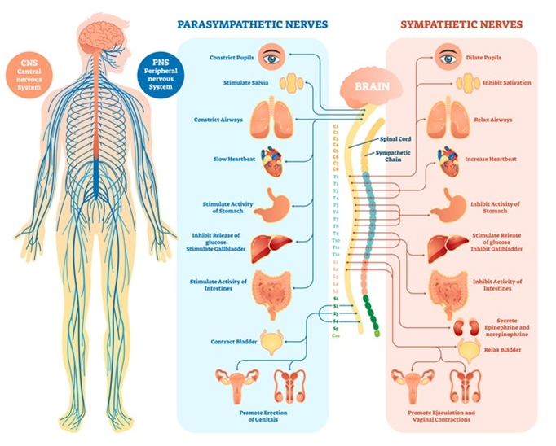
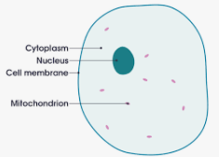


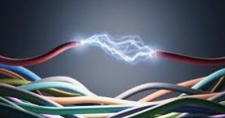

What is a neuron?
Each picture is a prompt to a keyword that ought to be in your definition.
Notes:
🍐 This is a Pear Deck Text Slide
🍐 To edit the type of question, go back to the "Ask Students a Question" in the Pear Deck sidebar.
Basic building blocks of the nervous system
Neurons are nerve cells
That process and transmit messages through electrical and chemical signals

Slide 4
Can you draw…
a sensory neuron?
Wrd
Think what is special about this sort of neuron?
Where do sensory neurons carry messages from?
Where do they carry message to?
They have long ….. and short ………….
Remember…
the word sensory is longer than neuron;
  sensory neurons have long dendrites.
the word neuron is shorter than sensory;
  sensory neurons have short axons.
Notes:
From the PNS
To the CNS
Long dendrites
Short axons

Slide 5
Can you draw…
a relay neuron?
Think what is special about this sort of neuron?
What do relay neurons connect to?
How are their dendrites different to a sensory neuron?
How are their axons similar to a sensory neuron?
Relay races are great; each runner only has to go a short distance to make up the whole race;
relay neurons have ……………… dendrites and …………….. axons.
Notes:
🍐 This is a Pear Deck Drawing Slide
🍐 To edit the type of question, go back to the "Ask Students a Question" in the Pear Deck sidebar.
Relay neurons connect sensory neurons with motor or other relay neurons.
They have short axons and short dendrites.
Similar to sensory due to short axns, different to sensory due to short dendrites

Slide 6
Can you draw…
a motor neuron?
What do motor neurons connect?
What is an effector?
How is a motor neurons similar to the relay neuron?
How is a motor neurons different to the sensory neuron but not a ?
How is a motor neuron different to both a sensory and a relay neuron?
Notes:
🍐 This is a Pear Deck Drawing Slide
🍐 To edit the type of question, go back to the "Ask Students a Question" in the Pear Deck sidebar.
An effector is an organ or cell that acts in response to a stimulus, in this case muscles or glands
Similar to a relay neuron as they both have short dendrites
Different to a sensory neuron as as sensory neurons have long dendrites and sensory neurons have short dendrites
Different to sensory and relay neurons as motor neurons have long axons

Slide 7
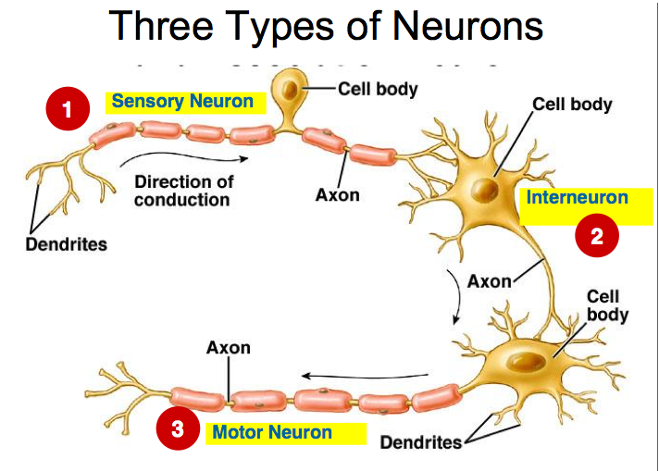

Place red dots on anything that is LONG
Place green dots on anything that is short
L S S S S L
Long
short
short
short
short
Long
Notes:
🍐 Sensory neurons - long dendrites and short axons
🍐 Relay neurons - short dendrites and short axons
🍐 Motor neurons - short dendrites and long axons
L S S S S L

Slide 8
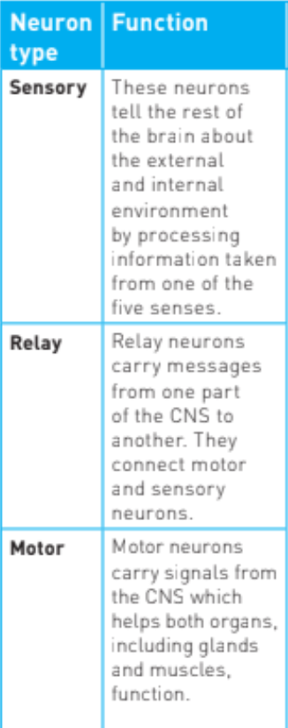
Drag orange dots to neurons found only in the brain and spinal cord.
Drag purple dots to neurons found in other areas of the body.
Notes:
🍐relay only in CNS so orange
🍐sensory and motor in other areas too so purple

Slide 9
Unipolar and multipolar
Cells that only send messages are called unipolar
Cells that send and receive message are called multipolar
ssages

Slide 10


Sensory neurons are multipolar
True
False
Notes:
False they only send messages to the CNS form the PNS

Slide 11
Relay neurons are unipolar
True
False
Notes:
False, like motor neurons they are multipolar and they send and receive messages.

Slide 12
Messages are received at the dendrites and travel along the axon to be passed to neighbouring cells
True
False
Notes:
True.

Slide 13
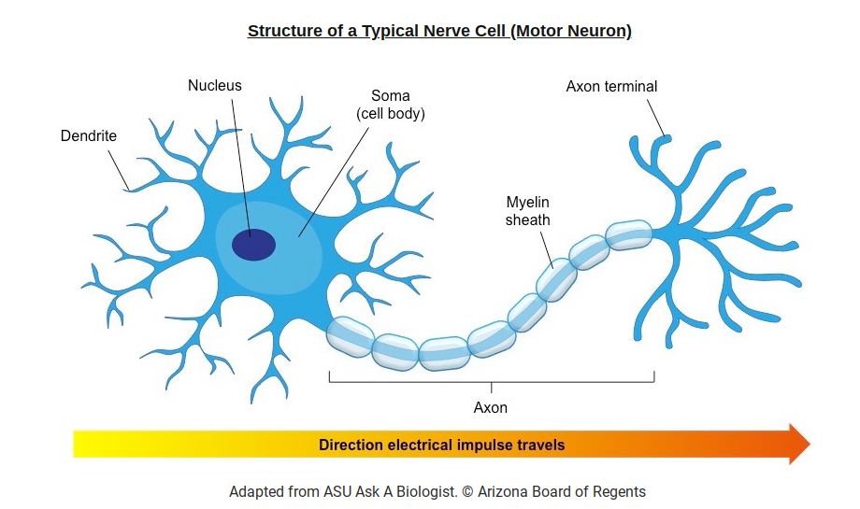
Notes:
Can you label the…
Dendrite in red
Axon in orange
Nodes of ranvier in yellow
Cell body in green
Nucleus in purple
Myelin sheaths in red
Terminal buttons is orange

Slide 14
Electrical transmission
What do we call the electrical signal that travels along the axon to the terminal buttons?
A…………………………….
When a neuron is resting it is negatively charged.
When a neuron is activated, the inside of the cell becomes positively charged.
Notes:
🍐 This is a Pear Deck Text Slide
🍐 To edit the type of question, go back to the "Ask Students a Question" in the Pear Deck sidebar.

Slide 15
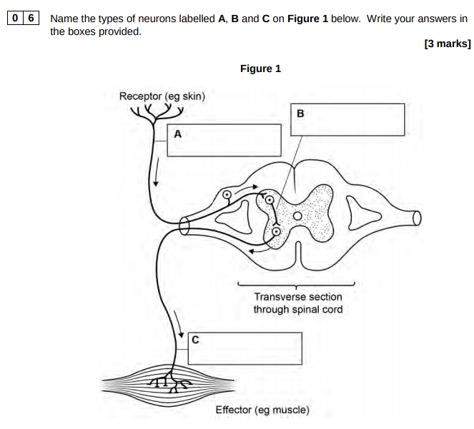
AQA June 2018 Paper 2
Notes:
🍐 A is sensory, B is relay (interneuron) and c is motor

Slide 16
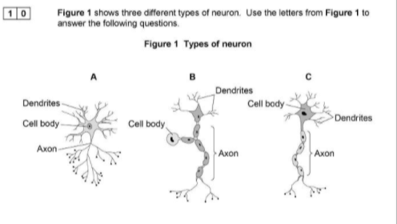
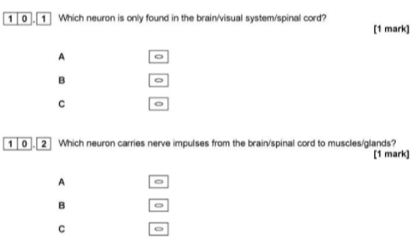
Tough question; this info is not in pink haired girl but could be worked out from the mask book
=
AQA June 2019 Paper 2
A is a ……………………..
B is a ……………………..
C is a ……………………..
Notes:
🍐 Relay neurons are only found in CNS so correct answer is A
Moror neurons is correct answer to Q2 so correct answer is C

Slide 17
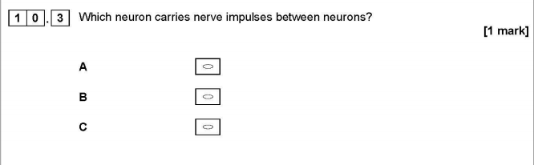
Just because you have used answers A and C before you might think the correct answer will be B..take care and read the statements carefully, every question is designed to make you think.
AQA June 2019 Paper 2
Notes:
🍐 A relay neuron

Slide 18
Synaptic transmission
What is a neural network or circuit?
The terminal button at the end of an axon, the gap between cells, and the receptor sites on the neighbouring cell are known as the
What is the gap called between neighbouring cells (axon and dendrite)?
Notes:
🍐 This is a Pear Deck Text Slide
🍐 To edit the type of question, go back to the "Ask Students a Question" in the Pear Deck sidebar.

Slide 19
Draw a synapse!
Notes:
🍐 This is a Pear Deck Drawing Slide
🍐 To edit the type of question, go back to the "Ask Students a Question" in the Pear Deck sidebar.

Slide 20
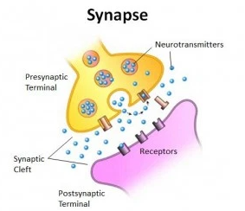
Label a synapse
Neurotransmitter molecules
Vesicles
Axon
Dendrite
Receptor sites
Synaptic cleft
Transporter molecule
Enzyme
Notes:
🍐 This is a Pear Deck Draggable™ Slide.
🍐 To edit the type of question, go back to the "Ask Students a Question" in the Pear Deck sidebar.

Slide 21
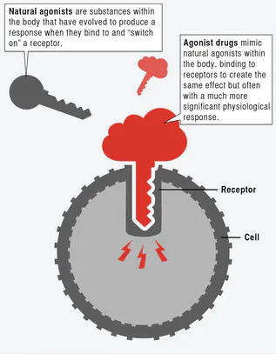

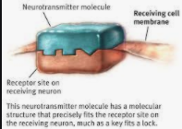
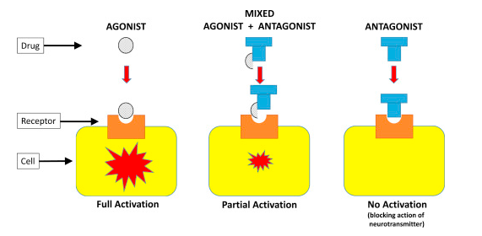
What do you know about neurotransmitters?
Notes:
🍐 This is a Pear Deck Text Slide
🍐 To edit the type of question, go back to the "Ask Students a Question" in the Pear Deck sidebar.

Slide 22
Agonist and antagonists

Slide 23
What do you know about excitatory and inhibitory neurotransmitters?
Notes:
🍐 This is a Pear Deck Text Slide
🍐 To edit the type of question, go back to the "Ask Students a Question" in the Pear Deck sidebar.
Excitatory - increases positive charge
Inhibitory - increases negative charge

Slide 24
Summation
A neuron might receive action potentials from many neighbouring cells at the same time or in quick succession.
Some messages are excitatory (+1), saying “turn on, get involved”;
Others are inhibitory (-1), saying “turn off, we don’t need you!”
Each cell has a threshold that it needs to get to in order to ‘fire’ and summation refers to the total input from neighbouring cells that bring the cell closer or further from firing.
http://learntech.uwe.ac.uk/synapsesNeuro/Default.aspx?pageid=1916

Slide 25
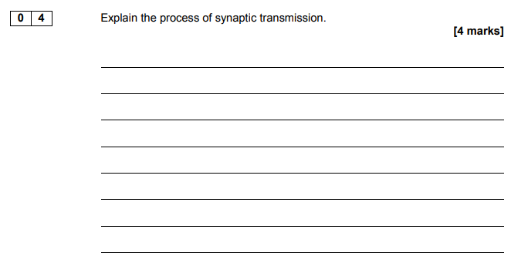
AQA AL June 2017 Paper 2
Notes:
🍐 This is a Pear Deck Text Slide
🍐 To edit the type of question, go back to the "Ask Students a Question" in the Pear Deck sidebar.

Slide 26
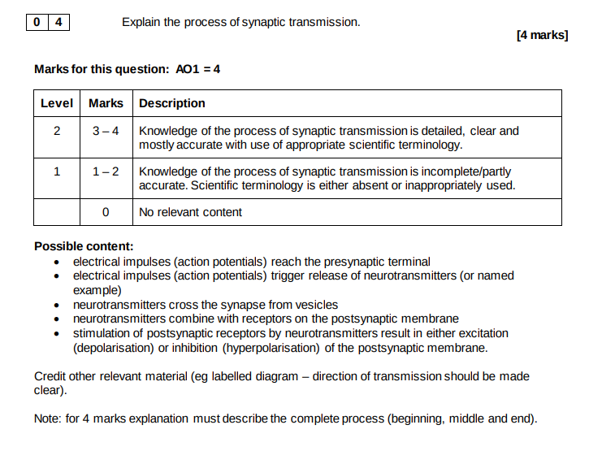

Slide 27
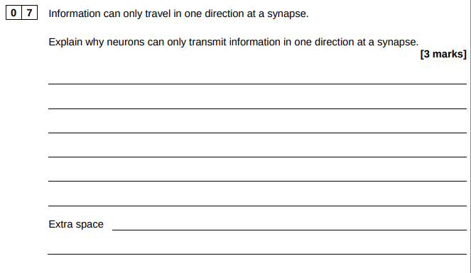
AQA June 2018 Paper 2
Notes:
🍐 This is a Pear Deck Text Slide
🍐 To edit the type of question, go back to the "Ask Students a Question" in the Pear Deck sidebar.

Slide 29
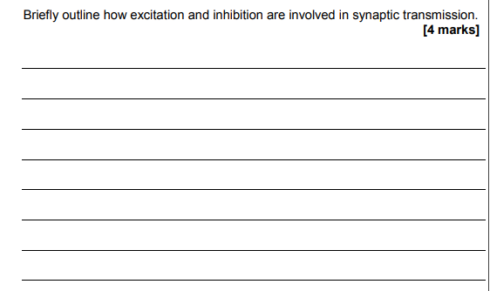
AQA AS June 2016 Paper 2
Notes:
🍐 This is a Pear Deck Text Slide
🍐 To edit the type of question, go back to the "Ask Students a Question" in the Pear Deck sidebar.

Slide 30
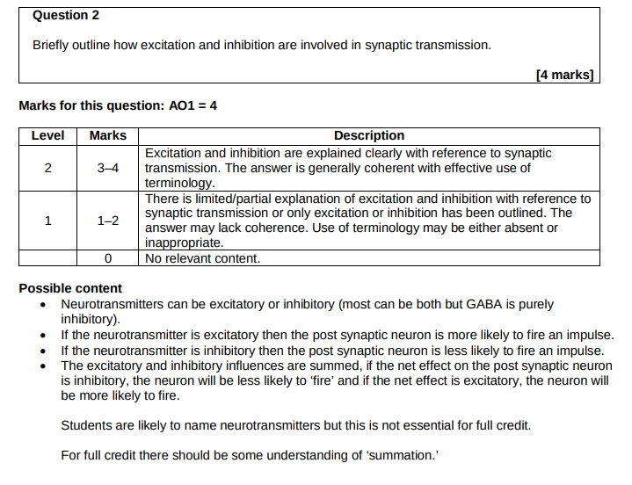

Slide 31
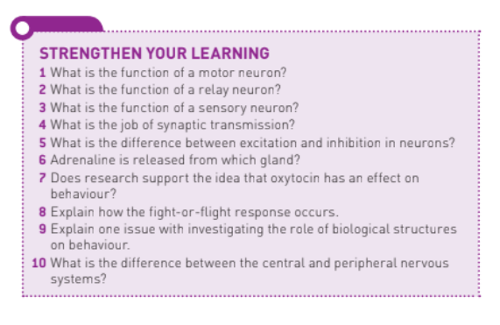

Slide 32
