Slide 1
Paper 2 Bio-Psychology
Biological Rhythms
Endogenous pacemakers and exogenous zeitgebers

Slide 2
Objectives
To describe what is meant by the terms biorhythm and circadian rhythm
To describe what is meant by endogenous pacemaker and exogenous zeitgebers
To outline how the SCN regulates the circadian rhythm
To discuss evidence to support the role of the endogenous pacemakers, including case studies (Siffre), controlled observation, (Aschoff and Wever) and animal experiments (De Coursey, Ralph)
To discuss evidence for and against the role of the exogenous zeitgebers, e.g. Campbell and Murphy (for), Folkhard (against)
To discuss individual differences in circadian rhythms (e.g. Duffy, Ralph)

Slide 3
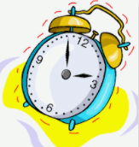
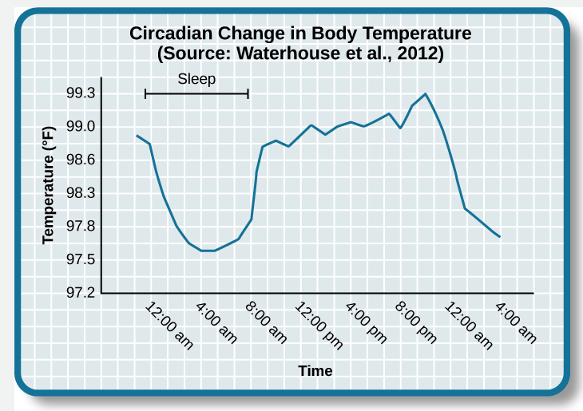
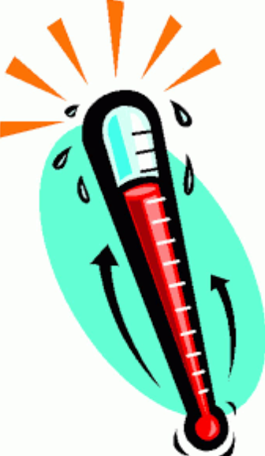
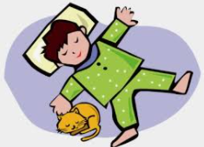
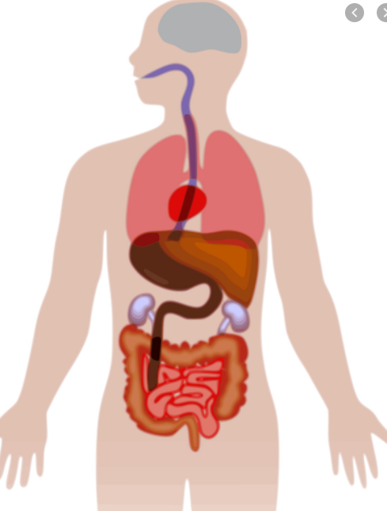
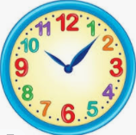
What is a biorhythm?
Notes:
🍐 This is a Pear Deck Text Slide
🍐 To edit the type of question, go back to the "Ask Students a Question" in the Pear Deck sidebar.

Slide 4

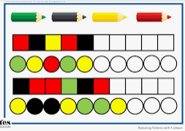
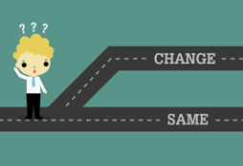

A biorhythm is...
A distinct P……………….. of C………………. in bodily activity that conforms to a C……………. T……….. period.
Notes:
A distinct Pattern of Changes in bodily activity that conforms to a Cyclical Time period.

Slide 5


Plants do not have biorhythms
True
False
Notes:
True or False
Use this template to do a quick check of students’ perceptions during your lesson.
🍐 This is a Pear Deck Multiple Choice Slide. Your current options are: A: True, B: False,
🍐 To edit the type of question or choices, go back to the "Ask Students a Question" in the Pear Deck sidebar.

Slide 6
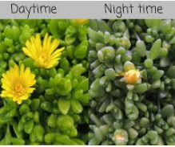
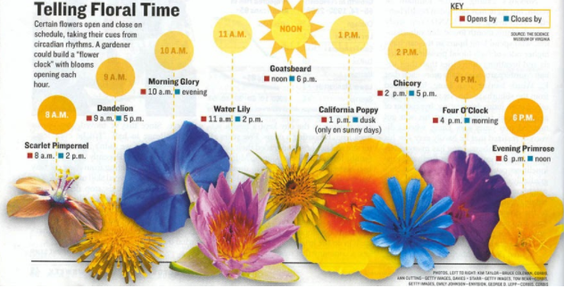
Linné's floral clock
In flowering plants, many flowers open during the day and close at night
exhibiting a 24-hour circadian rhythm
known as Linné's floral clock

Slide 7
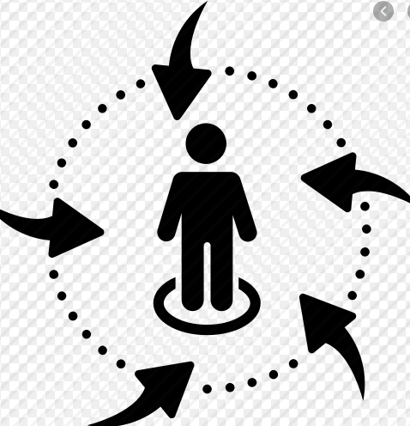
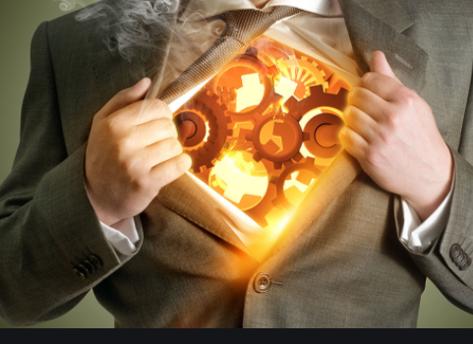
What governs these biorhythms?
Notes:
Internal and external influences, endogenous pacemakers and exogenous zeitgebers

Slide 8
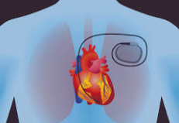
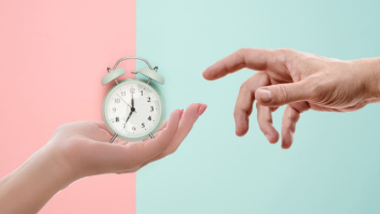
What are the correct words for the internal and external influences on our biorhythms?
En……………… P……………...
Ex……………… Z………………..
Notes:
Endogenous pacemakers
Exogenous zeitgeibers

Slide 9
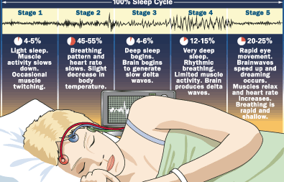

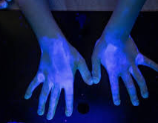
Name the biorhythm that occurs many times in a 24 hour period
The prefix U……. means more than once every 24 hours
…………………………...
Notes:
Ultra Ultradian

Slide 10
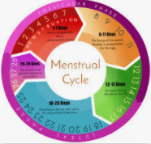
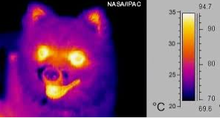
Name the biorhythm that occurs less frequently than once every 24 hours
The prefix I……. means less than once in every 24 hours
…………………………...
Notes:
Infra Infradian

Slide 11
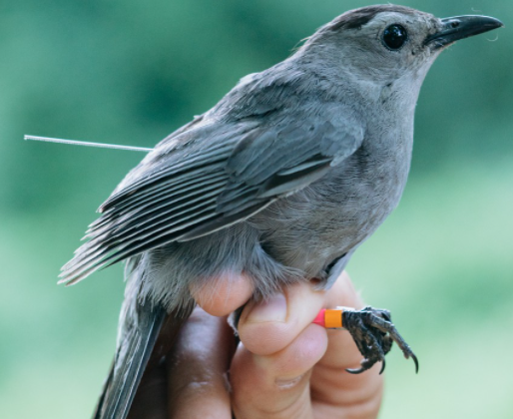
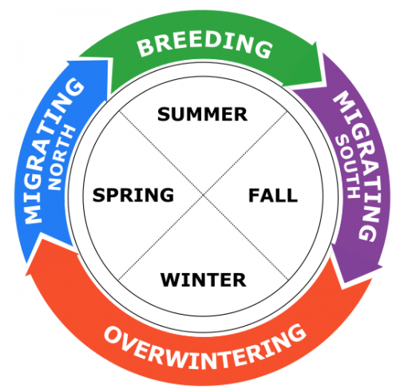
Name the biorhythm that occurs once a year
The prefix Circa means “once in”
C……………… A……………………..
I like to go on my holidays once a year, this is known as M……………………...
Notes:
Circa-annual

Slide 12
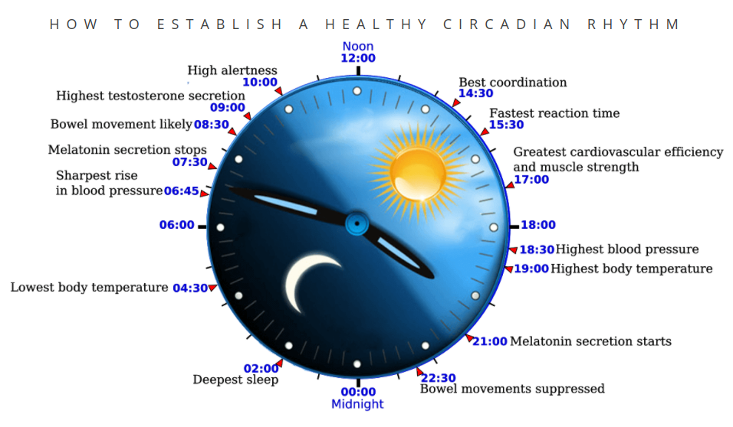
Name the biorhythm that occurs once every 24 hours
The latin word diem mean ‘day’, i..e 24 hours
C………………
Notes:
Circadian

Slide 13
Body Temperature follows a circadian rhythm
True
False
Notes:
True

Slide 14
Body temperature falls to its lowest point in the afternoon
True
False
Notes:
False: Body temperature is lowest in the early hours (4 am) of the morning (36 degrees) and peaks around 6 in the evening.

Slide 15
Cognitive ability follows a circadian rhythm
True
False
What evidence do you have for this point of view?
Notes:
True: Best when we are warmer (internally) supported by Folkhard’s stories study.

Slide 16

Folkhard’s ‘Stories’ Study
How did Folkhard’s findings support the idea that cognitive abilities follow a circadian rhythm?
Is there any reason to believe the findings are generalisable to adults?
Notes:
Children who were read the story in the afternoon (3pm) remembered the details better than children who were read the story at 9am. Yes, can generalise as Gupta fund IQ was higher when assessed at 7pm as opposed to 2pm or 9am. Important to consider where such studies were done and what month though as light levels may be different in summer and winter, i..e darkness triggers melatonin release which would lead to lower levels of alertness.

Slide 17
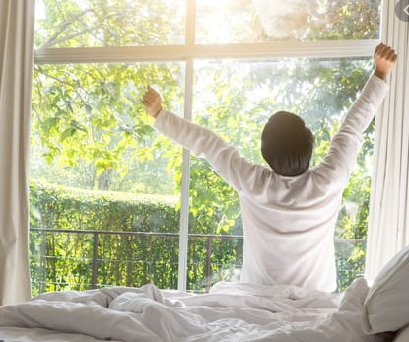
Example of a circadian rhythm: Sleep-Wake Cycle
Why do humans feel drowsy in the evening and more alert during the day?
Notes:
Daylight triggers the inhibition of melatonin, nature’s sleeping draught. Darkness triggers its secretion from the pineal gland.
Light is an important exogenous zeitgeiber.

Slide 18
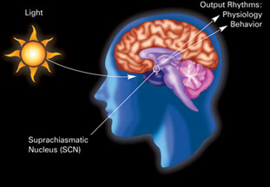
What is the name of the important endogenous pacemaker that regulates our sleep-wake cycle?
S……………… C……………… N……………...
S……………. means above in Greek
C…………… means cross-over in Greek and refer to the cross over point of the optic nerves coming from the eyes, refers to where thuis brain regions is situated.
N…………… means a cluster of cell bodies of neurons in the central nervous system

Slide 19
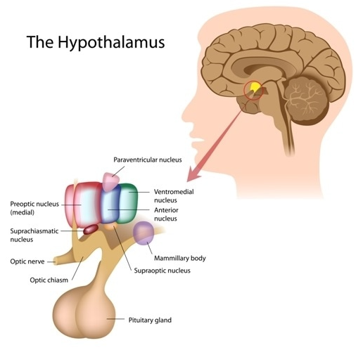
Where in the brain would we find the SCN?
H……………….….
Notes:
🍐 This is a Pear Deck Text Slide
🍐 To edit the type of question, go back to the "Ask Students a Question" in the Pear Deck sidebar.

Slide 20
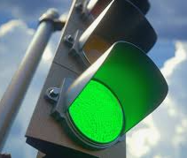

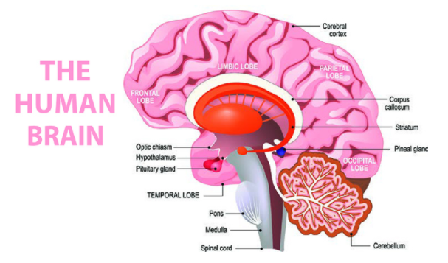
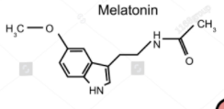
What happens when the SCN detects the presence and absence of light?

Slide 21
When the SCN detects light this increases the secretion of melatonin
True
False
Notes:
False, light decreases secretion of melatonin

Slide 22
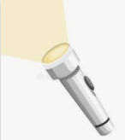
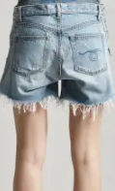
Light changes cannot be detected whilst we are asleep
True
False
What evidence do you have for this point of view?
Notes:
False: Even when are out eye closed and we are asleep the SCN is still able to detect changes in light levels, this is potentially due to the fact that our skin contains cells which detect light levels passing messages to the SCN and this is supported by Campbell and Murphy, shining light onto the back of the knees and entraining the Pps circadian rhythms by up to three hours.

Slide 23

Exogenous zeitgebers having a strong influence on our body clocks.
Agree
Disagree
Notes:
Agree - Campbell and Murphy, jet lag can be reduced by sticking to the norms of the new environment
Disagree - Folkhard speedy clocks, siffre, aschoff and wever, inuits sleep at normal times despite 6 months of light and 6 months of dark.

Slide 24
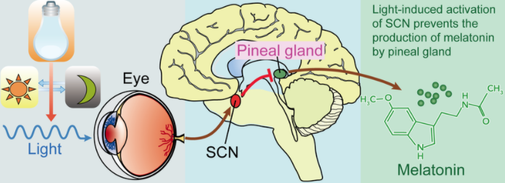
N…………… means a cluster of cell bodies of neurons in the central nervous system

Slide 25
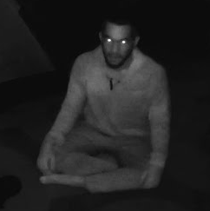
In the SCN is free-running, i.e. it cannot detect changes in light levels, the circadian rhythm gets longer
What evidence do you have for this point of view?
Agree
Disagree
Notes:
Agree or Disagree
Use this template to do a quick check of students’ opinions during your lesson.
🍐 This is a Pear Deck Draggable™ Slide.
🍐 To edit the type of question, go back to the "Ask Students a Question" in the Pear Deck sidebar.

Slide 26
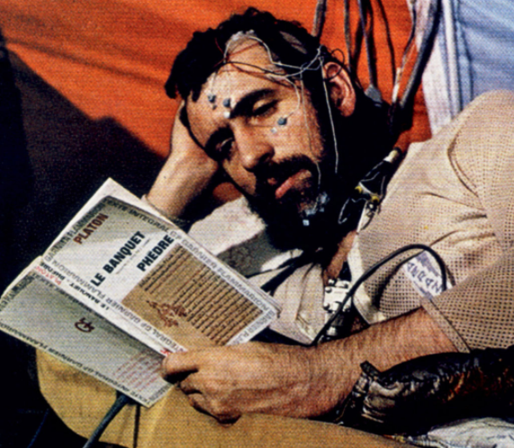
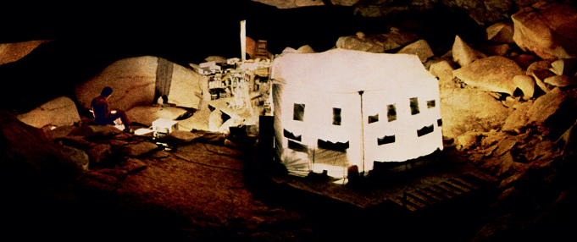

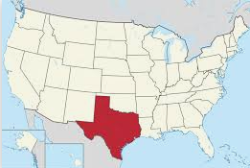
What was the name of the study about the man in the cave?
S……………… (1962)
What does this study tells us about…
the role of endogenous pacemakers
the role of exogenous zeitgeibers
Notes:
🍐 This is a Pear Deck Text Slide
🍐 To edit the type of question, go back to the "Ask Students a Question" in the Pear Deck sidebar.

Slide 27
Siffre’s study provides excellent evidence for the importance of zeitgeibers in regulating the sleep-wake cycle
Agree
Disagree
Notes:
Disagree
It in fact shows the power of the SCN even in the absence of light, light was only important to keep us aligned with the 24 hour rotation of the Earth on its axis.
It’s not great evidence even for that as its case study based on one male adult participant, thus the findings may not generalize to females, people who are older or younger or people from different parts of the world who may be used to spending long hours in darkness if they live near to the North pole for example. Siffre replicated his study in 1999 and noted that his circadian rhythms had shifted.

Slide 28
When Siffre replicated his study in 1999 the results were the same indicating that his data was reliable.
True
False
Notes:
False: His circadian rhythms had slowed down. He put this down to being older. This is was not a direct replication of the study as the participant was nearly 40 years older by this stage ;)

Slide 29
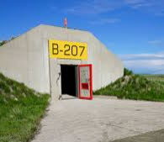
Can you name a study that support’s Siffre’s findings but has greater validity?
A……….. and W………..(1976)
Siffre
A…...and W…...
How was this study similar to Siffre’s?
How was this study different to Siffre’s?
Notes:
🍐 Aschoff and Wever (1976)
4 weeks only so much shorter than Siffre
A group of Pps though so more generalisable
WW2 bunker as opposed to a cave
One Pps S-W cycle extended to 29 hours demonstrating individual differences that could not be detected in a case study
Finsigns simialr in the mian, majroty S[W settled t somewhere between 24 and 25 hours.

Slide 30


What does Aschoff and Wever’s study suggest as the role of exogenous zeitgeibers?
Key term: E……………………..
Notes:
🍐 Aschoff and Wever (1976)
4 weeks only so much shorter than Siffre
A group of Pps though so more generalisable
WW2 bunker as opposed to a cave
One Pps S-W cycle extended to 29 hours demonstrating individual differences that could not be detected in a case study
Finsigns similar in the main, majority S[W settled t somewhere between 24 and 25 hours.

Slide 31
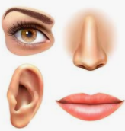
Can you think of any other exogenous zeitgebers? Think about things that you might hear or see (other than clocks or light levels that might help you to know how much time has passed?
Notes:
🍐 Aschoff and Wever (1976)
4 weeks only so much shorter than Siffre
A group of Pps though so more generalisable
WW2 bunker as opposed to a cave
One Pps S-W cycle extended to 29 hours demonstrating individual differences that could not be detected in a case study
Finsigns simialr in the mian, majroty S[W settled t somewhere between 24 and 25 hours.

Slide 32
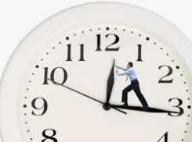
Exogenous zeitgebers exert a very powerful impact on the sleep-wake cycle
Agree
Disagree
What evidence do you have for this point of view?
Notes:
Disagree
Not really they help help to entrain the free running SCN to keep to a 24 hour cycle rather than 25 but…
Folkard speeded up the clock unbeknownst to participants to 22 hour cycle but only 1/12 Pps was able to keep pace with the clock comfortably.

Slide 33
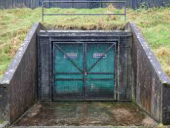
Which study goes against the role of zeitgebers?
Another day, another bunker….
F……………………. (1985)
Aschoff and Wever
F………...
How was this study similar to Aschoff and Wever?
How was this study different to Aschoff and Wever?
Notes:
🍐 Folkard et al (1985)
12 Pps
3 weeks
Dark cave
Clock - deception, sped up to 22 hour cycle
11.45 bedtime and 7.45 am wake up time
1/12 kept pace showing endogenous pacemaker is stronger than exogenous zeitgeber - in this case though the zeitgeber is just a clock not actual light which chemically affect the brain.

Slide 34
Folkhard speeded up the the clocks in the bunker
True
False
Notes:
True: Pps thought a whole day had passed but actually only 22 hours had gone by, they gt up when clock said 7.45 am and went to bed at 11.45 pam

Slide 35
Folkhard’s study supports the idea of a strong free-running endogenous body clock
True
False
Notes:
True: Only one Pps’s cycle was entrained by the 22 hour clock, everyone else found it very hard to adapt to this regime.

Slide 36
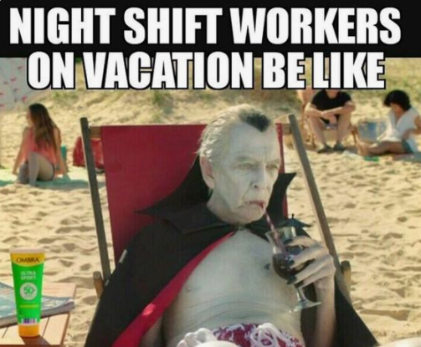
What is the correct word for the disruption of our circadian rhythm?
D……………………….
Why is helpful for psychologist to study the sleep-wake cycle? What real world applications are there?
Notes:
🍐 Desynchronisation

Slide 37
Shift workers often have poor health; this is likely to be due to the biological impact of shiftwork on the body
Agree
Disagree
Notes:
Middle: yes they do have higher incidence of heart disease, which could be from the physical stress of constantly disruption to biorhythms, BUT evidence also shows higher divorce rate suggesting relationship troubles which can also be stressful causing heart disease (social stress), relationships may be difficult when people have disrupted sleep as it makes them irritable but als they may miss family evetns etc.

Slide 38
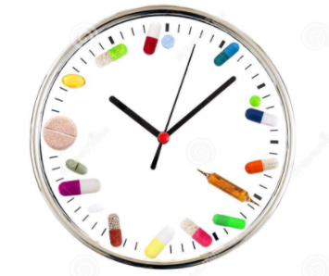

What is the correct name for the field of science associated with the effect of time on the efficacy of drug treatments?
C………………...
Notes:
Chronotherapeutic; e.g. taking aspirin last thing at night t prevent heart attacks which are common in the early hours of the morning. Reduces blood platelet activity and show to reduce heart attacks if taken late at night.

Slide 39
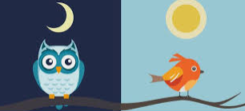
Individual differences
How would you use Duffy’s findings about larks and owls in an essay?
Notes:
USe it as a counter-argument against main effects in studies such us Aschoff and Wever etc….it demonstrates the importance of individual differences when thinking about circadian rhythms , that some people do seem to respond better in the morning then the evening and vice versa.

Slide 40


E: The found that...
P: Support for the argument that endogenous pacemakers are powerful determinants of our circadian rhythms comes from research by Aschoff and Wever who conducted a 4 week study in a WW2 bunker.
E
T: This was important evidence for the role of endogenous pacemakers such as the SCN as...
P
T
A: This said, studies such as this do not always detect individual differences in people’s circadian rhythms as they are more interested in comparing group averages. Duffy showed that...
L: This is an important findings as it suggests that our endogenous pacemakers may be...
L
A

Slide 41
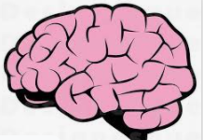
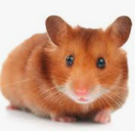

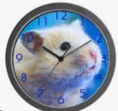
Is there any evidence to support the idea of individual differences being determined genetically?
Hi I’m Ralph
I’m a mutant :D
Notes:
🍐 This is a Pear Deck Text Slide
🍐 To edit the type of question, go back to the "Ask Students a Question" in the Pear Deck sidebar.

Slide 42
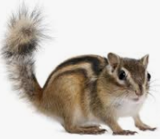
De Coursey’s chipmunk study provides strong support for the role of endogenous pacemakers?
Agree
Disagree
On what are you basing this viewpoint? What were the findings? Was this a strong study scientifically?
Notes:
Agree or Disagree
Use this template to do a quick check of students’ opinions during your lesson.
🍐 This is a Pear Deck Draggable™ Slide.
🍐 To edit the type of question, go back to the "Ask Students a Question" in the Pear Deck sidebar.

Slide 43

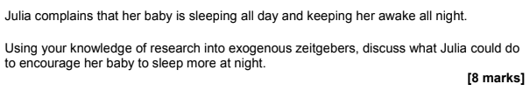
Sample exam questions
Notes:
USe it as a counter-argument against main effects in studies such us Aschoff and Wever etc….it demonstrates the importance of individual differences when thinking about circadian rhythms , that some people do seem to respond better in the morning then the evening and vice versa.

Slide 44
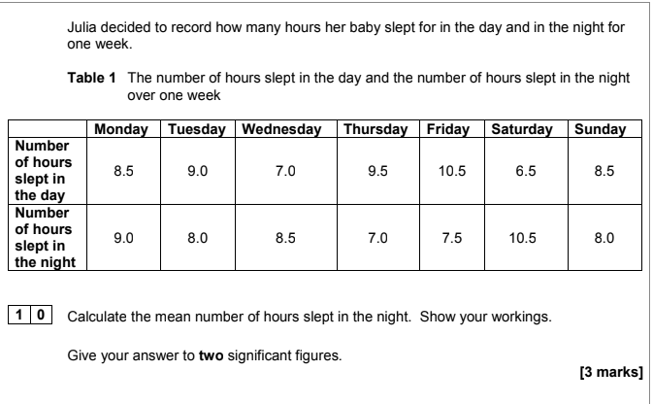
Sample exam questions
Notes:
USe it as a counter-argument against main effects in studies such us Aschoff and Wever etc….it demonstrates the importance of individual differences when thinking about circadian rhythms , that some people do seem to respond better in the morning then the evening and vice versa.

Slide 45
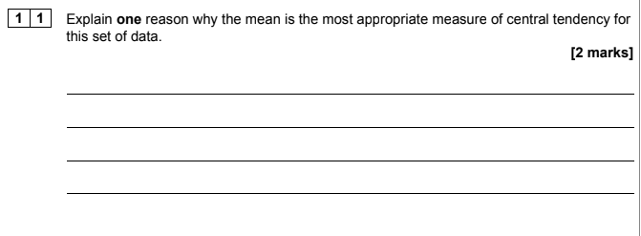
Sample exam questions
Notes:
USe it as a counter-argument against main effects in studies such us Aschoff and Wever etc….it demonstrates the importance of individual differences when thinking about circadian rhythms , that some people do seem to respond better in the morning then the evening and vice versa.

Slide 46
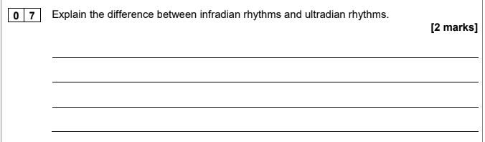
Sample exam questions
Notes:
USe it as a counter-argument against main effects in studies such us Aschoff and Wever etc….it demonstrates the importance of individual differences when thinking about circadian rhythms , that some people do seem to respond better in the morning then the evening and vice versa.

