Slide 1
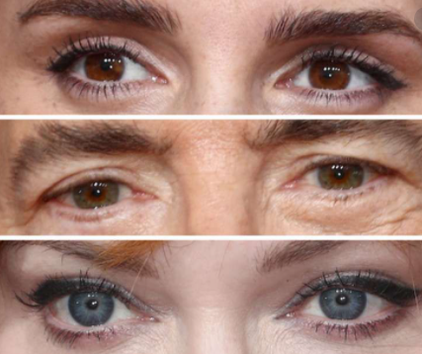
Baron-Cohen et al. (2001)
Ms. Wood

Slide 2
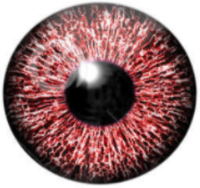
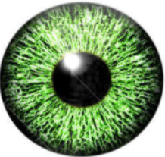


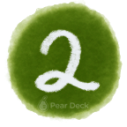

What do you remember about this study?
Aim:
Procedure:
Findings:
Notes:
Bell-Ringer or Do-Now
Transitioning from the hallway into class can be a chaotic time. Use this slide to help students know what to expect as they come into the room, and change the instructions to fit your activity.
🍐 This is a Pear Deck Text Slide
🍐 To edit the type of question, go back to the "Ask Students a Question" in the Pear Deck sidebar.

Slide 3

Lesson Objectives
By the end of the lesson you will …
Be able to outline Baron-Cohen et al.’s (2001) study
Be able to evaluate Baron-Cohen et al.’s (2001) study

Slide 4
What do these people have in common?
Isaac Newton
George Orwell
Beethoven
Mozart
Isaac Newton
George Orwell
Beethoven
Mozart
Hans Christian Andersen
Sir Anthony Hopkins
Courtney Love
Bill Gates

Slide 5
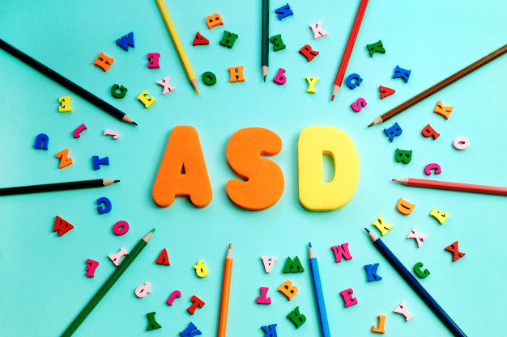

Slide 6
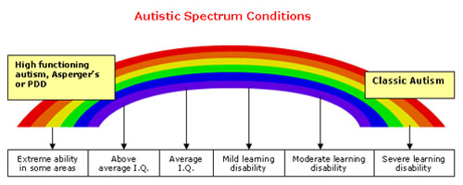
Experts say all show signs of Autism Spectrum Disorder
There have been changes to the diagnosis of autism since the original Baron-Cohen paper :D
https://www.autismspeaks.org/dsm-5-and-autism-frequently-asked-questions
Notes:
🍐 This is a Pear Deck Web Slide.
🍐 To edit the type of question, go back to the "Ask Students a Question" in the Pear Deck sidebar.

Slide 7
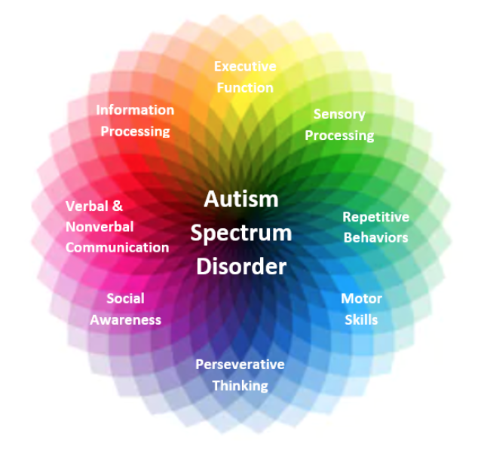
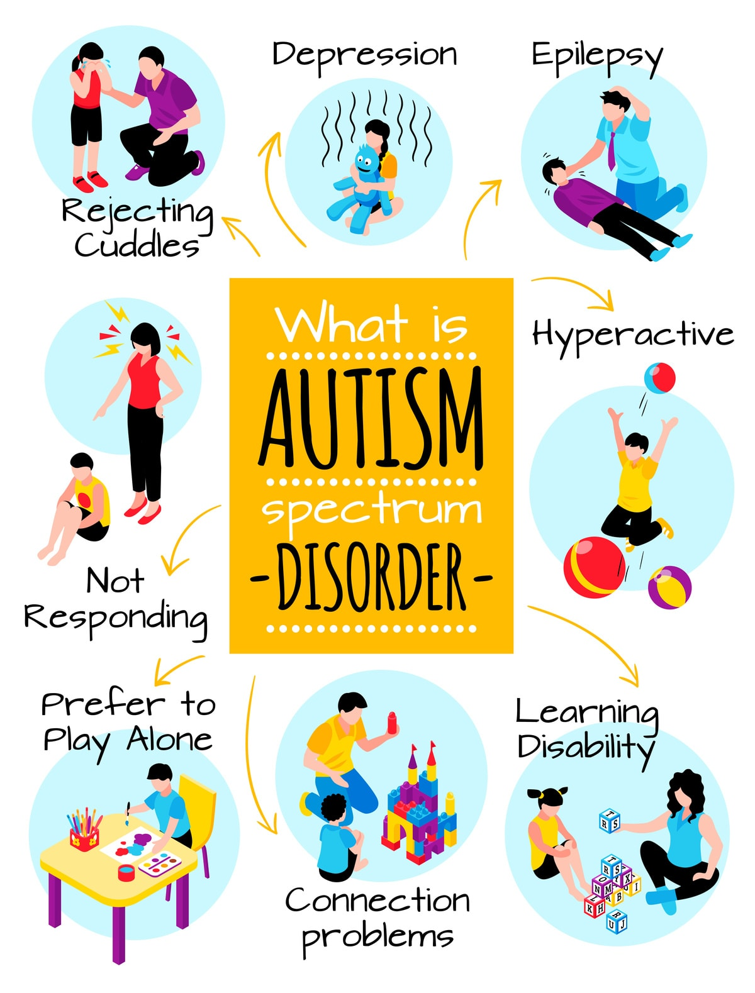

Slide 8
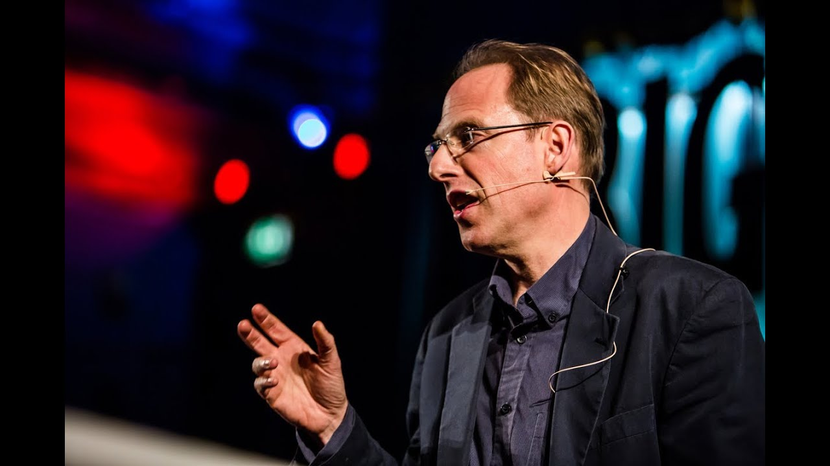
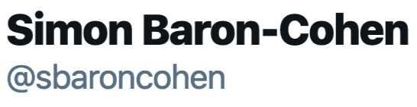
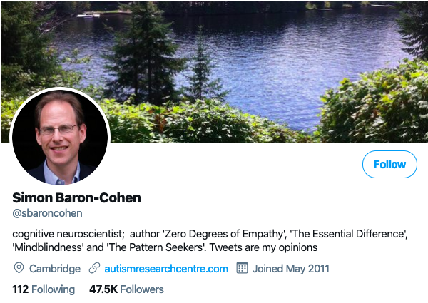
Simon Baron-Cohen
Leading researcher in Autism Spectrum Disorders

Slide 9
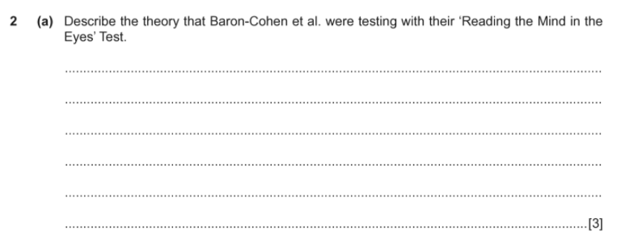
Notes:
🍐 This is a Pear Deck Text Slide
🍐 To edit the type of question, go back to the "Ask Students a Question" in the Pear Deck sidebar.

Slide 10
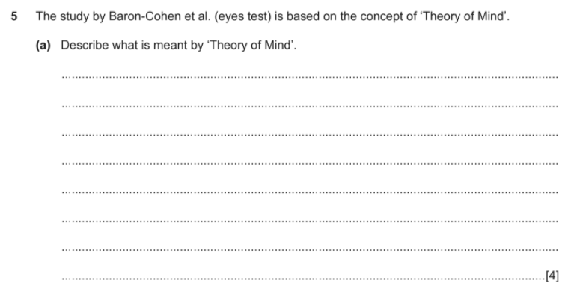
Notes:
🍐 This is a Pear Deck Text Slide
🍐 To edit the type of question, go back to the "Ask Students a Question" in the Pear Deck sidebar.

Slide 11
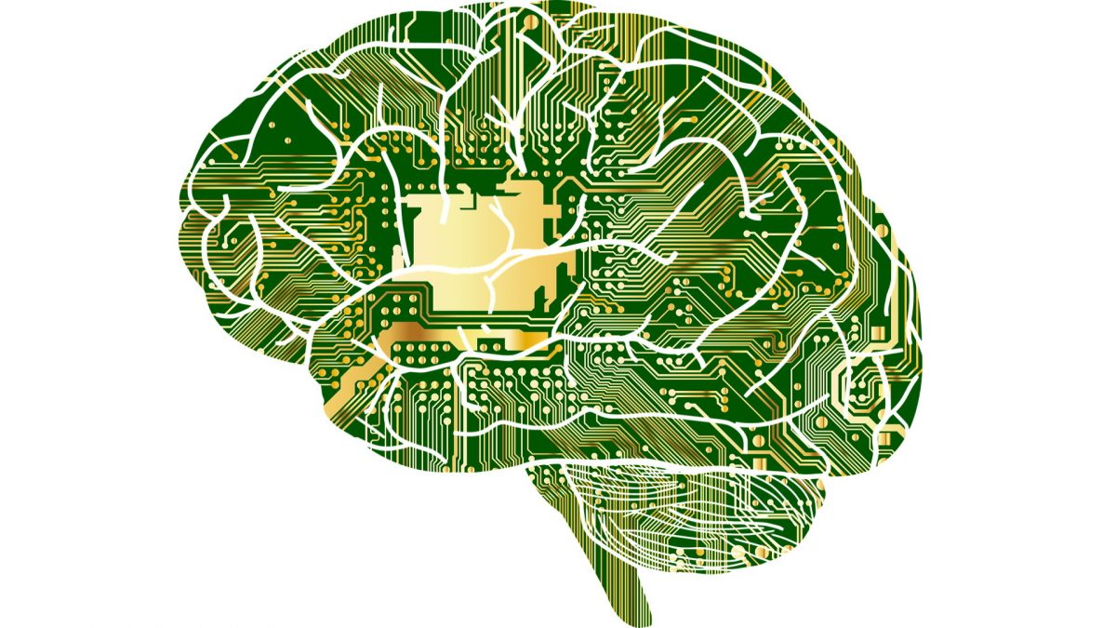
Baron-Cohen
et al.
(2001)

Slide 12
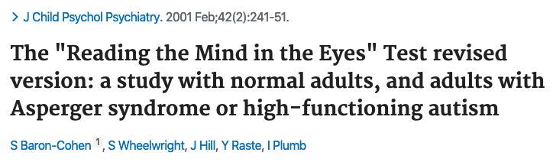
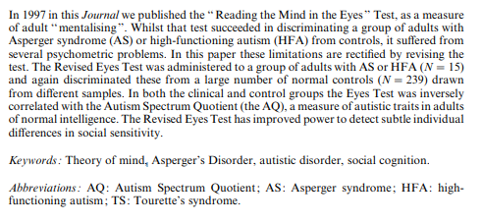

Slide 13
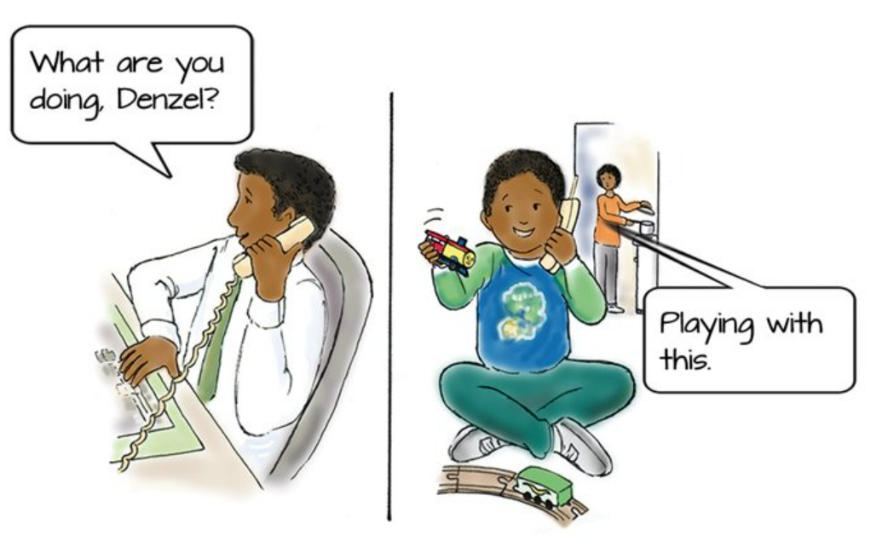
The Theory of Mind
the ability to determine the mental state of another person or ourselves (mentalising).
Linked to social sensitivity - ability to put oneself in the position of someone else (perspective-taking)
this knowledge is used to explain and predict other people’s behaviour
Two stages- the person must be able to determine…
  the mental state of a person (i.e. happiness)
  the content of the mental state (i.e. happiness at being reunited with a sibling).
Deficits can occur in those with ASD and this can explain some of the other symptoms

Slide 14
Background
A test of how well the participant can put themselves into the mind of the other person, and ‘‘ tune in’’ to their mental state.
For this reason, we described it as an ‘‘advanced theory of mind test’’.
‘‘Theory of mind’’ is the ability to attribute mental states to oneself or another person (Premack & Woodruff, 1978)
this ability is the main way we make sense of or predict another person’s behaviour.
Also referred to as ‘‘mentalising’’, ‘‘mind reading’’ and ‘‘social intelligence’’ (Baron-Cohen, Jolliffe, et al., 1999), overlaps with the term ‘‘empathy’’.

Slide 15
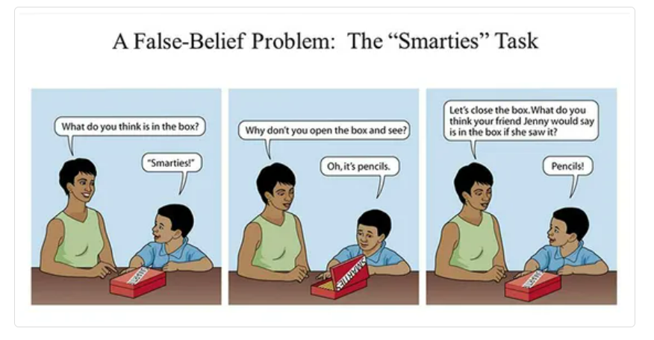
Testing ToM in children: False belief tasks

Slide 16
Autism Spectrum Disorder:
challenges with social interactions and communication
repetitive or inflexible patterns of behaviour
The onset of the disorder occurs during childhood, usually early childhood.
Asperger syndrome historic diagnosis - individuals with unimpaired language skills and intellectual functioning.
1st January 2022 the term will also no longer be used in the ICD-11 (see page XX)
Genetic research - no distinction between Asperger syndrome and high-functioning autism - terms used inconsistently by clinicians.

Slide 17
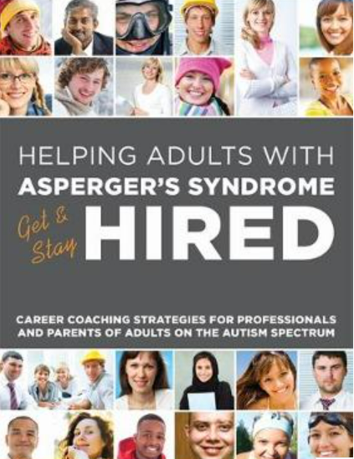
Measuring cognitive dysfunction
Developing diagnostic tests that are sensitive enough to detect subtle levels of dysfunction is difficult
False beliefs tests (e.g. Sally Anne) not useful for adults of typical intelligence
Neurodiverse adults may benefit from a different sort of test as they may have learned strategies to mask other more obvious signs

Slide 18
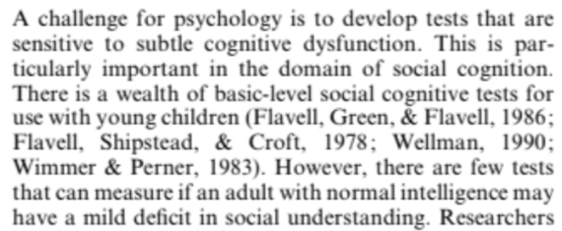
Background

Slide 19
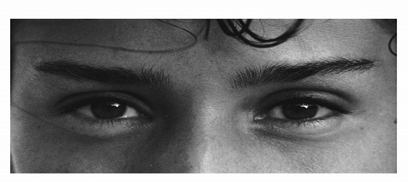
Background: The Eyes Test
The Eyes Test involves examining pairs of eyes (cut out from the face) and making a forced choice among descriptors to identify the mental state or emotion. Was able to discriminate adults with ASD from controls (including a group with Tourettes)

Slide 20


What were the problems with the original eyes test?
Type of questions?
Difficulty of questions?
Other issues?
Notes:
Temperature Check
WIth this slide, you can get a quick idea of how your students are feeling about the pace of the lesson. Getting consensus before moving on helps ensure everyone is still with you, and identify the students who might need extra attention.
🍐 This is a Pear Deck Draggable™ Slide.
🍐 To edit the type of question, go back to the "Ask Students a Question" in the Pear Deck sidebar.

Slide 21
Problems with original ‘Reading the Mind in the Eyes Test’ (1997)
2 choices and 25 pairs of eyes
Some too easy, some too hard
Some too easy due to eye direction (ignoring/noticing)
More female than male eyes
Options were always ‘semantic’ opposites
Possibility of word comprehension issues
Parents of children with ASD scored same as AS/HFA
Ceiling effect - too many high results

Slide 22
Original test results
males performed slightly worse than females
adults with High Functioning Autism (HFA) or Asperger syndrome (AS) scored significantly lower than sex-matched controls.
neurotypical adults could determine a person’s mental state from minimal cues; a 2D image of their eyes.

Slide 23
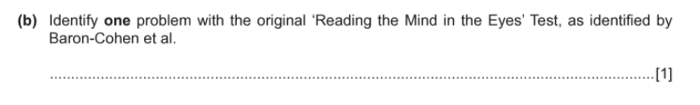
Notes:
🍐 This is a Pear Deck Text Slide
🍐 To edit the type of question, go back to the "Ask Students a Question" in the Pear Deck sidebar.

Slide 24

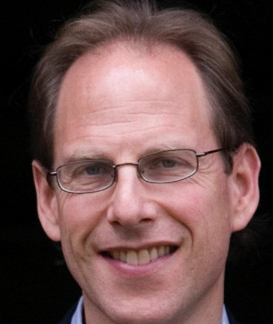
How did Baron-Cohen fix the problems?
Notes:
Temperature Check
WIth this slide, you can get a quick idea of how your students are feeling about the pace of the lesson. Getting consensus before moving on helps ensure everyone is still with you, and identify the students who might need extra attention.
🍐 This is a Pear Deck Draggable™ Slide.
🍐 To edit the type of question, go back to the "Ask Students a Question" in the Pear Deck sidebar.

Slide 25
How did they fix?
Add more question and more options (4)
Only used complex emotions
Eliminated items that could be linked to gaze direction
Equal number of male and female faces
The 3 foils similar to correct answer
Provided a glossary of key terms

Slide 26
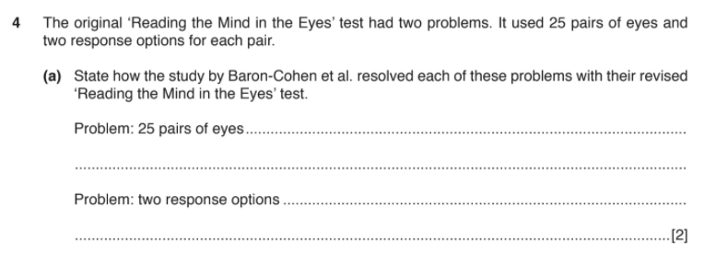
Notes:
🍐 This is a Pear Deck Text Slide
🍐 To edit the type of question, go back to the "Ask Students a Question" in the Pear Deck sidebar.

Slide 27
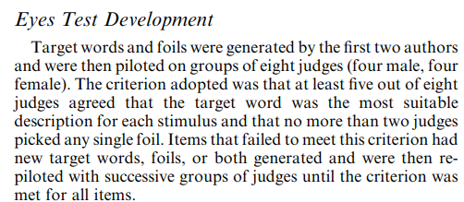
Criteria for questions
5/8 judges must agree
4 questions dropped as too much inconsistency

Slide 28
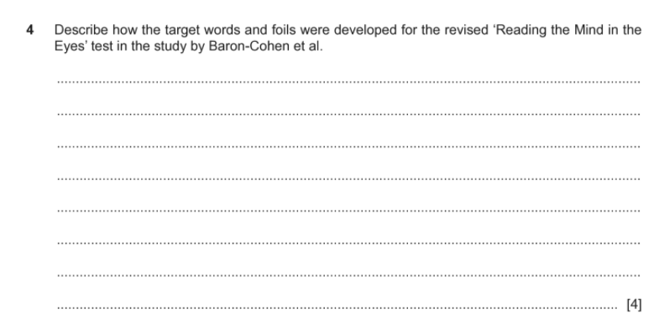
Notes:
🍐 This is a Pear Deck Text Slide
🍐 To edit the type of question, go back to the "Ask Students a Question" in the Pear Deck sidebar.

Slide 29
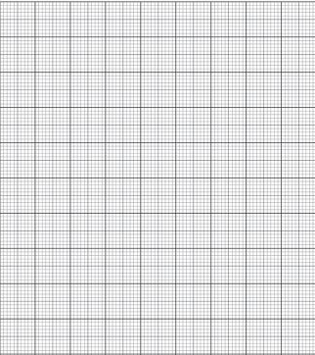
Draw a scattergram to show the relationship between scores on the ASQ and the Eyes Test
In the study by Baron-Cohen et al. (eyes test), a correlation was found.
(a) Describe the correlation found between the Eyes Test score and the Autism Spectrum
Quotient (AQ). [2]
(b) Explain why a researcher in a correlational study could not conclude that there was a causal relationship between variables. [2]
Summer 2019 TZ3
Notes:
Graph Paper
Change the numbers and/or scale of the graph and insert a prompt. Students will be able to draw lines or shade in areas as appropriate.
🍐 This is a Pear Deck Drawing Slide
🍐 To edit the type of question, go back to the "Ask Students a Question" in the Pear Deck sidebar.

Slide 30
Aims
To test a group of adults with AS or HFA on the revised scale of the eyes test. This was to check whether the same deficits seen in the original study could be replicated.
To test a sample of normal adults to see whether there was a negative correlation between the scores on the eyes test and their autism spectrum quotient (AQ).
To test whether females scored better on the eyes test than males.

Slide 31
Draw a bar chart to show Baron-Cohen’s thoughts about the potential difference between males and females on the eyes test
Notes:
Graph Paper
Change the numbers and/or scale of the graph and insert a prompt. Students will be able to draw lines or shade in areas as appropriate.
🍐 This is a Pear Deck Drawing Slide
🍐 To edit the type of question, go back to the "Ask Students a Question" in the Pear Deck sidebar.

Slide 32
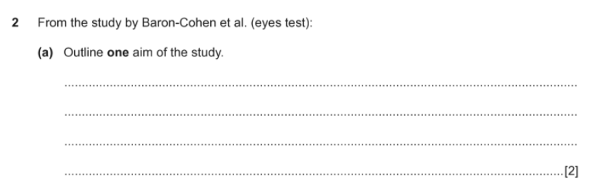
Notes:
🍐 This is a Pear Deck Text Slide
🍐 To edit the type of question, go back to the "Ask Students a Question" in the Pear Deck sidebar.

Slide 33
What research method is being
used in this study?
Natural experiment
Self Report
Correlation
Notes:
Use this template to help students become adept at identifying different types of sources and become more familiar with the types of sources available when doing their own research. To use this template, insert your own excerpt or otherwise direct students to the source you want them to evaluate.
🍐 This is a Pear Deck Multiple Choice Slide. Your current options are: A: Primary, B: Secondary, C: Tertiary,
🍐 To edit the type of question or choices, go back to the "Ask Students a Question" in the Pear Deck sidebar.

Slide 34
Experimental Method
Natural Experiment
with self-report

Slide 35
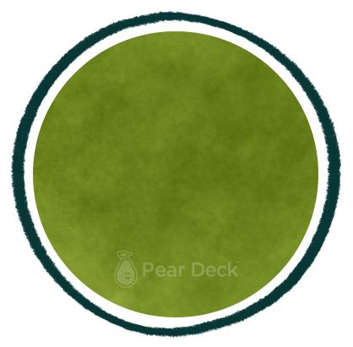
Describe the sample in this study in as much detail as you can
The Sample
Notes:
Mind Map
Starting with a central idea, give students time to branch out their thoughts visually to help build connections.
🍐 This is a Pear Deck Drawing Slide
🍐 To edit the type of question, go back to the "Ask Students a Question" in the Pear Deck sidebar.

Slide 36




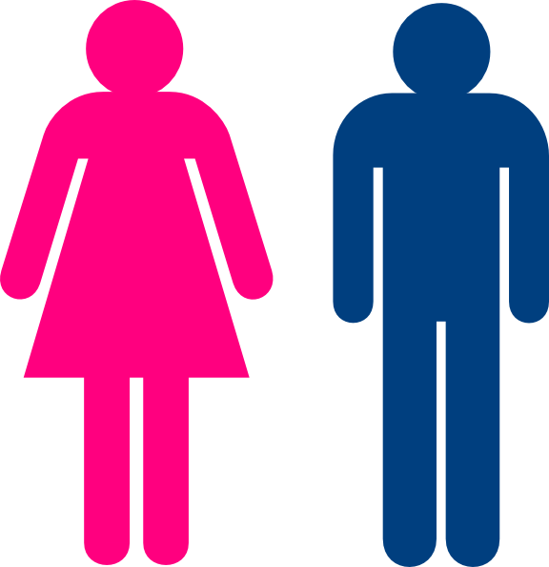
How did B-C find his people with ASD? What sampling methods is this?
Participants
WAIS
3
1
103
15
2
4
Typically developing (no ASD diagnosis)
122
14
Typically developing (no ASD)
Notes:
Students to describe each group.

Slide 37
Participants
Males diagnosed with AS/HFA
3
Cambridge undergraduates - High IQ
1
15
103
2
Typically developing
adults
4
Random males - IQ matched with Group 1
122
14

Slide 38
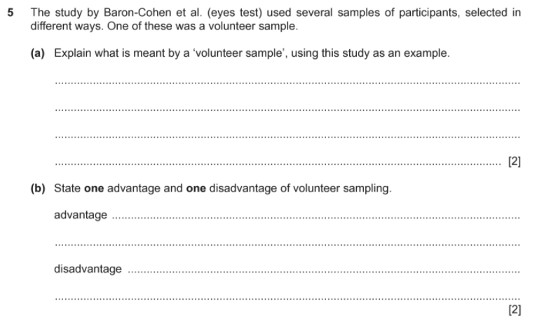
Notes:
🍐 This is a Pear Deck Text Slide
🍐 To edit the type of question, go back to the "Ask Students a Question" in the Pear Deck sidebar.

Slide 39
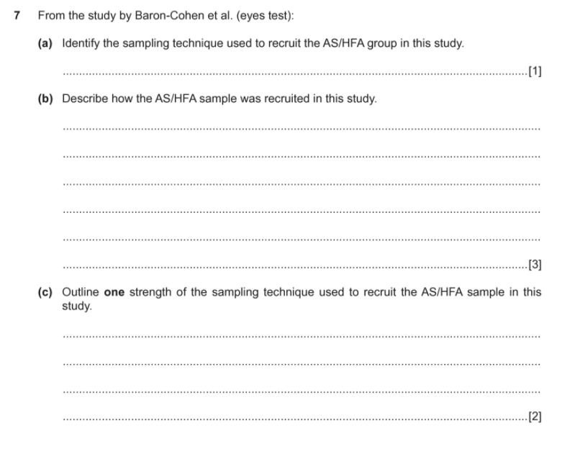
Notes:
🍐 This is a Pear Deck Text Slide
🍐 To edit the type of question, go back to the "Ask Students a Question" in the Pear Deck sidebar.

Slide 40
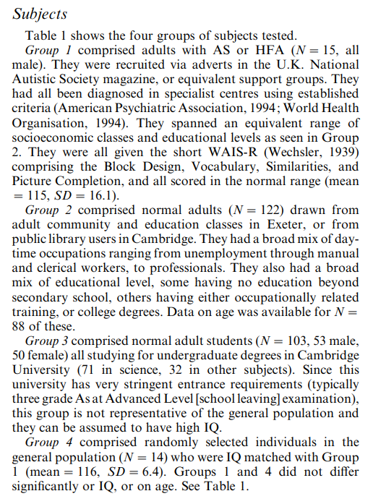

Slide 41
In the study by Baron-Cohen et al. (eyes test), there was more than one control condition.
(a) Identify one of the control conditions. [1]
(b) Explain one reason for having a control condition, using this study as an example. [2]
Notes:
🍐 This is a Pear Deck Text Slide
🍐 To edit the type of question, go back to the "Ask Students a Question" in the Pear Deck sidebar.

Slide 42

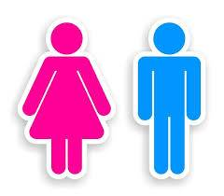
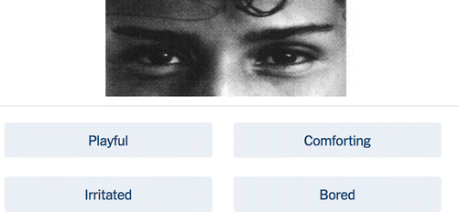
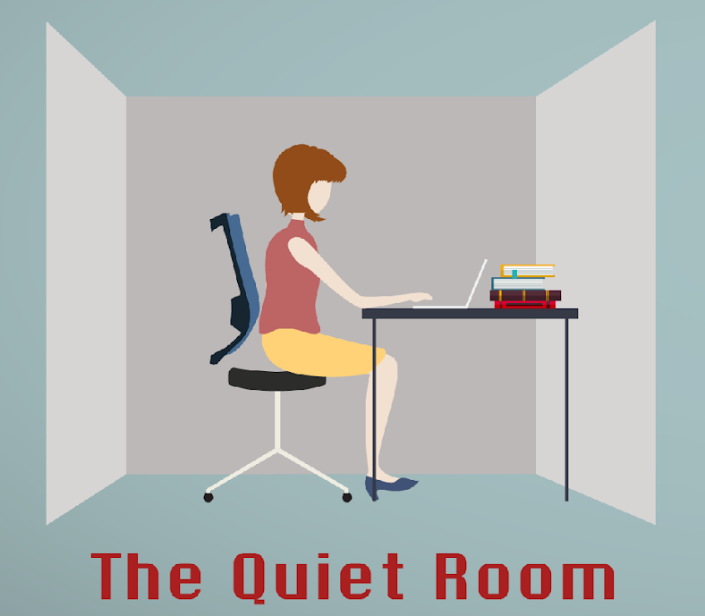

Procedure
Groups
1, 3, 4
1
2
3

Slide 43
Results
Group | Eye test | AQ
AS/HFA adults | 21.9 | 34.4
General Population | 26.2 | N/A
Students | 28.0 | 18.3
Matched | 30.9 | 18.9
Notes:
Group 1 – judge the gender of each image.
Group 1,3,4 – questionnaire to measure their AQ.

Slide 44
Results
The AS/HFA groups scored significantly worse than the other groups in the eye test.
Females scored only slightly better on the eyes test than males (trend only - not significant).
AS/HFA scored higher on the AQ.
Negative correlation between AQ and eye test
Notes:
Group 1 – judge the gender of each image.
Group 1,3,4 – questionnaire to measure their AQ.

Slide 45
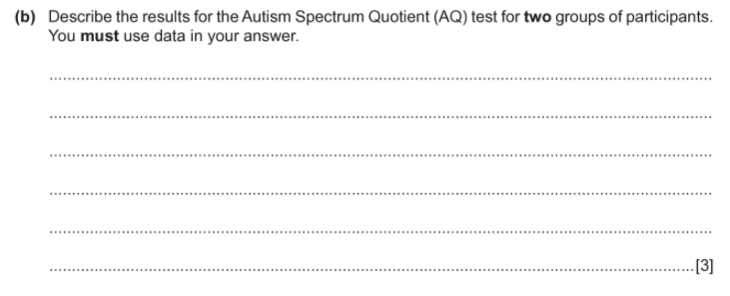
Notes:
🍐 This is a Pear Deck Text Slide
🍐 To edit the type of question, go back to the "Ask Students a Question" in the Pear Deck sidebar.

Slide 46
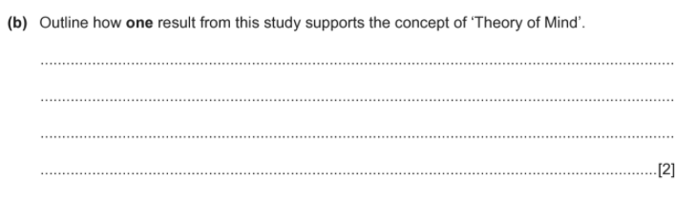
Notes:
🍐 This is a Pear Deck Text Slide
🍐 To edit the type of question, go back to the "Ask Students a Question" in the Pear Deck sidebar.

Slide 47
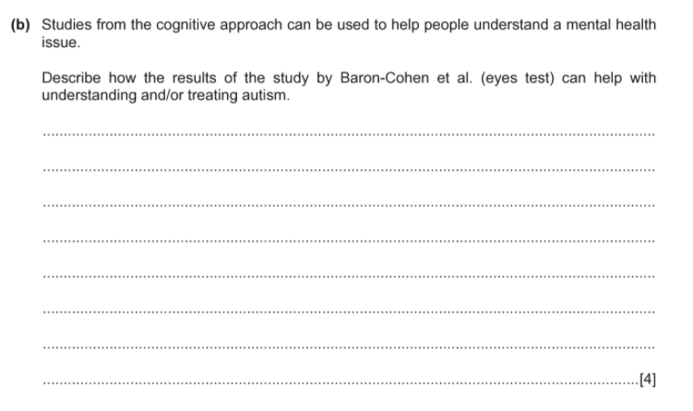
Notes:
🍐 This is a Pear Deck Text Slide
🍐 To edit the type of question, go back to the "Ask Students a Question" in the Pear Deck sidebar.

Slide 48
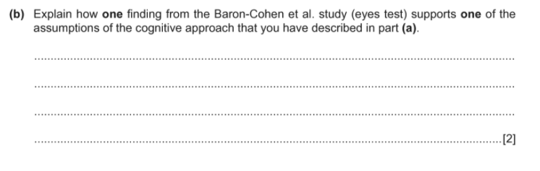
Notes:
🍐 This is a Pear Deck Text Slide
🍐 To edit the type of question, go back to the "Ask Students a Question" in the Pear Deck sidebar.

Slide 49
Conclusion
The revised version of the eye test could still discriminate between AS/HFA adults and controls.
The new eye test seemed to overcome initial problems of the original version – it validates it as a useful test to identify impairments in social intelligence in normally intelligent adults.

Slide 50
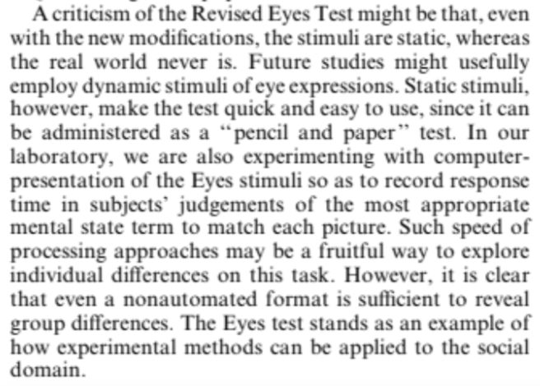
Evaluation

Slide 51
Evaluation of research method
Quantitative
Data
Internal validity
Reliability
Usefulness
Control
Groups
Ecological validity

Slide 52
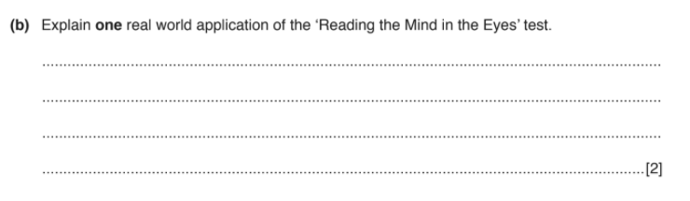
Notes:
🍐 This is a Pear Deck Text Slide
🍐 To edit the type of question, go back to the "Ask Students a Question" in the Pear Deck sidebar.

Slide 53
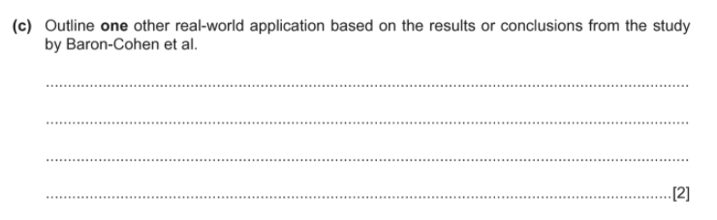
Notes:
🍐 This is a Pear Deck Text Slide
🍐 To edit the type of question, go back to the "Ask Students a Question" in the Pear Deck sidebar.

Slide 54
10 marks
Notes:
🍐 This is a Pear Deck Text Slide
🍐 To edit the type of question, go back to the "Ask Students a Question" in the Pear Deck sidebar.

Slide 55

10 marks
Notes:
🍐 This is a Pear Deck Text Slide
🍐 To edit the type of question, go back to the "Ask Students a Question" in the Pear Deck sidebar.

Slide 56
Carol is interested in theory of mind. She is comparing adults in ‘caring’ jobs such as nursing
with adults in ‘non-caring’ jobs that have less contact with the public. Carol believes that adults in caring jobs will score higher on the Eyes Test than those in non-caring jobs.
(a) Write a null hypothesis for Carol’s study. [1]
Notes:
🍐 This is a Pear Deck Text Slide
🍐 To edit the type of question, go back to the "Ask Students a Question" in the Pear Deck sidebar.

Slide 57
(b) Carol obtains a sample from 2000 people who found a job through an employment website.
Each person has an equal chance of being in her sample.
(i) Name the sampling technique that Carol used.[1]
(ii) Explain why it is an advantage that each person had an equal chance of being in Carol’s sample. [2]
Notes:
🍐 This is a Pear Deck Text Slide
🍐 To edit the type of question, go back to the "Ask Students a Question" in the Pear Deck sidebar.

Slide 58
(c) Explain the experimental design being used in Carol’s study. [2]

Slide 59

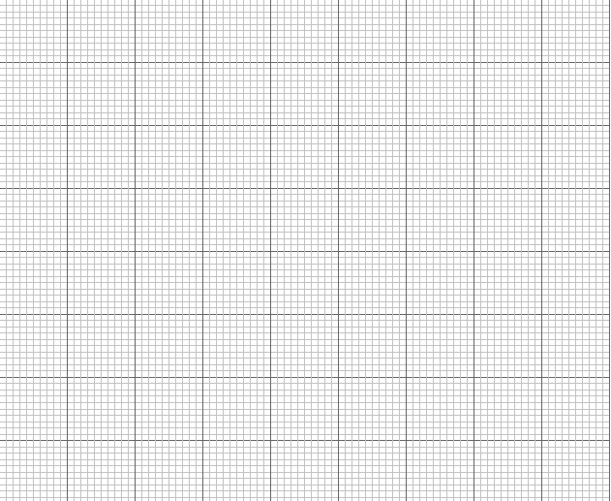

(d) Carol intends to draw a graph of the median Eyes Test score for each group of participants.
(i) Explain why the median was the most suitable measure of central tendency for Carol to use. [2]
(ii) Carol found that the median Eyes Test score for the caring job participants was 30/36 and the median Eyes Test score for the non-caring job participants was 20/36.
Draw an appropriate graph of these results on the axes below. You must label both axes.
Summer 2019 TZ3
Notes:
Use this template to encourage spatial awareness and geographic thinking. For younger students, start with a map of a place they know. Like their neighborhood, or home. For older students, help them think about different ways of portraying information. What will the map be used for - to help someone navigate, to display demographic data?
🍐 This is a Pear Deck Drawing Slide
🍐 To edit the type of question, go back to the "Ask Students a Question" in the Pear Deck sidebar.

Slide 60
Marla is working in a centre for adults with autism. She is observing social behaviour and communication, such as whether the residents seem to understand facial expressions.
(a) Identify and operationalise one behaviour that Marla could record to measure whether the residents understand facial expressions.
(b) Explain what Marla should do to be a participant observer. [2]
(c) Explain what Marla should do to be a non-participant observer. [2]
(d) Explain whether Marla should choose a participant observation or a non-participant observation for her study. [2]
Winter 2018 TZ2

Slide 61
Albert is investigating autism. He plans to obtain a sample of people with autism and a control group. He will compare how well these participants judge the feelings of dolls which are either dancing, crying, waving or smiling.
(a) Identify the independent variable in this experiment. [1]
(b) Suggest how the dependent variable in this experiment could be measured. [2]
(c) Explain one advantage of using dolls rather than people in this procedure. [2]
(d) Explain one disadvantage of using dolls rather than people in this procedure. [2]
(e) Describe the experimental design used in this experiment. [2]
Paper 2 Summer 2018 TZ3
Notes:
🍐 This is a Pear Deck Text Slide
🍐 To edit the type of question, go back to the "Ask Students a Question" in the Pear Deck sidebar.

