Slide 1
You are going to be see 20 images in this slideshow. You must rate each image from 0-3 for how emotionally intense you find it where 0 is not emotional at all to 3 highly emotional. In ‘present mode’ change the slides advance to “every 10 seconds.

Slide 2
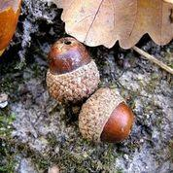

Slide 3
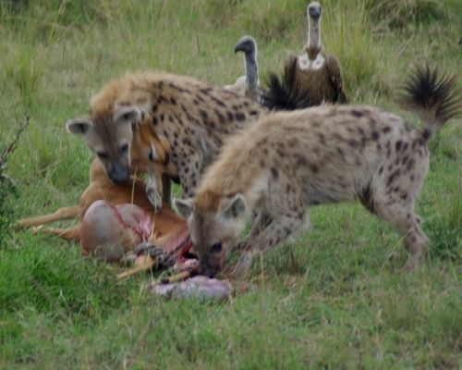

Slide 4
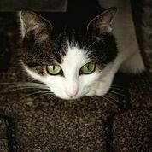

Slide 5


Slide 6


Slide 7
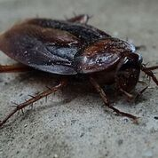

Slide 8


Slide 9
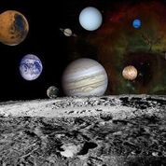

Slide 10
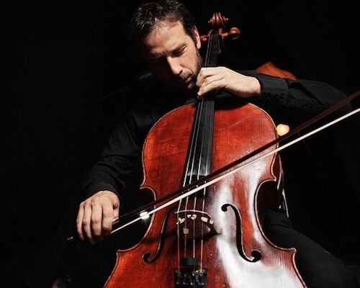

Slide 11


Slide 12


Slide 13


Slide 14


Slide 15


Slide 16


Slide 17
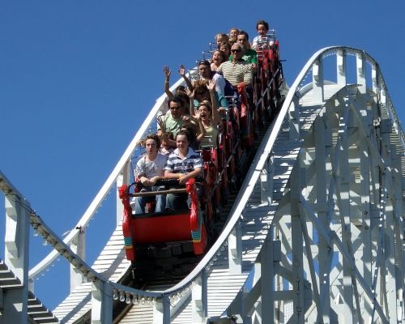

Slide 18


Slide 19
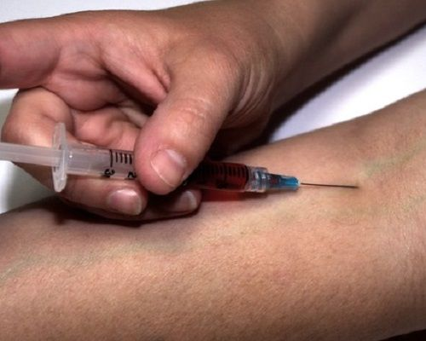

Slide 20


Slide 21


Slide 22
That was the last slide, thank you for participating!

